Slide 1
  ANSI SQL
  Understanding SQL

Slide 2
Objectives
At the end of this session, you will be able to:
  Define Database Management System (DBMS)
  Recall the concept that a developer needs to have, to work with it
  Define Database (DB)
  Describe Data Model
  Define Relational Database Management System (RDBMS)
  Describe Database Normalization
  Define Structured Query Language (SQL)
4

Slide 3
Introduction
After learning Programming Fundamentals, you might have encountered a need to retain the data which is input, manipulated, and displayed by your code.
Program manipulates data in RAM which is volatile storage.
Question: What if you need to refer to this data later?
Answer: Yes, you can do it.
Question: How can you achieve this data persistence?
Answer: Usually all applications, directly or indirectly, are connected to one or more persistent storage devices like Hard Disk Drive (HDD), Flash Drives, Optical Disk, and Memory Cards.
This implies that the applications have mobility to store data in various storage units or devices.
Question: How will you be able to manipulate and retrieve this stored data?
Answer: This is the job of a DBMS tool. Let us know about the tool in detail.
5

Slide 4
What is DBMS?
Database (DB)
Database Management System (DBMS)
  A database is a collection of logically related data.
  It is used to search data to answer queries.
  A database may be designed for batch processing, real time processing, or online processing.
  Database Management System is a set of software or programs that enables storing, modifying, and extracting information from a database.
  It also provide users with tools to add, delete, access, modify, and analyze data stored in one location.
  A group can access the data by using query and reporting tools that are part of the DBMS, or by using application programs specifically written to access the data.
6

Slide 5

Data Models
How are the data modeled or structured in DBMS?
  To answer this, let us understand the concept of Data Models.
A Data Model is a representation of a real world situation about which data is to be collected and stored in a database. A data model depicts the dataflow and logical interrelationship among different data elements.
7

Slide 6
Types of Data Models
Object-based Logical Models
The E-R Model
There are two types of Data Models:
The Relational Model
Record-based Logical Models
The Network Model
The Hierarchical Model
8

Slide 7
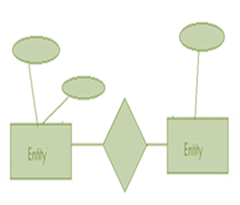
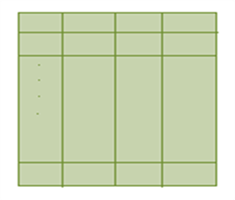
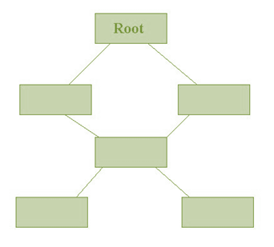
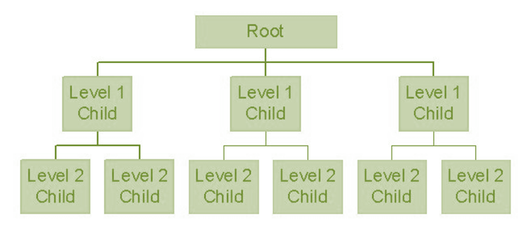
Types of Data Models (Contd.)
ER- Model
Relational Model
Network Model
Hierarchical Model
9

Slide 8
Object-based Logical Models
Object-based Logical Models:
They describe data at conceptual and view levels.
The E-R Model:
  The Entity-Relationship model is based on a perception of the world as a collection of basic objects (entities) and relationships among these objects.
10

Slide 9
Record-based Logical Models
Record-based Logical Models:
Unlike object-oriented models, this is used to:
  Specify overall logical structure of the database, and
  Provide a high-level description of the implementation
As the name implies, in this model the database is structured in fixed-format records of several types.
Each record type defines a fixed number of fields or attributes.
The Relational Model
Data and relationships are represented by a collection of tables.
Each table has a number of columns with unique names. For example: customer, account.
The Network Model
Data are represented by collection of records.
Relationships among data are represented by links.
Organization is that of an arbitrary graph.
The Hierarchical Model
The Hierarchical Model is similar to the Network model.
Organization of the records is like a collection of trees, rather than arbitrary graphs.
The DBMS systems are of different type. We are going to refer to RDBMS throughout this session.
11

Slide 10
Definition of RDMS
Relational Database Management System (RDBMS) is a Database Management System (DBMS) that is based on the Relational model.
12

Slide 11
Database Normalization
How to reduce data redundancy and inconsistency in database tables?
  Data redundancy and inconsistency in database tables can be reduced by following a process called Normalization.
Database Normalization:
  Database Normalization is the process of organizing the fields and tables of a relational database to minimize redundancy and dependency.
  Normalization usually involves dividing large tables into smaller (and less redundant) tables and defining relationships between them.
  The objective is to isolate data so that additions, deletions, and modifications of a field can be made in just one table and propagated through the rest of the database via defined relationships.
13

Slide 12
Normal Forms
Normal Forms:
  Edgar F. Codd, the inventor of the Relational Model, introduced the concept of Normalization in 1970. We now know this concept as the First Normal Form (1NF).
  Codd went on to define the Second Normal Form (2NF) and Third Normal Form (3NF) in 1971, and Codd and Raymond F. Boyce defined the Boyce-Codd Normal Form (BCNF) in 1974.
  Informally, a relational database table is often described as "normalized" if it is in the Third Normal Form. Most 3NF tables are free of insertion, update, and deletion anomalies.
14

Slide 13
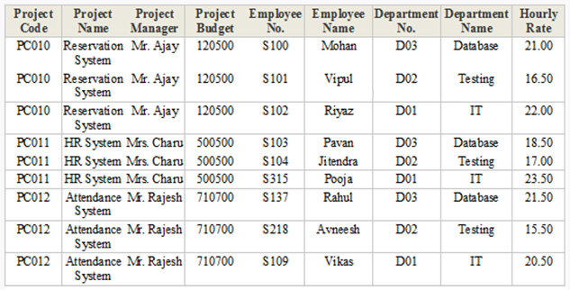
Normal Forms (Contd.)
To understand normal forms, consider the following denormalized database table. Now we will normalize the data of the following table using normal forms.
15

Slide 14
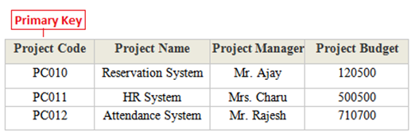
First Normal Form
First Normal Form (1NF):
  A database table is said to be in 1NF if it contains no repeated fields or columns.
  The process of converting the UNF table into 1NF is as follows:
    Separate the repeated fields into new database tables along with the key from de-normalized database table.
    The primary key of new database tables might be a composite key.
16

Slide 15
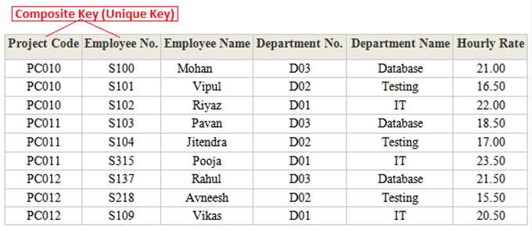
First Normal Form (Contd.)
First Normal Form (1NF)
17

Slide 16
Second Normal Form
Second Normal Form (2NF):
  A database table is said to be in 2NF if it is in 1NF and contains only those fields or columns that are functionally dependent (the value of the field is determined by the value of another field(s)) on the primary key.
  In 2NF, we remove the partial dependencies of any non-key field.
  The process of converting the database table into 2NF is as follows:
    Remove the partial dependencies (a type of functional dependency where a field is only functionally dependent on the part of primary key) of any non-key field.
    If field B depends on field A and vice versa, for a given value of B, we have only one possible value of A and vice versa, then we put the field B into new database table. In the new table, B will be primary key and also marked as foreign key in parent table.
18

Slide 17
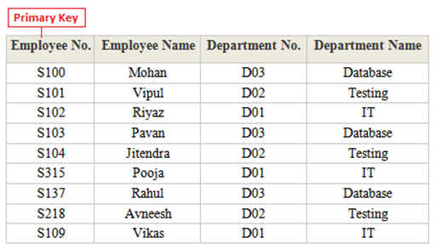
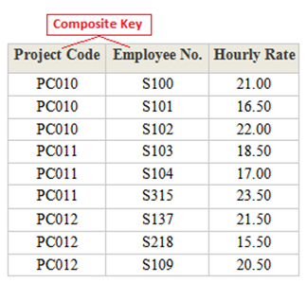
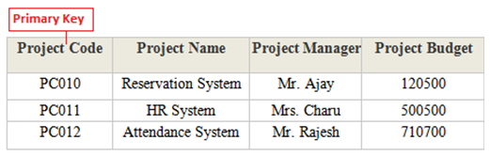
Second Normal Form (Contd.)
Second Normal Form (2NF):
  2NF of the 1NF tables shown above are as follows:
19

Slide 18
Third Normal Form
Third Normal Form (3NF):
  A database table is said to be in 3NF if it is in 2NF and all non key fields are dependent on a primary key. We can also consider a table to be in 3NF if it is in 2NF and none of the fields of the table are transitively functionally dependent on the primary key.
  The process of converting a table into 3NF is as follows:
    Remove the transitive dependencies (a type of functional dependency where a field is functionally dependent on the field that is not the primary key. Hence its value is determined, indirectly by the primary key).
    Make separate table for transitive dependent field.
20

Slide 19
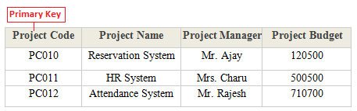
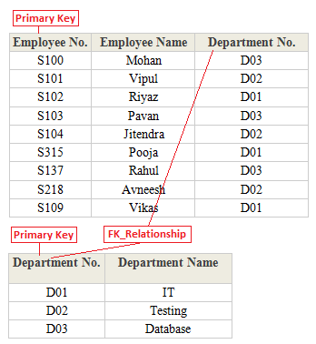
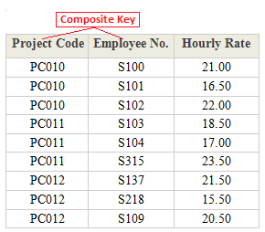
Third Normal Form (Contd.)
Third Normal Form (3NF):
21

Slide 20
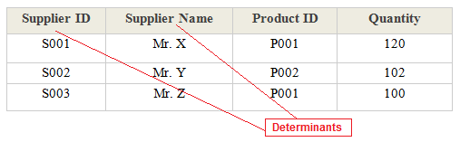
Boyce Code Normal Form
Boyce Code Normal Form (BCNF):
  A database table is said to be in BCNF if it is in 3NF and contains each and every determinant as a candidate key.
  The process of converting a table into BCNF is as follows:
    Remove the non-trivial functional dependency
    Make separate table for the determinants
  Let us consider the special situation given below to understand BCNF:
22

Slide 21
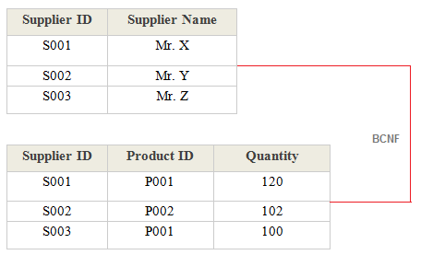
Boyce Code Normal Form (Contd.)
Boyce Code Normal Form (BCNF) :
  After applying BCNF:
23

Slide 22
SQL
Structured Query Language (SQL):
  It is a special-purpose programming language designed for managing data in RDBMS.
  It is a 4th Generation Language or 4GL.
What is 1GL, 2GL, 3GL, 4GL, 5GL?
First Generation Language or 1GL:
These are machine languages.
Second Generation Language or 2GL:
These are assembly languages.
Third Generation Language or 3GL:
These are high-level programming languages, such as C, C++, and Java.
Fourth Generation Language or 4GL:
These are programming languages closer to human languages than typical high-level programming languages.
Fifth Generation Language or 5GL:
These languages are used for artificial intelligence and neural networks.
25

Slide 23

ANSI SQL
Question: Does projects recommend knowledge of ANSI SQL?
Answer: Yes
American National Standards Institute (ANSI):
  It is a private non-profit organization that is responsible for development of voluntary standards for products, services, processes, systems, and personnel in the United States.
  SQL was adopted as a standard by the American National Standards Institute (ANSI) in 1986 as SQL-86 and the International Organization for Standardization (ISO) in 1987.
Question : Do you want more clarification on why one should follow ANSI?
Answer: Let us understand why one should adhere to ANSI.
In this course, we will adhere to ANSI SQL syntax.
24

Slide 24
Why ANSI SQL?
Why do we need ANSI SQL standard?
  Without a central standard entity, every database manufacturer would be free to use whatever syntax they find appropriate.
  Even though there are some variations from one to the next regarding various extensions, the main code is going to be the same from one to another.
  A SELECT will always be a SELECT instead of a SELECT on one, GET on another, READ on a third, etc.
  This will not allow vendor based monopoly.
Note: Every vendor available in market has their own DIALECTS (something additional apart from ANSI recommendation).
“The dialect of the database is simply a term that define the specific features of the SQL language that are available when accessing that database.”
26

Slide 25
Keywords
DBMS
  Database Management System
RDBMS
  Relational Database Management System
1NF
  First Normal Form
2NF
  Second Normal Form
3NF
  Third Normal Form
BCNF
  Boyce Code Normal Form
SQL
  Structured Query Language
ANSI
  American National Standards Institute
28

Slide 26

Check Your Understanding
What is RDBMS?
What is Normalization?
Why should I know ANSI SQL?
29

Slide 27
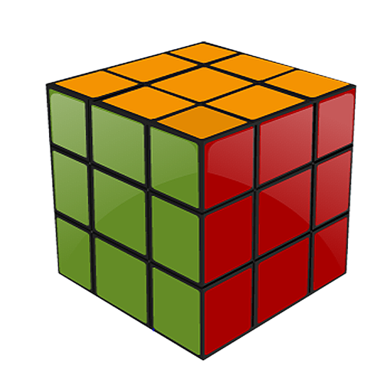
Summary
In this session you have learned the following:
  Database (DB) is a collection of logically related data.
  Database Management System (DBMS) is a set of software or programs that enables storing, modifying, and extracting information from a database.
  Data Model is a representation of a real world situation about which data is to be collected and stored in a database.
  Relational Database Management System (RDBMS) is a Database Management System (DBMS) that is based on the Relational model.
31

Slide 28
Summary (Contd.)
Database Normalization is the process of organizing the fields and tables of a relational database to minimize redundancy and dependency.
Structured Query Language (SQL) is a special-purpose programming language designed for managing data in Relational Database Management Systems (RDBMS).
SQL was adopted as a standard by the American National Standards Institute (ANSI) in 1986 as SQL-86 and the International Organization for Standardization (ISO) in 1987.
30

Slide 29
  ANSI SQL
  You have successfully completed the session on Understanding SQL

