Slide 1
AI FitTrack
Personalized Fitness Recommendations
Secure • Scalable • AI-Powered RESTful Backend
Built with Node.js • Express.js • MongoDB • Mongoose
Powered by Google Gemini AI
Team ID : SWTID-2026-1960
Team Size : 4
Team Leader : GOWSALYA K
Team Members : HARINI B • HEMA T • JANANI R

Slide 2
Project Overview & Problem
02
The Challenge
Our Solution
Fitness enthusiasts often maintain workout records manually, making it difficult to organize history, monitor progress, and choose workouts that match their goals.
AI FitTrack provides a centralized RESTful backend for secure authentication, workout CRUD, searching, AI recommendations, and personalized fitness insights.
Key Problems Addressed
Expected Outcome
• Scattered or inaccurate workout history
• No personalized workout guidance
• Manual tracking of duration and calories
• Limited performance insights
A secure, modular and scalable backend that combines reliable workout tracking with Google Gemini-powered fitness guidance.
AI FitTrack • Personalized Fitness Recommendations

Slide 3
System Architecture & Technology Stack
03
Client
React / Mobile App / Postman
API Gateway
Express.js Server
Security
JWT Authentication Middleware
Logic
Controllers + Services
Data & AI
MongoDB + Mongoose | Google Gemini
Node.js • Express.js • MongoDB • Mongoose • JWT • bcrypt.js • Google Gemini AI • Postman
AI FitTrack • Personalized Fitness Recommendations

Slide 4
Core Modules & Database Design
04
Authentication Module
Workout Management
AI Module
• Registration and secure login
• bcrypt.js password hashing
• JWT token generation
• Protected APIs through middleware
• Add, view, update and delete workouts
• Search by name, category or date
• Every workout is linked to its authenticated user
• Personalized workout recommendations
• Weekly exercise suggestions
• Fitness insights from workout statistics
• Safety and motivational guidance
User
Workout
1 → Many
_id • name • email • password
createdAt • updatedAt
_id • user • workoutName • category
duration • caloriesBurned • workoutDate
AI FitTrack • Personalized Fitness Recommendations

Slide 5
Project Setup & Configuration
05
1. Create Project
2. Initialize Node.js
3. Install Dependencies
AI-FitTrack-API
Open the project in Visual Studio Code and create the server folder.
npm init -y
Creates package.json for project metadata and dependencies.
npm install express mongoose dotenv bcryptjs jsonwebtoken cors
npm install --save-dev nodemon
.env configuration
PORT=5000
MONGO_URI=mongodb://localhost:27017/aifittrack
JWT_SECRET=your_secret_key
GEMINI_API_KEY=your_google_gemini_api_key
Environment variables keep database credentials, JWT secrets and AI keys outside the source code.
AI FitTrack • Personalized Fitness Recommendations

Slide 6
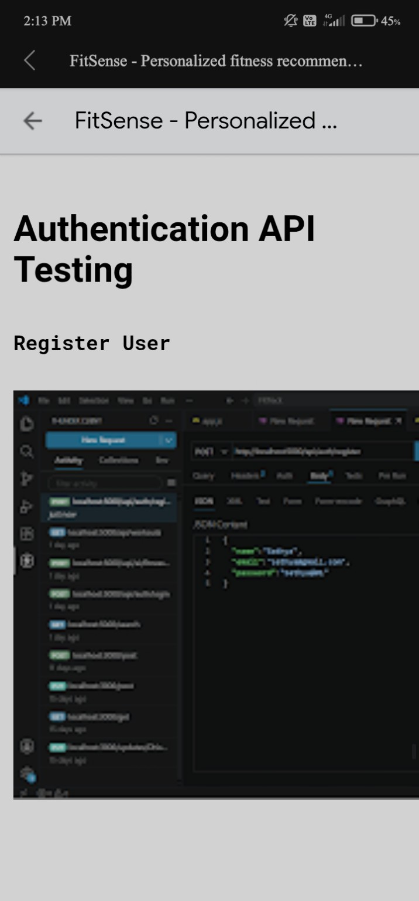
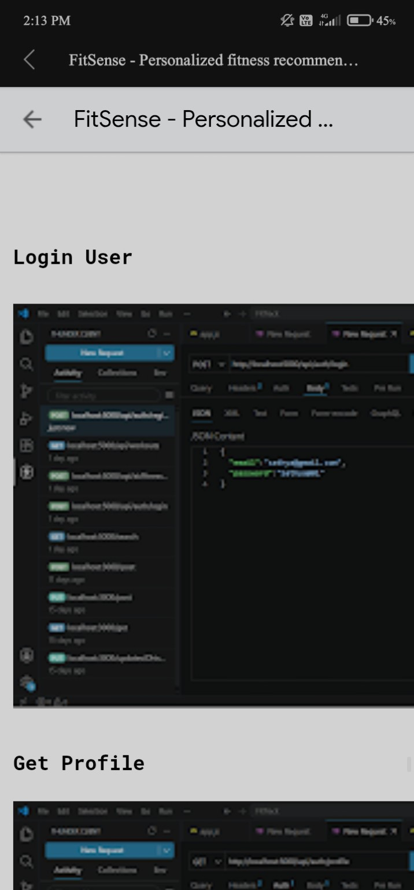
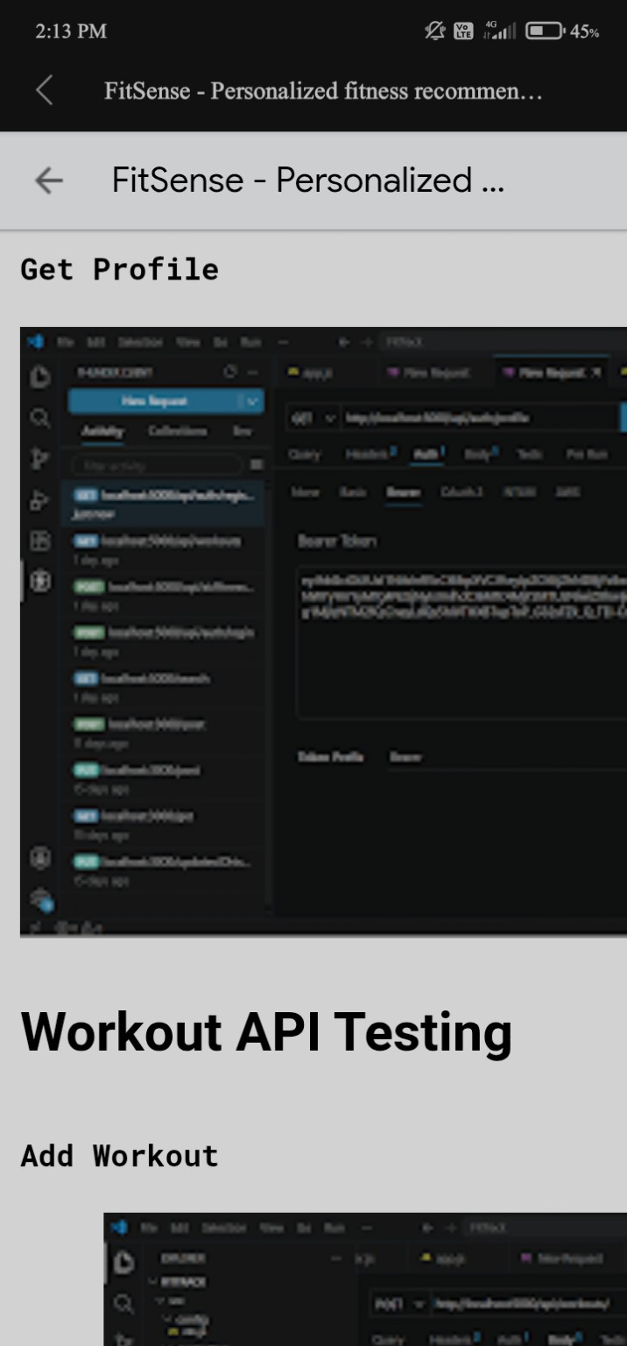
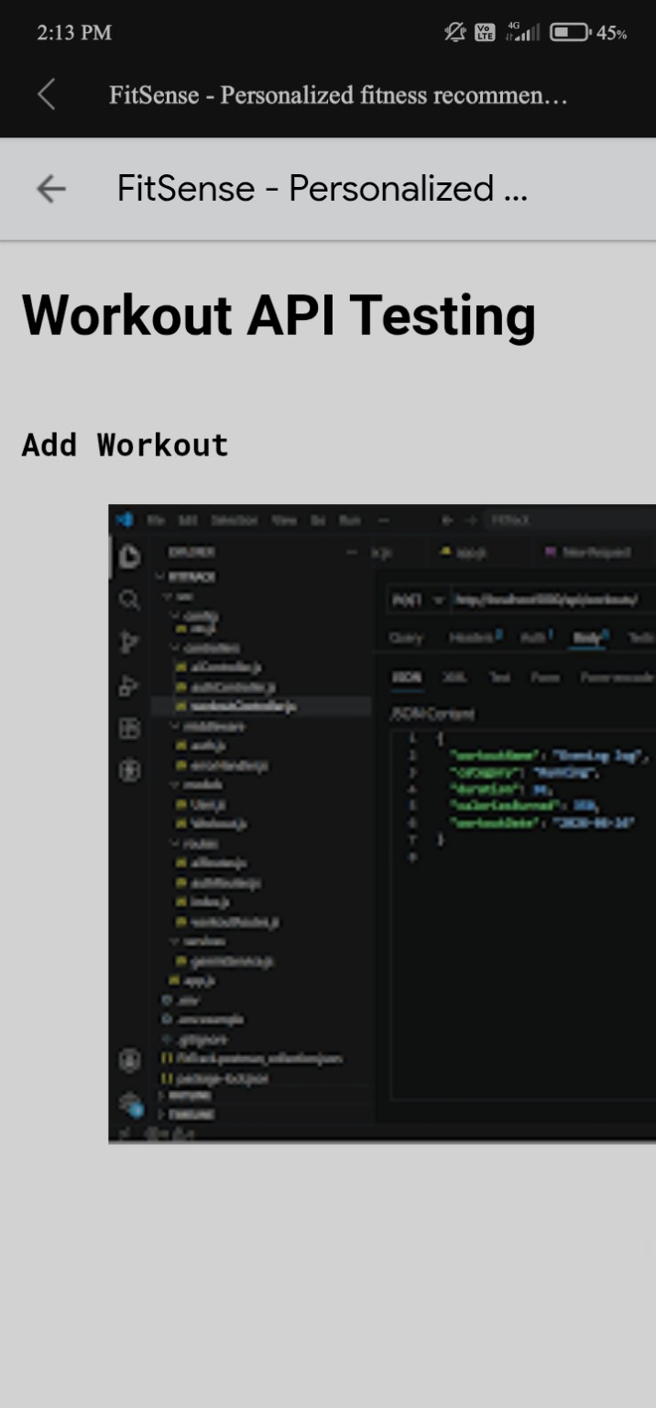
API Testing with Postman
06
Testing Sequence
1. Authentication APIs
2. Workout APIs
3. AI APIs
Each endpoint is checked for request handling, authorization, validation, database operations and expected JSON responses.
Register • Login • Get Profile • Add Workout • Get Workouts • Get by ID
AI FitTrack • Personalized Fitness Recommendations

Slide 7
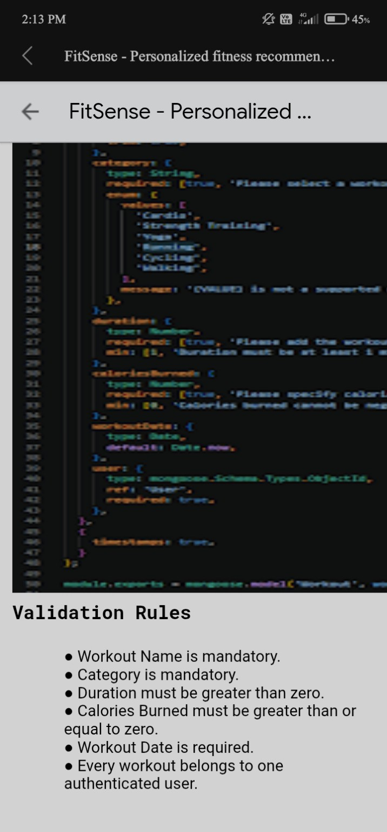
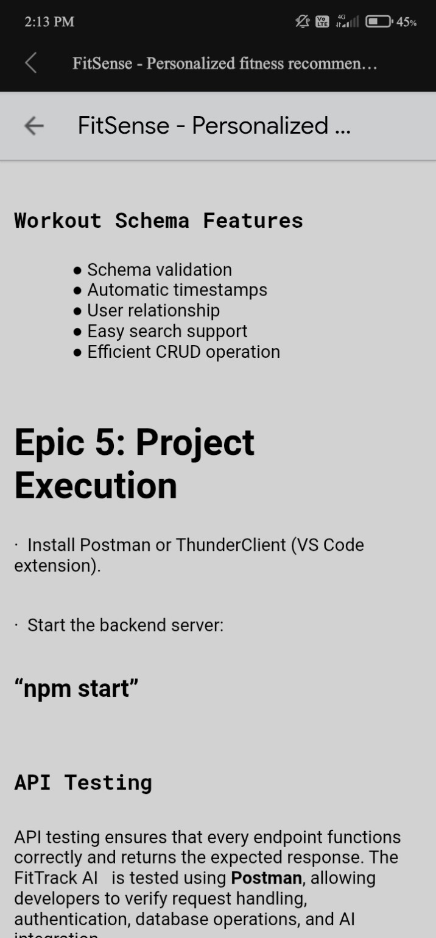
Workout Schema & CRUD Operations
07
Workout Validation Rules
• Workout name is mandatory
• Category is mandatory
• Duration must be greater than zero
• Calories burned must be ≥ 0
• Workout date is required
• Every workout belongs to one authenticated user
Workout Schema Features
• Schema validation
• Automatic timestamps
• User relationship
• Easy search support
• Efficient CRUD operations
Mongoose schema validation keeps workout data consistent and linked to the correct user.
AI FitTrack • Personalized Fitness Recommendations

Slide 8
AI Recommendations, Outcomes & Future Scope
Gemini AI Workflow
Project Outcome
User profile + workout statistics → Gemini AI → Personalized plan, weekly suggestions, training tips, safety guidance and fitness insights.
Secure authentication + reliable workout CRUD + search + AI guidance create a centralized fitness tracking backend that is modular, maintainable and scalable.
Future Enhancements
Key Takeaway
Nutrition tracking • BMI calculation • Wearable integration • Workout reminders • Analytics dashboard • Progress visualization
AI FitTrack combines secure backend engineering with AI-assisted personalization to turn workout data into actionable fitness guidance.
THANK YOU
Questions & Discussion

