Slide 1
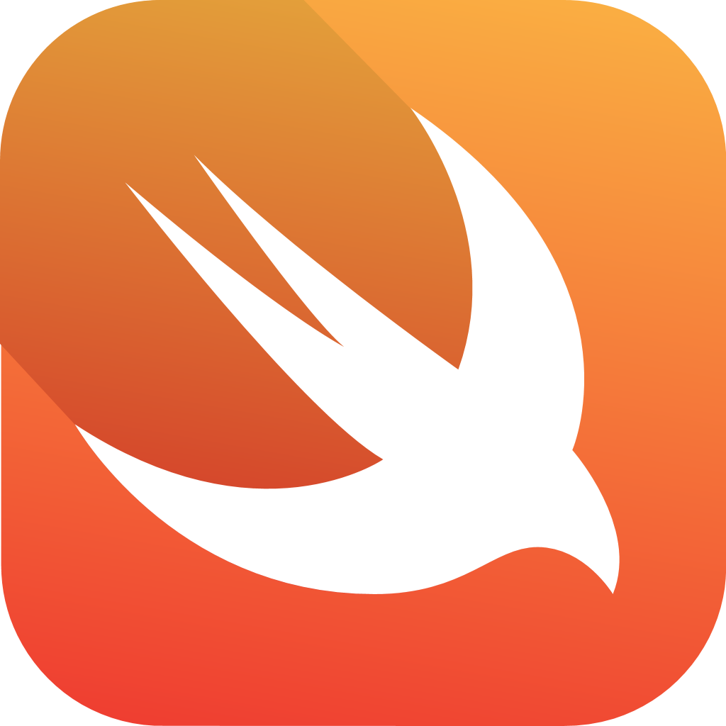



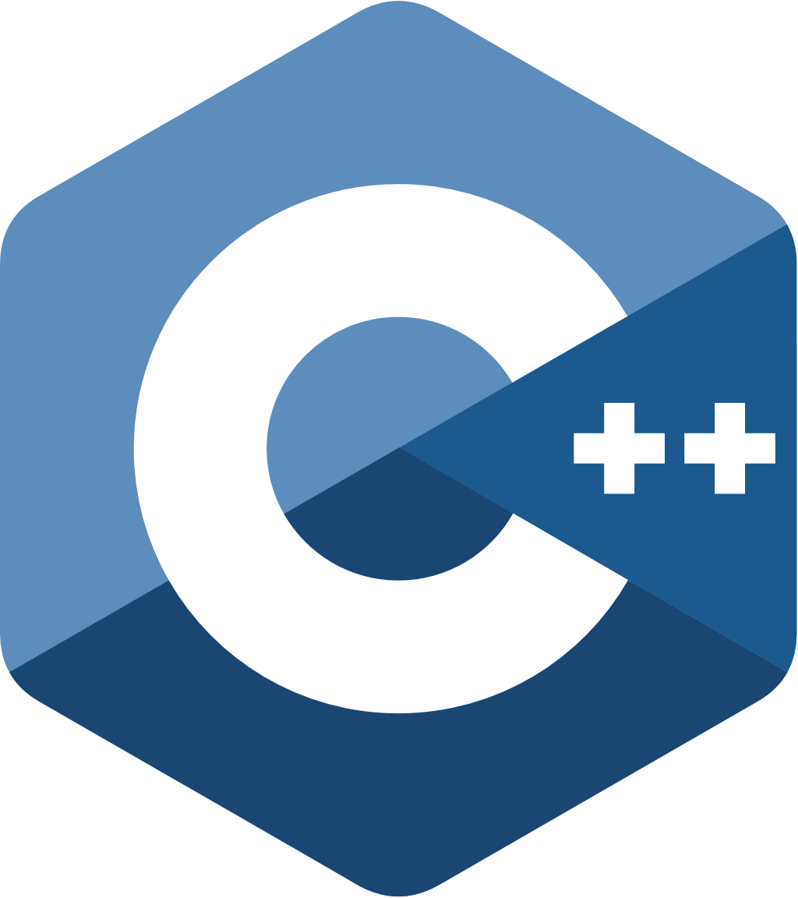


Hello World

Slide 2
// Hello world program in c
#include <stdio.h>
int main()
{
printf("Hello World!");
return 0;
}

Slide 3
// Hello world program in c++
#include <iostream>
using namespace std;
int main()
{
cout << "Hello World";
return 0;
}

Slide 4
// Hello world program in Java
public class one {
public static void main(String[] args) {
System.out.println("Hello, World!");
}
}

Slide 5
// Hello world program in go
package main
import "fmt"
func main() {
fmt.Println("Hello, World!")
}

Slide 6
// Hello world program in python
print("Hello World")

Slide 7
// Hello world program in Swift
print("Hello World")

Slide 8
console.log("Hello World");

