Slide 1


Prometheus
– Overview

Slide 2
Prometheus
Prometheus is an open source project designed to dive deep into our application data, creating the filtering layers to collect and analyze everything from the simplest to the most complex.
It’s not just about numbers and charts, either: It’s about understanding the heartbeat of our application through its advanced query language and time-series data capabilities.
Integrating Prometheus gives us the ability to identify problems before they occur, fine-tune our systems, ensure our application runs at peak performance, and ultimately, means a better experience for our users – convenient, fast, and reliable.

Slide 3
Why Prometheus?
It designed for reliability and scalability.
It excels at collecting and processing metrics, offering a powerful querying language and flexible alerting mechanisms.
With Prometheus, you gain real-time visibility into the performance and health of your Spring Boot application.

Slide 4
Why Prometheus?
Containers: Applications that are containerized can be dynamically scaled up or down. Metric collection and analysis from containerized applications may become challenging as a result.
Cloud-native apps: These programs are frequently set up across several cloud environments. Because of this, it could be challenging to obtain a complete picture of the functionality and state of cloud-native apps.
Microservices: Applications built using microservices are made up of numerous tiny, independent services. Because of this, it could be challenging to monitor dependencies between services and find the source of issues.

Slide 5
Prometheus - Architecture
Prometheus has several components which help in the overall monitoring of your application. These components of the architecture are:
• Prometheus Server
• Push Gateway
• Alert Manager
• Prometheus Targets
• Client Libraries
• Prometheus Exporters
• Service Discovery

Slide 6
Prometheus - Architecture

Slide 7
Prometheus – Prometheus Server
The Prometheus server is the brain of the metric-based monitoring system. The main job of the server is to collect the metrics from various targets using pull model.
Target is nothing but a server, pod, endpoints etc which we will look in to detail in the next topic.
The general term for collecting metrics from the targets using Prometheus is called scraping.
Prometheus periodically scrapes the metrics, based on the scrape interval that we mention in the Prometheus configuration file.

Slide 8
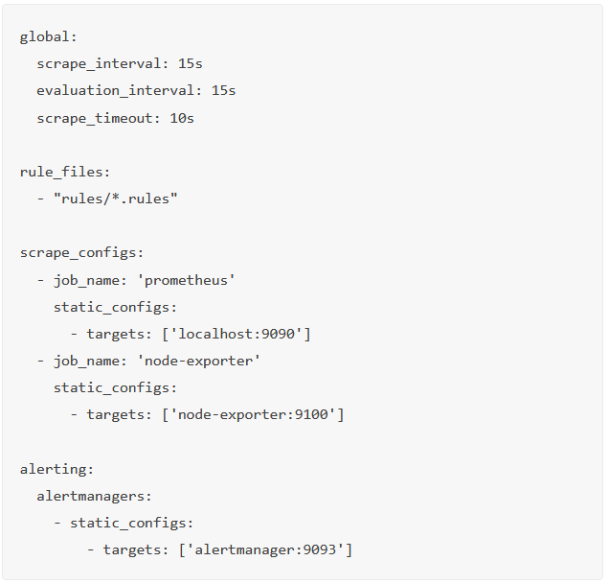
Prometheus – Prometheus Server

Slide 9
Prometheus – Time Series Database (TSDB)
The metric data which prometheus receives changes over time (CPU, memory, network IO etc..). It is called time-series data. So Prometheus uses a Time Series Database (TSDB) to store all its data.
By default Prometheus stores all its data in an efficient format (chunks) in the local disk. Overtime, it compacts all the old data to save space. It also has retention policy to get rid of old data.
The TSDB has inbuilt mechanisms to manage data kept for long time. You can choose any of the following data retention policies.
Time based retention: Data will be kept for the specified days. The default retention is 15 days.
Size-based retention: You can specify the maximum data TSDB can hold. Once this limit it reached, Prometheus will free up the space to accommodate new data.

Slide 10
Prometheus – Targets
Target is the source where Prometheus scrape the metrics. A target could be servers, services, Kubernetes pods, application endpoints, etc.
Exporters act as intermediaries between the target system and Prometheus.
They extract metrics from the target system, transform them into the Prometheus data format, and expose an HTTP endpoint for the Prometheus Server to scrape the metrics.
There are numerous exporters available for popular systems and frameworks, or you can develop custom exporters to expose specific metrics.

Slide 11
Prometheus – Targets
By default prometheus looks for metrics under /metrics path of the target. The default path can be changed in the target configuration. This means, if you don’t specify a custom metric path, Prometheus looks for the metrics under /metrics.
Target configurations are present under the scrape_configs in the Prometheus configuration file.
From the target endpoints, prometheus expects data in certain text format. Each metric has to be on a new line.
Usually these metrics are exposed on target nodes using prometheus exporters running on the targets.

Slide 12
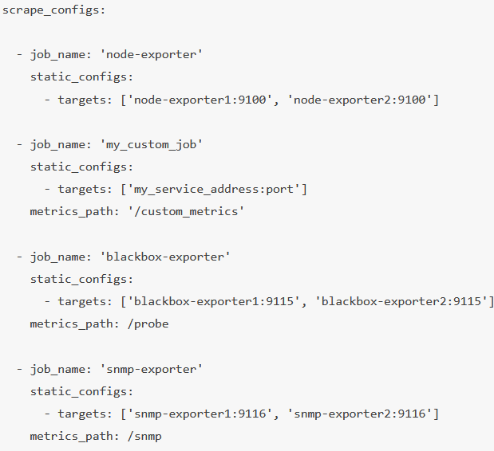
Prometheus – Targets

Slide 13
Prometheus – Exporters
Exporters are like agents that run on the targets. It converts metrics from specific system to format that prometheus understands.
It could be system metrics like CPU, memory etc, or Java JMX metrics, MySQL metrics etc.
By default these converted metrics are exposed by the exporter on /metrics path(HTTPS endpoint) of the target.
For example, if you want to monitor a servers CPU and memory, you need to install a node exporter on that server and the node exporter exposes the CPU and memory metrics in the prometheus metrics format on /metrics.
Once the Prometheus pulls the metrics, it will then combine the metric name, labels, value, and timestamp to give a structure to that data.

Slide 14
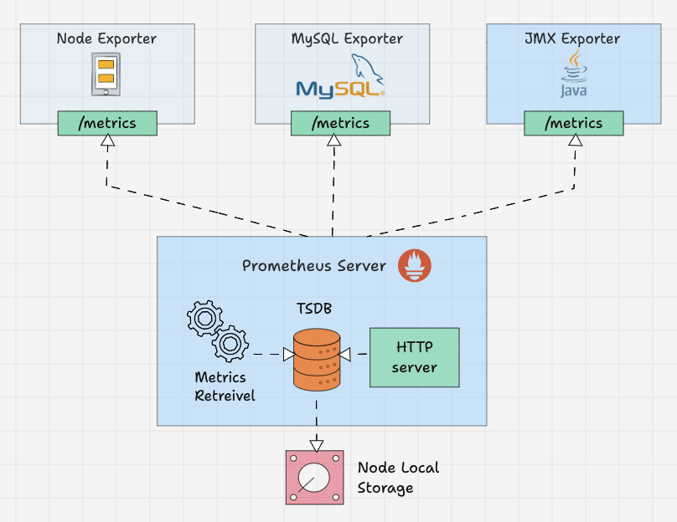
Prometheus – Exporters

Slide 15
Prometheus – Service Discovery (Consul)
Prometheus uses two methods to scrape metrics from the targets.
Static configs:
When the targets have a static IP or DNS endpoint, we can use those endpoints as targets.
Sevice Discovery:
In most autoscaling systems and distributed systems like Kubernetes, the target will not have a static endpoint. In this case, that target endpoints are discovered using prometheus service discovery and targets are added automatically to the prometheus configuration.

Slide 16
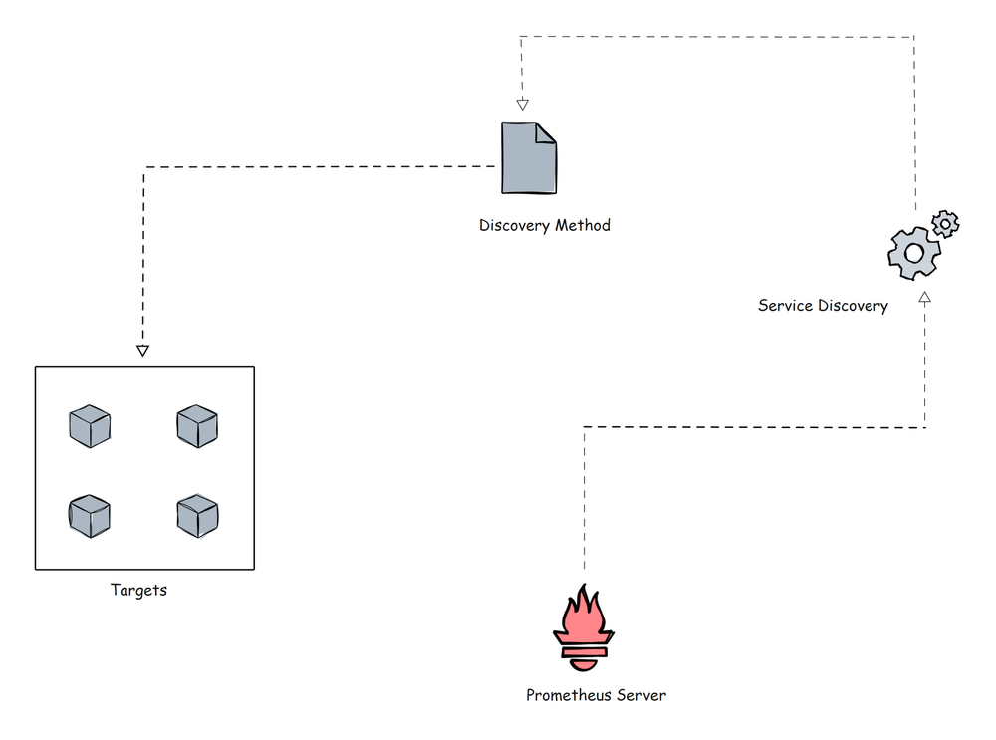
Prometheus – Service Discovery (Consul)

Slide 17
Prometheus – PushGateway
Prometheus by default uses pull mechanism to scrap the metrics.
However, there are scenarios where metrics need to be pushed to prometheus.
Lets take an example of a batch job running on a Kubernetes cronjob that runs daily for 5 mins based on certain events.
In this scenario, Prometheus will not be able to scrape the service level metrics properly using pull mechanism.
So instead for waiting for prometheus to pull the metrics, we need to push the metrics to prometheus.
To push metrics, prometheus offers a solution called Pushgateway. It is kind of a intermediate gateway.

Slide 18
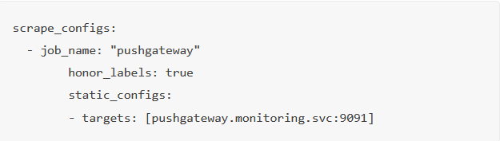
Prometheus – PushGateway
Pushgateway needs to be run as a standalone component.
The batch jobs can push the metrics to the pushgateway using HTTP API. Then Pushgateway exposes those metrics on /metrics endpoint. Then prometheus scrapes those metrics from the Pushgateway.
Pushgateway stores the metrics data temporarily in in-memory storage. It's more of a temporary cache.
Pushgateway configuration also will be configured under the scrape_configs section in the Prometheus configuration.

Slide 19
Prometheus – Client Library
Prometheus Client Libraries are software libraries that can be used to instrument application code to expose metrics in the way Prometheus understands.
In cases where you need custom instrumentation or you want to create your own exporters, you can use the client libraries.
A very good use case is batch jobs that need to push metrics to the Pushgateway.
The batch job needs to be instrumented with client libraries to expose requirement metrics in prometheus format.

Slide 20
Prometheus – Alert Manager
Alertmanager is the key part of Prometheus monitoring system. Its primary job is to send alerts based on metric thresholds set in the Prometheus alert configuration.
The alert get triggered by Prometheus and sent to Alertmanager.
It in turn sends the alerts to the respective notification systems/receivers (email, slack etc) configured in the alert manager configurations.

Slide 21
Prometheus – Alert Manager
Also, alert manager takes care of the following.
Alert Deduplicating: Process of silencing duplicated alerts.
Grouping: Process of grouping related alerts togther.
Silencing: Silence alerts for maintenance or false positives.
Routing: Routing alerts to appropriate receivers based on severities.
Inhibition: Process of stopping low severity alert when there is a medium of high severity alert.

Slide 22
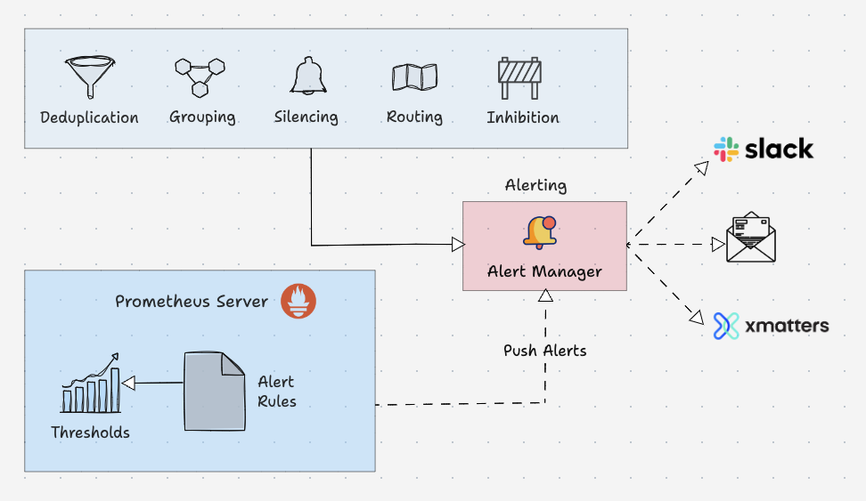
Prometheus – Alert Manager

Slide 23
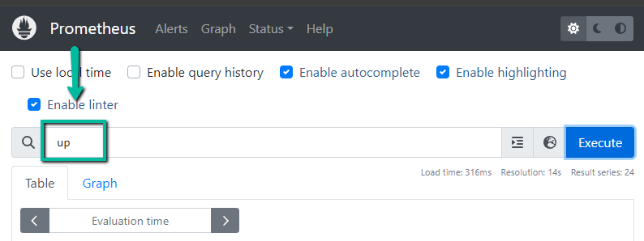
Prometheus – PromQL
PromQL is a flexible query language that can be used to query time series metrics from the prometheus.
We can directly used the queries from the Prometheus user interface or we can use curl command to make a query over the command line interface.

Slide 24
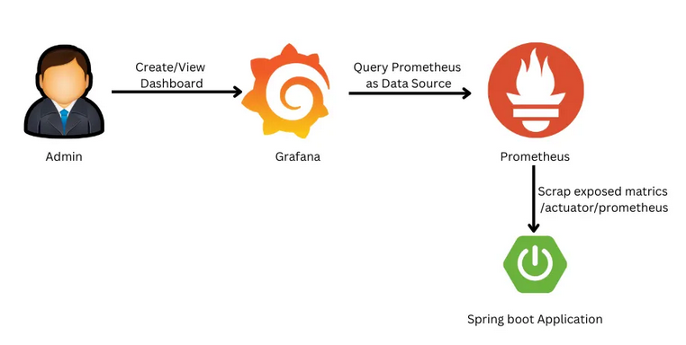
Prometheus in Spring Boot
Prometheus and Grafana offer a strong monitoring solution for Spring Boot apps.
Prometheus collects metrics and manages alerts, while Grafana visualizes matrices and manages alerts. Together, they help detect and resolve problems before they affect users.

