Slide 1
OPTIMIZING PICKING ROUTE FOR IMPROVING WAREHOUSE EFFICIENCY
Kannan Nova
Grand Canyon University: DSC-590
08-14-2021

Slide 2
Project Overview
Finding the shortest optimal path for picking operation in warehouse
The capstone project helps to find the shortest optimal picking path in warehouse using reinforcement Q-learning (RL) algorithm
The warehouse is a part of supply chain logistics industry where we store the goods and bring back it from storage for shipment (Picking Operation).
Most of the warehouse floor layout will be a grid or matrix layout so we can use it for RL’s state variable
Reinforcement Q-Learning
Environment, Agent, States, Actions and Rewards
Notes:
The warehouse is a part of supply chain logistics industry where we store the goods and bring back it from storage for shipment.
Today’s consumers are shopping online more than store purchase and 31% of consumers purchase online weekly as per “Global Consumer Insights 2019” report from PWC and this rate will keep increase. They expect the goods within a couple of days. This shift / expectation increase pressure on warehouse facilities to meet this new demand, so we need to optimize each and every warehouse operations to achieve the efficiency and meet consumer’s demand. Warehouse has two major core processes such as
Put away where we download the goods from truck and place it into final location inside warehouse (McCrea, 2016).
Picking where we take out the goods from final location and stuff into truck for shipping (Lopienski, 2020).
These two warehouse operations are very complex and more labor-oriented tasks. The workers manually go there and pick the goods if it is a small and light weight otherwise, they operate forklifts for picking. Sometimes robots are used for picking. If the system is not providing the proper optimal route/shortest path details for picking a particular order, then workers spend more time on walking instead of performing the actual picking job.
Based on literature reviews, the picking process is optimized by linearly or deterministic or deep learning, but it is a dynamic and stochastic because goods can be placed anywhere in warehouse during put away/storing. Thus, these enable to use reinforcement learning (RL) and if system is not providing the shortest optimal path for picking operation, then the most of times, workers spend more time on walking on warehouse instead performing the actual task.
It also shows that the optimizing and improving picking process will improve / cause warehouse efficiency positively. This project is based on dynamic environment and if picking process failed, system/agent will learn it from failure for future improvement and it needs the data for environment, state, Q-table and locations.

Slide 3
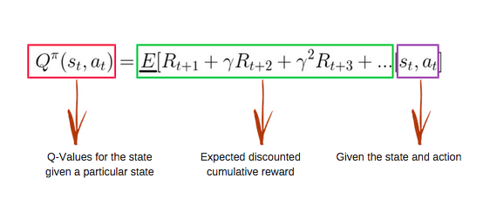
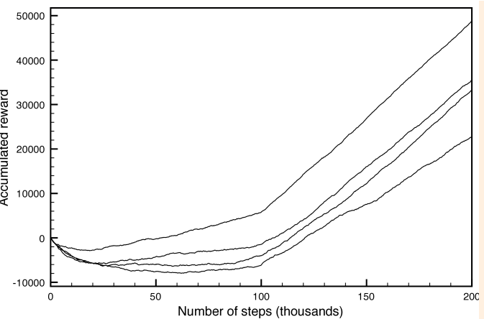
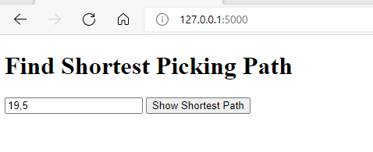
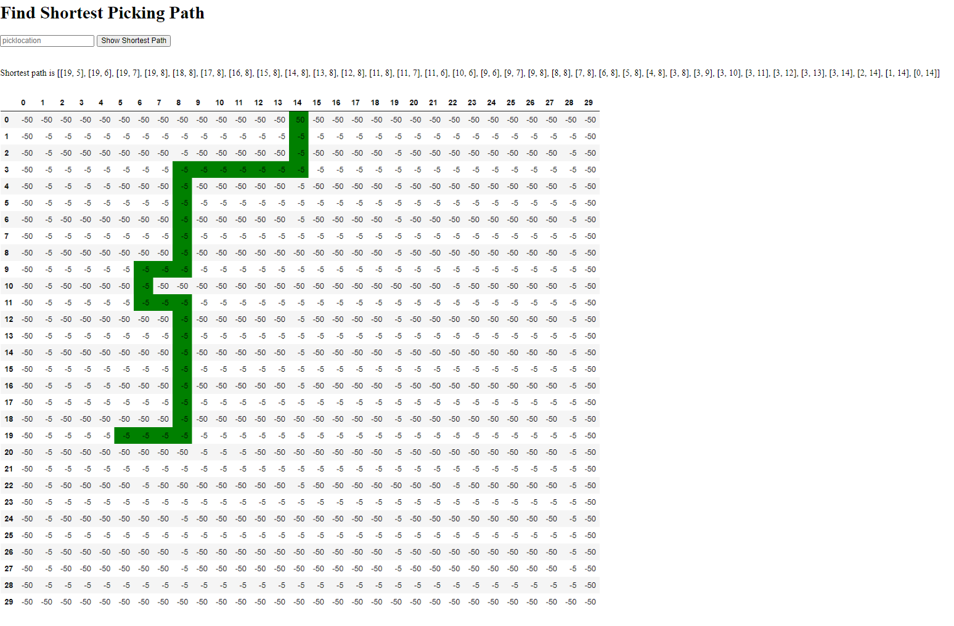
poster
Context and Background
The warehouse is a part of supply chain logistics industry where store the goods and bring back it from storage for shipment. Warehouse has two major core processes such as
Put away where download the goods from truck and place it into final location inside warehouse (McCrea, 2016).
Picking where take out the goods from final location and stuff into truck for shipping (Lopienski, 2020).
Based on literature reviews, the picking process is optimized by linearly or deterministic or deep learning, but it is dynamic and stochastic because goods can be placed anywhere in warehouse during put away/storing (Janse, 2019). Thus, these enable to use reinforcement Q-learning (RL) for optimizing the pricking process.
Components of Project - Model
Reinforcement Q-Learning Algorithm
Environment
Agent
States – Warehouse layout location
Actions
Rewards, Q-Tables
Bellman equation
Code
Index page, WMS.py, App.py, Requirements.txt
Performance graph between rewards vs steps
Implications
This project optimizes the efficiency of the warehouse picking operation by providing the shortest optimal path, and warehouse will ship the goods to consumer on time.
This will improve the overall warehouse efficiency and returns good ROI
Hardware and Software
Operating Systems: UNIX or Windows with RAM 32GB
Environment: Cloud or On-Premises
For visualizing the warehouse layout / structure: CAD floor software
GitHub for storing codes and maintaining versions.
Cloud: Google Cloud Provider (GCP) – App Engine.
Language: Python (version 3:8)
Python Libraries
dataframe-image==0.1.1, Flask==1.1.2, gunicorn==19.9.0,
numpy>=1.9.2, imagesize==1.2.0, imgkit==1.2.2, Jinja2==2.11.2,
joblib==1.0.1, json5==0.9.5, matplotlib>=1.4.3, pandas>=0.19,
Werkzeug==0.15.1, requests==2.24.0
Previews - UI and Output
UI
Output
The prediction results will be shown in text and visual representation as below
References
Bhatt, S. (2019, April 19). Reinforcement Learning 101. Medium. https://towardsdatascience.com/reinforcement-learning-101-e24b50e1d292.
Gillman, D. (2016, May 16). 5 Ways Machine Learning Improves Warehouse Operations. Retrieved from https://www.toolbox.com/tech/erp/blogs/5-ways-machine-learning-improves-warehouse-operations-051616
Janse, L., & Rensburg, V. (2019). Artificial Intelligence for warehouse picking optimization. – An NP-Hard Problem. Retrieved from http://uu.diva-portal.org/smash/record.jsf?pid=diva2%3A1413926&dswid=4306
Lopienski, K. (2020, November 31). Warehouse order Picking 101: Systems, Methods, & strategies. Retrieved from https://www.shipbob.com/blog/warehouse-picking/
McCrea, B. (2016, August 19). 8 new ways to think About putaway and storage in your warehouse. from https://www.mmh.com/article/8_new_ways_to_think_about_putaway_and_storage in_your_warehouse
Shyalika, C. (2019, November 16). A Beginners Guide to Q-Learning. Retrieved from https://towardsdatascience.com/a-beginners-guide-to-q-learning-c3e2a30a653c
Notes:
The warehouse is a part of supply chain logistics industry where we store the goods and bring back it from storage for shipment.
Today’s consumers are shopping online more than store purchase and 31% of consumers purchase online weekly as per “Global Consumer Insights 2019” report from PWC and this rate will keep increase. They expect the goods within a couple of days. This shift / expectation increase pressure on warehouse facilities to meet this new demand, so we need to optimize each and every warehouse operations to achieve the efficiency and meet consumer’s demand. Warehouse has two major core processes such as
Put away where we download the goods from truck and place it into final location inside warehouse (McCrea, 2016).
Picking where we take out the goods from final location and stuff into truck for shipping (Lopienski, 2020).
These two warehouse operations are very complex and more labor-oriented tasks. The workers manually go there and pick the goods if it is a small and light weight otherwise, they operate forklifts for picking. Sometimes robots are used for picking. If the system is not providing the proper optimal route/shortest path details for picking a particular order, then workers spend more time on walking instead of performing the actual picking job.
Based on literature reviews, the picking process is optimized by linearly or deterministic or deep learning, but it is a dynamic and stochastic because goods can be placed anywhere in warehouse during put away/storing. Thus, these enable to use reinforcement learning (RL) and if system is not providing the shortest optimal path for picking operation, then the most of times, workers spend more time on walking on warehouse instead performing the actual task.
It also shows that the optimizing and improving picking process will improve / cause warehouse efficiency positively. This project is based on dynamic environment and if picking process failed, system/agent will learn it from failure for future improvement and it needs the data for environment, state, Q-table and locations.

Slide 4
Planning and Design
Scope
This project addresses only picking operation even if warehouse has a lot of operations.
Completion
Four Phases such as Milestone 1, Milestone 2, Milestone 3 and Milestone 4
Schedule
Milestone | Duration | Start Date | End Date
Milestone 1 | 8 Weeks | 1/7/2021 | 3/3/2021
Milestone 2 | 8 Weeks | 3/4/2021 | 4/28/2021
Milestone 3 | 8 Weeks | 4/29/2021 | 6/23/2021
Milestone 4 | 8 Weeks | 6/24/2021 | 8/18/2021
Notes:
Project Scope
This project addresses only picking operation even if warehouse has a lot of operations.
Assumptions
It picks one order at a time from one location. It works for warehouse where its layout or locations can be derived as grid/matrix format. RL requires states or locations.
Project Completion
The project has four major milestones such as milestone 1, milestone 2, milestone 3 and milestone 4. In milestone 1, the requirement analysis, project title selection, and proposals are done. In milestone 2, model design, data collection, and preprocessing are done. In milestone 3, the code execution, and deployment are done. In milestone 4, project submission and presentation are done.

Slide 5
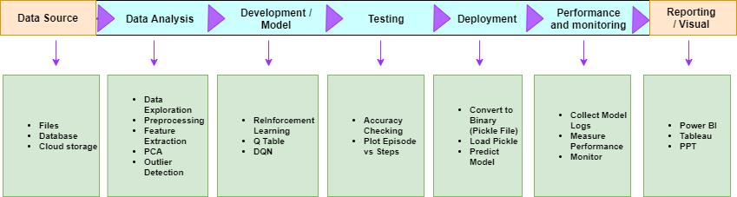
Planning and Design
Pipeline Design
Pipeline Design Achitecture Diagram
Notes:
It has seven major modules/stages such as data source, data analysis, development/model build, testing, deployment, monitoring and reporting.

Slide 6
Implementation
Creating Deployment Package
Rlwms.pkl
System Configuration
Operating Systems: UNIX or Windows with RAM 32GB
Environment: Cloud or On-Premises
Language: Python (version 3:8)
For visualizing the warehouse layout / structure: CAD floor software
GitHub for storing codes and maintaining versions.
Google cloud provider (GCP) is used for cloud environment.

Slide 7
Implementation
Source Code Listing
Wms.py
App.py
User Interface
Index.html
Notes:
WMS.py is a core or main python application which has the reinforcement Q-learning algorithm code.
APP.py is a webserver code and it uses python’s flask web framework
Index.html which is UI screen where user enters the picking location and gets the response back from trained model.

Slide 8
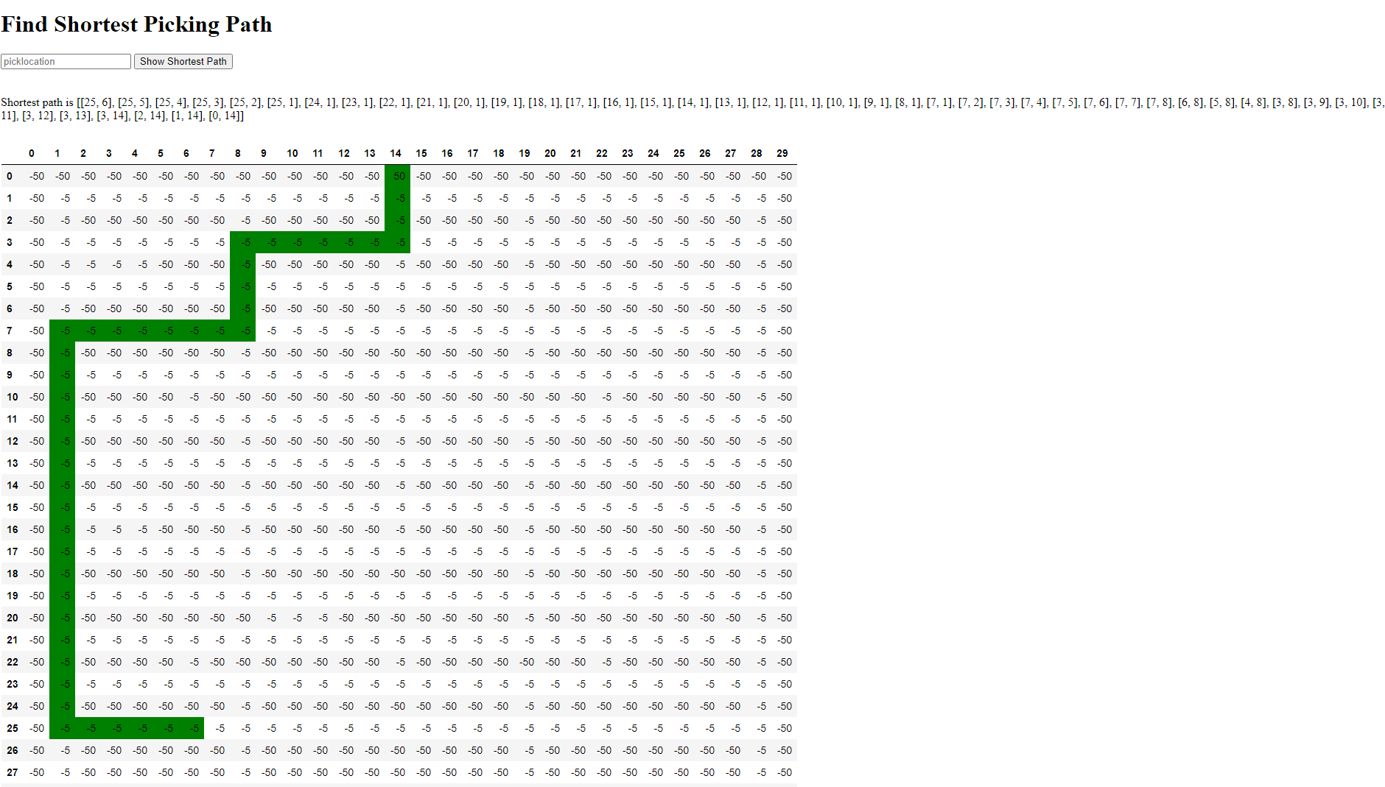
Implementation
Reinforcement Q-Learning Code
Bellman Equation
Testing and Validation
Testing built model
Notes:
For building the mode, first, environment, agents, states, and rewards are defined then build the mode. Initially Q table has zeroes and there is an iterative process for updating the values. Once start exploring the environment, q-function provides the better approximations continuously updating q-value in the table (Shyalika, 2019).
Testing
This project is based on reinforcement learning algorithms, so there several evaluation / validation measures are done, and they are such as agent performance, cumulative rewards, steps and total time taken for shortest optimal path. Due to reinforcement learning algorithm, there is a need for testing the agent’s quality whether it is trained well or not

Slide 9
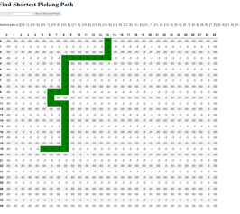
Implementation
Outcome
Model prediction result
Performance Analysis

Slide 10
Project Completion
Performance Analysis
Test Cases
Presentation
Final Project Submission
8/18/2021

Slide 11
Does this research lend itself to an exploration/application of the Christian worldview?
A Christian worldview is not just one's personal faith expression, not ... the humanities, and all disciplines of study with application for all of life.
This research will bring good disciplines and humanities.
Faithfull to work.
Faithfull to study.
Notes:
God Cares about All Work
This means that all types of work matter in the kingdom of God.
For it is by grace you have been saved, through faith—and this not from yourselves, it is a gift of God.

Slide 12
References
Aissa, N., & Guerroumia, M. (2016). Semi-Supervised Statistical Approach for Network Anomaly Detection. Retrieved from https://core.ac.uk/download/pdf/82602135.pdf
Bhatt, S. (2019, April 19). Reinforcement Learning 101. Medium. https://towardsdatascience.com/reinforcement-learning-101-e24b50e1d292.
Bonner, A. (2019, November 17). The complete beginner's guide to data cleaning and preprocessing. Medium. https://towardsdatascience.com/the-complete-beginners-guide-to-data-cleaning-and-preprocessing-2070b7d4c6d.
Broda, E. (2019, September 19). Why cloud config mgmt is mandatory for ai/machine learning. Retrieved April 21, 2021, from https://medium.com/@ericbroda/why-cloud-config-mgmt-is-mandatory-for-ai-machine-learning-8d376b2b7459
Brownlee, J. (2020, August 27). Save and Load Machine Learning Models in Python with scikit-learn. Machine Learning Mastery. https://machinelearningmastery.com/save-load-machine-learning-models-python-scikit-learn/.
Buchanan, I. A. N. (2018). Configuration management: definition and benefits. Atlassian. https://www.atlassian.com/continuous-delivery/principles/configuration-management.
Chaudhary, M. (2020, August 14). Importance of principal component analysis. Medium. https://medium.com/@cmukesh8688/importance-of-principal-component-analysis-e9184a47ffa8.
Creswell, J, & Creswell, D. (2017). Research Design: Qualitative, Quantitative, and Mixed Methods Approaches (5th Edition). Retrieved from https://www.gcumedia.com/digital-resources/sage/2018/research-design_qualitative-quantitative-and-mixed-methods-approaches_5e.php
Dhanani, S. (2018, January 8). Code Reviewing Data Science Work. Medium. https://medium.com/@shanif/code-reviewing-data-science-work-774747248e33.
Gajare, S. (2019, October 03). Data science methodology and approach. Retrieved from https://www.geeksforgeeks.org/data-science-methodology-and-approach

