Slide 1
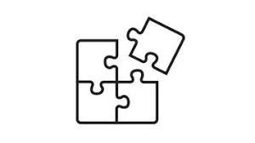

Design Patterns through C#
Kannan Sudhakaran

Slide 2
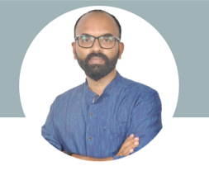




Instructor Introduction
Instructor: Kannan Sudhakaran
Microsoft Certified Trainer
Koenig Solutions
15 Years in IT Training and Development
@kannan-sudhakaran​

Slide 3
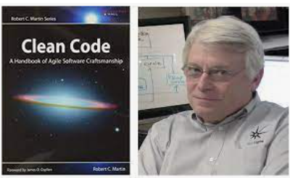
Course Overview
Module 01
- OO Design
- Relationships
- SOLID
Module 02
- Creational patterns(5)
Module 03
- Structural patterns(7)
Module 04
- Behavioral patterns(11)
Module 05
- DDD

Slide 4
Day wise schedule
day1: OOAD relationships
Programming to interface principle
SRP,OCP,LSP
Labs/Live Qubits
day2: ISP,DIP
(1)Singleton
(2) simple factory and factory method
Labs/Live Qubits
day3: (3)Abstract factory
(4)prototype pattern
(5)builder pattern
Labs/Live Qubits
day4: (6) Composite pattern
(7) Facade
(8) Decorator
Labs/Live Qubits
day5: (9) Proxy
(10)flyweight
(11)Adapter
Labs/Live Qubits

Slide 5
Day wise schedule
day6: (12)Bridge
(13)Observer
(14)Mediator
Labs/Live Qubits
day7: (15)Iterator
(16)Strategy
(17)Template method
Labs/Live Qubits
day8: (18)Visitor
(19)Interpreter
(20)Command
Labs/Live Qubits
day9: (21)State
(22)COR
(23)Memento
Labs/Live Qubits
day10: Domain driven design concept and pattern
MVC pattern- Composite,Strategy,observer
Dependency Injection
Labs/Live Qubits

