Slide 1
OO Relationship
Generalization
Realization
Association
Composition
Aggregation
Dependency

Slide 2
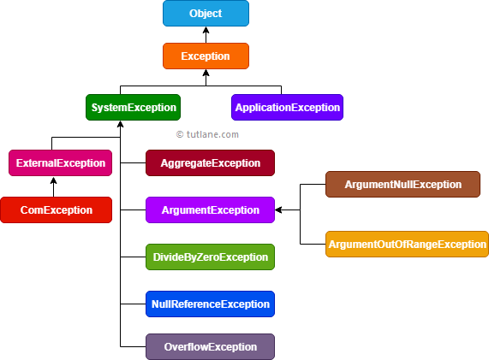
Generalization/Specialization
Inheritance
ISA relationship

Slide 3
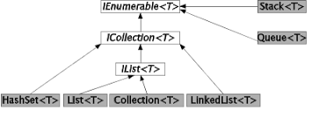
Realization Relationship
Interface
A class implements the interface
ISA relationship

Slide 4
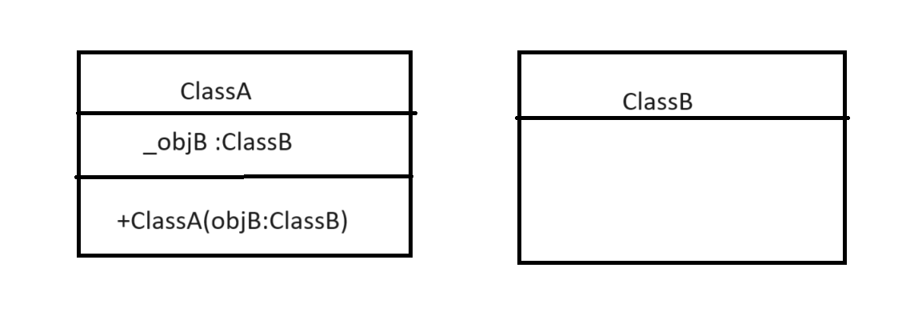
Association Relationship
Has a relationship
ClassA is said to have an association with ClassB ,if ClassA stores the instance of ClassB in its field.
Composition and Aggregation

Slide 5
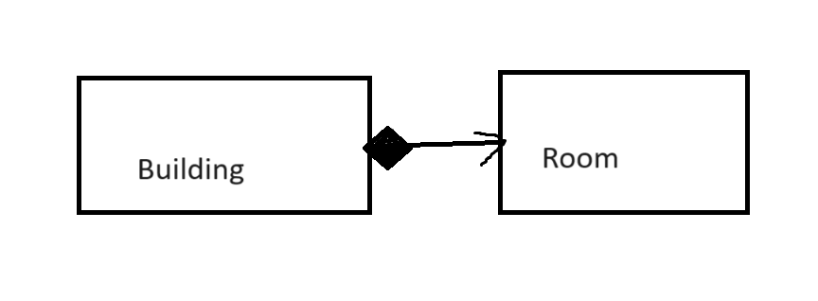
Composition Relationship
Ownership
If part cannot exist without the whole or part will be destroyed if whole is destroyed .
The whole owns the part both can exist independently eg: Order and LineItem
Diamond shows a belong to relationship

Slide 6
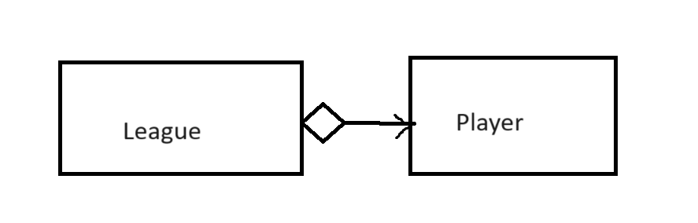
Aggregation Relationship
Part can exist independently without the whole
If whole is destroyed part can still exist
Eg Organization and Employee

Slide 7
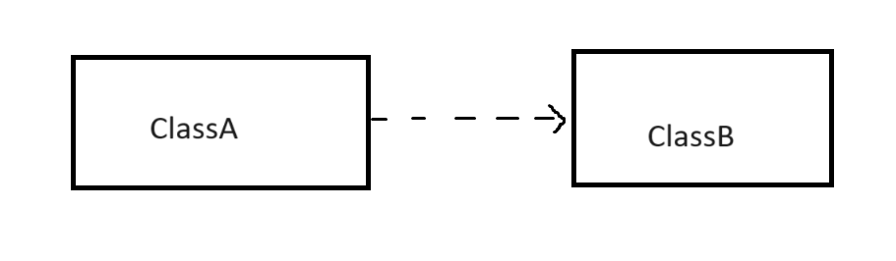
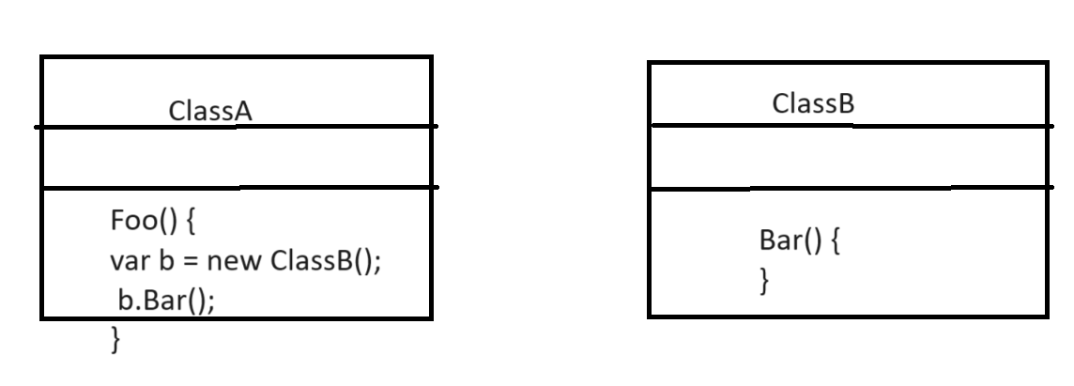
Dependency Relationship
ClassA has dependency on ClassB , if ClassA doesnot store instance of ClassB in field .
ClassA creates a local variable of ClassB inside a method
class ClassA {
void anotherMethod() {
ClassB b = new ClassB();
// Method implementation using b
}
}

