Slide 1
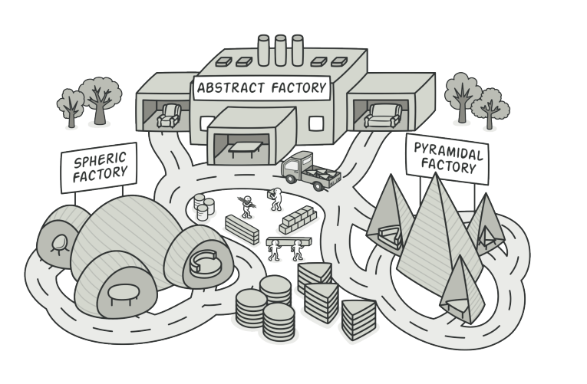
Abstract Factory Pattern

Slide 2
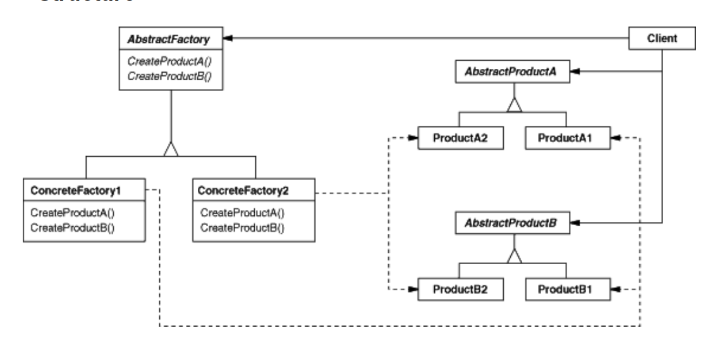
Intent
Provide an interface for creating families of related or dependent objects without specifying their concrete classes.

Slide 3
Demo

