Slide 1
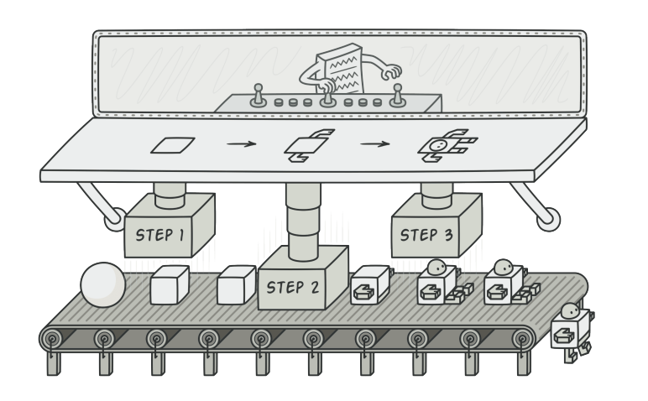
Builder Pattern

Slide 2
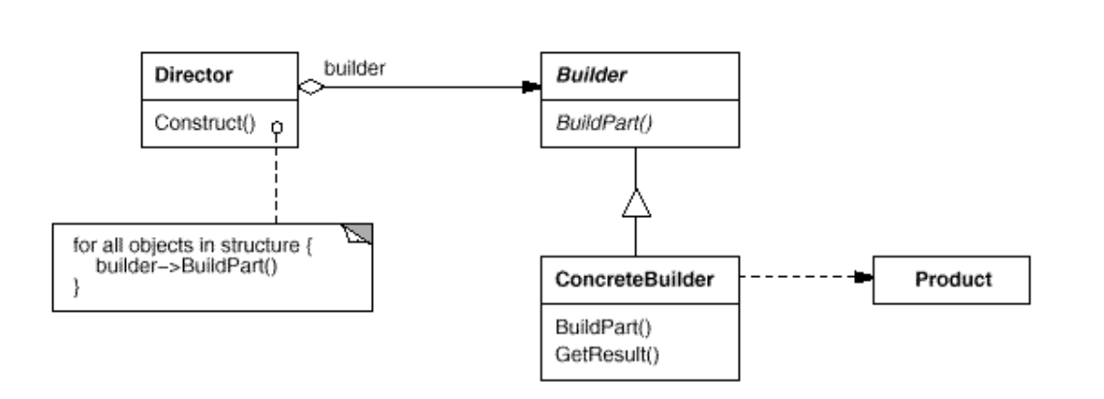
Intent
Separate the construction of a complex object from its representation so that the same construction process can create different representations.

Slide 3
Demo

