Slide 1
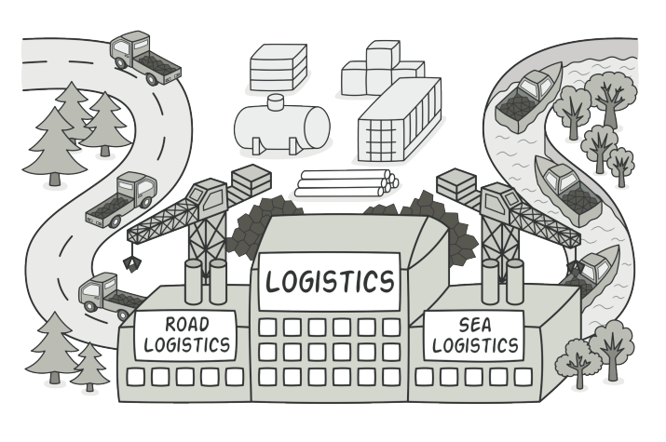
Factory Method Pattern

Slide 2
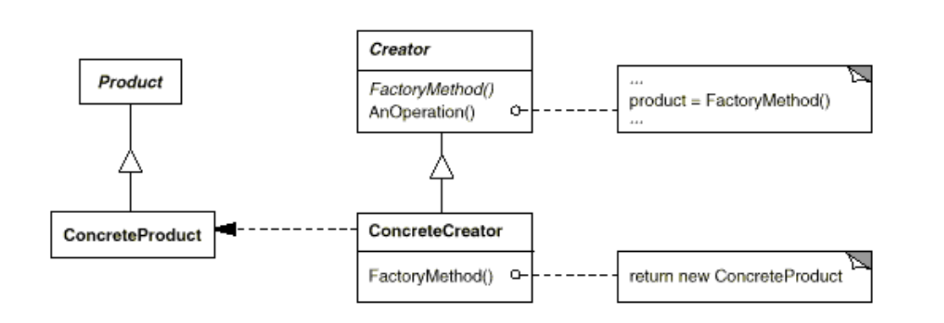
Intent
Define an interface for creating an object, but let subclasses decide which class to instantiate. Factory Method lets a class defer instantiation to subclasses

Slide 3
Demo

