Slide 1

Prototype pattern

Slide 2
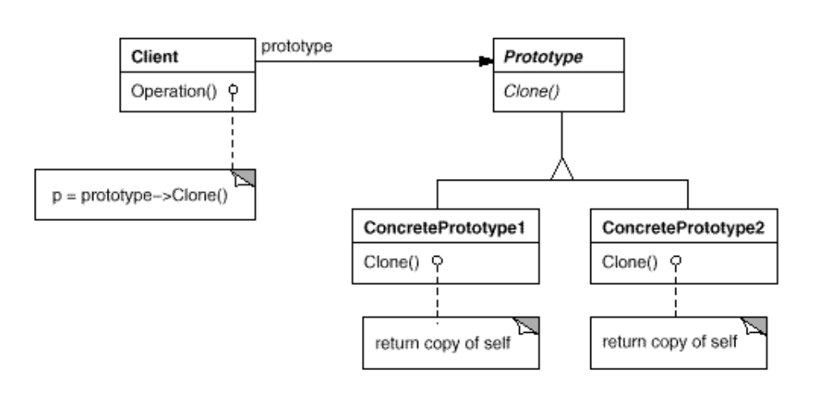
Intent
Specify the kinds of objects to create using a prototypical instance, and create new objects by copying this prototype.

Slide 3
Demo

