Slide 1

Singleton pattern

Slide 2
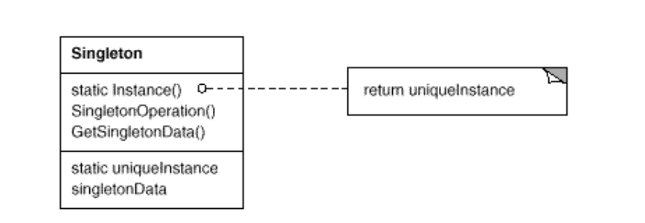
Intent
Ensure a class only has one instance, and provide a global point of access to it.

Slide 3
Demo

