Slide 1
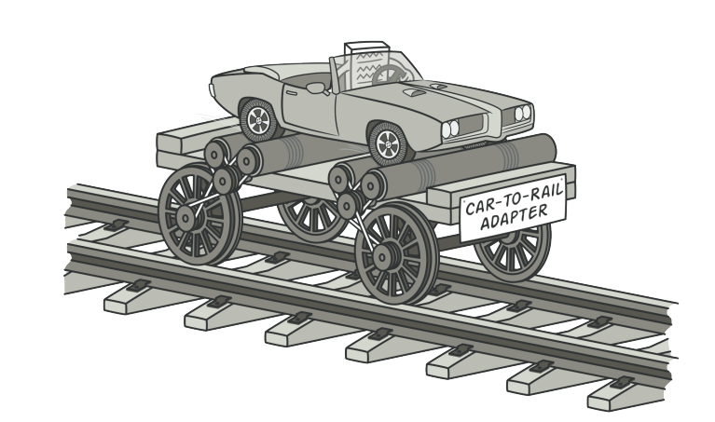
Adapter pattern

Slide 2
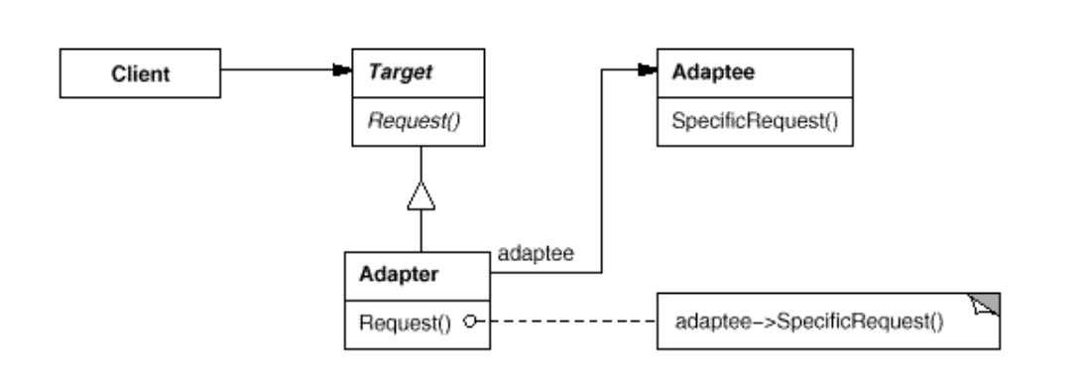
Intent
Convert the interface of a class into another interface clients expect. Adapter lets classes work together that couldn't otherwise because of incompatible interfaces

Slide 3
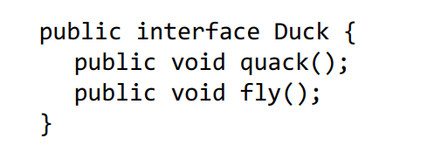
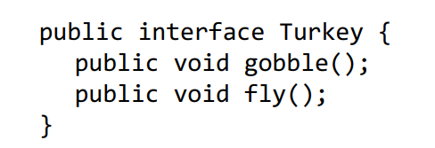
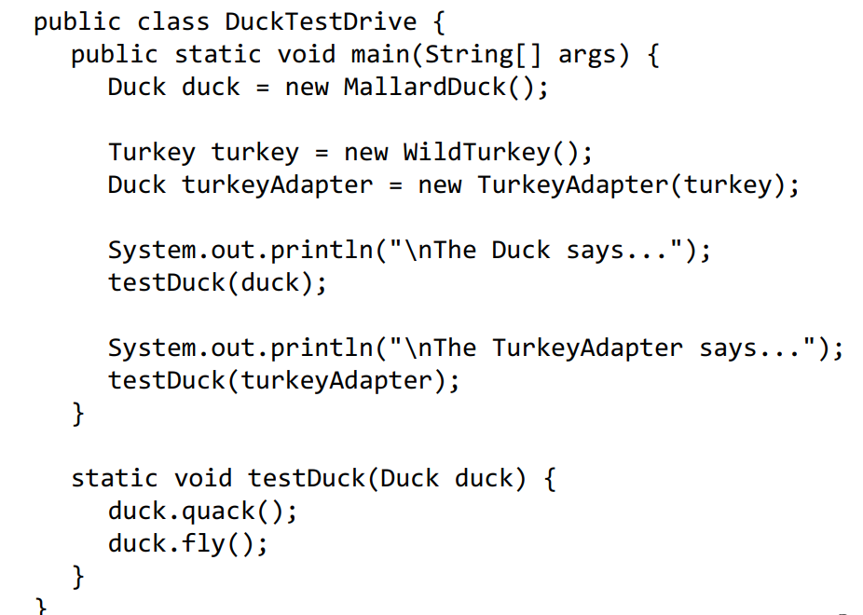
Demo

Slide 4
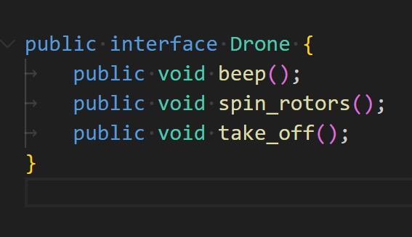

Demo

Slide 5
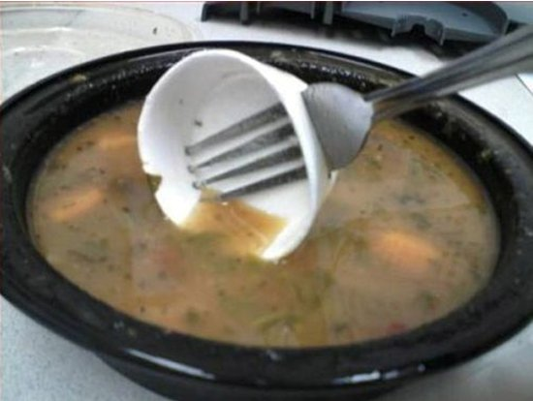


Improvisation/Jugad

