Slide 1
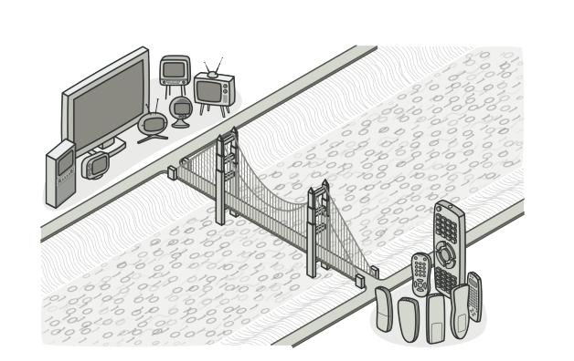
Bridge pattern

Slide 2
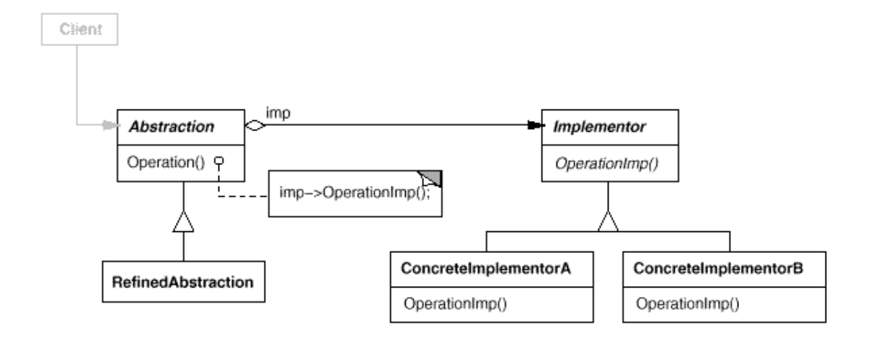
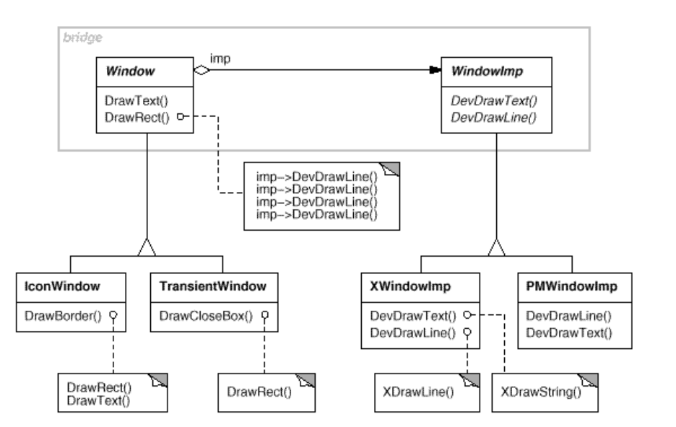
Intent
Decouple an abstraction from its implementation so that the two can vary independently

Slide 3
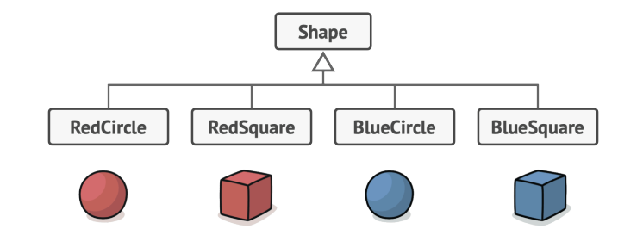
Bridge pattern
A mechanism that decouples an interface(hierarchy) from an implementation (hierarchy)
Use bridge when there is a hierarchy which grow in two different dimensions

Slide 4
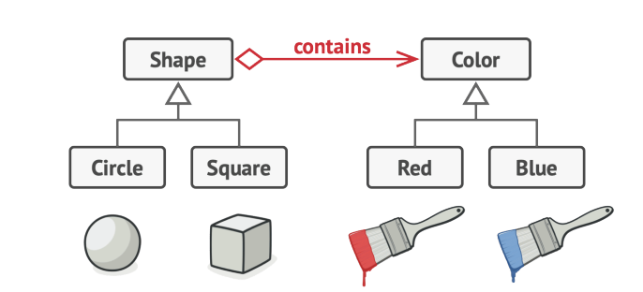
Bridge pattern
A mechanism that decouples an interface(hierarchy) from an implementation (hierarchy)
Use bridge when there is a hierarchy which grow in two different dimensions

Slide 5
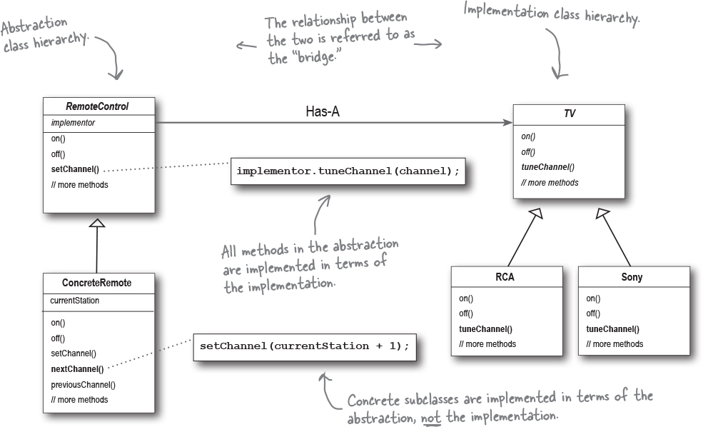
Demo

Slide 6
Demo

