Slide 1
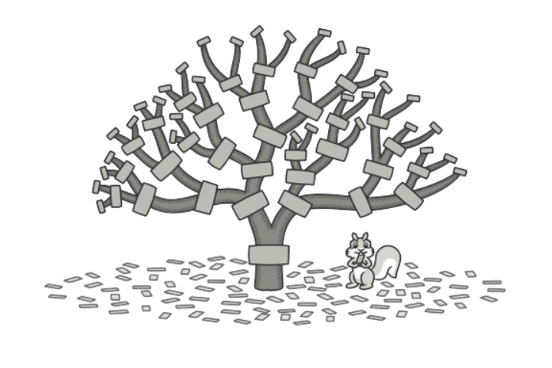
Composite pattern

Slide 2
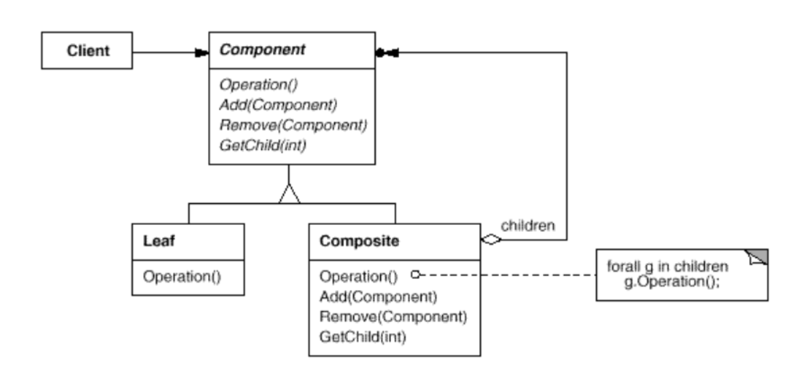
Intent
Compose objects into tree structures to represent part-whole hierarchies. Composite lets clients treat individual objects and compositions of objects uniformly.

Slide 3
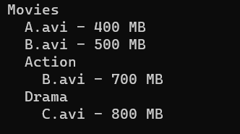
Demo

Slide 4
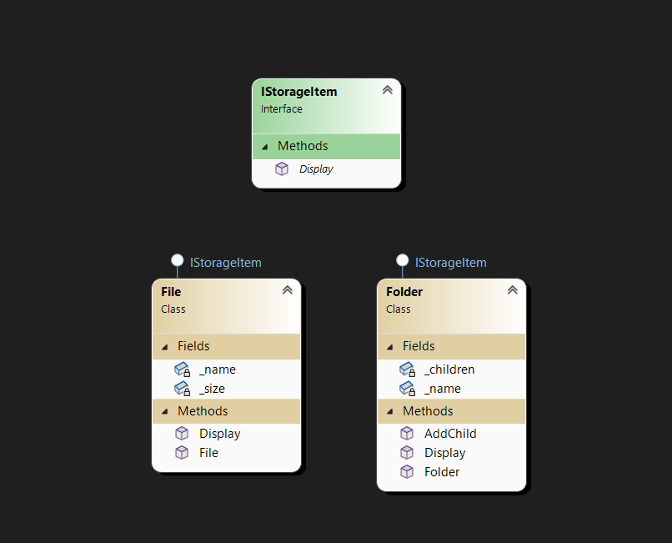
Demo

Slide 5
Demo
internal interface IStorageItem
{
void Display(int depth=0);
}

Slide 6
Demo
internal class File : IStorageItem
{
private string _name;
private int _size;
public File(string name, int size)
{
_name = name;
_size = size;
}
public void Display(int depth = 0)
{
for(int i = 0; i < depth; i++)
Console.Write(" ");
Console.WriteLine("{0} - {1} MB",_name,_size);
}
}

Slide 7
Demo
internal class Folder : IStorageItem
{
private string _name;
private List<IStorageItem> _children;
public Folder(string name)
{
_name = name;
_children = new List<IStorageItem>();
}
public void AddChild(IStorageItem item) {
_children.Add(item);
}
public void Display(int depth = 0)
{
for (int i = 0; i < depth; i++)
Console.Write(" ");
Console.WriteLine("{0}",_name);
foreach (IStorageItem item in _children)
{
int temp = depth;
item.Display(++temp);
}
}
}

Slide 8
Demo
static void Main(string[] args)
{
Folder compositeRoot = new Folder("Movies");
compositeRoot.AddChild(new File("A.avi", 400));
compositeRoot.AddChild(new File("B.avi", 500));
Folder action = new Folder("Action");
action.AddChild(new File("B.avi",700));
compositeRoot.AddChild(action);
Folder drama = new Folder("Drama");
drama.AddChild(new File("C.avi", 800));
compositeRoot.AddChild(drama);
compositeRoot.Display();
}

