Slide 1

Decorator pattern

Slide 2
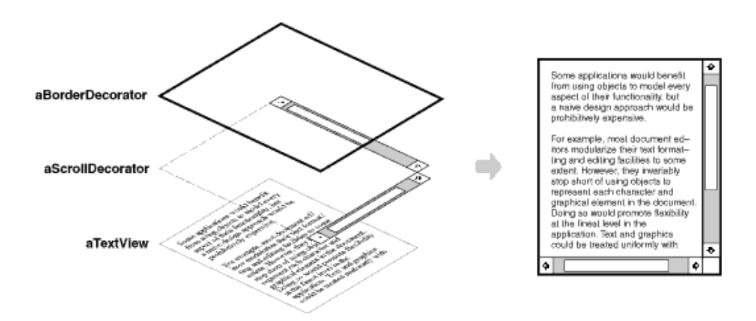
Intent
Attach additional responsibilities to an object dynamically. Decorators provide a flexible alternative to subclassing for extending functionality.

Slide 3
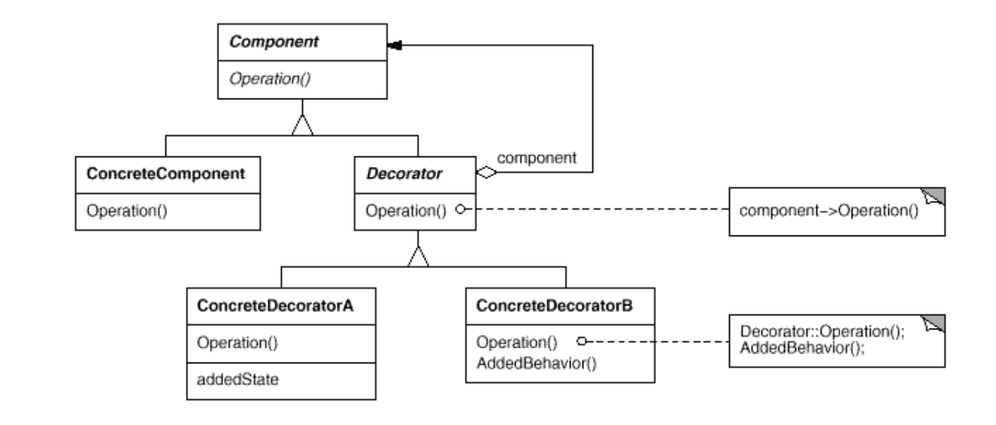
Structure

Slide 4
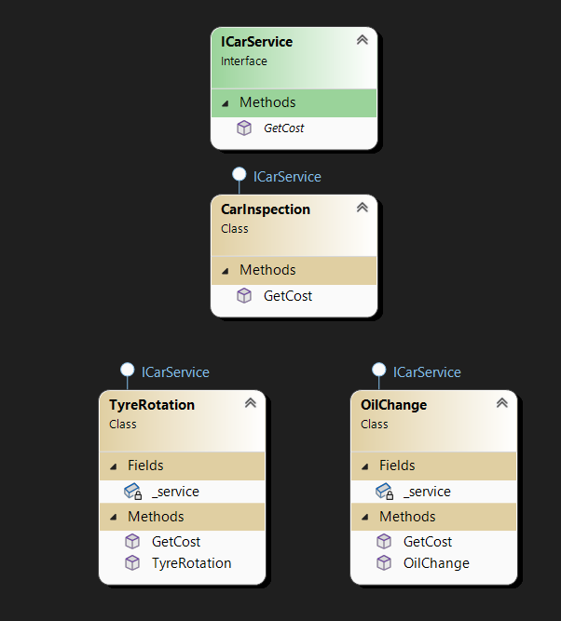
Demo

Slide 5
Demo
static void Main(string[] args)
{
var total = new TyreRotation(new OilChange(new CarInspection())).GetCost();
Console.WriteLine(total);
}

Slide 6
Demo
public class OilChange : ICarService
{
private ICarService _service ;
public OilChange(ICarService service) {
_service = service;
}
public double GetCost()
{
return 1200 + _service.GetCost();
}
}

Slide 7
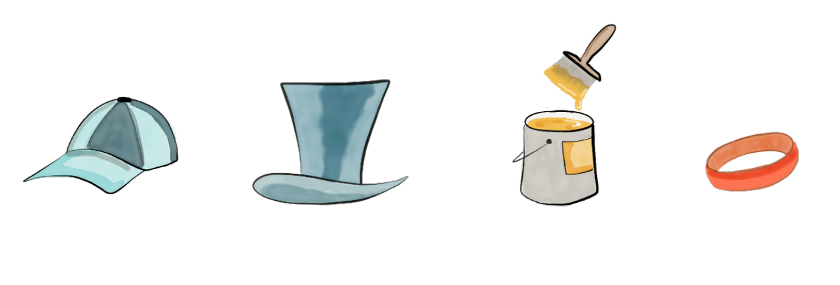

Slide 8
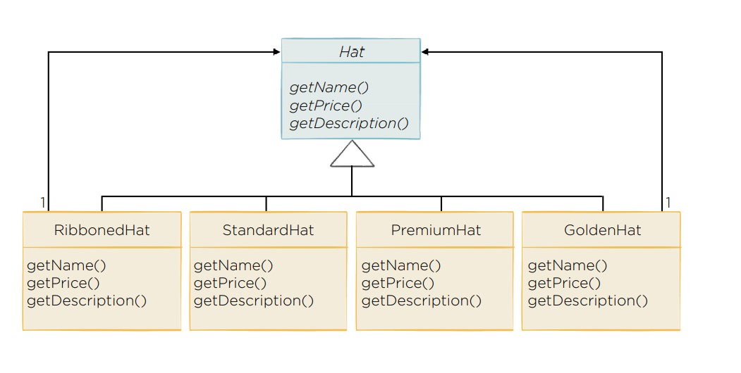

Slide 9
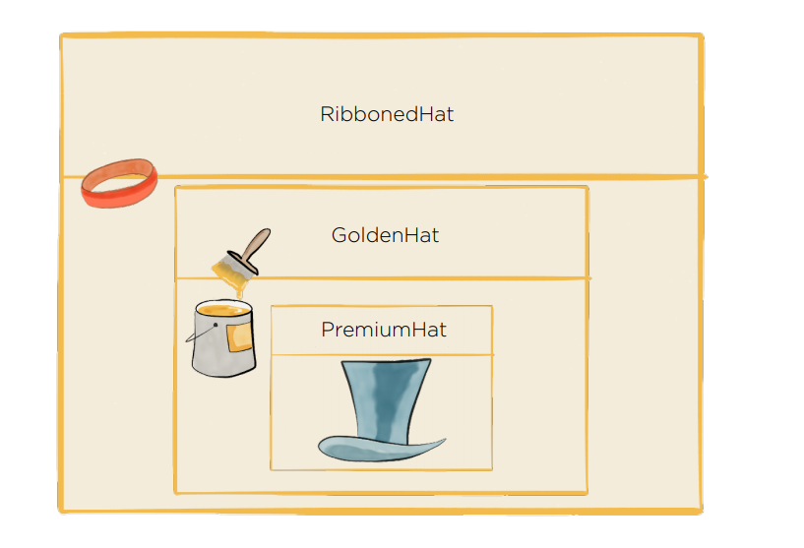

Slide 10
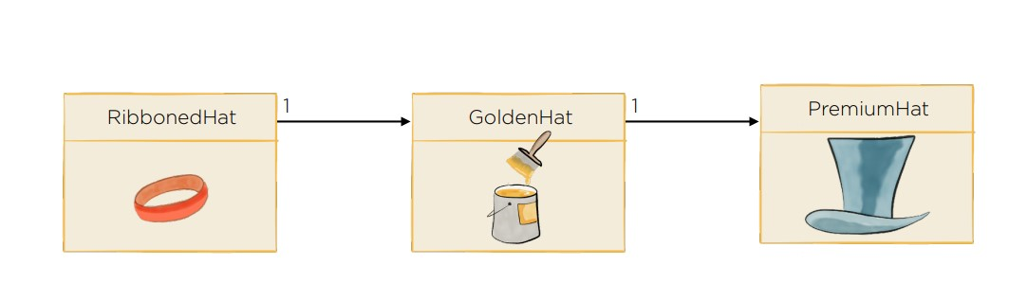

Slide 11
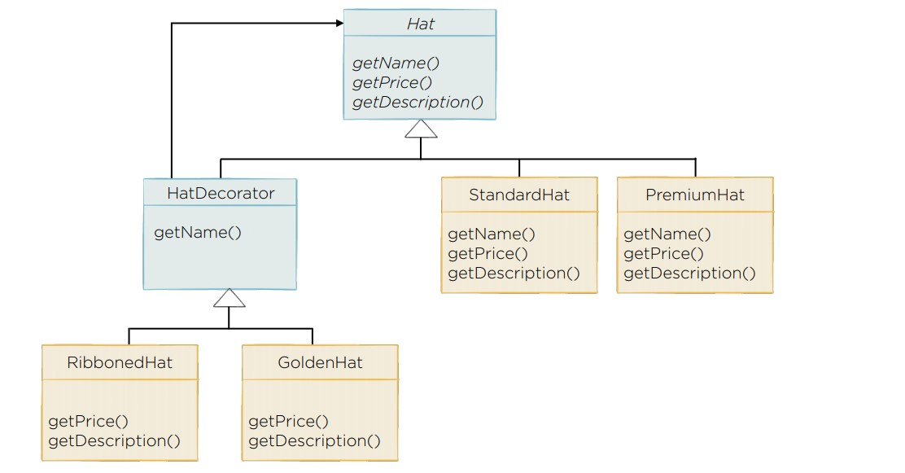

Slide 12
