Slide 1
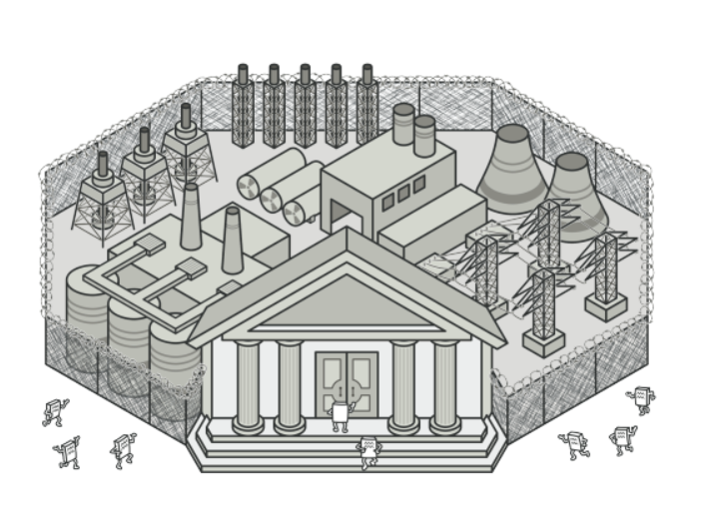
Facade pattern

Slide 2
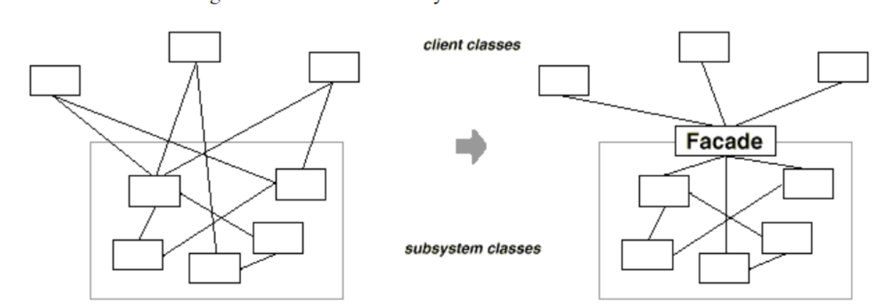
Intent
Provide a unified interface to a set of interfaces in a subsystem. Facade defines a higher evel interface that makes the subsystem easier to use

Slide 3
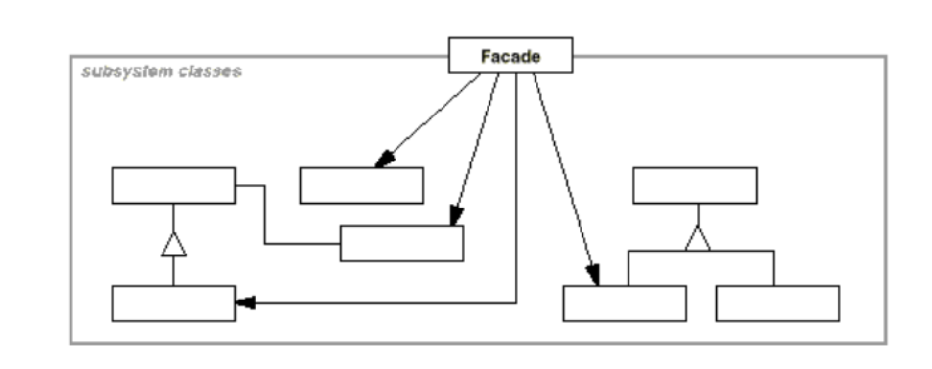
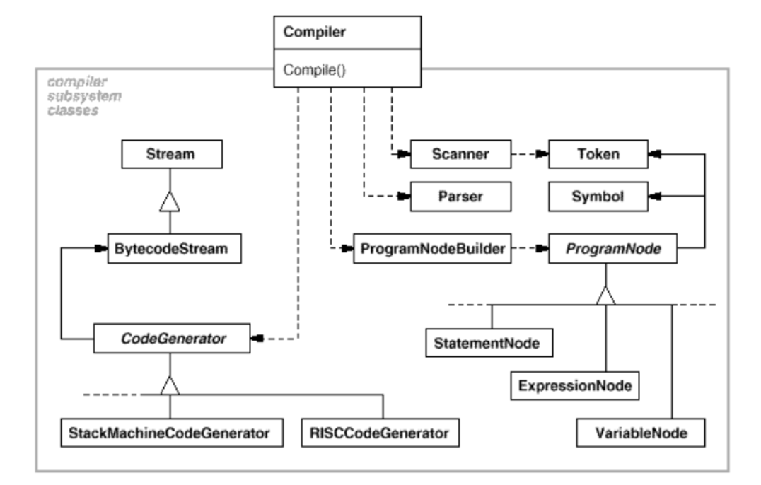
Structure

Slide 4
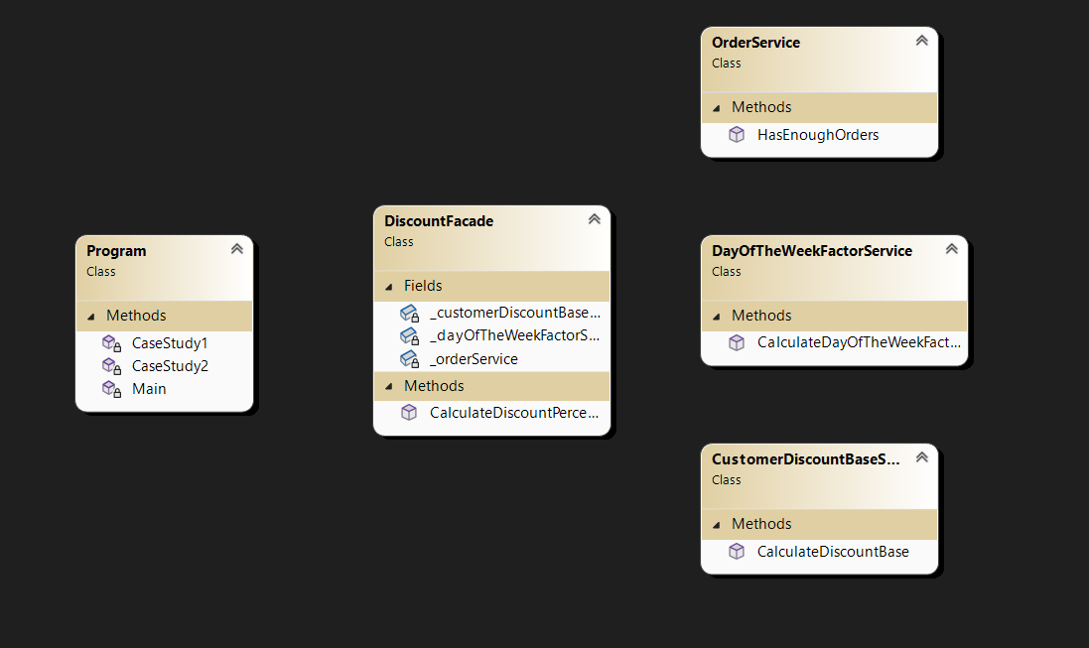
Demo

Slide 5
Demo
public class DiscountFacade
{
private readonly OrderService _orderService = new();
private readonly CustomerDiscountBaseService _customerDiscountBaseService = new();
private readonly DayOfTheWeekFactorService _dayOfTheWeekFactorService = new();
public double CalculateDiscountPercentage(int customerId)
{
if (!_orderService.HasEnoughOrders(customerId))
{
return 0;
}
return _customerDiscountBaseService.CalculateDiscountBase(customerId) * _dayOfTheWeekFactorService.CalculateDayOfTheWeekFactor();
}
}

Slide 6
Demo
HttpClient httpClient = new HttpClient();
//DNS resolution,authentication,networks connection,serialization/desrialization
string apiUrl = "http://numbersapi.com/10";
HttpResponseMessage response = await httpClient.GetAsync(apiUrl);
string content = await response.Content.ReadAsStringAsync();
Console.WriteLine("Response Content:");
Console.WriteLine(content);

