Slide 1
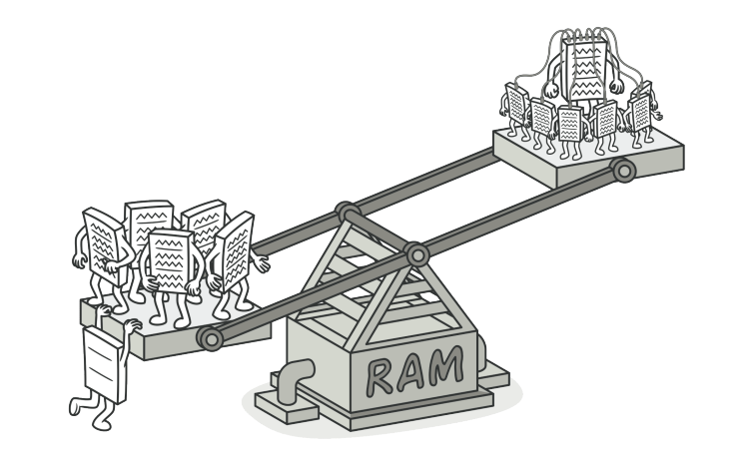
Flyweight pattern

Slide 2
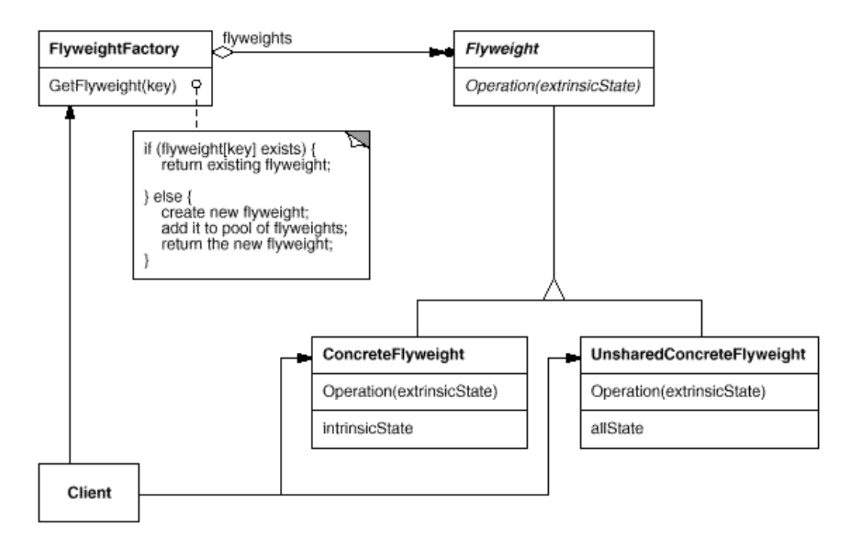
Intent
Use sharing to support large numbers of fine-grained objects efficiently.

Slide 3
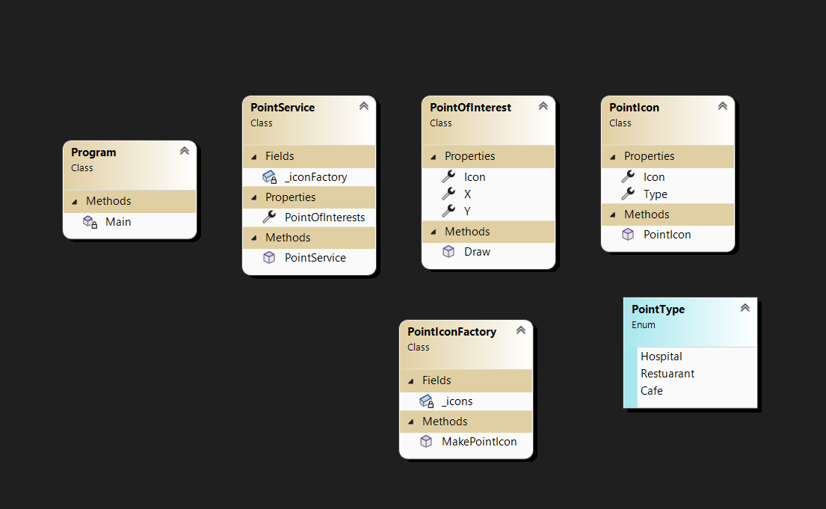
Demo

Slide 4
Demo
public enum PointType
{
Hospital,Restuarant,Cafe
}
internal class PointOfInterest
{
public int X { get; set; }
public int Y { get; set; }
public PointIcon Icon { get; set; }
public void Draw() {
Console.WriteLine( "adding point of interest to map");
Console.WriteLine($"{Icon.Type} at ({X},{Y})");
}
}

Slide 5
Demo
internal class PointIcon
{
public PointType Type { get;private set; }
public byte[] Icon { get; private set; } //20KB x 1000 icons --> 20MB
public PointIcon(PointType type, byte[] icon) {
Type = type;
Icon = icon;
}
}

Slide 6
Demo
internal class PointService
{
public List<PointOfInterest> PointOfInterests{ get; set; }
private PointIconFactory _iconFactory;
public PointService(PointIconFactory iconFactory) {
_iconFactory = iconFactory;
PointOfInterests = new List<PointOfInterest>();
var p1 = new PointOfInterest { X = 1, Y = 2,
Icon = _iconFactory.MakePointIcon(PointType.Hospital) };
PointOfInterests.Add(p1);
}
}

