Slide 1
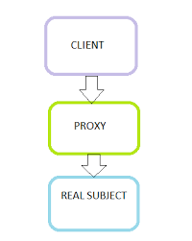
Proxy pattern

Slide 2
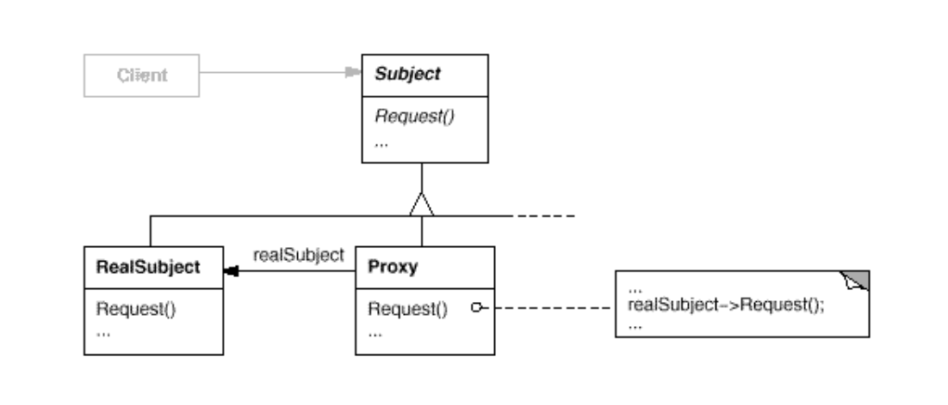
Intent
Provide a surrogate or placeholder for another object to control access to it.

Slide 3
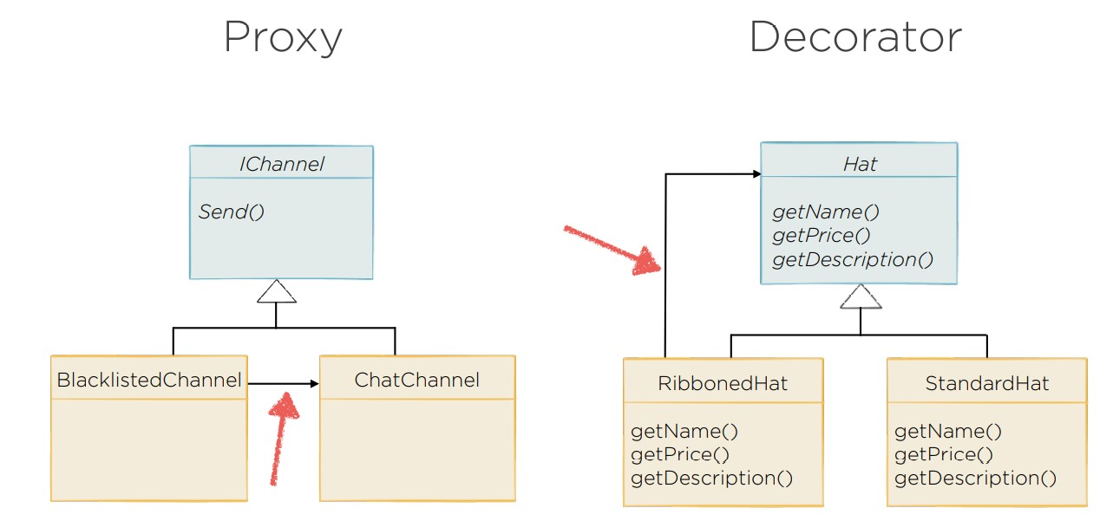

Slide 4
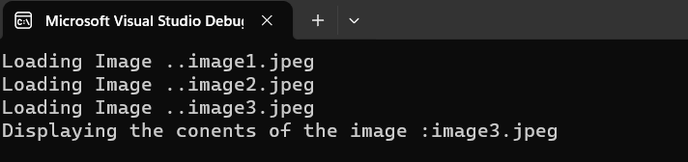
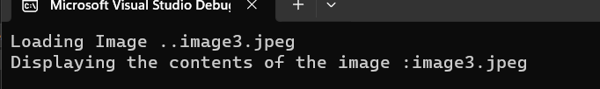
Demo
var image1 = new RealImage("image1.jpeg");
var image2 = new RealImage("image2.jpeg");
var image3 = new RealImage("image3.jpeg");
image3.Display();
var image1 = new ProxyImage("image1.jpeg");
var image2 = new ProxyImage("image2.jpeg");
var image3 = new ProxyImage("image3.jpeg");
image3.Display();

Slide 5
Demo
internal class ProxyImage : Image
{
private RealImage _realImage;
private string _filePath;
public ProxyImage(string filePath) {
_filePath = filePath;
}
public void Display()
{
if(_realImage == null )
{
_realImage = new RealImage(_filePath);
}
_realImage.Display();
}
}

