Slide 1
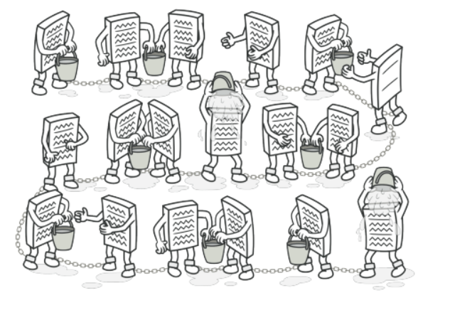
Chain of Responsibility pattern

Slide 2
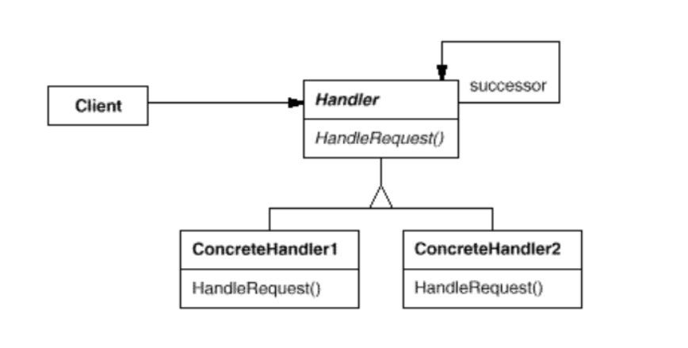
Intent
Avoid coupling the sender of a request to its receiver by giving more than one object a chance to handle the request. Chain the receiving objects and pass the request along the chain until an object handles it.

Slide 3
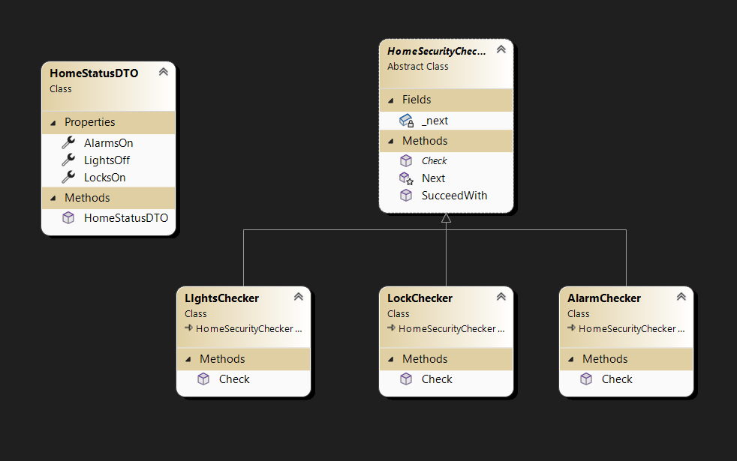
Demo

Slide 4
Demo
static void Main(string[] args)
{
HomeStatusDTO dto = new HomeStatusDTO();
dto.LightsOff = true;
dto.AlarmsOn = true;
dto.LocksOn = true;
LIghtsChecker lights = new LIghtsChecker();
AlarmChecker alarm = new AlarmChecker();
LockChecker locks = new LockChecker();
lights.SucceedWith(alarm);
alarm.SucceedWith(locks);
lights.Check(dto);
}

Slide 5
Demo
public abstract class HomeSecurityCheckerBase
{
private HomeSecurityCheckerBase _next;
public abstract void Check(HomeStatusDTO status);
public void SucceedWith(HomeSecurityCheckerBase checker) {
this._next = checker;
}
protected void Next(HomeStatusDTO dto) {
if (this._next != null) {
this._next.Check(dto);
}
}
}

Slide 6
Demo
class AlarmChecker : HomeSecurityCheckerBase
{
public override void Check(HomeStatusDTO status)
{
Console.WriteLine("checking alarm..");
if (!status.AlarmsOn)
{
throw new Exception("Alarms are not off..Abort");
}
this.Next(status);
}
}

Slide 7
Demo
class LIghtsChecker : HomeSecurityCheckerBase
{
public override void Check(HomeStatusDTO status) {
Console.WriteLine("checking lights..");
if (!status.LightsOff) {
throw new Exception("Lights are not off..Abort");
}
this.Next(status);
}
}

