Slide 1

Command pattern

Slide 2
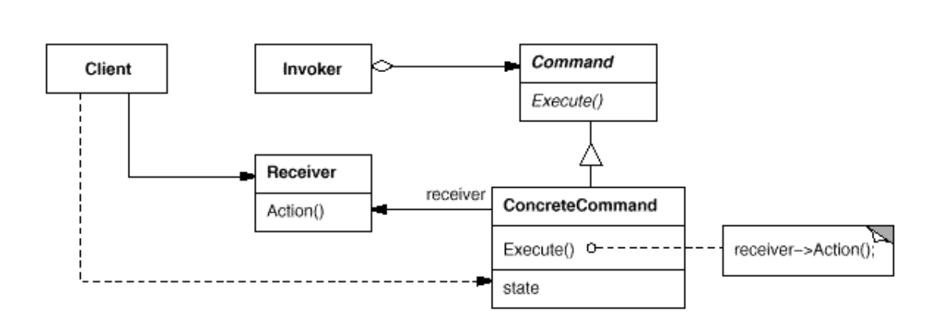
Intent
Encapsulate a request as an object, thereby letting you parameterize clients with different requests, queue or log requests, and support undoable operations

Slide 3
Demo

