Slide 1

Interpreter pattern

Slide 2
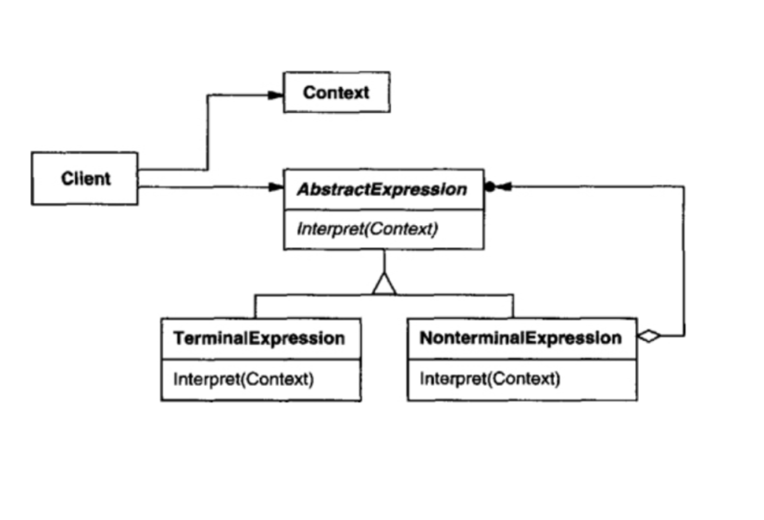
Intent
Given a language, define a representation for its grammar along with an interpreter that uses the representation to interpret sentences in language

Slide 3
Interpreter pattern
The Interpreter Pattern typically involves defining a grammar and implementing an interpreter to interpret sentences in that grammar.
This Pattern interprets grammar in code solutions
Every grammar is a class
Context contains the data

Slide 4
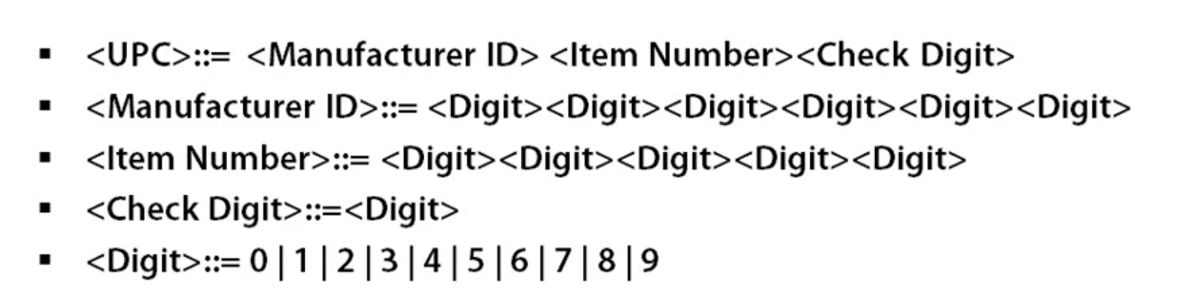
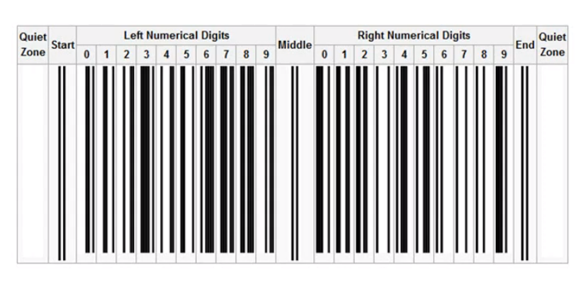
BNF notation for UPC bar code

Slide 5
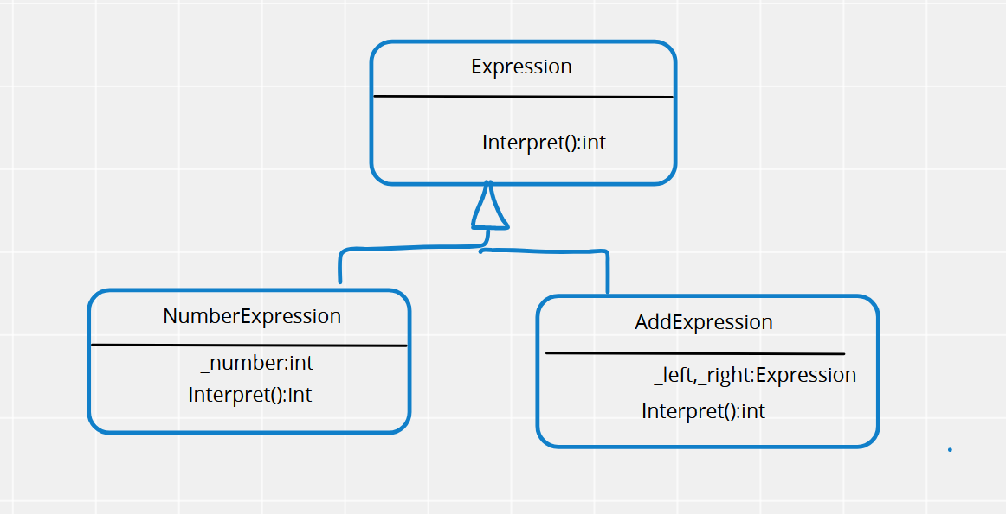
Demo

Slide 6
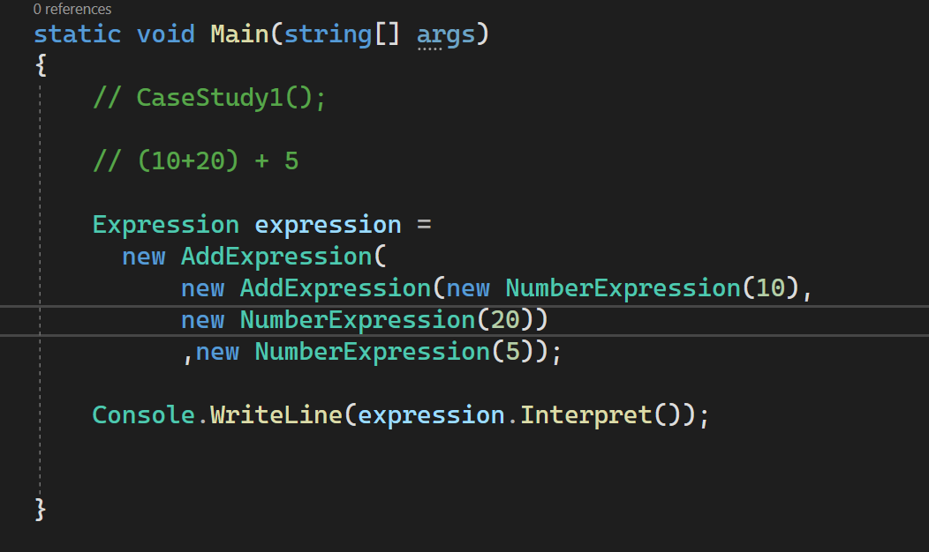
Demo

