Slide 1

Iterator pattern

Slide 2
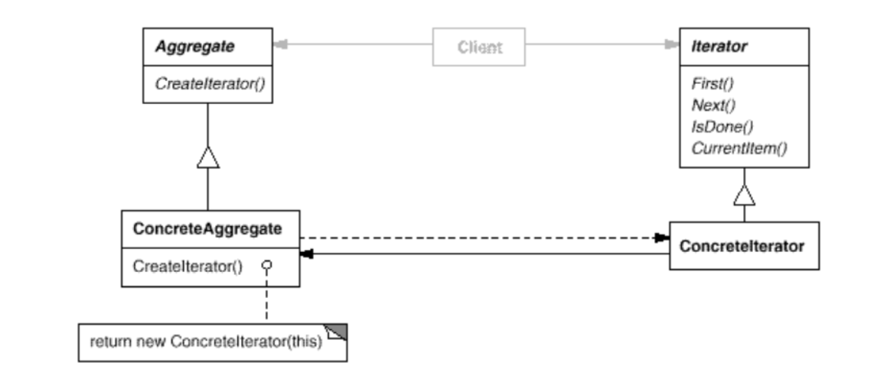
Intent
Provide a way to access the elements of an aggregate object sequentially without exposing its underlying representation.

Slide 3
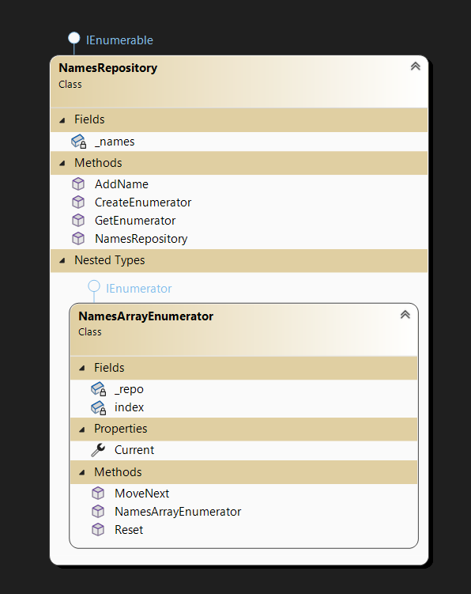
Demo

Slide 4
Demo
static void Main(string[] args)
{
var repo = new NamesRepository("abc,pqr,lmno");
var enumerator = repo.CreateEnumerator();
Console.WriteLine(enumerator.GetType());
while (enumerator.MoveNext())
{
Console.WriteLine(enumerator.Current);
}
foreach (var item in repo) {
Console.WriteLine(item?.ToString()?.ToUpper()) ;
}
repo.AddName("kannan");
foreach (var item in repo)
{
Console.WriteLine(item?.ToString()?.ToUpper());
}
}

Slide 5
Demo
internal class NamesRepository : IEnumerable
{
private string[] _names;
public NamesRepository(string namesCsvList) {
_names = namesCsvList.Split(',');
}
public IEnumerator CreateEnumerator()
{
return new NamesArrayEnumerator(this);
}
public IEnumerator GetEnumerator()
{
return CreateEnumerator();
}
public void AddName(string newName)
{
// Resize the array to accommodate the new name
Array.Resize(ref _names, _names.Length + 1);
// Add the new name to the end of the array
_names[_names.Length - 1] = newName;
}

Slide 6
Demo
public class NamesArrayEnumerator : IEnumerator
{
private NamesRepository _repo;
int index = -1;
public NamesArrayEnumerator(NamesRepository repso) {
_repo = repso;
}
public object Current {
get {
string current = _repo._names[index];
return current;
}
}
public bool MoveNext()
{
index++;
return index < _repo._names.Length;
}
public void Reset()
{
index = -1;
}
}

