Slide 1
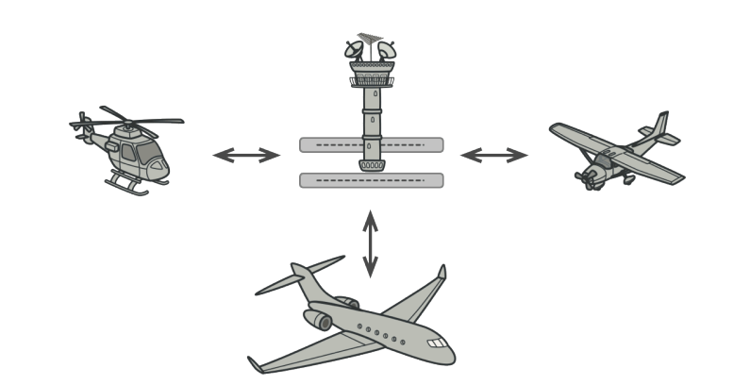
Mediator pattern

Slide 2
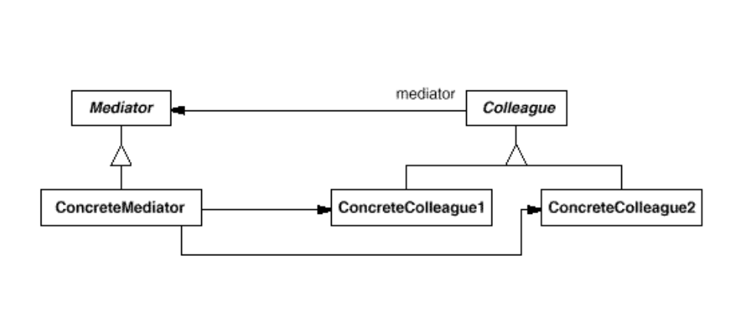
Intent
Define an object that encapsulates how a set of objects interact. Mediator promotes loose coupling by keeping objects from referring to each other explicitly, and it lets you vary their interaction independently.

Slide 3
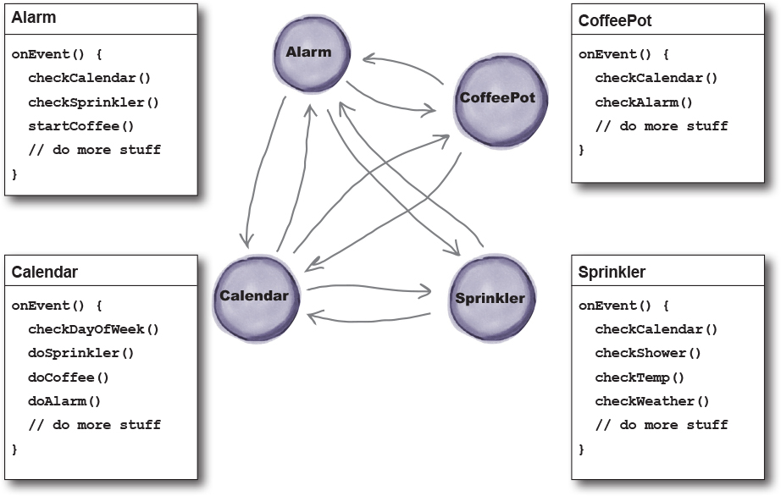
Home automation

Slide 4
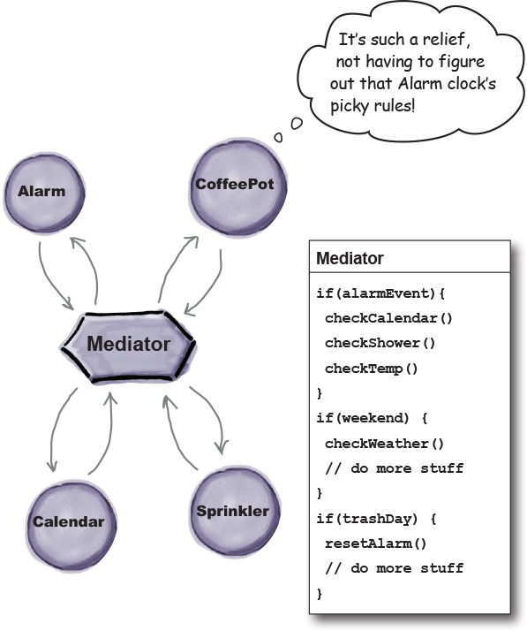
Home automation

