Slide 1
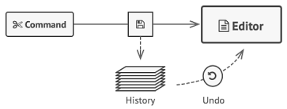
Memento pattern

Slide 2
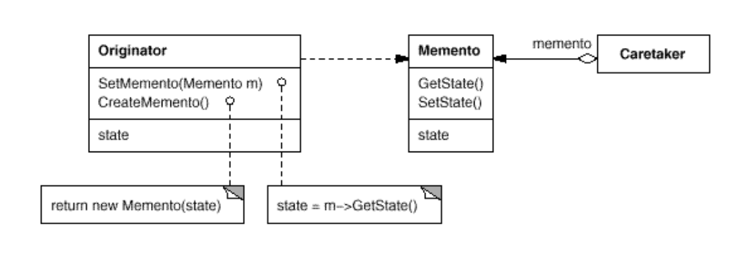
Intent
Without violating encapsulation, capture and externalize an object's internal state so that the object can be restored to this state later.

Slide 3
Demo

