Slide 1
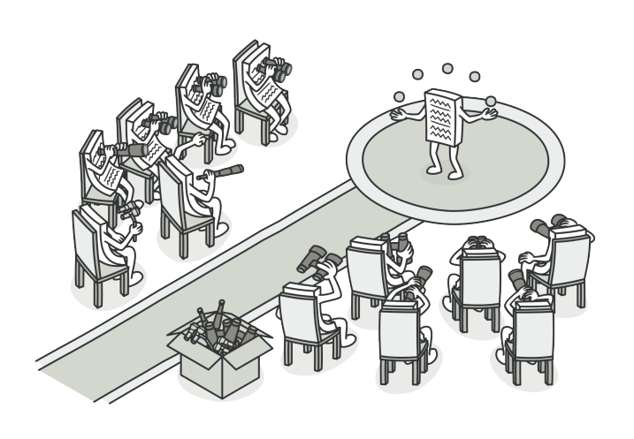
Observer pattern

Slide 2
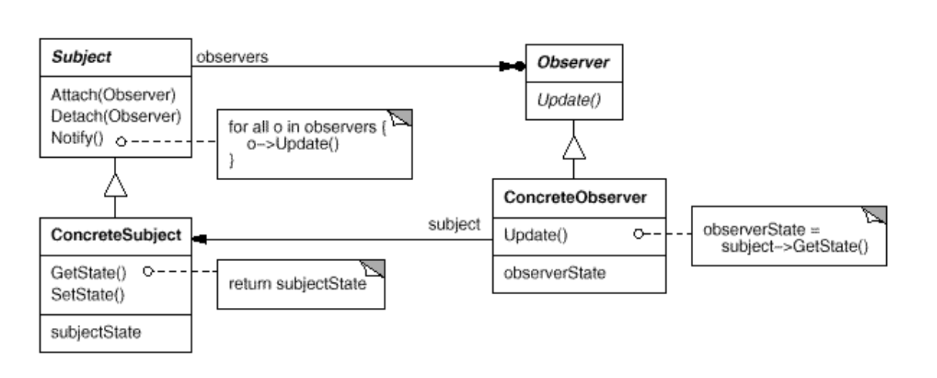
Intent
Define a one-to-many dependency between objects so that when one object changes state, all its dependents are notified and updated automatically.

Slide 3
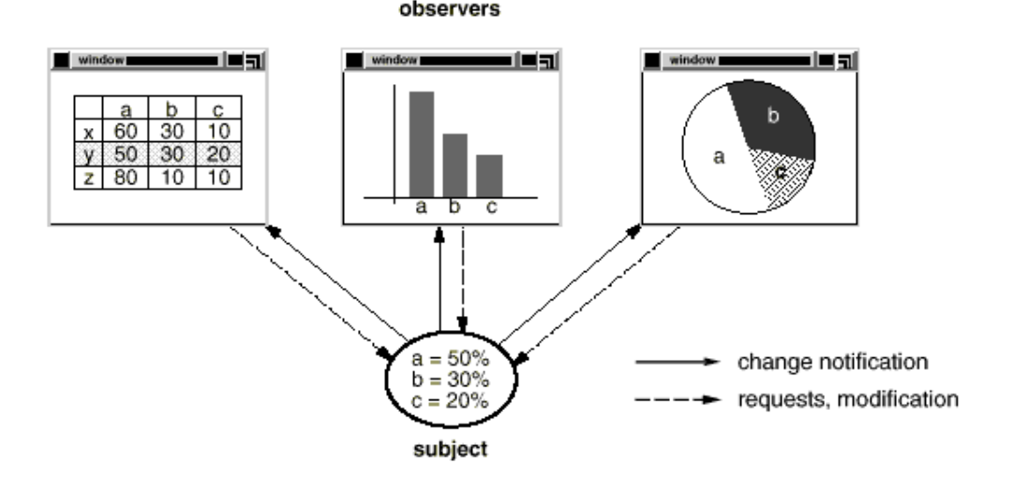
Model change

Slide 4
Demo

