Slide 1
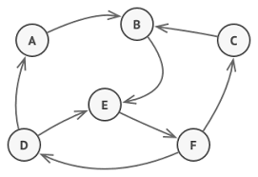
State pattern

Slide 2
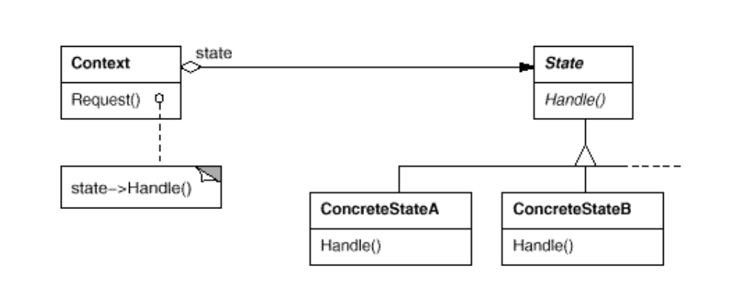
Intent
Allow an object to alter its behavior when its internal state changes. The object will appear to change its class

Slide 3
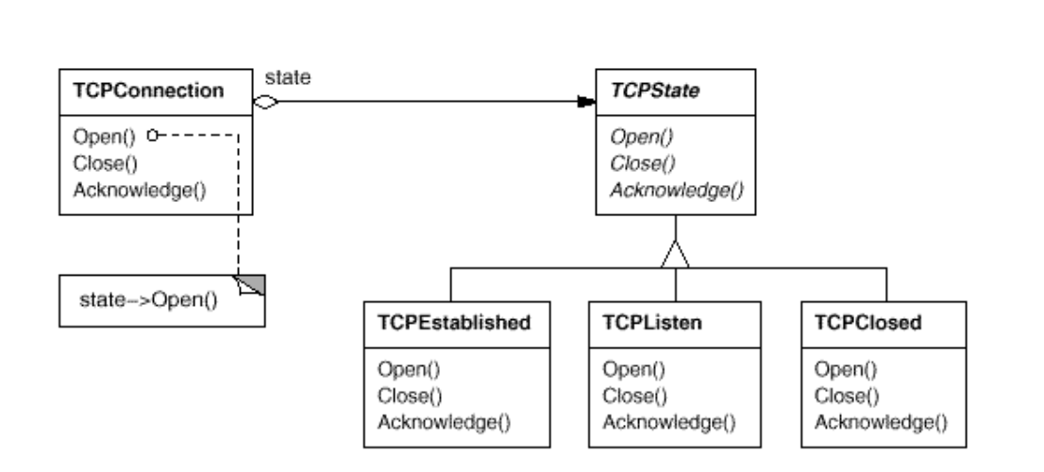
Intent
Allow an object to alter its behavior when its internal state changes. The object will appear to change its class

Slide 4

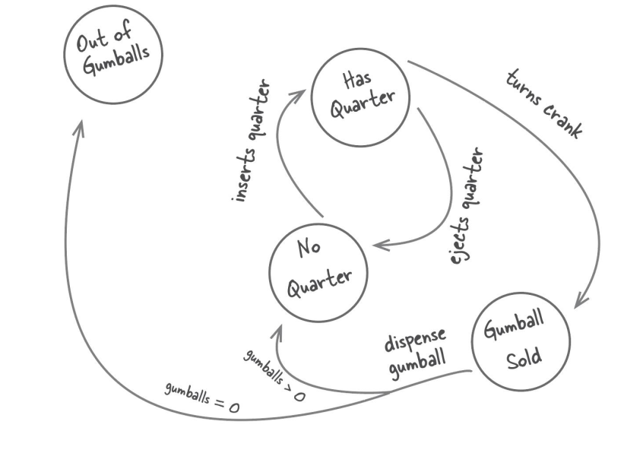
State Pattern

Slide 5
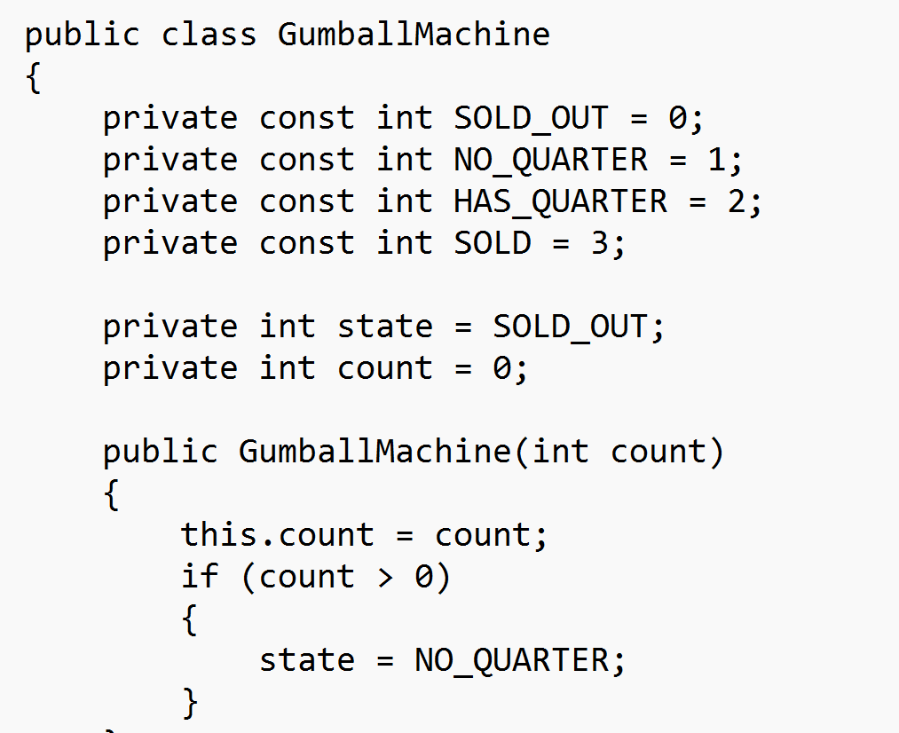
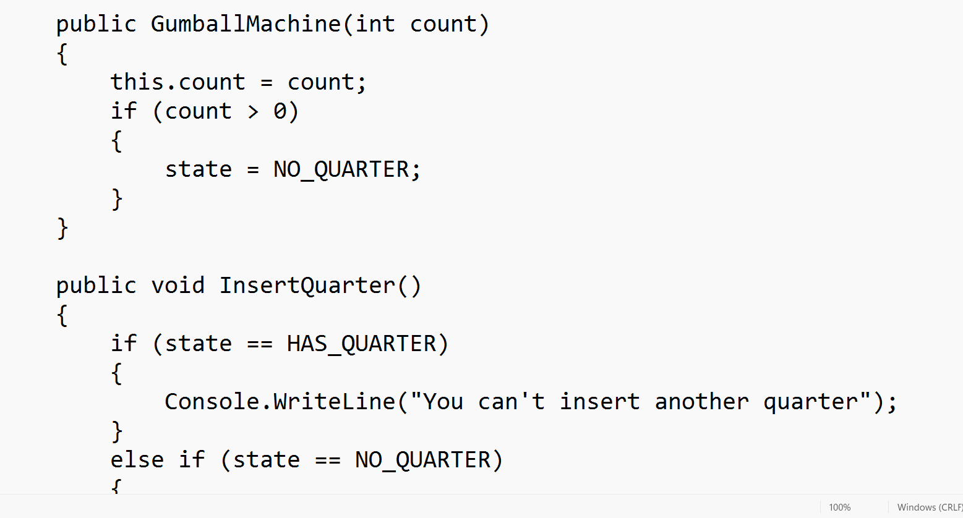
Without state pattern

Slide 6
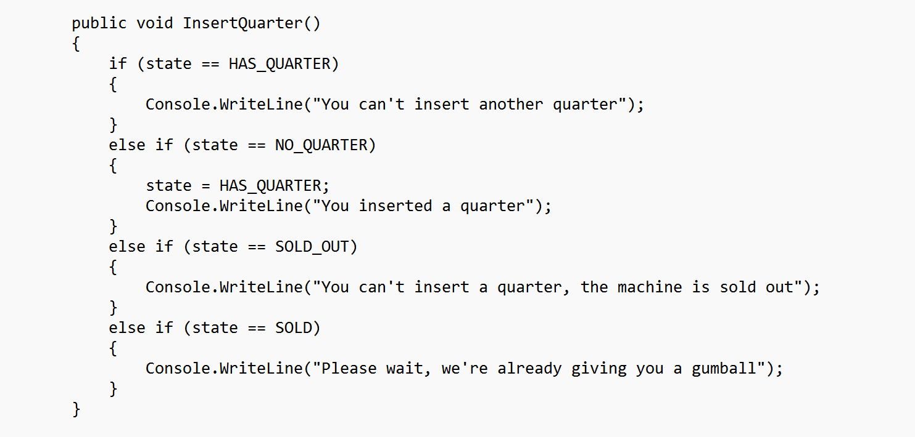
Without state pattern

Slide 7
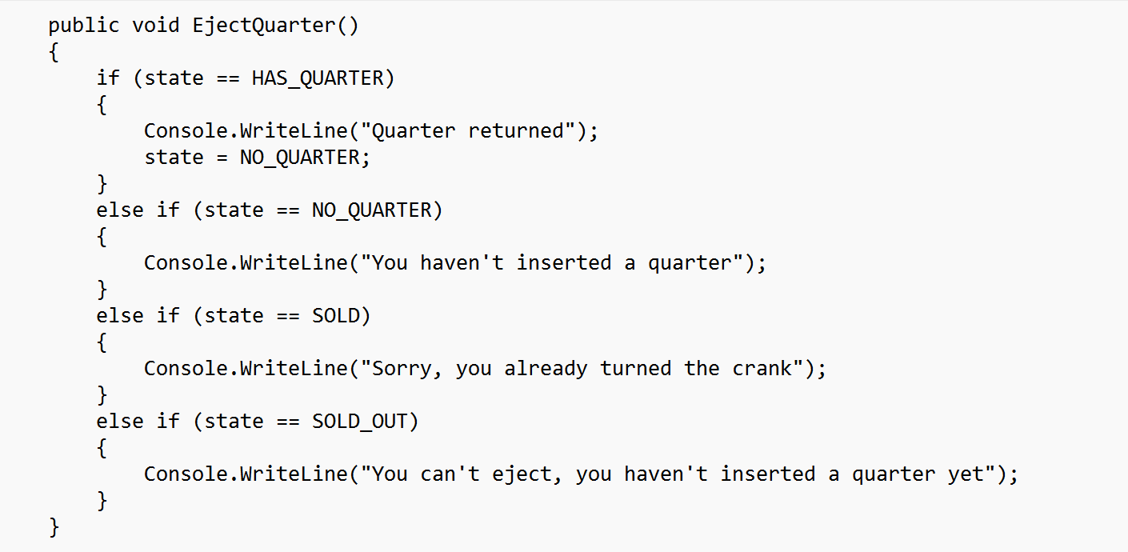
Without state pattern

Slide 8
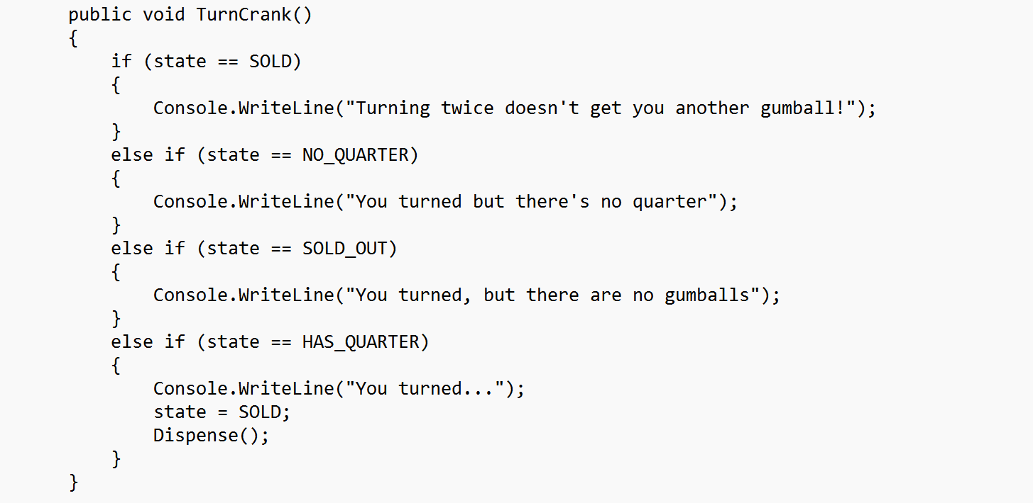
Without state pattern

Slide 9
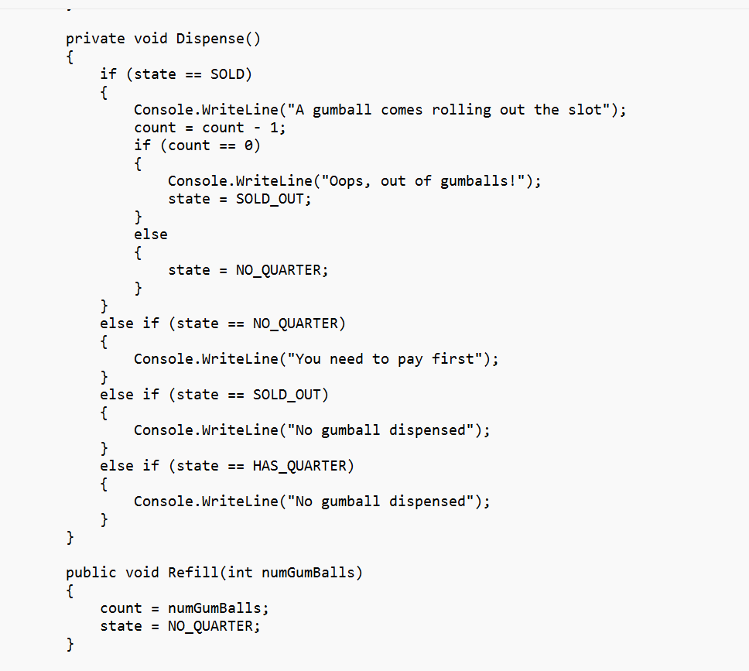
Without state pattern

Slide 10
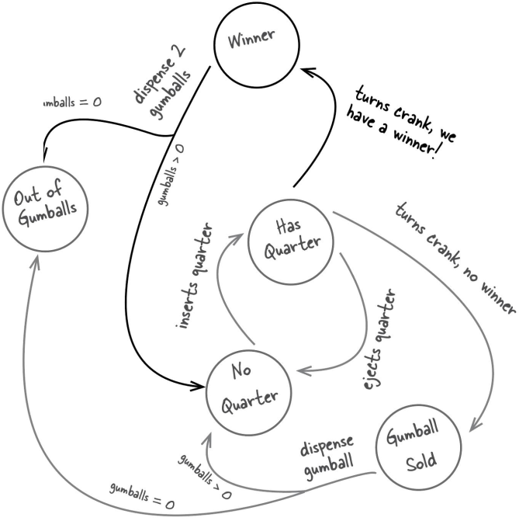
Adding a new state

Slide 11
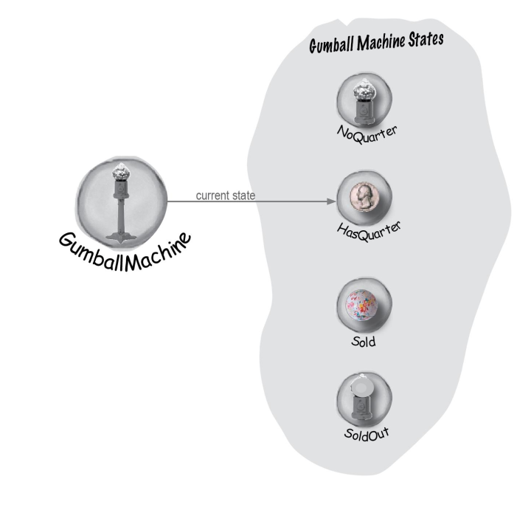
State Pattern

Slide 12
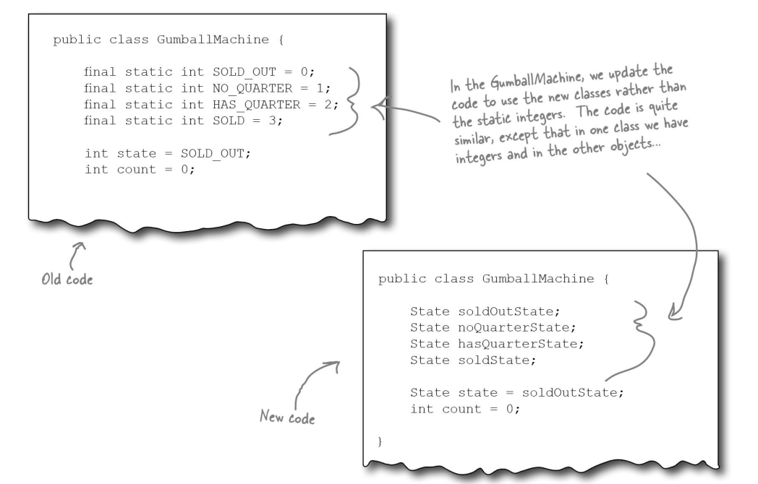
State Pattern

Slide 13
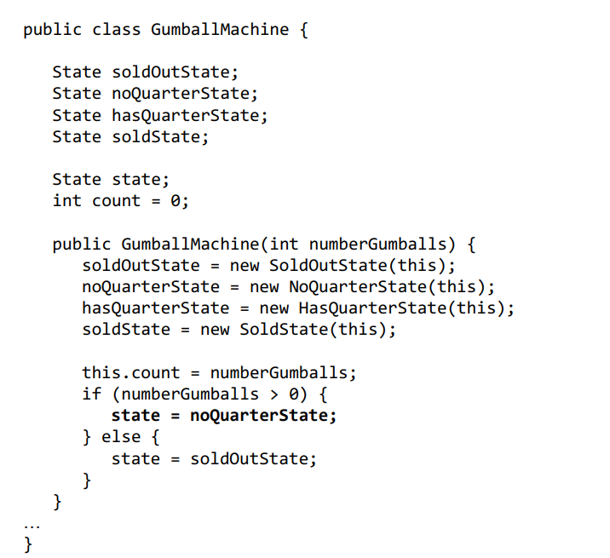
State Pattern

Slide 14
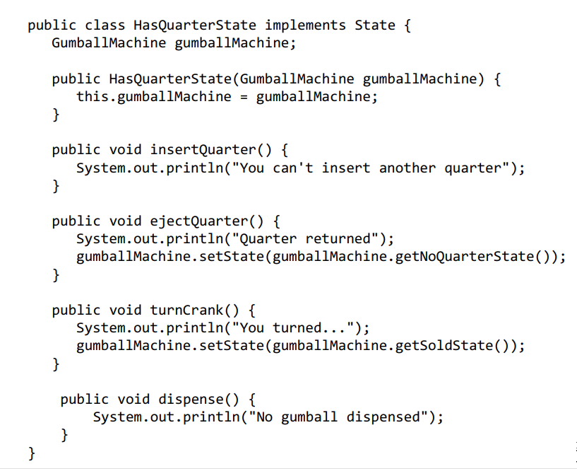
State Pattern

Slide 15
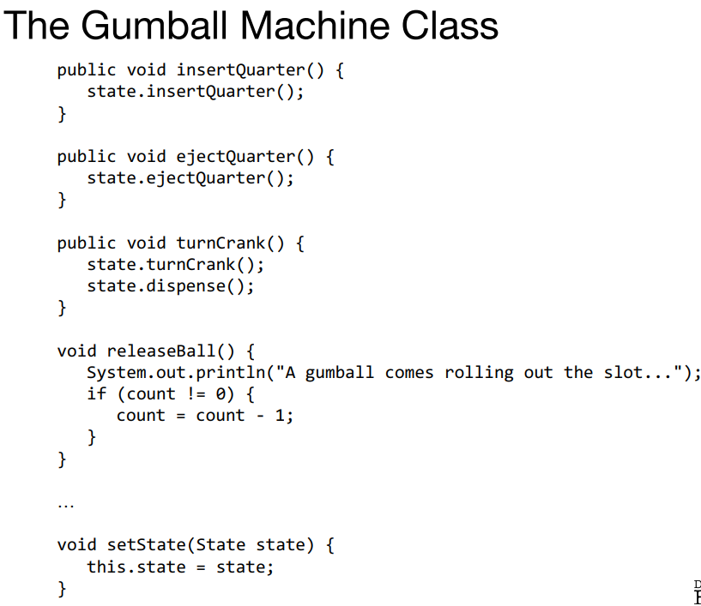
State Pattern

Slide 16
Demo

