Slide 1

Strategy Pattern

Slide 2
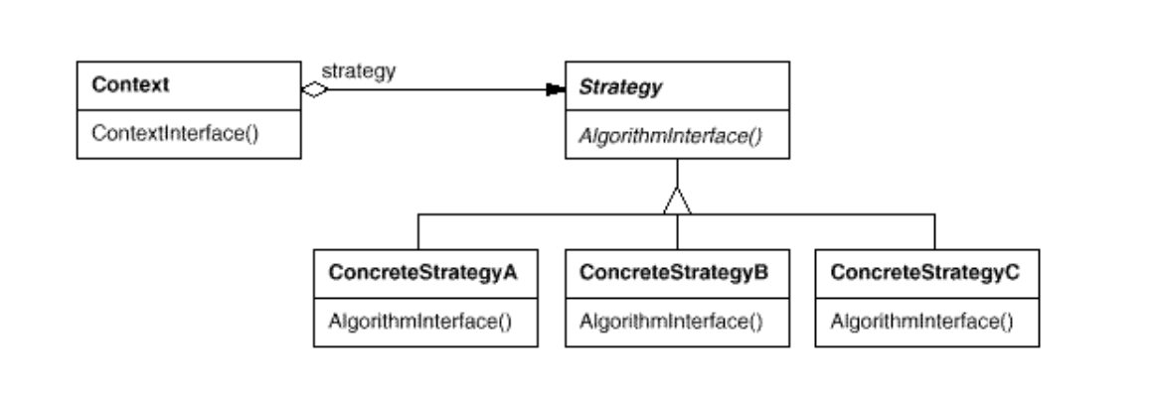
Intent
Define a family of algorithms, encapsulate each one, and make them interchangeable.Strategy lets the algorithm vary independently from clients that use it.

Slide 3
Demo

