Slide 1
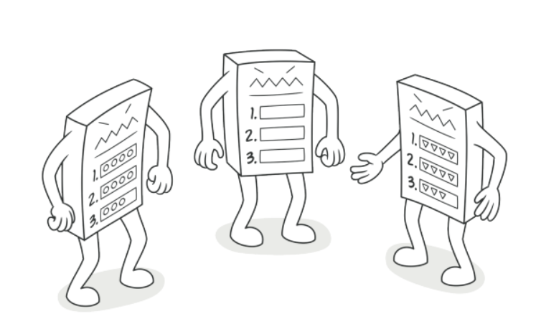
Template Method Pattern

Slide 2
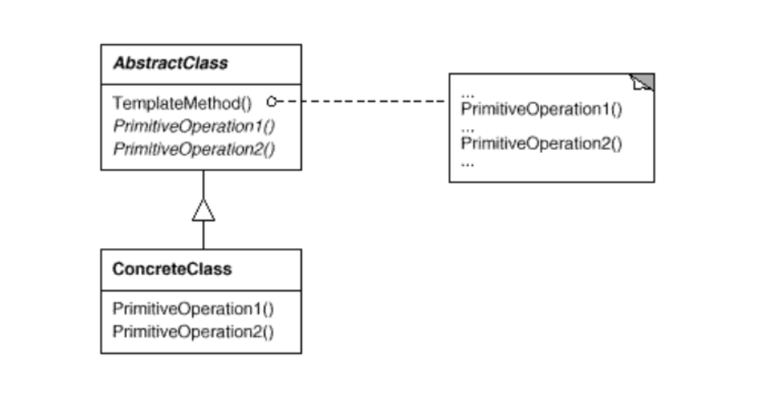
Intent
Define the skeleton of an algorithm in an operation, deferring some steps to subclasses.Template Method lets subclasses redefine certain steps of an algorithm without changing the algorithm's structure

Slide 3
Demo

