Slide 1

Visitor pattern

Slide 2
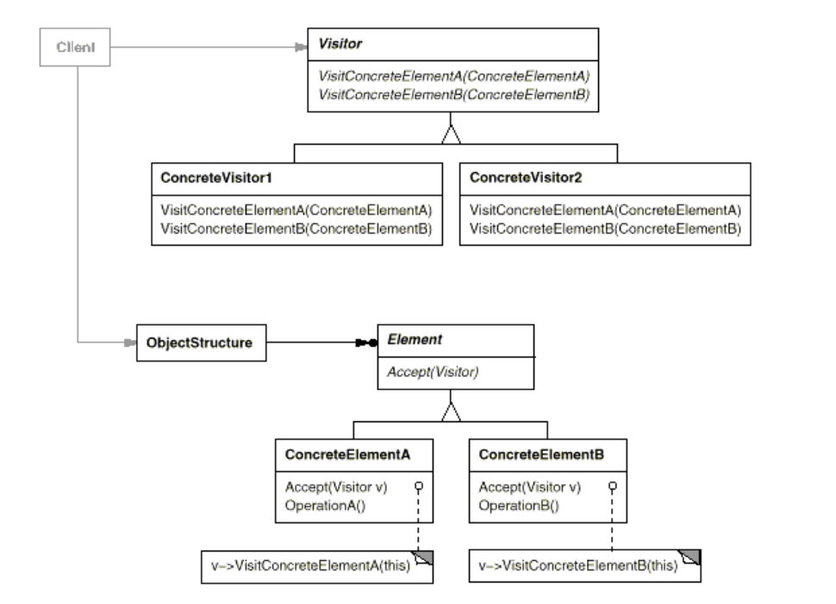
Intent
Represent an operation to be performed on the elements of an object structure. Visitor lets you define a new operation without changing the classes of the elements on which it operates.

Slide 3
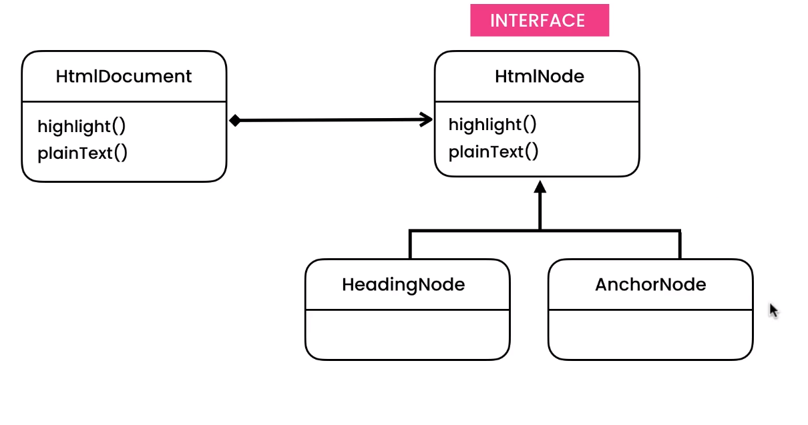
Visitor pattern

Slide 4
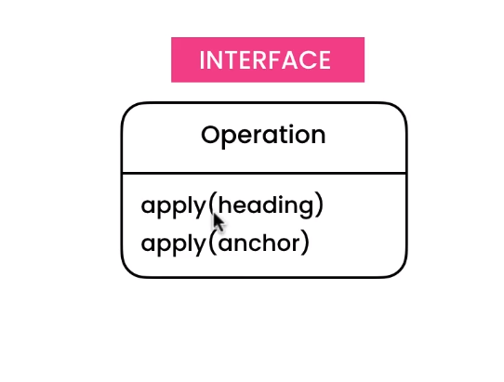
Visitor pattern

Slide 5
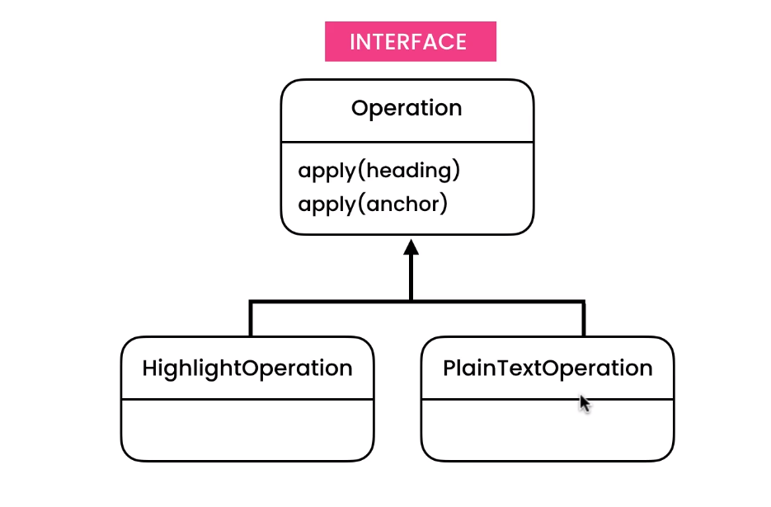
Visitor pattern

Slide 6
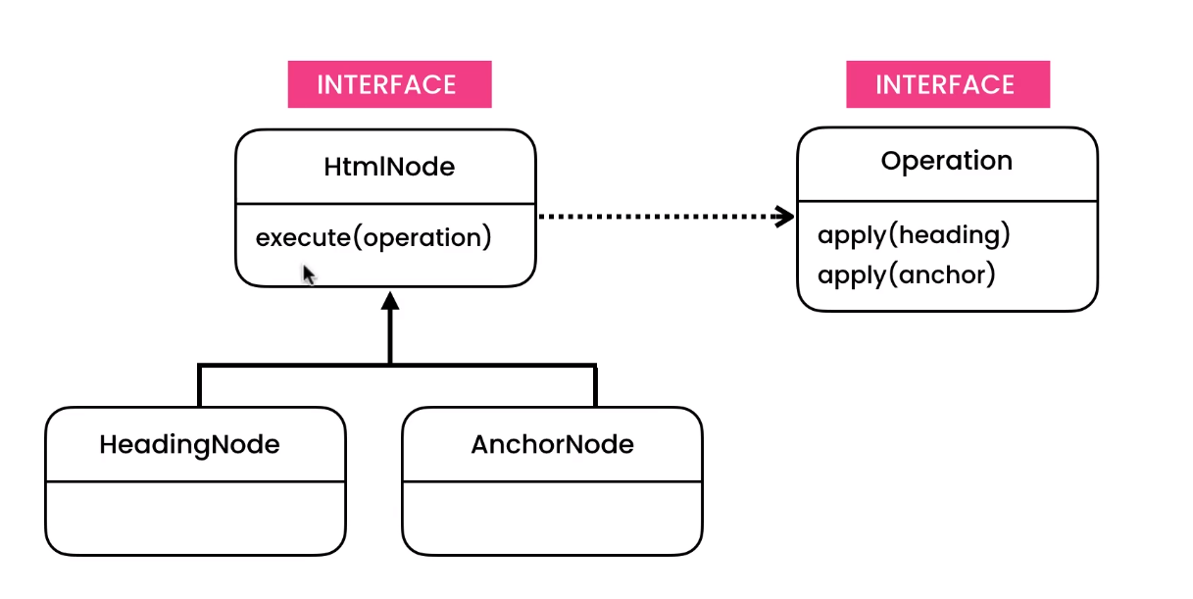
Visitor pattern

Slide 7
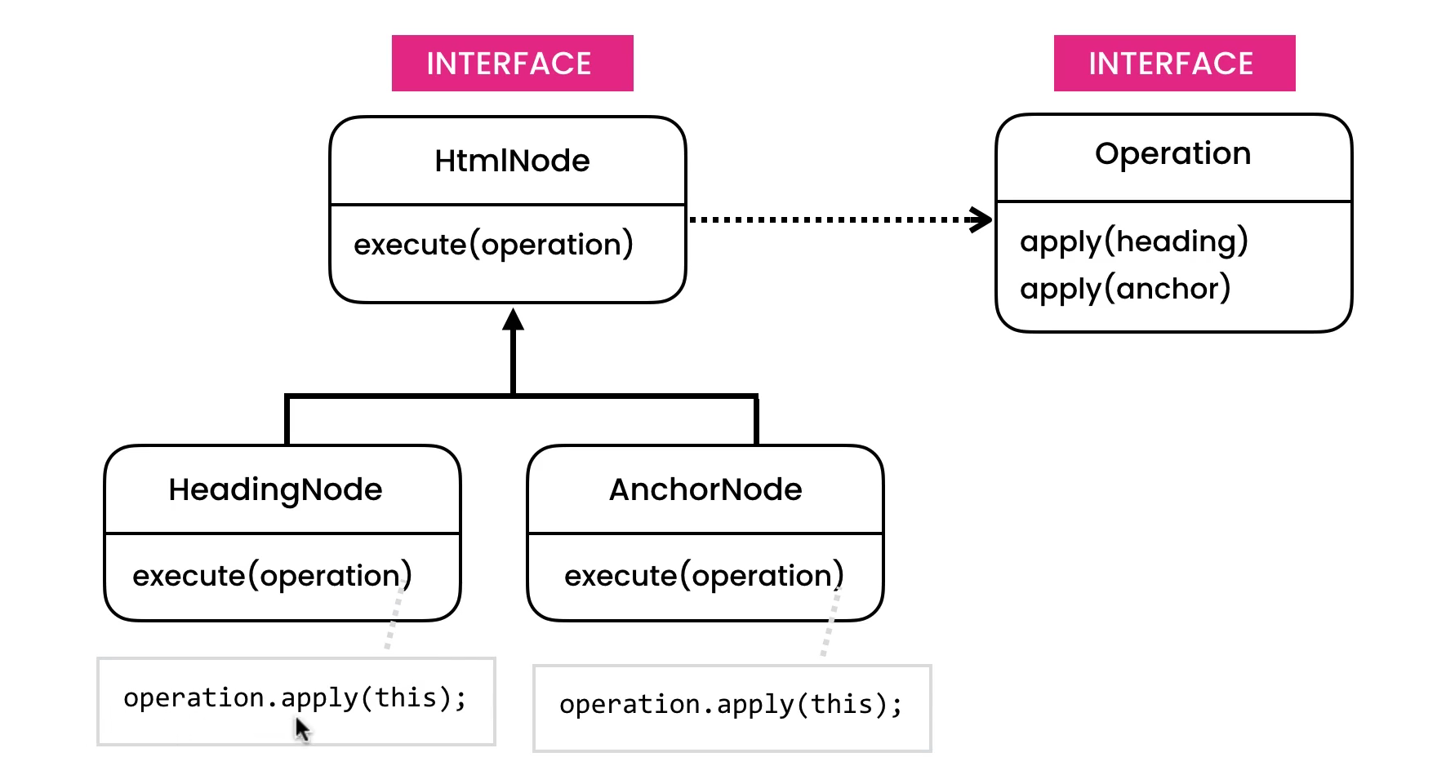
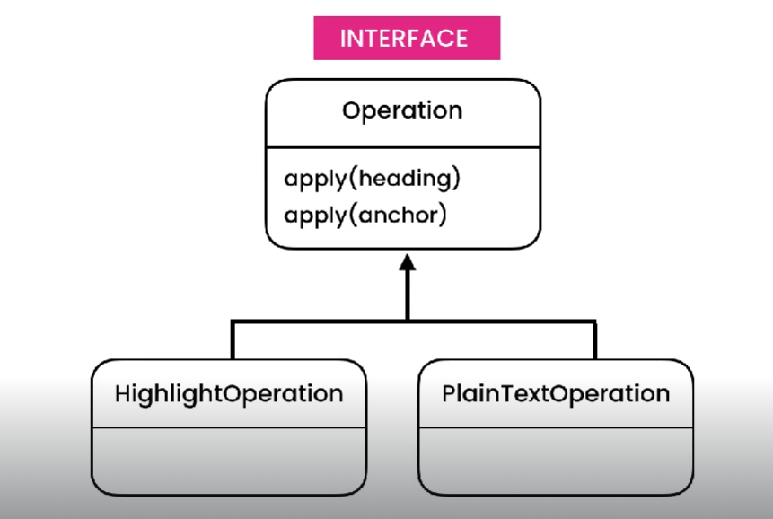
Visitor pattern

Slide 8
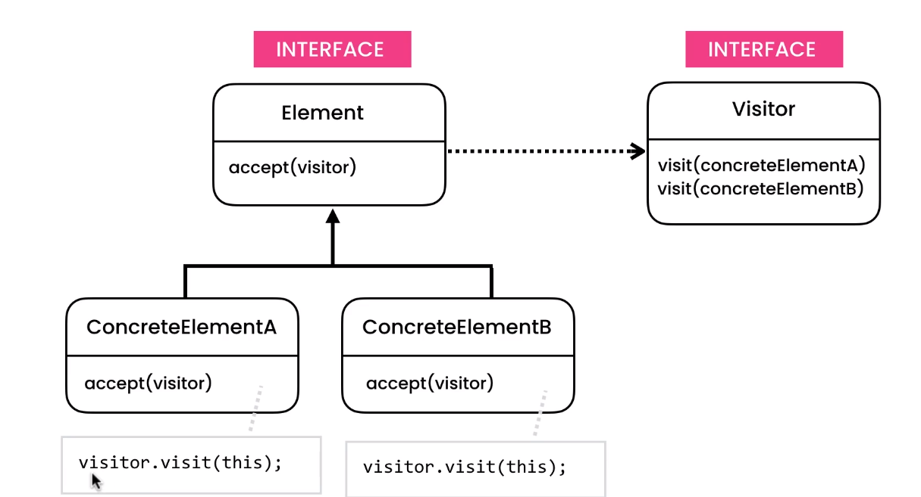
Visitor pattern

Slide 9
Demo

