Slide 1
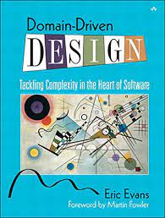
Domain Driven Design

Slide 2
What is a Domain ?
Problem Space
For Which we have to design a solution includes entities,behavior and business rules
Domain → Domain Models
Cannot create a single Domain model to solve complex problems
Business domain is company’s overall area of activity

Slide 3
What is a Subdomain ?
Domain can be decomposed into subdomains
Fine grained area of business activity
Core Subdomain
Differentiates company from its competitors
Supporting Subdomain
Activity that provides no competitive advantage
Required for implementation of core subdomain
No readymade solution available , can be outsourced
Generic Subdomain
Ready made solution available,problem domain with existing proven solutions

Slide 4
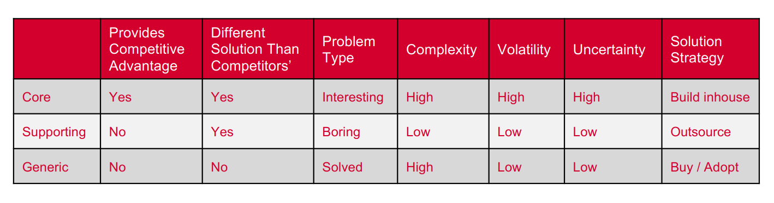
Types of Subdomains

Slide 5
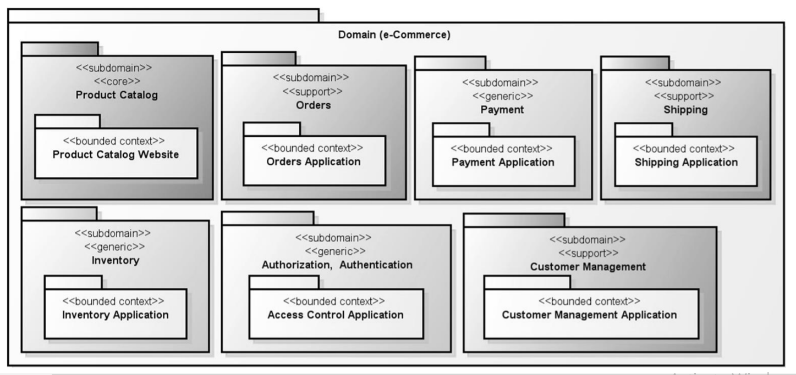
Types of Subdomains

Slide 6
Gigmaster : identify Core,Supporting,Generic
Gigmaster is a ticket sales and distribution company.Its mobile app analyzes users’ music libraries, streaming services’ accounts, and social media profiles to identify nearby shows that are relevant to its
Gigmaster’s users are conscious about their privacy.Hence, all users’ personal information has to be anonymized, or at least encrypted.
To improve the app’s recommendation, a new module was implemented to allow manual entry of past gigs a user has attended, even if the tickets weren’t purchased through Gigmaster

Slide 7
Gigmaster : identify Core,Supporting,Generic
Core : Recommendation Engine, Data Anonymization
Supporting: Integration with music streaming services and social networks, past gigs tracking module
Generic: Data Encryption,Identity and access,clearing and accounting

Slide 8
Gigmaster : identify Core,Supporting,Generic
Core : Recommendation Engine, Data Anonymization
Supporting: Integration with music streaming services and social networks, past gigs tracking module
Generic: Data Encryption,Identity and access,clearing and accounting

Slide 9
What is DDD ?
Is an approach to building software with a focus on the domain
Helps building Domain Model in right way
Complex Business Logic

Slide 10
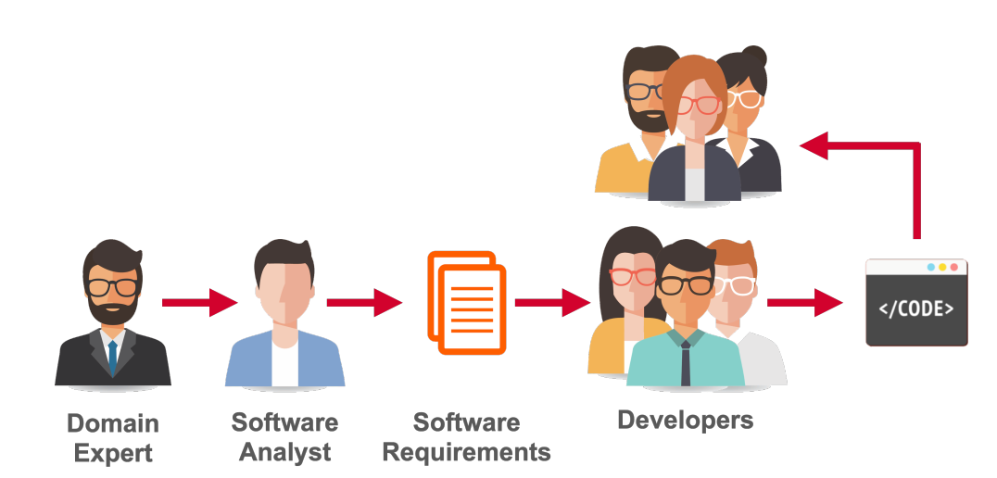
Domain Driven Design

Slide 11
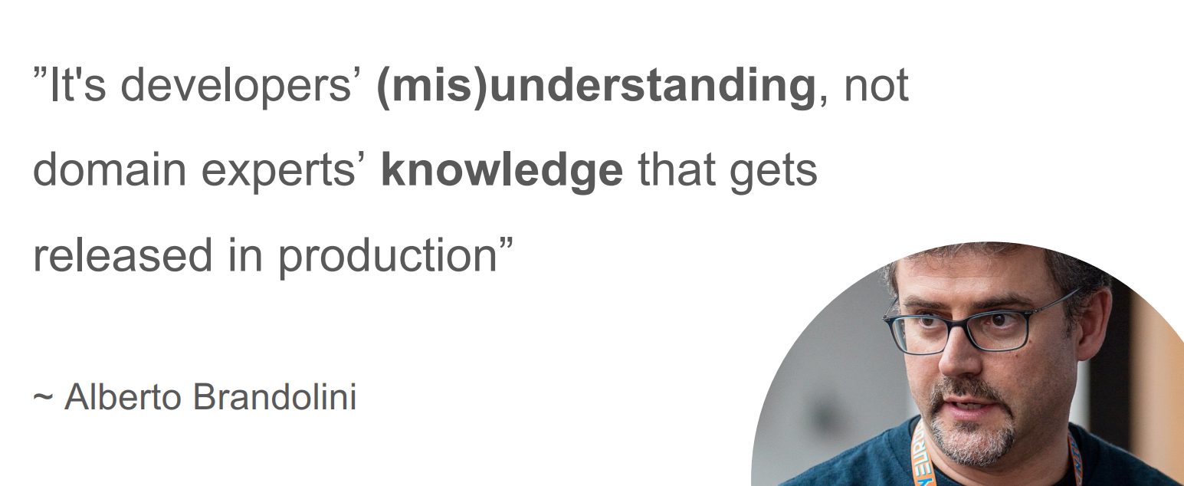
Domain Driven Design

Slide 12
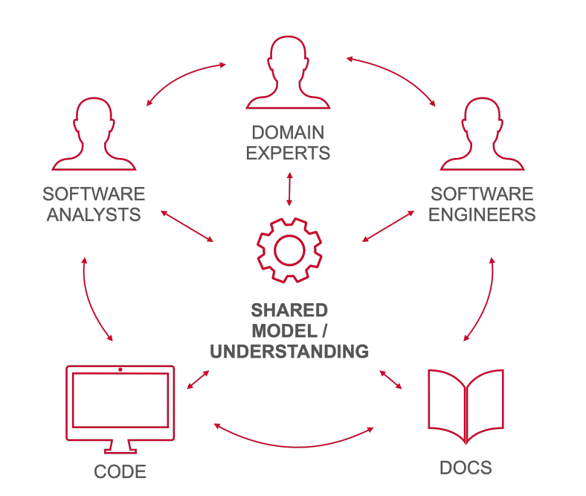
Domain Driven Design

Slide 13
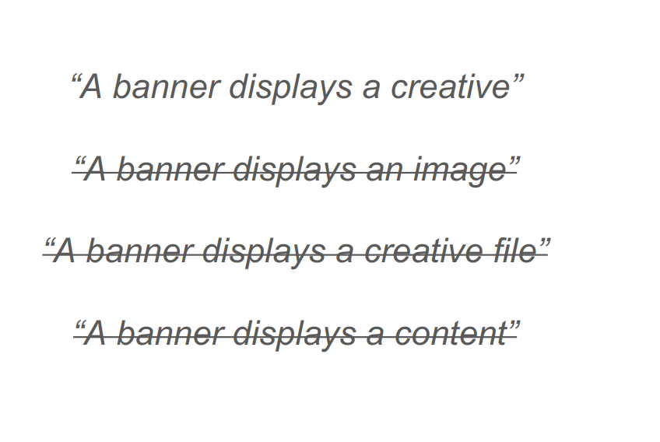
Domain Driven Design

Slide 14
Main Pillars of DDD
Strategic Design
Goal is to find Bounded Contexts and Ubiquitous Language
Tactical Design
Entities,Services,Repositories,ValueObjects,Aggregates,Events,
Modules,Factories etc

Slide 15
What is Bounded Context?
Finding the Boundary or Box with one Ubiquitous language
Create domain model for each bounded context
Each Domain Model in Bounded Context will have Entities, Aggregates,Value Objects etc

Slide 16
Bounded Context vs Subdomain
Subdomain are discovered , Bounded Contexts are created
Subdomain are logical boundaries and BC are technical solutions
Subdomain is problem space and bounded context is solution space
Single team assigned to work on one or more BC
One BC should not be shared by many teams
There must be a separate code repository for each BC

Slide 17
What is Ubiquitous Language ?
Universal Language : shared language to avoid confusion
Reduces gap between developers and business expert
Not a set of technical jargons imposed by domain experts
Developed in agreement with the whole team

Slide 18
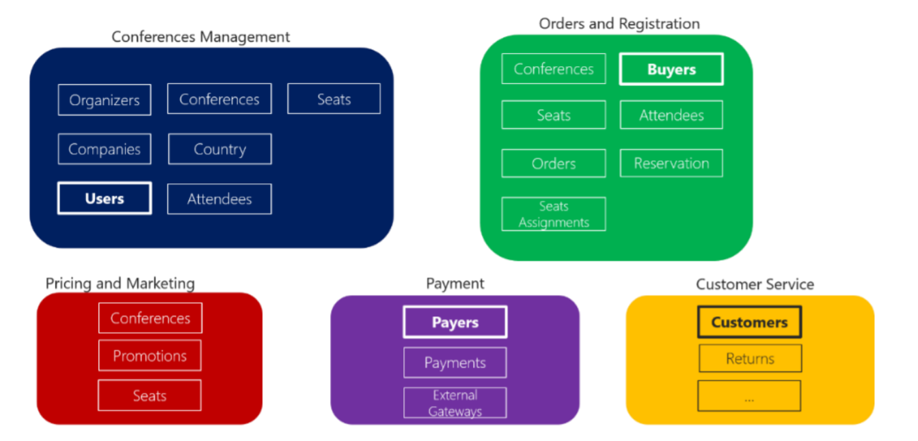
What is Ubiquitous Language ?

Slide 19
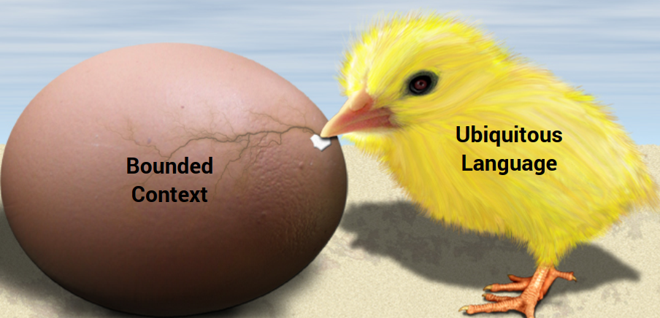
What came first?

Slide 20
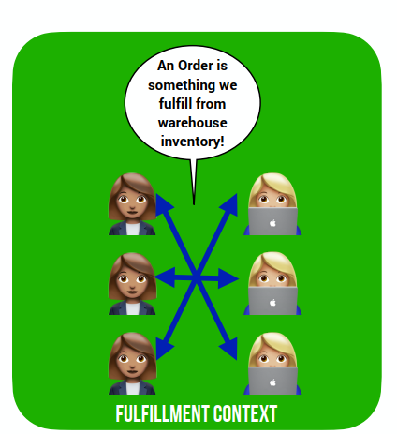
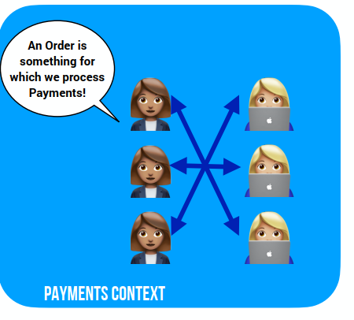
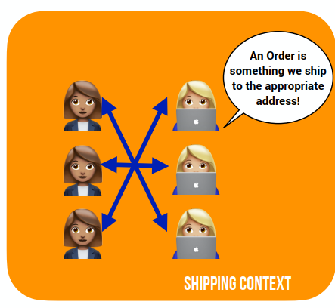
What came first?

Slide 21
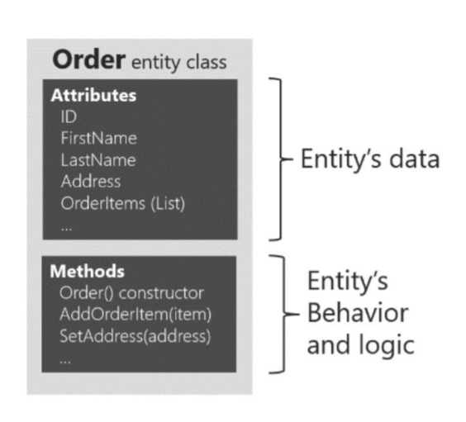
Tactical Design : Domain Entity
An entity is potentially changeable object
It has a unique identifier
State changes over time but identity same

Slide 22
Tactical Design : Value Object
Immutable object
Do not have Unique identity
Address, Color , Currency
Address in an e commerce application might not have an identity at all, since it might only represent a group of attributes of the customer’s profile for a person or company.

Slide 23
Tactical Design : Aggregate
Cluster of one or more entities , value objects
Treated as a single unit.
Cluster accessed via root entity called Aggregate root

Slide 24
Tactical Design : Aggregate Root
Composed of at least one entity
Can have multiple child entities, value objects
Aggregate root ensures consistency of the aggregates
Responsible for maintaining any /all business invariants(rules)
Atomic unit / transaction behavior

Slide 25
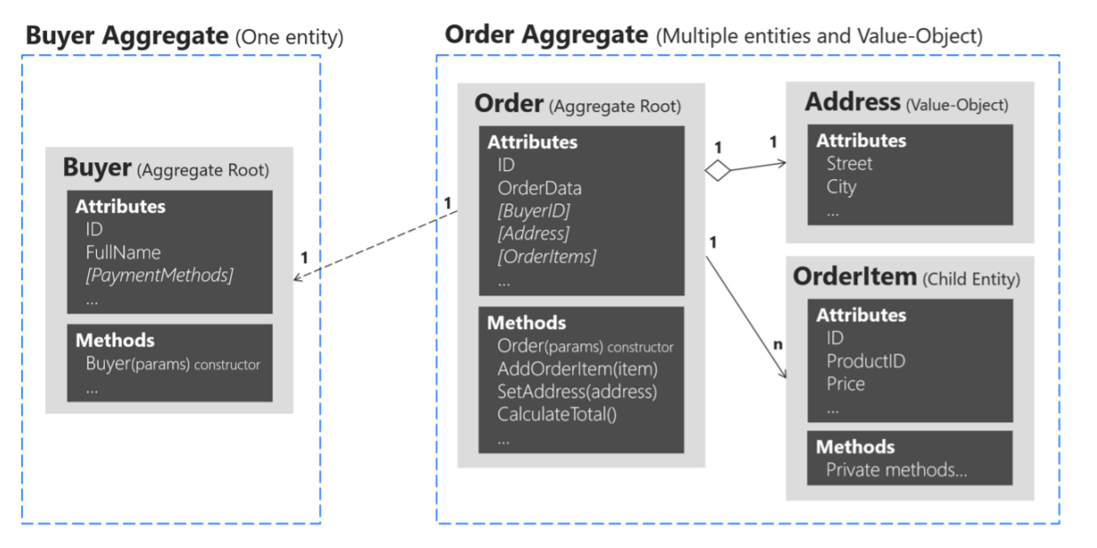
Tactical Design : Aggregate Root

Slide 26
Tactical Design : Services,Repository,Factories,Events
Services are stateless objects that perform domain specific logic on multiple value objects or Entities. Can have multiple child entities, value objects
Repositories deal with storage. Persistence of aggregates
Factories builds aggregate root ,entity ,value objects. . Factories are an alternative for building objects that have complexity in building
Events indicate significant occurrences that have occurred in the domain and need to be reported to other stakeholders belonging to the domain. It is common for Aggregates to publish event

Slide 27
Bounded Context Integration Patterns
Shared Kernel
Conformist
Anti Corruption Layer
Open Host Service

Slide 28
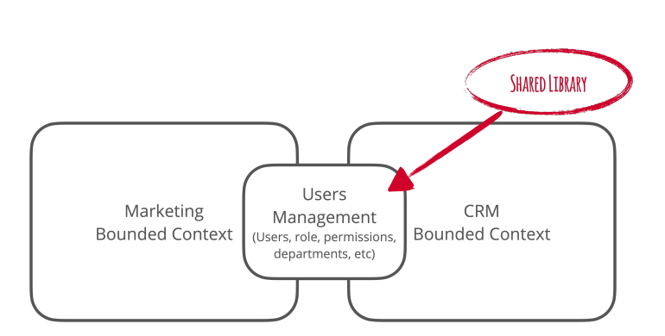
Shared Kernel
Shared library that multiple BCs use
Overlapping code
Tightly coupled relationship
The same team owns all the BCs

Slide 29
Customer - Supplier Integration Patterns
One bounded context provides a service to other BCs
Upstream - a service provider
Downstream - the service’s client

Slide 30
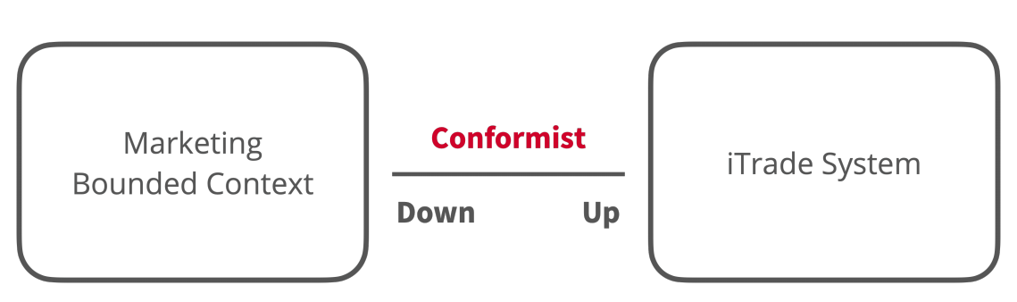
Conformist
Downstream conforms to the model of upstream
Client written in the language as defined by upstream

Slide 31
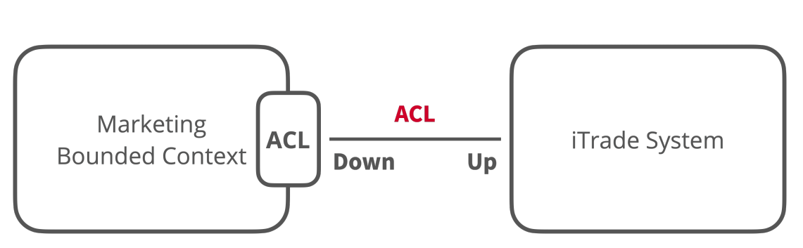
Anti-Corruption Layer
Protects the language of downstream from the language of upstream
Part of the client

Slide 32
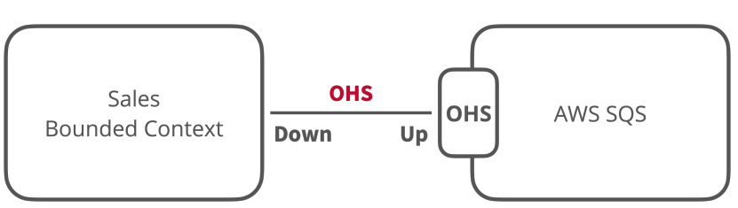
Open Host Service
Public API as part of the upstream service design
Public interface stable and protects service clients

Slide 33
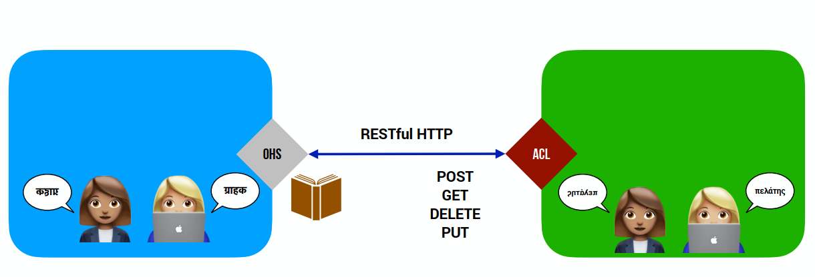
RESTful HTTP
Public API as part of the upstream service design
Public interface stable and protects service clients

Slide 34
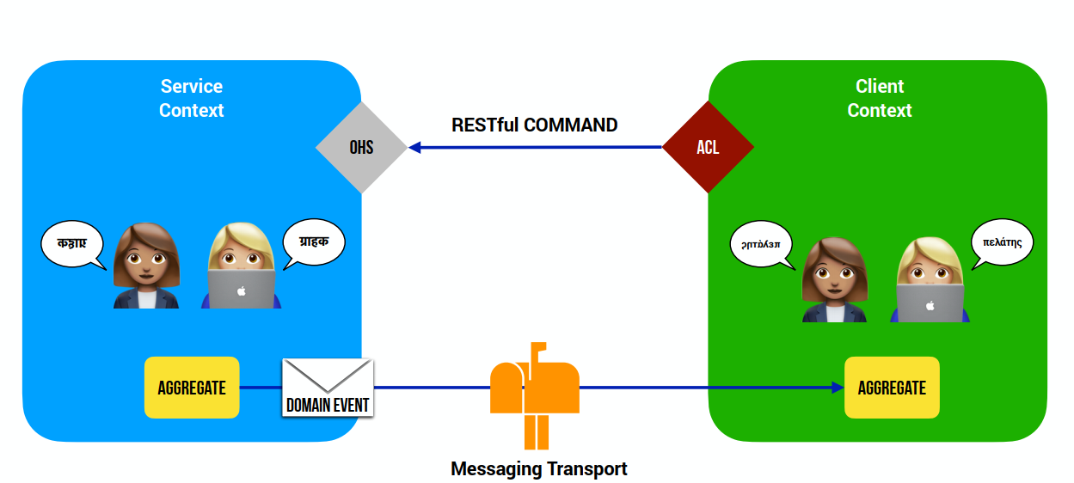
Messaging

