Slide 1
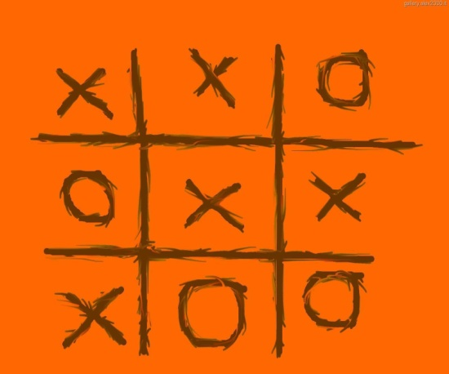
Tic-Tac-Toe
Prepared by:
Vaibhavi Gandhi

Slide 2
Contents
Problem Definition
Use Case
Deciding classes and methods
Solid principals
Class Diagram

Slide 3
Problem Definition:
Tic-tac-toe is a board game. It has two players. Each player has an mark depicting a nought ( O ) or a cross ( X ). The board is divided into 3X3 cells and each cell can be occupied by one mark. Three marks of same type appear in a row either vertically or horizontally or diagonally, the user of that mark will be declared winner by the system. If all the squares of the board are filled and no user is the winner then the game is declared as draw by the system.

Slide 4
Requirements
Board game divided into 3X3 cells.
Two player game.
Each player has their mark either O or X.
Mark should be placed in valid cell according to the input taken from the player
Board should check rows, colomns and diagonals, if mark of the same type appear, Player wins!
If the board is full,then game is declared as draw by the System!

Slide 5
Classes to be Pruned
Board - Game
This sounds like a vague class as it conveys different meanings at different perspective. It is better to be skipped.
Player
Sounds useful and also relevant to the system. So let us keep this class.
Mark
players are distinguished by the mark they are playing with. So no need to model this class.
Board
The whole game is played on the board. Let us model this class.
Cells
Cells are part of board only. so Let us not keep this class.
Type
It refers to the group of mark. A player is declared a winner if three icon of the same 'type' occupies a row, either horizontally, vertically or diagonally. If we study the sentences closely, it would be clear that 'type' is merely an attribute of the class Icon. Obeying the modeling guidelines, let us not model this term.

Slide 6
Classes to be Pruned
User
This is a redundant class as we have decided to keep a Player class.
Winner
Clearly, Winner is an attribute of a Player. There is no need to model on attributes as the rules say so.
System
System is another example, that conveys a lot of meanings at different perspective. What we really mean is the whole system. This is really significant and so let us keep it.
Game
It refers to a play where two players compete and a winner is decided. Or maybe it ends in a draw. Then the board is flushed and the next game is started upon. Let us model this class.

Slide 7
Classes after Elimination
Player
Board
System
Game

Slide 8
Giving appropriate name to Class
Player
Cannot be a better term to replace this term. Let us keep it.
Board
Conveys the right meaning. No need to modify.
System
We have just discussed about this term and it is a bit misleading. Hence it becomes imperative on our part to choose a better term. Let us replace this term with 'Game Startup' .
Game
Sounds appropriate. Still, the term would cause confusion. This class will be the start up of the game.Let us give it a different name - ‘GameRunner’

Slide 9
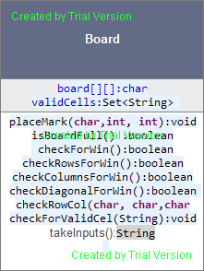
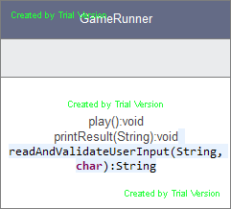
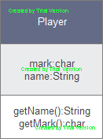
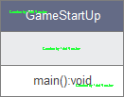
Classes and methods

Slide 10
Single Responsibility Principal
Violates SRP

Slide 11
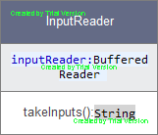
Separate class for input

Slide 12
Open Closed Principal
IPlayer
Human
Computer

Slide 13
Dependency Inversion Principal
GameRunner gets two Objects, that implement the IPlayer-interface and does not need to know whether one of them is a human. Or both.
Iplayer player=new Human();
Iplayer player=new Computer();

Slide 14

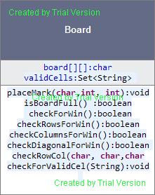
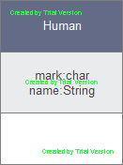
Final Class Diagram
2
1
inputReader
player
1
board
runner
1

Slide 15
Thank You!

