Slide 1
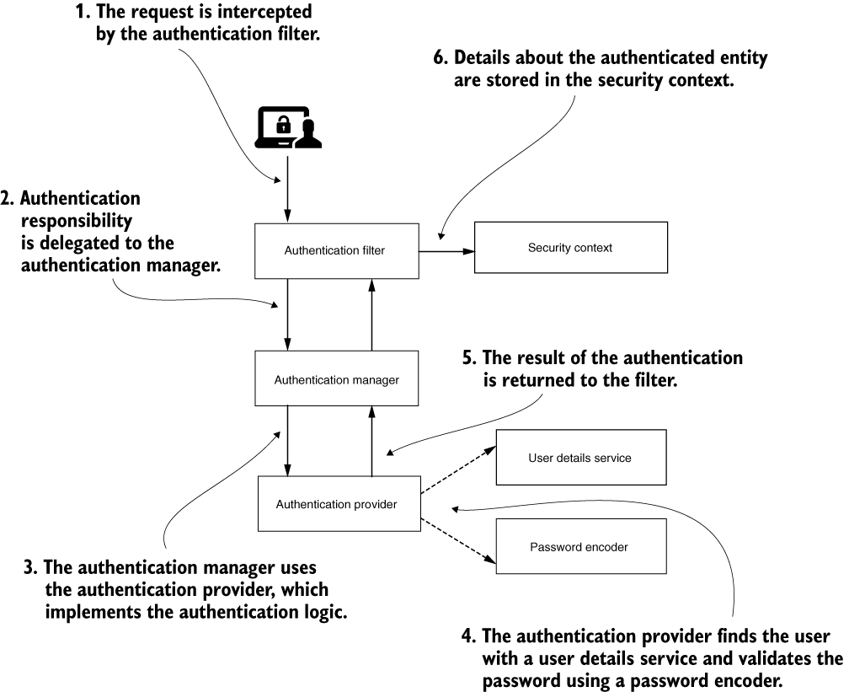
Notes:
https://learning.oreilly.com/library/view/spring-security-in/9781617297731/

Slide 2
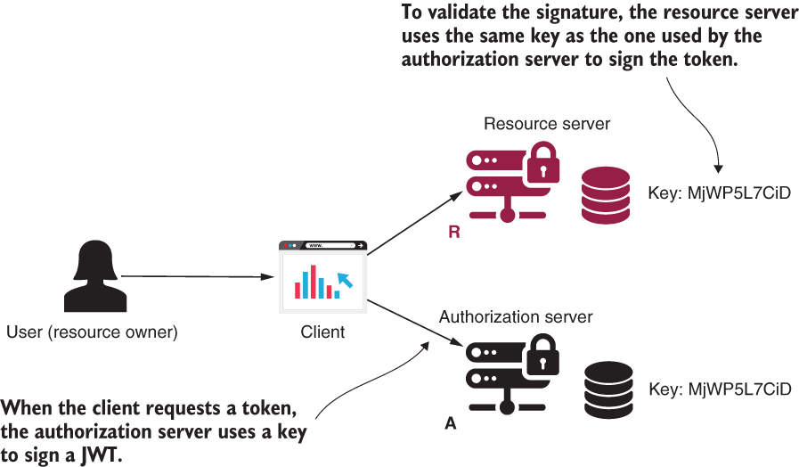
Notes:
https://learning.oreilly.com/library/view/spring-security-in/9781617297731/

Slide 3
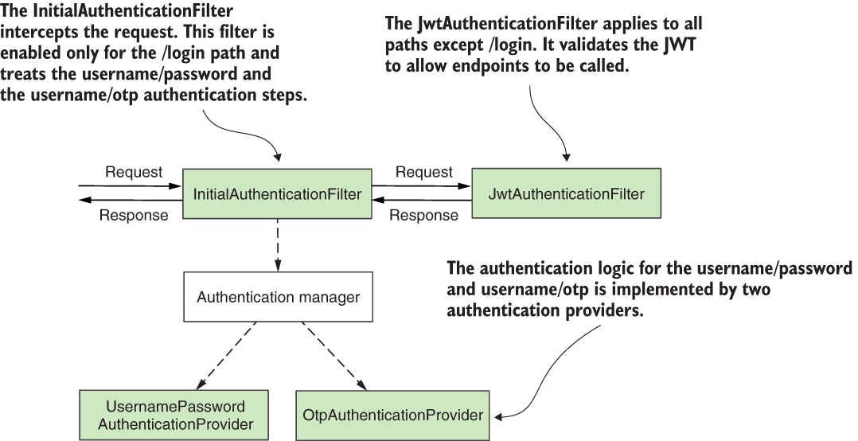
Notes:
https://learning.oreilly.com/library/view/spring-security-in/9781617297731/

