Slide 1
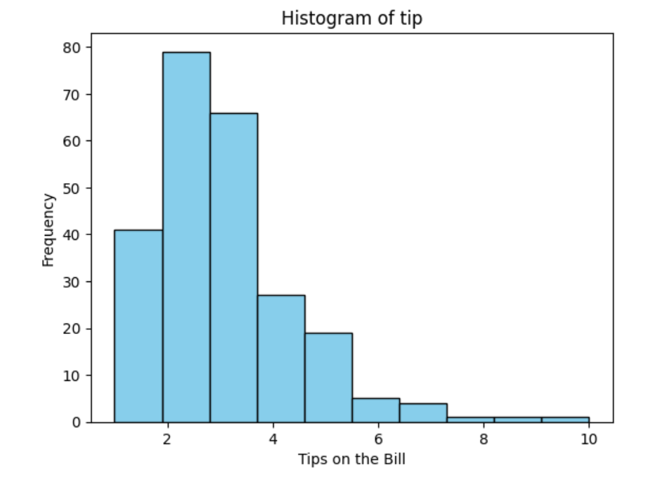
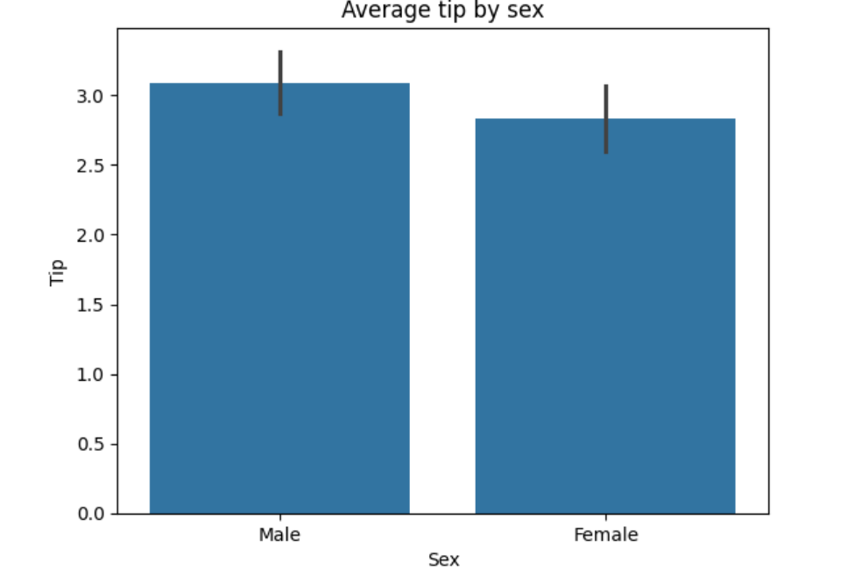
Tip Dataset Visualization
Histogram Chart
Bar Plot Chart
Insights
Most of the customers are providing tips between 2 to 3 Rs
The highest tips amount is 10 RS, but very few customers only provided
Insights
The average tip is provided by female is 2.8
The average tip is provded by male is 3
So compare to Female , male is providing more tips

Slide 2
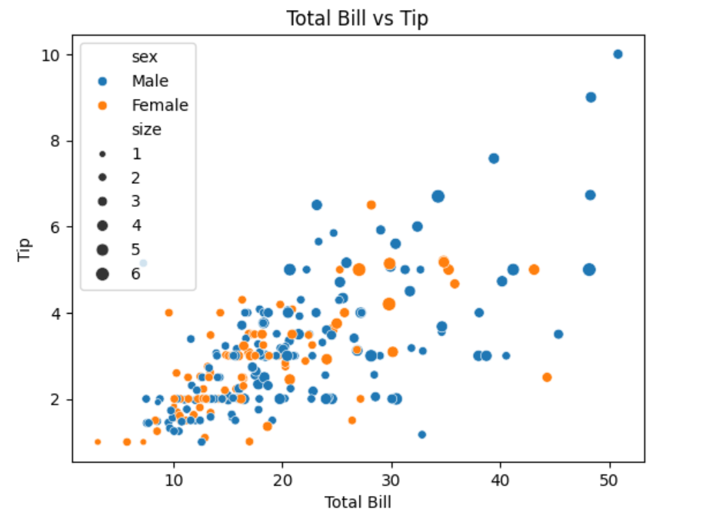
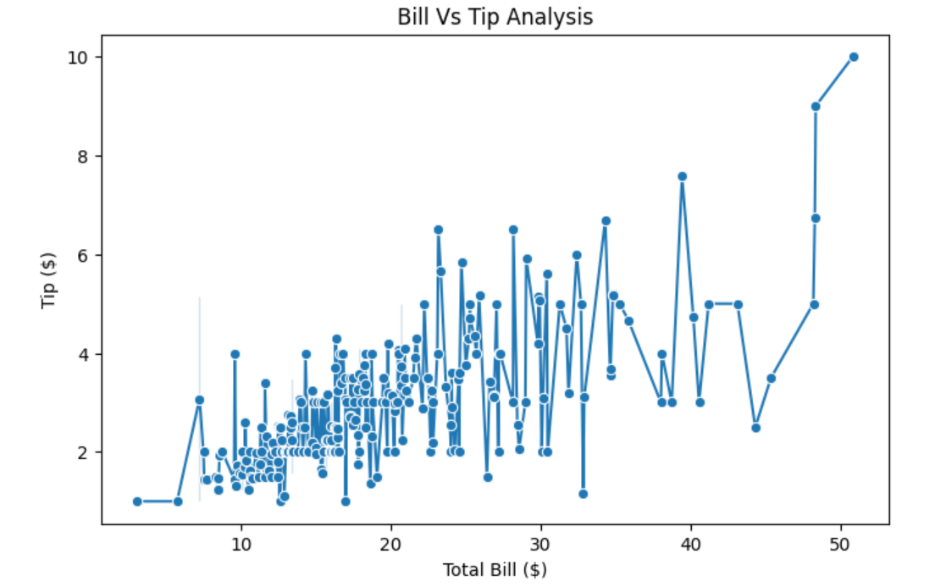
Tip Dataset Visualization
Scatter plot
Line Chart
Insights
I see if the bill amount is near 50 then tip amout falls between 8 to 10
Compare to Female , Male customers are giving higher tip
Also, I see if customer heads are increased then tip amount also is collected reasonably
Insights
If bill amounts are increasing then tip amount increased

Slide 3
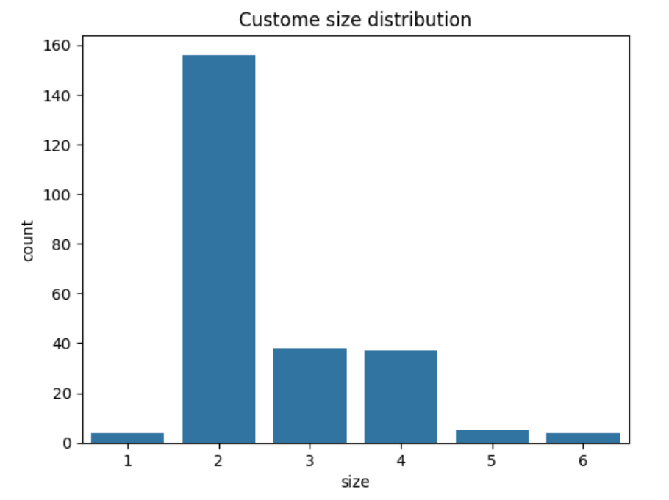
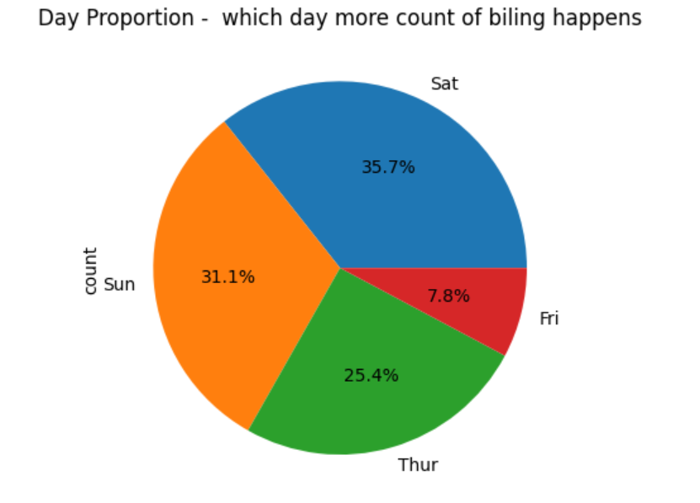
Tip Dataset Visualization
Count Plot Chart
Pie Chart
Insights
Mostly customer with 2 heads are visting the restaraunt
Customers with more than 2 to 4 heads visting restaraunt is moderate
Insights
Looking at chart , on saturday and sunday more billing count is happening, since it is fall on week ends

Slide 4
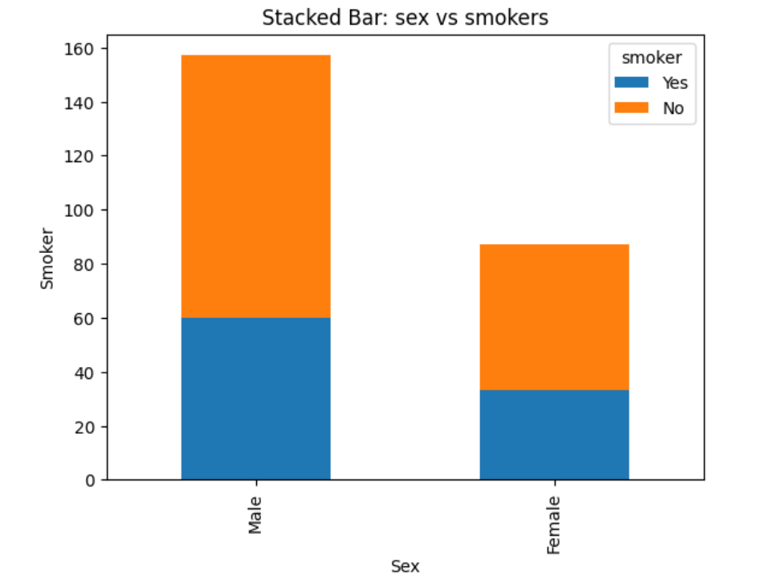
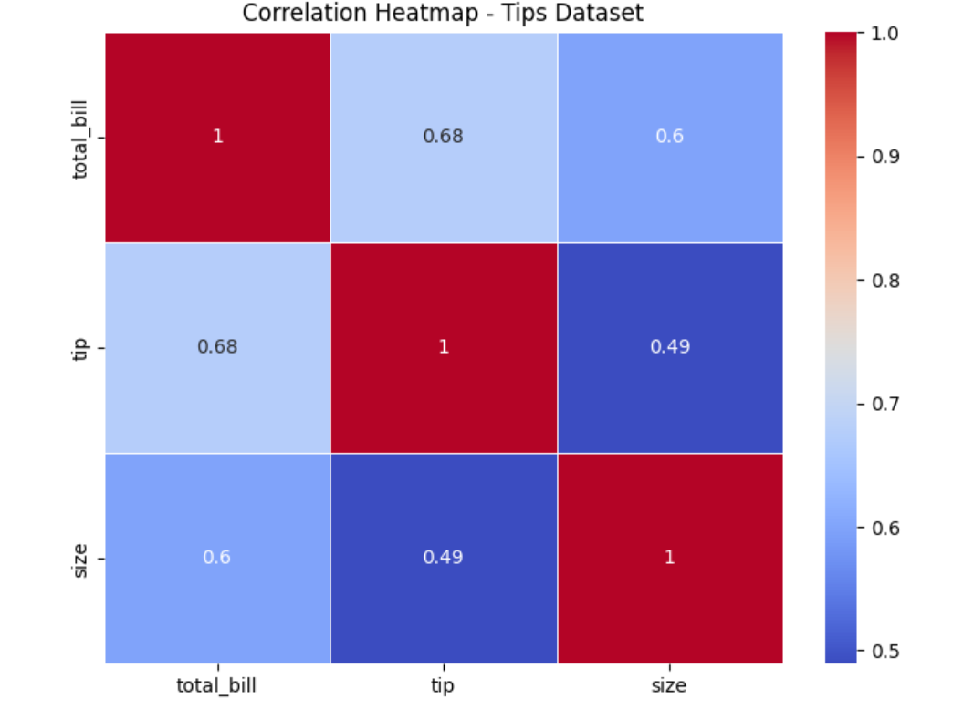
Tip Dataset Visualization
Stacked Chart
Heatmap Chart
Insights
60% of male not a smoker
In Female, out of 90 , 30% are smoker
Insights
Strong Positive Correlation between total_bill ↔ tip As the bill amount increases, the tip amount also increases.
Weak Correlation bertween size ↔ tip The number of people at the table doesn’t strongly determine the tip amount.

