Slide 1
AI PARADIGM SHIFT: CHATGPT
Dr. S KANNIMUTHU,
Professor / CSE Department,
Head-Center of Excellence in Algorithms,
Karpagam College of Engineering,
Coimbatore.
Tamilnadu, India

Slide 2
Agenda
Introduction
How Popular is ChatGPT?
How Smart is ChatGPT?
How do we train our own ChatGPT or GPT-3?
How Can You Use ChatGPT?
How to Get Started With ChatGPT
The Limitations of ChatGPT
Opportunities
Introduction to Conversational AI
About ChatGPT API
Developing Applications using ChatGPT
Sentiment Analysis with ChatGPT

Slide 3
Introduction
ChatGPT (Chat Generative Pre-trained Transformer) is a chatbot developed by OpenAI and launched in November 2022.
It is built on top of OpenAI's GPT-3 family of large language models and has been fine-tuned (an approach to transfer learning) using both supervised and reinforcement learning techniques.
ChatGPT was launched as a prototype on November 30, 2022, and quickly garnered attention for its detailed responses and articulate answers across many domains of knowledge.

Slide 4
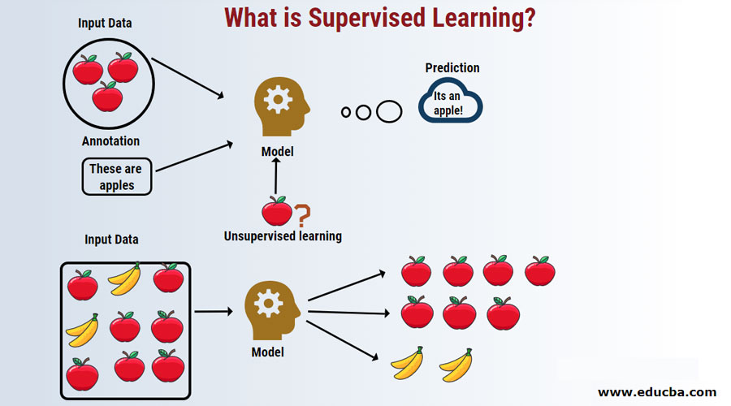
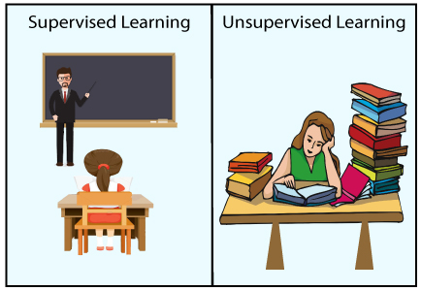
Supervised Learning
Supervised learning, also known as supervised machine learning, is a subcategory of machine learning and artificial intelligence.
It is defined by its use of labeled datasets to train algorithms that to classify data or predict outcomes accurately.

Slide 5
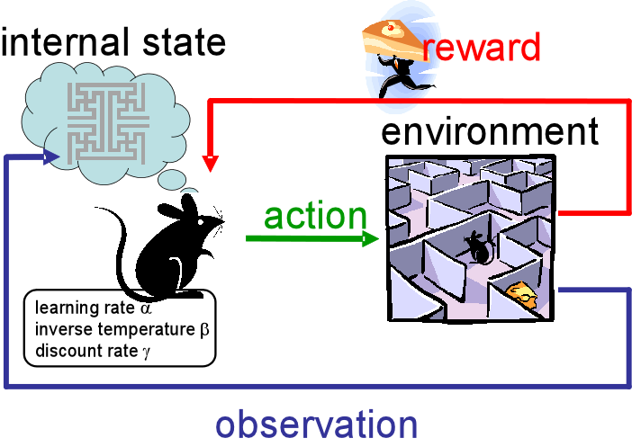
Reinforcement Learning
Reinforcement learning is an area of Machine Learning.
It is about taking suitable action to maximize reward in a particular situation.
It is employed by various software and machines to find the best possible behavior or path it should take in a specific situation.

Slide 6
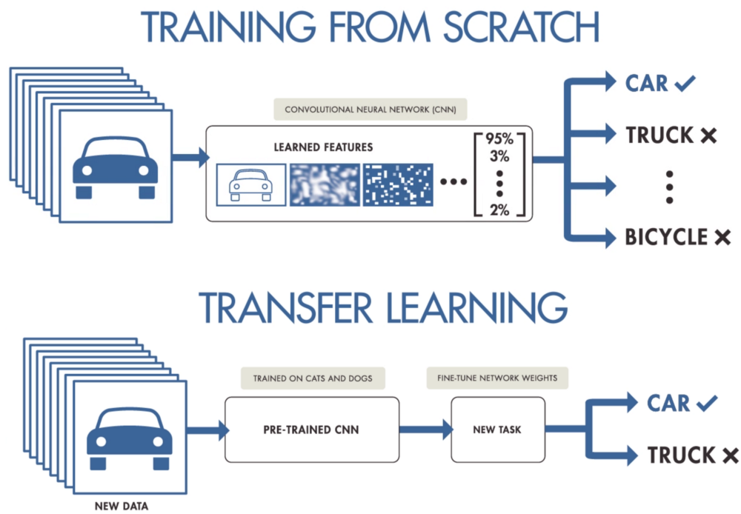
Transfer Learning
Transfer learning (TL) is a research problem in machine learning (ML) that focuses on storing knowledge gained while solving one problem and applying it to a different but related problem.
For example, knowledge gained while learning to recognize cars could be applied when trying to recognize trucks.

Slide 7
Introduction
The original May 2020 release of GPT-3 by OpenAI (founded by Elon Musk) received a lot of press coverage and public attention. Within two years, GPT-3 had amassed one million subscribed users.
In December 2022, the fine-tuned version of GPT-3.5—called ‘ChatGPT’—brought in one million users within five days, and then 100 million users within two months (the entire population of adult males in the United States is also 100M).

Slide 8
Introduction
OpenAI’s John Schulman developed the ChatGPT platform, and its popularity has been surprising.
Despite the availability of a much more powerful model in GPT-3, ChatGPT provides an intuitive interface for users to have a conversation with AI, perhaps meeting an innate human desire to communicate and connect with others.

Slide 9
How Popular is ChatGPT?
GPT-3 was outputting 3.1 million wpm in Mar/2021 (“We currently generate an average of 4.5 billion words per day, and continue to scale production traffic.”) (OpenAI blog, March 2021) https://openai.com/blog/gpt-3-apps/
GPT-3 had 1 million users about a year later in Jun/2022 (“more than 1 million signups! took gpt-3 ~24 months to get there”) (Sam Altman tweet, 22/Jun/2022) https://twitter.com/sama/status/1539737789310259200

Slide 10
How Popular is ChatGPT?
ChatGPT had 100 million monthly users in Jan/2023 (UBS). https://archive.is/XRl0R
So, with very nonrigorous math, ChatGPT may be currently outputting 310 million wpm.
Twitter users output 350,000 tweets sent per minute (2022), at 8 words (34 chars) average, a total of 2.8 million wpm.
So, in Jan/2023, ChatGPT is probably outputting at least 110x the equivalent volume of Tweets by human Twitter users every day.

Slide 11
How Popular is ChatGPT?
A study conducted by Google Books found that there have been 129,864,880 books published since the invention of Gutenberg’s printing press in 1440. At an average of 50,000 words per book, that is about 6.5T words total.
So, in Jan/2023, ChatGPT is probably outputting at least the equivalent of the entire printed works of humanity every 14 days.

Slide 12
How smart is ChatGPT?
It is estimated that GPT-3 would have an IQ of 150 (99.9th percentile). ChatGPT has a tested IQ of 147 (99.9th percentile) on a verbal-linguistic IQ test, and a similar result on the Raven’s ability test.
Note also that GPT-3.5 has achieved passing results for the US bar exam, CPA, & US medical licensing exam (more information via The Memo 18/Jan/2023 edition).

Slide 13
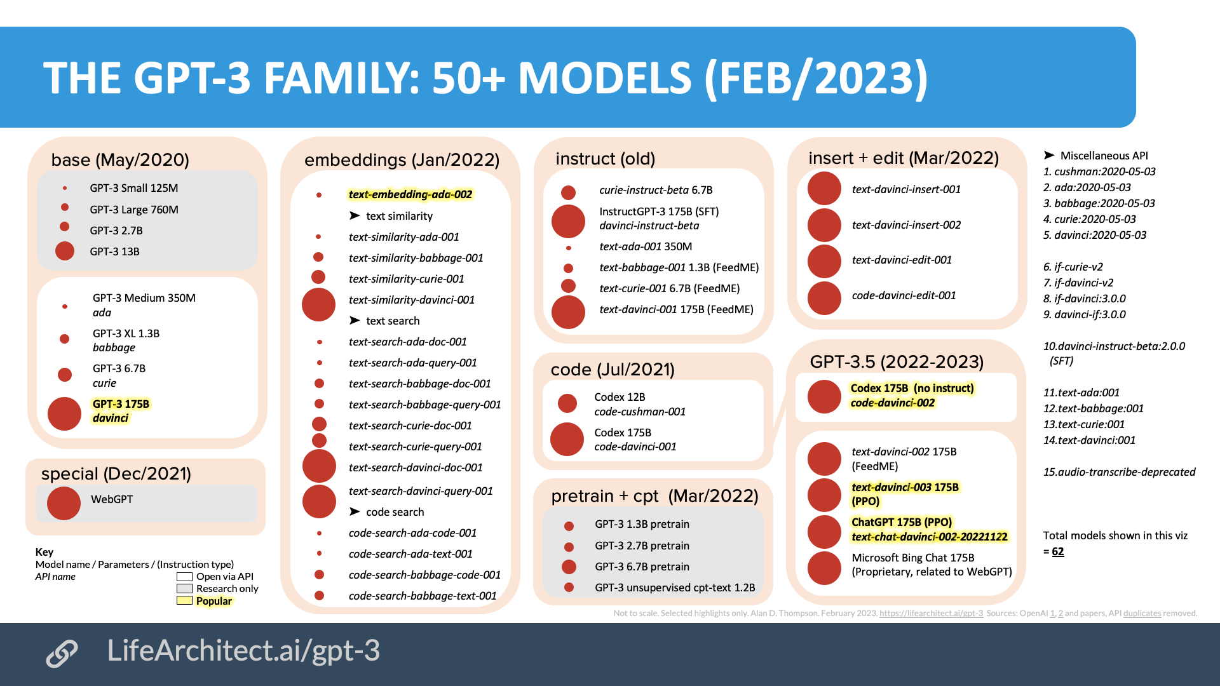

Slide 14
How do we train our own ChatGPT or GPT-3?
Training hardware
Staffing
Time (data collection)
Time (training)

Slide 15
Training hardware
Access to a supercomputer with ~10,000 GPUs and ~285,000 CPU cores. If you can’t buy it, you could do as OpenAI did with Microsoft, spending their $1 billion dollars (USD) to rent it.

Slide 16
Staffing
For training, you’ll need access to the smartest PhD-level data scientists in the world.
OpenAI paid their Chief Scientist Ilya Sutskever $1.9 million dollars per year (USD) in 2016, and they have a team of 120 people. Perhaps budget >$200 million for staffing the first year.

Slide 17
Time (data collection)
EleutherAI took a solid 12-18 months to agree on, collect, clean, and prepare data for the The Pile (Language Modeling DataSet).
Note that if The Pile is only ~400B tokens, you need to somehow find The Pile-quality data at least four times to even make something similar to the new efficiency standard, DeepMind’s Chinchilla 70B (1400B tokens), and you might want to aim for a few TB now to outperform GPT-3.

Slide 18
Time (training)
Expect a model to take 9-12 months of training, and that’s if everything goes perfectly.
You may need to run it several times, and you may need to train several models in parallel. Things do go wrong, and they can completely mess up the results

Slide 19
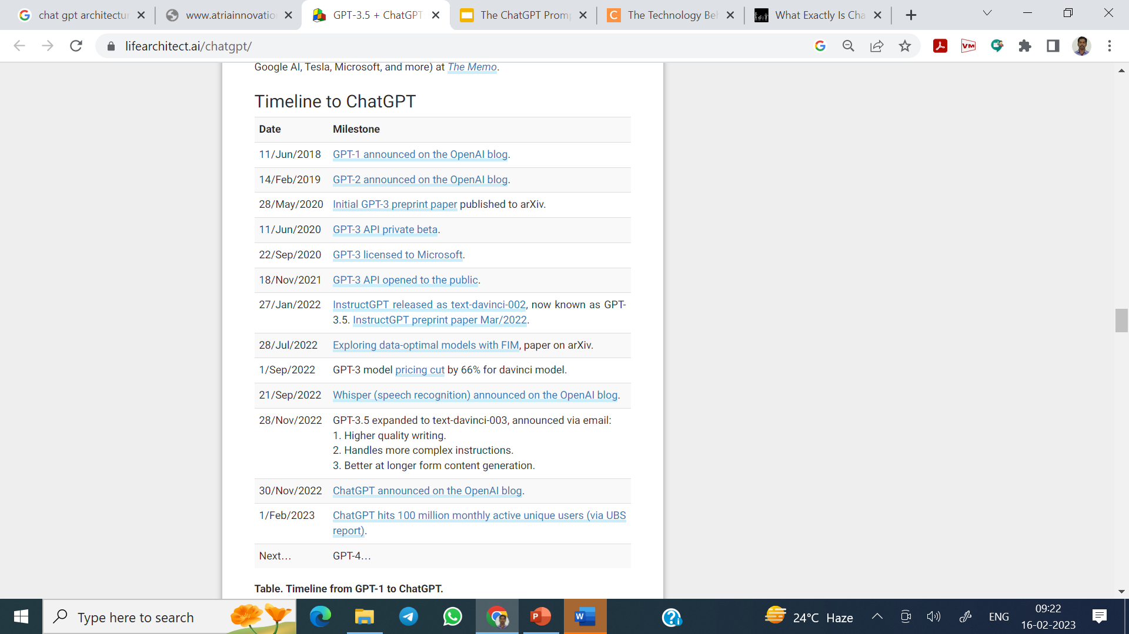
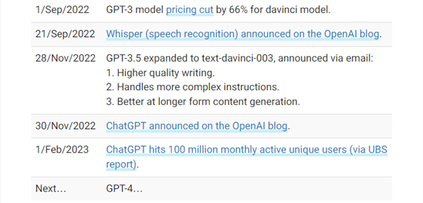

Slide 20
InstructGPT
The OpenAI API is powered by GPT-3 language models which can be coaxed to perform natural language tasks using carefully engineered text prompts.
But these models can also generate outputs that are untruthful, toxic, or reflect harmful sentiments.

Slide 21
InstructGPT
This is in part because GPT-3 is trained to predict the next word on a large dataset of Internet text, rather than to safely perform the language task that the user wants.
In other words, these models aren’t aligned with their users.
The InstructGPT models are much better at following instructions than GPT-3. They also make up facts less often, and show small decreases in toxic output generation.

Slide 22
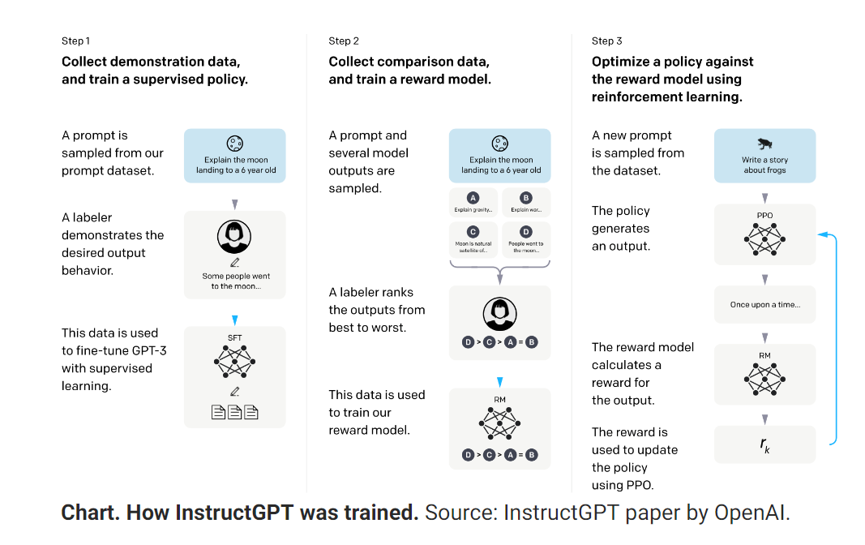

Slide 23
ChatGPT’s success
While the functionality of ChatGPT is not brand new, the public interface—including layout, templating for code and related outputs, and general user experience—is new and innovative.
The user interface has played a key role in ChatGPT’s rapid adoption. The interface is similar in design to common messaging applications like Apple Messages, WhatsApp, and other chat software.

Slide 24
Algorithm Behind Chat GPT!
It uses a transformer algorithm. This algorithm is based on a neural network, which is a type of computer program that is designed to mimic the way the human brain works.
The transformer algorithm is able to analyze and understand large amounts of data, such as text, and use this understanding to generate text that is similar to human conversation.
Y=x1.w1+x2.w2

Slide 25
Algorithm Behind Chat GPT!
ChatGPT is a type of artificial intelligence that can understand and generate natural language text.
It is trained using a transformer algorithm and large amounts of text data, and is able to generate responses to prompts or questions based on what it has learned.

Slide 26
Other Alternatives
Google bard is the chatbot which is launched under Artificial Intelligence just like ChatGPT.
The new AI has taken the world by storm with the work it does.
They both stimulate the conversations with the human and help to provide responses to the questions one might ask.

Slide 27
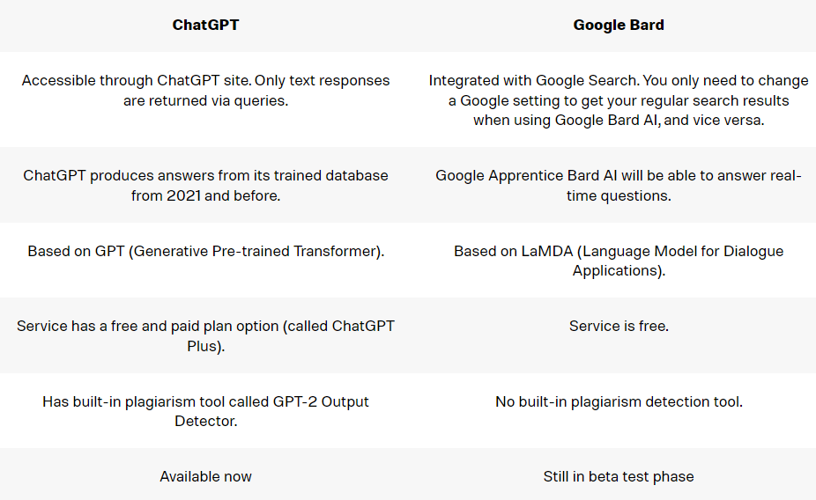
ChatGPT vs Google Bard

Slide 28
Opportunities
How Might ChatGPT Impact the Crypto Market?
ChatGPT: the future of discharge summaries?
Use of ChatGPT in social science survey research

Slide 29
What ChatGPT is all about?
With the help of the advanced technology ChatGPT, crypto enthusiasts may have substantial discussions on recent events and trends in the industry. With the use of this technology, traders may easily acquire market data and base their choices on accurate information from their peers in the cryptocurrency industry.
ChatGPT is a Natural language processing (NLP) technology that creates discussions in the present using deep learning algorithms. It may be helpful for promoting communication among cryptocurrency dealers.

Slide 30
How Might ChatGPT Impact the Crypto Market?
The crypto market may be impacted by ChatGPT in a number of ways. It can be used to analyze market data, identify trading opportunities, and predict potential trends.
Additionally, it can be utilized to develop automated trading algorithms and provide direction while making judgments.

Slide 31
Benefits Of ChatGPT On The Crypto Market:
The following are some possible advantages of ChatGPT's impact on the crypto market:
Better decision-making: ChatGPT can give traders information on market movements, assisting them in coming to more educated conclusions.
Automated trading: It can create automated algorithms to aid traders in taking advantage of fresh chances and opportunities.

Slide 32
How Can I Trade in Crypto Markets Using ChatGPT?
Trading digital tokens is made possible by the AI Chatbots' ability to be analyzed and mechanized. With ChatGPT, trading digital tokens, traders may take wise decisions based on current information, optimizing opportunities and earnings.
1. Real-Time Cryptocurrency Analysis by ChatGPT: Due to ChatGPT's powerful analysis and automation capabilities, the cryptocurrency market may completely shift. A chatbot can assist traders and investors in making more strategic decisions that optimize price developments and opportunities by offering real-time data and insights.

Slide 33
How Can I Trade in Crypto Markets Using ChatGPT?
2. To create a cryptocurrency trading algorithm Using pine Script, a TradingView's programming language Twitter user demonstrated how to interact with Chatbot.
A rudimentary trading bot was also created by the tool out of a simple notification.
Traders can also instruct ChatGPT to write code by using the application programming interface that offers.
The current orders for Bitcoin BTC and other cryptocurrency trading pairs will, however, be displayed there.

Slide 34
Some Thoughts
Innovative technology like ChatGPT has the potential to help cryptocurrency traders with their analysis and decision-making greatly. Trading cryptos with chatGPT will reduce the losses & almost accurate predictions with its third-level deep learning technology.
Till now, we are just experiencing a beta version, in the future, we can expect more in-depth processes in the chatGPT. Even the chatGPT can provide in-depth trading suggestions or it can make trades for the respected user with its predictions for better results.
There are chances that chatGPT effect in cryptocurrency trading market can be more effective.

Slide 35
How Can You Use ChatGPT?
ChatGPT can be used for a variety of applications, including customer service, online shopping, hiring and training staff, streamlining operations, and providing more personalized customer experiences.
ChatGPT can also be used to create interactive storytelling experiences, allowing users to explore and learn from virtual worlds.

Slide 36
How Can You Use ChatGPT?
Some use cases for ChatGPT include:
Generating responses in a chatbot or virtual assistant, to provide more natural and engaging interactions with users
Brainstorming content ideas on keywords or topics
Creating personalized communication, such as email responses or product recommendations
Creating marketing content like blog posts or social media updates

Slide 37
How Can You Use ChatGPT?
Translating text from one language to another
Recapping long documents by providing the full text and asking ChatGPT to generate a shorter summary
Using chatbot-generated answers to create automated customer service tools
If you’re a business leader and you’re looking for ways to make content creation easier or provide customers with a more personalized experience, ChatGPT can be a great tool for you.

Slide 38
How to Get Started With ChatGPT
ChatGPT is in beta right now, and you can get started by going to chat.openai.com. Click “Sign Up” to set up your account.
Once you’ve created your account, ChatGPT will provide examples of what you can do with the tool, and help you through the process of running your first queries.
Right now, ChatGPT is free to use — but the company admits they may need to monetize in the future to deal with “eye-watering” compute costs.

Slide 39
ChatGPT: the future of discharge summaries?

Slide 40
Introduction
ChatGPT (Open AI, San Francisco, CA, USA) has taken the world by storm.
Released to the public in November, 2022, ChatGPT is based on artificial intelligence (AI) technology and trained on data from the internet written by humans, including conversations.
This AI-powered chatbot has vast capabilities ranging from poem composition, essay writing, solving coding issues, and explanation of complex concepts including “how can we fix the UK National Health Service?” Some consider that ChatGPT has advanced the online search to the next level;
the program offers rapid and in-depth understanding of complex matters and generates custom responses in a conversational manner to the exact question asked, recalling its own previous responses.

Slide 41
Introduction
Although still only a research preview, ChatGPT has shown impressive performance across multiple use cases.
One potential area of ChatGPT's application could be to generate discharge summaries.
Composition of high-quality discharge summaries containing the requisite information can be time consuming, with the burden usually falling on junior doctors.

Slide 42
Introduction
Therefore, when balanced against clinical commitments, discharge summaries are often left under-prioritised resulting in delays in patients' discharges or insufficient discharge summaries, which not only places pressure on an already stretched junior doctor workforce, but also presents potential patient safety issues in the transition of care from secondary to primary care.

Slide 43
Benefits
ChatGPT allows doctors to input a brief of the specific information to include, concepts to elaborate on, and guidance to explain, outputting a formal discharge summary in a matter of seconds (panel).
Discharge summaries are an obvious choice for this technology because of their largely standardized format; this standardization has previously been recognized through the creation of templates—eg, from the Royal College of Physicians.

Slide 44
Benefits
Automation of this process could therefore ease the work burden upon junior doctors allowing more time for the delivery of patient care and the seeking of training opportunities in often roles centered on service provision.
ChatGPT could also improve the quality of the discharge summaries themselves, with previous literature showing discharge summaries that are written through traditional means often missing details.

Slide 45
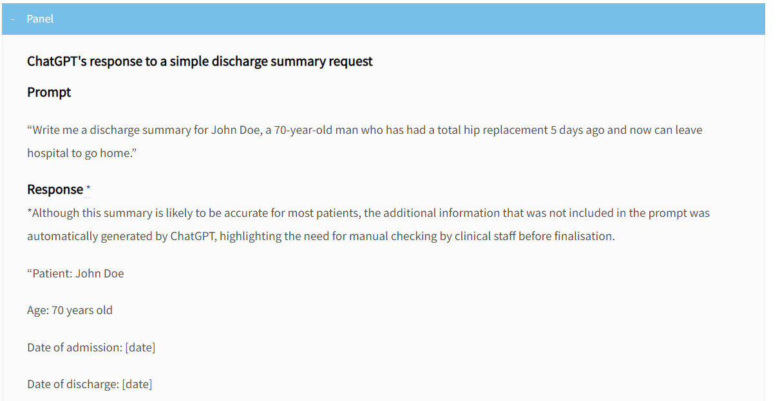

Slide 46
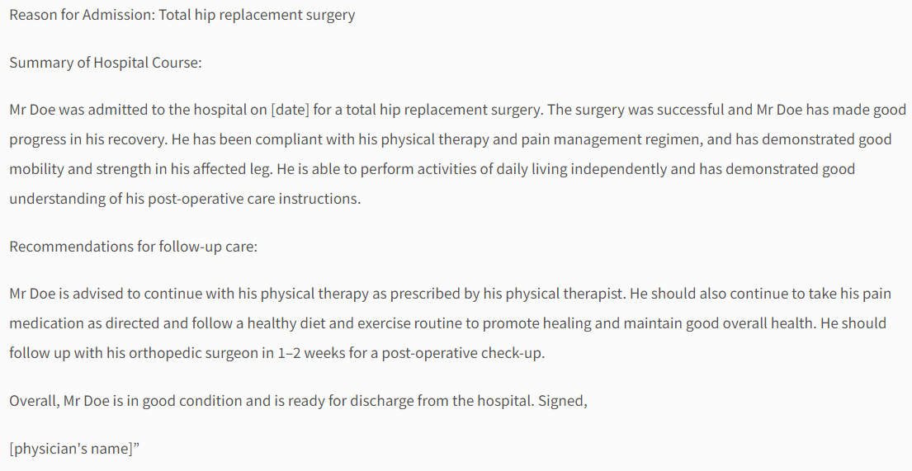

Slide 47
Some thoughts
Although ChatGPT offers significant promise, deployment into clinical practice will require multiple barriers to be overcome.
First, ChatGPT depends on the data it receives and therefore still necessitates salient information to be manually inputted.
Future iterations might allow automatic scraping of data from the patient's electronic health record without the need for manual inputting of a brief.

Slide 48
Some thoughts
This practice, however, presents significant issues with respect to data governance.
Previous use of AI within health care has been associated with failings that significantly damage patients' trust and therefore care must be taken around data storage and access.

Slide 49
Some thoughts
Acceptability of this technology, from patients in particular, must be considered.
The concern that automation might lead to depersonalisation of care could lead to resistance to this technology.
Pilot trial data is therefore necessary to gather stakeholder views and ultimately show improvements in efficiency and quality of processes.
Finally, the consequences of technology failure must be considered.

Slide 50
Some thoughts
Although asking trivial questions to a chatbot at home might have few consequences, incorrect or inadequate information concerning medication changes or follow-up can greatly affect patient care.
Therefore, although ChatGPT can be considered as a first step in the writing process, manual checking of its output by a doctor will be required before completion.

Slide 51
Some thoughts
ChatGPT demonstrates the power of this next generation of chatbots powered by large language models.
Although the use of chatbots within health care is by no means novel, having previously been applied to areas such as triage, this next generation aims to advance the field significantly through its generative capacities.
Health care is an industry that has significant scope for automation, especially in areas of documentation.

Slide 52
Some thoughts
We should be reactive to these advances in technology and explore potential use cases and feasibility of using chatbots such as ChatGPT across diverse areas in health care.
Proactive early adoption of this technology at a central level might also reduce the risk of issues in the future; parallels can be drawn with interoperability issues due to differing electronic health records adopted at a local level.
The question for the future will be how, not if, we adopt this technology.

Slide 53
Use of ChatGPT in social science survey research
In recent years, the development of artificial intelligence (AI) and machine learning technologies has further expanded the capabilities of survey data collection and data management and analysis in social science research.
ChatGPT is one such AI software designed to generate human-like text and can be trained on large datasets of human language to produce responses to questions or prompts.

Slide 54
Use of ChatGPT in social science survey research
Social scientists use ChatGPT and similar technologies to help with their research and to learn about people's attitudes, opinions, and behaviors.
It's important to remember that ChatGPT and other AI systems may have limitations and biases and that researchers should carefully consider the ethical implications of using them.

Slide 55
Benefits of Use
Efficiency and cost-effectiveness:
ChatGPT can automate certain tasks and processes, such as generating survey questions or analyzing large amounts of data. This can help researchers save time and resources and potentially reduce the overall cost of conducting research.

Slide 56
Benefits of Use
Increased accessibility:
ChatGPT can facilitate online research, which can be more convenient and accessible for participants, particularly if they are located in remote areas or cannot travel to a research site.

Slide 57
Benefits of Use
Ability to handle large amounts of data:
ChatGPT can analyze and interpret large amounts of data, such as open-ended survey responses or social media posts, in a relatively short time. This can help researchers gain insights into people’s attitudes, opinions, and behaviors that might not be possible with traditional methods.

Slide 58
Benefits of Use
Greater flexibility:
ChatGPT can be customized and programmed to perform specific tasks or functions, making it more flexible than traditional methods. For example, researchers can use ChatGPT to generate different versions of a survey or to analyze data in different ways.

Slide 59
Benefits of Use
Increased objectivity:
ChatGPT can be programmed to follow a set of predefined rules and procedures, which can help reduce the potential for bias in the research process.

Slide 60
Examples of Use
Automated survey generation: ChatGPT could generate customized survey questions based on predefined parameters. This could allow researchers to more efficiently and cost-effectively conduct large-scale surveys.
Natural language processing: ChatGPT could be used to analyze and interpret large amounts of text data, such as open-ended survey responses or social media posts. This could help researchers gain insights into people's attitudes, opinions, and behaviors.

Slide 61
Examples of Use
Virtual focus groups: ChatGPT could facilitate online focus groups, where participants can converse with the AI and share their thoughts and opinions on a particular topic. This could be particularly useful for researchers who cannot conduct in-person focus groups due to geographical or other constraints.
Chatbots for customer service or market research: ChatGPT could be used to develop chatbots that can interact with customers or potential customers and gather information about their preferences and needs. This could be a useful tool for market research or customer service.

Slide 62
Limitations of ChatGPT in social science survey research
Accuracy and reliability: There is a risk that ChatGPT-generated responses may not be accurate or reliable, particularly if the software has not been trained on a diverse and representative dataset. This could lead to flawed or misleading results.
Bias: ChatGPT and other artificial intelligence systems can be biased in various ways, such as reflecting the biases of the data they are trained on or the researchers who design them. This could result in biased or discriminatory outcomes in the research process.

Slide 63
Limitations of ChatGPT in social science survey research
Limited understanding of AI: Some researchers may not have a deep understanding of how ChatGPT and other AI systems work, which could lead to misunderstandings or misapplications of the technology.
Dependence on technology: Relying on ChatGPT and other AI systems can create a dependency on technology, which could be problematic if the technology fails or is unavailable.

Slide 64
The Limitations of ChatGPT
Although ChatGPT is a powerful AI-based chatbot system, it does have some limitations. It can only provide answers based on the data it has been trained on.
ChatGPT is not a search engine, therefore it does not have the ability to search the internet for information. Rather, it uses the information it learned from training data to generate responses. This leaves room for error — so all output should be fact-checked for accuracy and timeliness.

Slide 65
The Limitations of ChatGPT
The chatbot may not be able to provide in-depth information or understand context or nuances in conversation.
As with all AI tools, all business leaders should be aware of the dangers of potential bias. If the data ChatGPT is trained on is biased, the answers the bot provides will be biased, as well. All companies need to be vigilant about monitoring output from the chatbot to ensure it is free of bias and offensive content.

Slide 66
The Threats
The chatbot has increased the risk of academic fraud and plagiarism, but could also help break down language barriers
If you ask the bot directly, it will give you a list of ways that it can help scientists – although it will also warn about accuracy
The artificial intelligence chatbot ChatGPT is causing concern among scientists and educators that it could be misused to fabricate studies and write essays for students, but researchers say it could also help bring down language barriers and shape higher education.

Slide 67
The Threats
The technology can translate and summarise texts as well as answer questions, heightening concerns about academic fraud.
To test how believable the AI-generated texts are in the eyes of the professionals, a team of scientists in the United States asked their peers to tell research paper abstracts written by the AI writer apart from those by humans.

Slide 68
The Threats
The blind reviews misidentified 32 per cent of generated abstracts as being real and 14 per cent of original abstracts as being written by the chatbot, according to the study published in late December on the bioRxiv website ahead of peer review.

Slide 69
Opportunities
But using the AI service, which is capable of translation and writing in languages including English, Chinese, Spanish and French, could also help scientists publish in a second language, according to Gao.
“[The tools] can be used to help scientists with the burden of writing and help improve equity, particularly for scientists who may have language barriers to disseminating their work,” she said.

Slide 70
Opportunities
When the Post asked ChatGPT to write a scientific abstract without providing data, on some trials the service generated texts listing the objective and results of a study in the style of medical journals, with a note saying “the results and conclusion may not be accurate”.
“It’s important to note that creating an original scientific abstract would require access to primary data, the expertise to conduct a study, and the research team’s permission to share their findings.

Slide 71
Opportunities
When the Post asked ChatGPT to write a scientific abstract without providing data, on some trials the service generated texts listing the objective and results of a study in the style of medical journals, with a note saying “the results and conclusion may not be accurate”.
“It’s important to note that creating an original scientific abstract would require access to primary data, the expertise to conduct a study, and the research team’s permission to share their findings.

Slide 72
Opportunities
Providing information and answering questions about specific topics in their field of study
Generating hypotheses and predictions based on data; summarising and analysing large sets of data;
Assisting with the writing of research papers and grant proposals; and helping to design and plan experiments and translating texts.

Slide 73
Opportunities
For the scientific community, it is about the collective efforts to build a research environment where transparency, honesty and creativity will be honored and rewarded, with or without the impact of AIs.
That’s why data sharing, procedure revealing and replication are so key for scientific research.”

Slide 74
THANK YOU

