Slide 1
Conversational AI
Dr. S KANNIMUTHU,
Professor / CSE Department,
Head-Center of Excellence in Algorithms,
Karpagam College of Engineering,
Coimbatore.
Tamilnadu, India

Slide 2
What is Conversational AI?
A programmatic and intelligent way of offering a conversational experience to mimic conversations with real people, through digital and telecommunication technologies.
Informed by rich data sets and intents
Providing users with informal, engaging experiences that mirror everyday language
Digitally enabled products, platforms, and experiences relating to communication, sales and service consultations as well as other customer services

Slide 3
Conversational AI brings together eight technology components
Natural Language Processing (NLP)
Ability to “read” or parse human language text
Pre-requisite for understanding natural sentence structures versus simple keyword “triggers”
Intent Recognition
Ability to understand what the user is requesting, even if phrased unexpectedly
Good intent recognition is vital if you don’t want to annoy your users with roadblocks in the experience

Slide 4
Conversational AI brings together eight technology components
Entity Recognition
Understand that some text refers to informative abstract categories (entities) such as “February 2” = Date
Necessary for more complex commands and analysis
Fulfilment
The ability to pull data from web services or databases using APIs, run conditions and inform the Dialog Manager

Slide 5
Conversational AI brings together eight technology components
Voice Optimized Responses
Ability to engage in conversation in a humanlike manner and show emotions to deliver an optimized experience
Dynamic Text to Speech
Converts written text to natural sounding speech, supporting various languages, voices and accents
Allows for emphasize of capital letters and tonal inflection

Slide 6
Conversational AI brings together eight technology components
Machine Learning
Learn how to better respond to the user by analyzing human agent responses
Necessary to improve intent recognition
Contextual Awareness
Ability to follow conversation history, translate, recall and memorize information over conversations
Necessary for natural, human-like back and forth conversation

Slide 7
Why Conversational AI / chatbots?
Messaging is a popular form of interaction and chatbots streamlines the interaction between people and services.
Easy Scalability of bots.
Always Available !
Helpful for organizations with presence in multiple geographies
According to Forbes, the chatbot market is forecasted to reach $1.25 billion by 2025.

Slide 8
Chatbot Conversation Framework

Slide 9
Use-case in hand
HR policies bot: At Walmart scale, allows employees to query the bot regarding various policies of Walmart.
How will bot help?
Very convenient to get queries clarified on various policies
Available 24x7!
Eliminates person dependency.
Provides a consistent experience.
Integrated with various communication platforms.

Slide 10
Chatbot Flow Diagram

Slide 11
Components of NLU Engine
Intent: This tells what user would like to do.
Example: search for a restaurant, raise a ticket, book a taxi etc.
Entity: These are the attributes which give details about the user’s task.
Example: if the user intent is to search for a restaurant possible entities could be:
a. the type of restaurant user is looking for i.e cuisine
b. the area in which the user looking for restaurant i.e location, etc...
In ML & NLP domain above two components are more frequently called as sentence classification and named entity recognition(NER) problems.

Slide 12
Transformers for Intent Classification
Contextual embeddings
word “bank” has different embedding
based on the context in which it is used.
word “bank” has same embedding!

Slide 13
Transformers for Intent Classification
Parallel training with positional encodings
Sentences are processed as a whole, rather than word by word compared to typical RNN/LSTM models.
Positional embeddings: encode information related to a specific position of a token in a sentence.

Slide 14
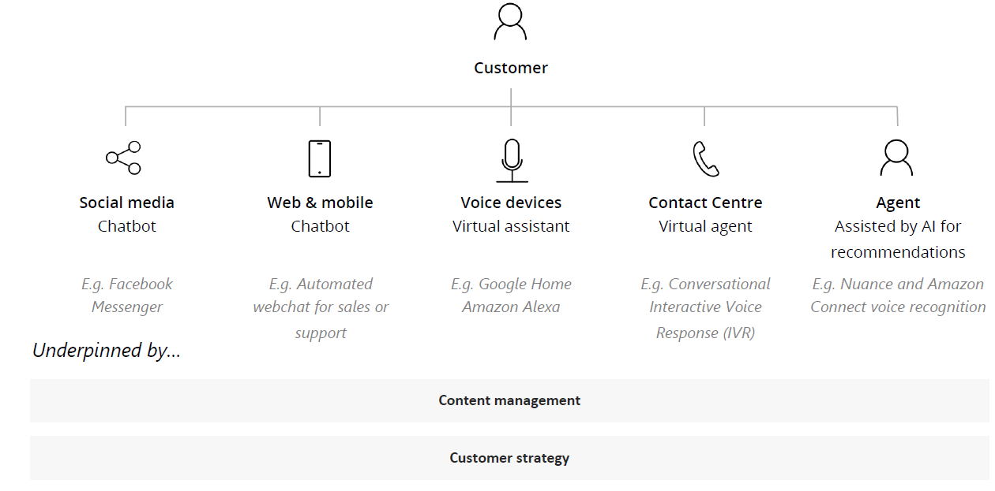
The opportunities for organizations and their customers
Conversational AI is an enabler to personalization
Using conversational AI, organizations can provide personalized and differentiated experiences that build relationships with their customers.
Each interaction can feel like a 1:1 conversation that is context-aware and informed by past interactions.

