Slide 1
Hands-on Sentiment Analysis on Hotels Reviews Using Artificial Intelligence and Open AI’s ChatGPT, with Python

Slide 2
Topics
How to generate an API key for ChatGPT?
How to Integrate ChatGPT in Python

Slide 3
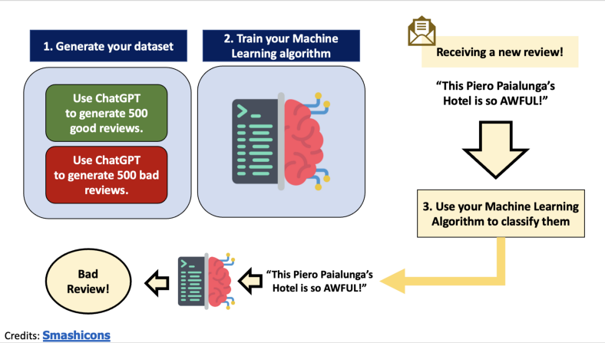

Slide 4
THANK YOU

