Slide 1
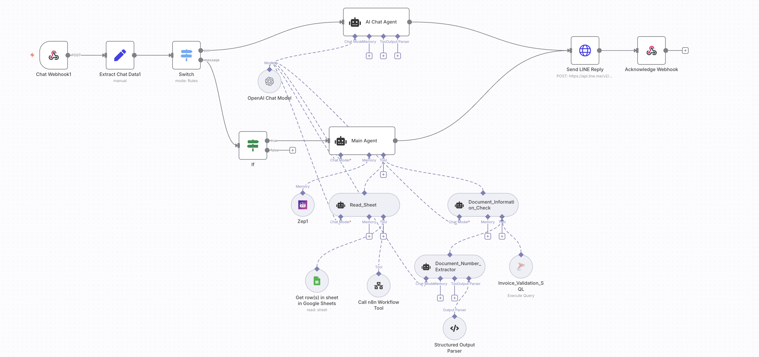
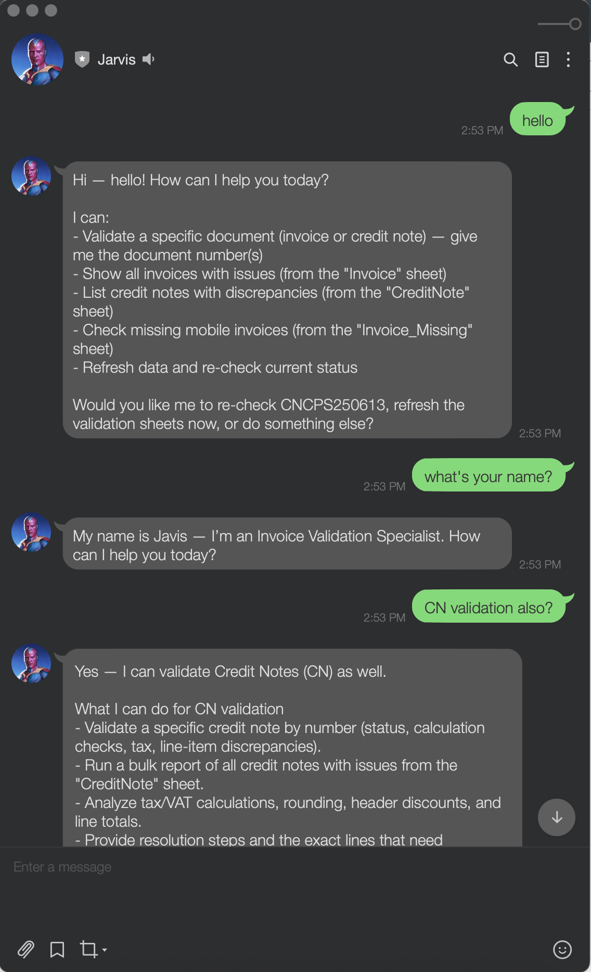
N8N : AI Chat Bot Auditor
Automated Invoice & Credit Note Validation Specialist

Slide 2
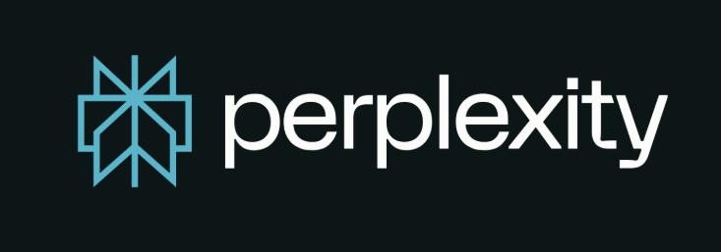
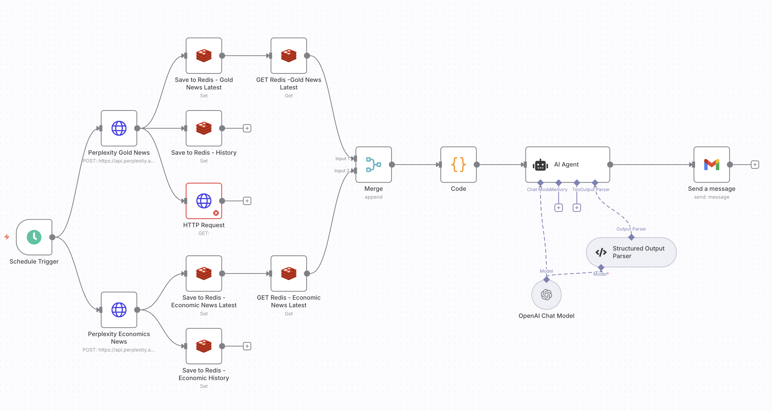
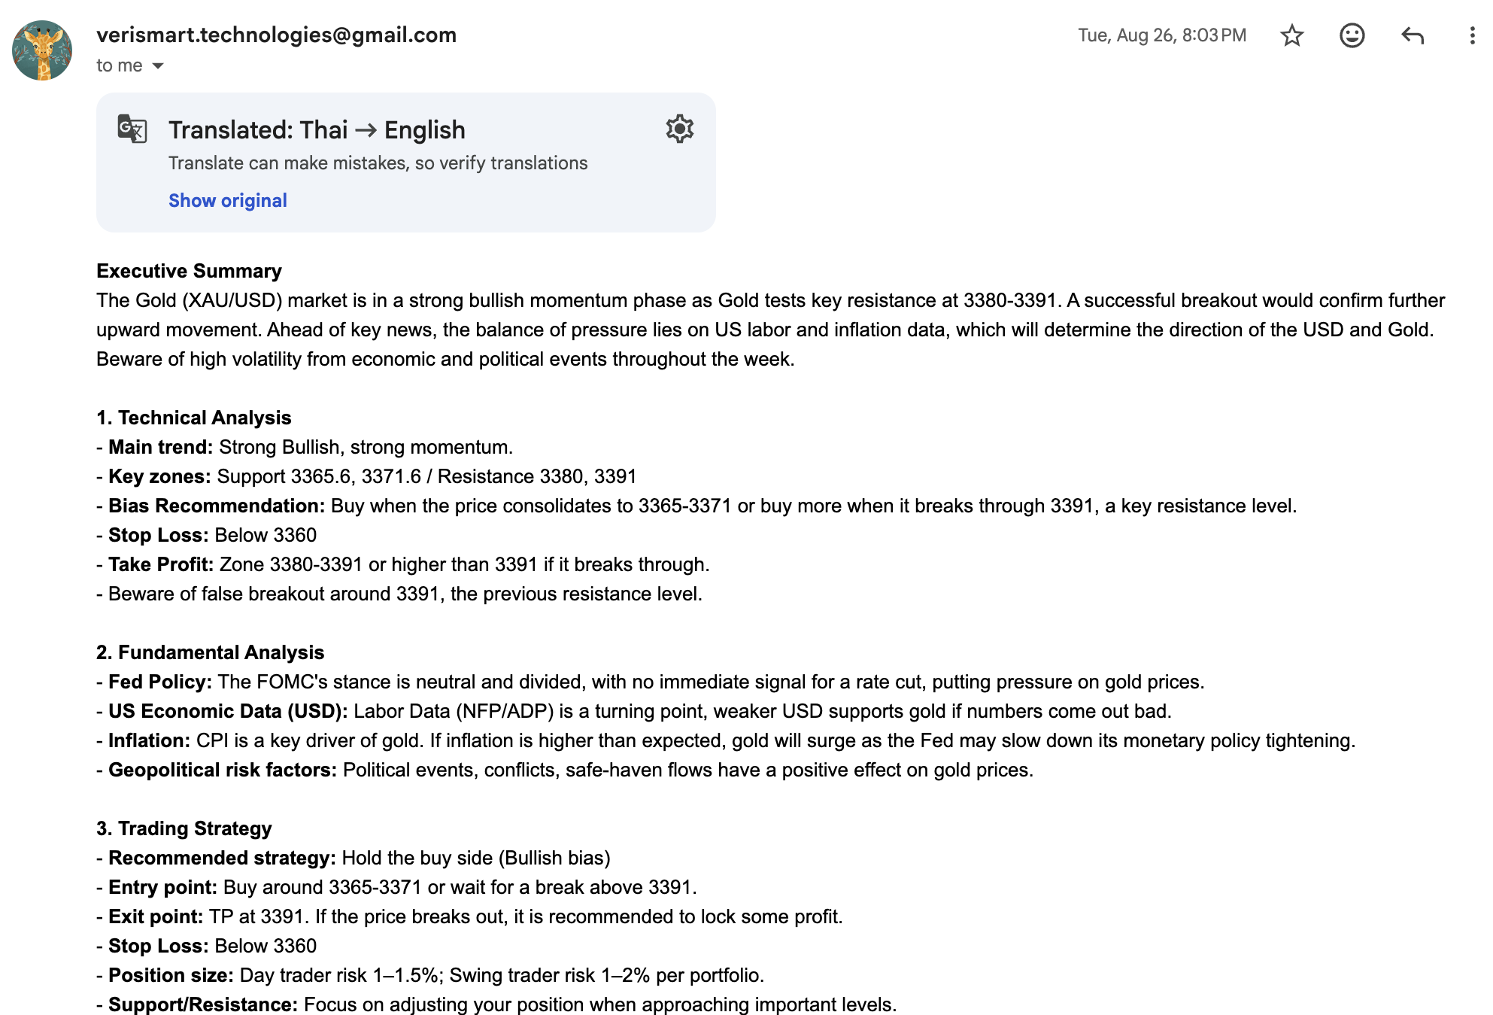
AI Market Intelligence: Gold & Macro
Automated analysis of gold trends and economic indicators, powered by Perplexity AI.

