Slide 1
Chapter 5
Network Layer:
Control Plane
A note on the use of these PowerPoint slides:
We’re making these slides freely available to all (faculty, students, readers). They’re in PowerPoint form so you see the animations; and can add, modify, and delete slides (including this one) and slide content to suit your needs. They obviously represent a lot of work on our part. In return for use, we only ask the following:
If you use these slides (e.g., in a class) that you mention their source (after all, we’d like people to use our book!)
If you post any slides on a www site, that you note that they are adapted from (or perhaps identical to) our slides, and note our copyright of this material.
For a revision history, see the slide note for this page.
Thanks and enjoy! JFK/KWR
All material copyright 1996-2025
J.F Kurose and K.W. Ross, All Rights Reserved
Computer Networking: A Top-Down Approach
9th edition
Jim Kurose, Keith Ross
Pearson, 2025
Notes:
Version History
8.0 (May 2020)
All slides reformatted for 16:9 aspect ratio
All slides updated to 8th edition material
Use of Calibri font, rather that Gill Sans MT
Add LOTS more animation throughout
lighter header font
Re-do of network management slides; redo of Bellman-Ford slides
8.2 (changes over 8.0)
improved animations of Dijkstra’s algorithm and Bellman Ford
various improvements to BGP
SDN: added Google Orion (2021 Google network SDN control plane)

Slide 2
Network layer control plane: our goals
understand principles behind network control plane:
  traditional routing algorithms
  SDN controllers
  network management, configuration
instantiation, implementation in the Internet:
  OSPF, BGP
  OpenFlow, ODL and ONOS controllers
  Internet Control Message Protocol: ICMP
  SNMP, YANG/NETCONF

Slide 3

Network layer: “control plane” roadmap
introduction
routing protocols
  link state
  distance vector
intra-ISP routing: OSPF
routing among ISPs: BGP
SDN control plane
Internet Control Message Protocol
network management, configuration
  SNMP
  NETCONF/YANG

Slide 4
Network-layer functions
forwarding: move packets from router’s input to appropriate router output
data plane
routing: determine route taken by packets from source to destination
control plane
Two approaches to structuring network control plane:
per-router control (traditional)
logically centralized control (software defined networking)

Slide 5

Per-router control plane
Individual routing algorithm components in each and every router interact in the control plane
Routing
Algorithm
control
plane
data
plane
values in arriving
packet header
0111
1
3
2

Slide 6
Software-Defined Networking (SDN) control plane
Remote controller computes, installs forwarding tables in routers
Remote Controller
control
plane
data
plane
CA
CA
CA
CA
CA
values in arriving
packet header
0111
1
3
2

Slide 7
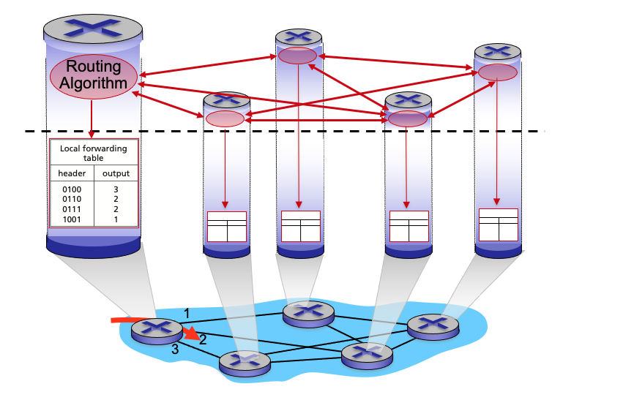
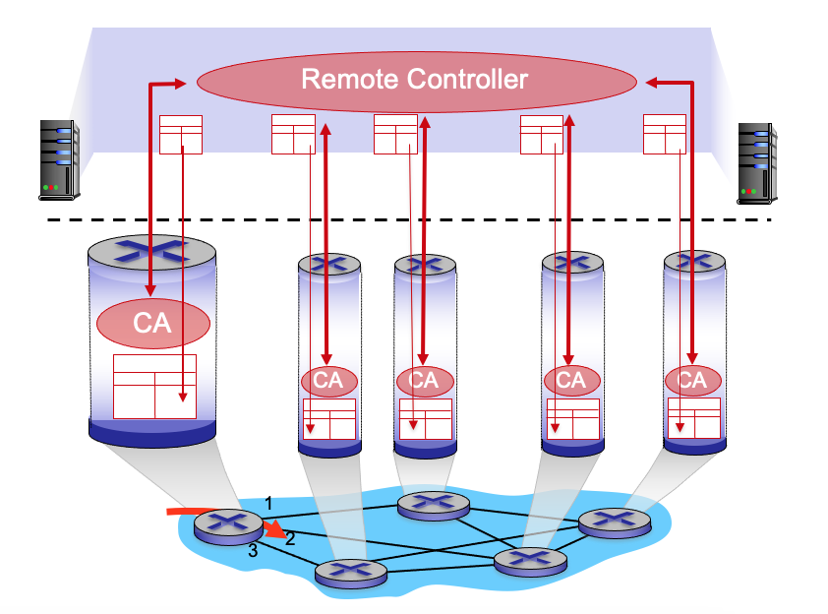
Per-router control plane
SDN control plane

Slide 8
Network layer: “control plane” roadmap
introduction
routing protocols
  link state
  distance vector
intra-ISP routing: OSPF
routing among ISPs: BGP
SDN control plane
Internet Control Message Protocol
network management, configuration
  SNMP
  NETCONF/YANG

Slide 9
















Routing protocols
mobile network
Routing protocol goal: determine “good” paths (equivalently, routes), from sending hosts to receiving host, through network of routers
path: sequence of routers packets traverse from given initial source host to final destination host
“good”: least “cost”, “fastest”, “least congested”
routing: a “top-10” networking challenge!
national or global ISP
application
transport
network
link
physical
network
link
physical
network
link
physical
network
link
physical
network
link
physical
network
link
physical
datacenter
network
application
transport
network
link
physical
enterprise
network
Routing algorithm มักพยายามเลือก path ที่มี cost ต่ำที่สุด
cost คำนวณจาก เช่น bandwidth delay congestion reliability จำนวน hop หรือค่าที่ผู้ดูแลกำหนดเอง

Slide 10
Graph abstraction: link costs
5
c_{a,b}: cost of direct link connecting a and b
e.g., c_{w,z} = 5, c_{u,z} = ∞
cost defined by network operator: could always be 1, or inversely related to bandwidth, or inversely related to congestion
v
3
w
2
5
u
2
1
z
3
1
2
x
y
1
graph: G = (N,E)
N: set of routers = { u, v, w, x, y, z }
E: set of links ={ (u,v), (u,x), (v,x), (v,w), (x,w), (x,y), (w,y), (w,z), (y,z) }
algorithm เราจะมอง router แต่ละตัวเป็น node และ link เป็น edge แล้วใส่ cost ให้แต่ละ link
c(u,z) = ∞ ในสไลด์หมายถึง ไม่มี direct link u–z ไม่ได้หมายความว่าไม่มีเส้นทางจาก u ไป z ใน network
u → x → y → z มี total path cost ?

Slide 11
Routing algorithm classification
global: all routers have complete topology, link cost info
“link state” algorithms
dynamic: routes change more quickly
  periodic updates or in response to link cost changes
How fast do routes change?
static: routes change slowly over time
decentralized: iterative process of computation, exchange of info with neighbors
routers initially only know link costs to attached neighbors
“distance vector” algorithms
global or decentralized information?
1.ข้อมูลที่ใช้ในการคำนวณเส้นทาง (information available / computation model ) / 2.การเปลี่ยนแปลง route ตามเวลา

Slide 12
Network layer: “control plane” roadmap
introduction
routing protocols
  link state
  distance vector
intra-ISP routing: OSPF
routing among ISPs: BGP
SDN control plane
Internet Control Message Protocol
network management, configuration
  SNMP
  NETCONF/YANG

Slide 13
Dijkstra’s link-state routing algorithm
centralized: network topology, link costs known to all nodes
  accomplished via “link state broadcast”
  all nodes have same info
computes least cost paths from one node (“source”) to all other nodes
  gives forwarding table for that node
iterative: after k iterations, know least cost path to k destinations
notation
c_{x,y}: direct link cost from node x to y; = ∞ if not direct neighbors
D(v): current estimate of cost of least-cost-path from source to destination v
p(v): predecessor node along path from source to v
N': set of nodes whose least-cost-path definitively known
c=direct-link cost, D=ค่าประมาณปัจจุบันของ least-cost path, p= predecessor บน path ที่กำลังเลือก, N′ = เซตของ nodes ที่ least-cost path ถูกยืนยันแล้ว
Dijkstra’s อ่านว่า ไดก์สตราส์ มาจากชื่อ Edsger Dijkstra นักวิทยาการคอมพิวเตอร์ชาวดัตช์

Slide 14
Dijkstra’s link-state routing algorithm
1 Initialization:
2 N' = {u} /* compute least cost path from u to all other nodes */
3 for all nodes v
4 if v adjacent to u /* u initially knows direct-path-cost only to direct neighbors */
5 then D(v) = c_{u,v} /* but may not be minimum cost! */
6 else D(v) = ∞
7
8 Loop
9
10
11
12
13
14
15 until all nodes in N'
find w not in N' such that D(w) is a minimum
add w to N'
update D(v) for all v adjacent to w and not in N' :
D(v) = min ( D(v), D(w) + c_{w,v} )
/* new least-path-cost to v is either old least-cost-path to v or known
least-cost-path to w plus direct-cost from w to v */

Slide 15
Dijkstra’s algorithm: an example
v
w
x
y
z
Step
0
1
2
3
4
5
N'
D(v),p(v)
D(w),p(w)
D(x),p(x)
D(y),p(y)
D(z),p(z)
u
2,u
5,u
1,u
∞
∞
D(w),p(w)
5,u
4,x
3,y
3,y
5
Initialization (step 0):
For all a: if a adjacent to u then D(a) = c_{u,a}
v
3
w
2
5
u
2
1
z
3
1
2
x
y
1

Slide 16
Dijkstra’s algorithm: an example
v
w
x
y
z
Step
0
1
2
3
4
5
N'
D(v),p(v)
D(w),p(w)
D(x),p(x)
D(y),p(y)
D(z),p(z)
u
2,u
5,u
1,u
∞
∞
ux
D(w),p(w)
5,u
4,x
3,y
3,y
8 Loop
9
10
find a not in N' such that D(a) is a minimum
add a to N'
5
v
3
w
2
5
u
2
1
z
3
1
2
x
y
1

Slide 17

Dijkstra’s algorithm: an example
v
w
x
y
z
Step
0
1
2
3
4
5
N'
D(v),p(v)
D(w),p(w)
D(x),p(x)
D(y),p(y)
D(z),p(z)
u
2,u
5,u
1,u
∞
∞
ux
2,u
4,x
2,x
∞
D(w),p(w)
5,u
4,x
3,y
3,y
8 Loop
9
10
11
find a not in N' such that D(a) is a minimum
add a to N'
5
v
3
w
2
5
update D(b) for all b adjacent to a and not in N' :
D(b) = min ( D(b), D(a) + c_{a,b} )
u
2
1
z
3
1
2
D(v) = min ( D(v), D(x) + c_{x,v} ) = min(2, 1+2) = 2
x
y
1
D(w) = min ( D(w), D(x) + c_{x,w} ) = min (5, 1+3) = 4
D(y) = min ( D(y), D(x) + c_{x,y} ) = min(inf,1+1) = 2

Slide 18
Dijkstra’s algorithm: an example
v
w
x
y
z
Step
0
1
2
3
4
5
N'
D(v),p(v)
D(w),p(w)
D(x),p(x)
D(y),p(y)
D(z),p(z)
u
2,u
5,u
1,u
∞
∞
ux
2,u
4,x
2,x
∞
uxy
D(w),p(w)
5,u
4,x
3,y
3,y
8 Loop
9
10
find a not in N' such that D(a) is a minimum
add a to N'
5
v
3
w
2
5
u
2
1
z
3
1
2
x
y
1

Slide 19
Dijkstra’s algorithm: an example
v
w
x
y
z
Step
0
1
2
3
4
5
N'
D(v),p(v)
D(w),p(w)
D(x),p(x)
D(y),p(y)
D(z),p(z)
u
2,u
5,u
1,u
∞
∞
ux
2,u
4,x
2,x
∞
uxy
2,u
3,y
4,y
8 Loop
9
10
11
find a not in N' such that D(a) is a minimum
add a to N'
5
v
3
w
2
5
update D(b) for all b adjacent to a and not in N' :
D(b) = min ( D(b), D(a) + c_{a,b} )
u
2
1
z
3
1
2
D(w) = min ( D(w), D(y) + c_{y,w} ) = min (4, 2+1) = 3
x
y
1
D(z) = min ( D(z), D(y) + c_{y,z} ) = min(inf,2+2) = 4

Slide 20
Dijkstra’s algorithm: an example
v
w
x
y
z
Step
0
1
2
3
4
5
N'
D(v),p(v)
D(w),p(w)
D(x),p(x)
D(y),p(y)
D(z),p(z)
u
2,u
5,u
1,u
∞
∞
ux
2,u
4,x
2,x
∞
uxy
2,u
3,y
4,y
uxyv
8 Loop
9
10
find a not in N' such that D(a) is a minimum
add a to N'
5
v
3
w
2
5
u
2
1
z
3
1
2
x
y
1

Slide 21
Dijkstra’s algorithm: an example
v
w
x
y
z
Step
0
1
2
3
4
5
N'
D(v),p(v)
D(w),p(w)
D(x),p(x)
D(y),p(y)
D(z),p(z)
u
2,u
5,u
1,u
∞
∞
ux
2,u
4,x
2,x
∞
uxy
2,u
3,y
4,y
uxyv
3,y
4,y
8 Loop
9
10
11
find a not in N' such that D(a) is a minimum
add a to N'
5
v
3
w
2
5
update D(b) for all b adjacent to a and not in N' :
D(b) = min ( D(b), D(a) + c_{a,b} )
u
2
1
z
3
1
2
D(w) = min ( D(w), D(v) + c_{v,w} ) = min (3, 2+3) = 3
x
y
1

Slide 22
Dijkstra’s algorithm: an example
v
w
x
y
z
Step
0
1
2
3
4
5
N'
D(v),p(v)
D(w),p(w)
D(x),p(x)
D(y),p(y)
D(z),p(z)
u
2,u
5,u
1,u
∞
∞
ux
2,u
4,x
2,x
∞
uxy
2,u
3,y
4,y
uxyv
3,y
4,y
uxyvw
8 Loop
9
10
find a not in N' such that D(a) is a minimum
add a to N'
5
v
3
w
2
5
u
2
1
z
3
1
2
x
y
1

Slide 23
Dijkstra’s algorithm: an example
v
w
x
y
z
Step
0
1
2
3
4
5
N'
D(v),p(v)
D(w),p(w)
D(x),p(x)
D(y),p(y)
D(z),p(z)
u
2,u
5,u
1,u
∞
∞
ux
2,u
4,x
2,x
∞
uxy
2,u
3,y
4,y
uxyv
3,y
4,y
uxyvw
4,y
8 Loop
9
10
11
find a not in N' such that D(a) is a minimum
add a to N'
5
v
3
w
2
5
update D(b) for all b adjacent to a and not in N' :
D(b) = min ( D(b), D(a) + c_{a,b} )
u
2
1
z
3
1
2
D(z) = min ( D(z), D(w) + c_{w,z} ) = min (4, 3+5) = 4
x
y
1

Slide 24
Dijkstra’s algorithm: an example
v
w
x
y
z
Step
0
1
2
3
4
5
N'
D(v),p(v)
D(w),p(w)
D(x),p(x)
D(y),p(y)
D(z),p(z)
u
2,u
5,u
1,u
∞
∞
ux
2,u
4,x
2,x
∞
uxy
2,u
3,y
4,y
uxyv
3,y
4,y
uxyvw
4,y
uxyvwz
8 Loop
9
10
find a not in N' such that D(a) is a minimum
add a to N'
5
v
3
w
2
5
u
2
1
z
3
1
2
x
y
1

Slide 25
Dijkstra’s algorithm: an example
v
w
x
y
z
Step
0
1
2
3
4
5
N'
D(v),p(v)
D(w),p(w)
D(x),p(x)
D(y),p(y)
D(z),p(z)
u
2,u
5,u
1,u
∞
∞
ux
2,u
4,x
2,x
∞
uxy
2,u
3,y
4,y
uxyv
3,y
4,y
uxyvw
4,y
uxyvwz
8 Loop
9
10
11
find a not in N' such that D(a) is a minimum
add a to N'
5
v
3
w
2
5
update D(b) for all b adjacent to a and not in N' :
D(b) = min ( D(b), D(a) + c_{a,b} )
u
2
1
z
3
1
2
x
y
1

Slide 26
Dijkstra’s algorithm: an example
v
w
x
y
z
Step
0
1
2
3
4
5
N'
D(v),p(v)
D(w),p(w)
D(x),p(x)
D(y),p(y)
D(z),p(z)
u
2,u
5,u
1,u
∞
∞
ux
2,u
4,x
2,x
∞
uxy
2,u
3,y
4,y
uxyv
3,y
4,y
D(w),p(w)
5,u
4,x
3,y
3,y
uxyvw
4,y
uxyvwz
Initialization (step 0): For all a: if a adjacent to then D(a) = c_{u,a}
5
find a not in N' such that D(a) is a minimum
add a to N'
update D(b) for all b adjacent to a and not in N' :
D(b) = min ( D(b), D(a) + c_{a,b} )
v
3
w
2
5
u
2
1
z
3
1
2
x
y
1

Slide 27
Dijkstra’s algorithm: an example
5
v
3
w
2
5
u
2
1
z
3
1
2
D(w),p(w)
5,u
4,x
3,y
3,y
x
y
1
resulting least-cost-path tree from u:
resulting forwarding table in u:
v
w
destination
outgoing link
v
x
y
w
x
(u,v)
(u,x)
(u,x)
(u,x)
(u,x)
route from u to v directly
u
z
x
route from u to all other destinations via x
y

Slide 28
Dijkstra’s algorithm: another example
v
w
x
y
z
x
D(v),
p(v)
D(w),
p(w)
D(x),
p(x)
D(y),
p(y)
D(z),
p(z)
9
Step
N'
0
u
7,u
3,u
5,u
∞
∞
5
7
4
1
uw
6,w
5,u
11,w
∞
8
2
uwx
6,w
11,w
14,x
u
3
w
y
z
2
3
uwxv
10,v
14,x
3
4
uwxvy
12,y
7
4
5
uwxvyz
v
notes:
construct least-cost-path tree by tracing predecessor nodes
ties can exist (can be broken arbitrarily)

Slide 29
Dijkstra’s algorithm: discussion
algorithm complexity: n nodes
each of n iteration: need to check all nodes, w, not in N
n(n+1)/2 comparisons: O(n²) complexity
more efficient implementations possible: O(nlogn)
message complexity:
each router must broadcast its link state information to other n routers
efficient (and interesting!) broadcast algorithms: O(n) link crossings to disseminate a broadcast message from one source
each router’s message crosses O(n) links: overall message complexity: O(n²)

Slide 30
Dijkstra’s algorithm: oscillations possible
when link costs depend on traffic volume, route oscillations possible
sample scenario:
  routing to destination a, traffic entering at d, c, e with rates 1, e (<1), 1
  link costs are directional, and volume-dependent
a
a
a
a
1
1+e
2+e
0
0
2+e
2+e
0
d
b
d
1
b
d
b
d
b
0
0
1+e
0
0
1+e
1
1
0
e
1
0
c
0
1
1
1
c
1+e
1
1
0
0
1
c
1
c
e
e
e
e
given these costs,
find new routing….
resulting in new costs
given these costs,
find new routing….
resulting in new costs
given these costs,
find new routing….
resulting in new costs
initially

Slide 31
Network layer: “control plane” roadmap
introduction
routing protocols
  link state
  distance vector
intra-ISP routing: OSPF
routing among ISPs: BGP
SDN control plane
Internet Control Message Protocol
network management, configuration
  SNMP
  NETCONF/YANG

Slide 32
Distance vector algorithm
Based on Bellman-Ford (BF) equation (dynamic programming):
Bellman-Ford equation
Let D_{x}(y): cost of least-cost path from x to y.
Then:
D_{x}(y) = min_{v} { c_{x,v} + D_{v}(y) }
v’s estimated least-cost-path cost to y
min taken over all neighbors v of x
direct cost of link from x to v

Slide 33
Bellman-Ford Example
Suppose that u’s neighboring nodes, x,v,w, know that for destination z:
D_{v}(z) = 5
D_{w}(z) = 3
Bellman-Ford equation says:
5
D_{u}(z) = min { c_{u,v} + D_{v}(z),
c_{u,x} + D_{x}(z),
c_{u,w} + D_{w}(z) }
v
3
w
2
5
u
2
1
z
3
= min {2 + 5,
1 + 3,
5 + 3} = 4
1
2
x
y
1
D_{x}(z) = 3
node achieving minimum (x) is next hop on estimated least-cost path to destination (z)

Slide 34
Distance vector algorithm
key idea:
from time-to-time, each node sends its own distance vector estimate to neighbors
when x receives new DV estimate from any neighbor, it updates its own DV using B-F equation:
D_{x}(y) ← min_{v}{c_{x,v} + D_{v}(y)} for each node y ∊ N
under minor, natural conditions, the estimate D_{x}(y) converge to the actual least cost d_{x}(y)

Slide 35
Distance vector algorithm:
each node:
iterative, asynchronous: each local iteration caused by:
local link cost change
DV update message from neighbor
wait for (change in local link cost or msg from neighbor)
recompute DV estimates using DV received from neighbor
distributed, self-stopping: each node notifies neighbors only when its DV changes
  neighbors then notify their neighbors – only if necessary
  no notification received, no actions taken!
if DV to any destination has changed, notify neighbors

Slide 36
Distance vector: example
DV in a: D_{a}(a)=0
D_{a}(b) = 8
D_{a}(c) = ∞
D_{a}(d) = 1
D_{a}(e) = ∞
D_{a}(f) = ∞
D_{a}(g) = ∞
D_{a}(h) = ∞
D_{a}(i) = ∞
a
b
c
8
1
t=0
1
1
All nodes have distance estimates to nearest neighbors (only)
A few asymmetries:
missing link
larger cost
d
e
f
1
1
All nodes send their local distance vector to their neighbors
1
1
1
g
h
i
1
1

Slide 37
Distance vector example: iteration
a
b
c
8
1
t=1
1
1
All nodes:
receive distance vectors from neighbors
compute their new local distance vector
send their new local distance vector to neighbors
d
e
f
1
1
1
1
1
g
h
i
1
1

Slide 38
Distance vector example: iteration
a
compute
compute
compute
b
c
8
1
t=1
1
1
All nodes:
receive distance vectors from neighbors
compute their new local distance vector
send their new local distance vector to neighbors
d
compute
e
f
compute
compute
1
1
1
1
1
g
h
i
compute
compute
1
compute
1

Slide 39
Distance vector example: iteration
a
b
c
8
1
t=1
1
1
All nodes:
receive distance vectors from neighbors
compute their new local distance vector
send their new local distance vector to neighbors
d
e
f
1
1
1
1
1
g
h
i
1
1

Slide 40
Distance vector example: iteration
a
b
c
8
1
t=2
1
1
All nodes:
receive distance vectors from neighbors
compute their new local distance vector
send their new local distance vector to neighbors
d
e
f
1
1
1
1
1
g
h
i
1
1

Slide 41
Distance vector example: iteration
compute
compute
compute
a
b
c
2
1
t=2
1
1
All nodes:
receive distance vectors from neighbors
compute their new local distance vector
send their new local distance vector to neighbors
d
compute
compute
compute
e
f
1
1
1
1
1
g
compute
compute
compute
h
i
8
1

Slide 42
Distance vector example: iteration
a
b
c
8
1
t=2
1
1
All nodes:
receive distance vectors from neighbors
compute their new local distance vector
send their new local distance vector to neighbors
d
e
f
1
1
1
1
1
g
h
i
1
1

Slide 43
Distance vector example: iteration
…. and so on
Let’s next take a look at the iterative computations at nodes

Slide 44
Distance vector example: computation
DV in b:
DV in c:
D_{c}(a) = ∞
D_{c}(b) = 1
D_{c}(c) = 0
D_{c}(d) = ∞
D_{c}(e) = ∞
D_{c}(f) = ∞
D_{c}(g) = ∞
D_{c}(h) = ∞
D_{c}(i) = ∞
D_{b}(a) = 8
D_{b}(c) = 1
D_{b}(d) = ∞
D_{b}(e) = 1
D_{b}(f) = ∞
D_{b}(g) = ∞
D_{b}(h) = ∞
D_{b}(i) = ∞
DV in a: D_{a}(a)=0
D_{a}(b) = 8
D_{a}(c) = ∞
D_{a}(d) = 1
D_{a}(e) = ∞
D_{a}(f) = ∞
D_{a}(g) = ∞
D_{a}(h) = ∞
D_{a}(i) = ∞
a
b
c
8
1
t=1
1
1
b receives DVs from a, c, e
DV in e:
D_{e}(a) = ∞
D_{e}(b) = 1
D_{e}(c) = ∞
D_{e}(d) = 1
D_{e}(e) = 0
D_{e}(f) = 1
D_{e}(g) = ∞
D_{e}(h) = 1
D_{e}(i) = ∞
d
e
f
1
1
1
1
1
g
h
i
1
1

Slide 45
Distance vector example: computation
DV in b:
DV in c:
D_{c}(a) = ∞
D_{c}(b) = 1
D_{c}(c) = 0
D_{c}(d) = ∞
D_{c}(e) = ∞
D_{c}(f) = ∞
D_{c}(g) = ∞
D_{c}(h) = ∞
D_{c}(i) = ∞
D_{b}(a) = 8
D_{b}(c) = 1
D_{b}(d) = ∞
D_{b}(e) = 1
D_{b}(f) = ∞
D_{b}(g) = ∞
D_{b}(h) = ∞
D_{b}(i) = ∞
DV in a: D_{a}(a)=0
D_{a}(b) = 8
D_{a}(c) = ∞
D_{a}(d) = 1
D_{a}(e) = ∞
D_{a}(f) = ∞
D_{a}(g) = ∞
D_{a}(h) = ∞
D_{a}(i) = ∞
a
b
c
b
8
compute
1
t=1
1
1
b receives DVs from a, c, e, computes:
DV in e:
D_{e}(a) = ∞
D_{e}(b) = 1
D_{e}(c) = ∞
D_{e}(d) = 1
D_{e}(e) = 0
D_{e}(f) = 1
D_{e}(g) = ∞
D_{e}(h) = 1
D_{e}(i) = ∞
e
d
e
f
1
1
D_{b}(a) = min{c_{b,a}+D_{a}(a), c_{b,c} +D_{c}(a), c_{b,e}+D_{e}(a)} = min{8,∞,∞} = 8
D_{b}(c) = min{c_{b,a}+D_{a}(c), c_{b,c} +D_{c}(c), c _{b,e} +D_{e}(c)} = min{∞,1,∞} = 1
D_{b}(d) = min{c_{b,a}+D_{a}(d), c_{b,c} +D_{c}(d), c _{b,e} +D_{e}(d)} = min{9,2,∞} = 2
1
1
1
D_{b}(e) = min{c_{b,a}+D_{a}(e), c_{b,c} +D_{c}(e), c _{b,e} +D_{e}(e)} = min{∞,∞,1} = 1
DV in b:
D_{b}(f) = min{c_{b,a}+D_{a}(f), c_{b,c} +D_{c}(f), c _{b,e} +D_{e}(f)} = min{∞,∞,2} = 2
D_{b}(g) = min{c_{b,a}+D_{a}(g), c_{b,c} +D_{c}(g), c _{b,e}+D_{e}(g)} = min{∞, ∞, ∞} = ∞
D_{b}(a) = 8
D_{b}(c) = 1
D_{b}(d) = 2
D_{b}(e) = 1
D_{b}(f) =2
D_{b}(g) = ∞
D_{b}(h) = 2
D_{b}(i) = ∞
g
h
1
i
1
D_{b}(h) = min{c_{b,a}+D_{a}(h), c_{b,c} +D_{c}(h), c _{b,e}+D_{e}(h)} = min{∞, ∞, 2} = 2
D_{b}(i) = min{c_{b,a}+D_{a}(i), c_{b,c} +D_{c}(i), c _{b,e}+D_{e}(i)} = min{∞, ∞, ∞} = ∞

Slide 46
Distance vector example: computation
DV in b:
DV in c:
D_{c}(a) = ∞
D_{c}(b) = 1
D_{c}(c) = 0
D_{c}(d) = ∞
D_{c}(e) = ∞
D_{c}(f) = ∞
D_{c}(g) = ∞
D_{c}(h) = ∞
D_{c}(i) = ∞
D_{b}(a) = 8
D_{b}(c) = 1
D_{b}(d) = ∞
D_{b}(e) = 1
D_{b}(f) = ∞
D_{b}(g) = ∞
D_{b}(h) = ∞
D_{b}(i) = ∞
DV in a: D_{a}(a)=0
D_{a}(b) = 8
D_{a}(c) = ∞
D_{a}(d) = 1
D_{a}(e) = ∞
D_{a}(f) = ∞
D_{a}(g) = ∞
D_{a}(h) = ∞
D_{a}(i) = ∞
a
b
c
8
1
t=1
1
1
c receives DVs from b
DV in e:
D_{e}(a) = ∞
D_{e}(b) = 1
D_{e}(c) = ∞
D_{e}(d) = 1
D_{e}(e) = 0
D_{e}(f) = 1
D_{e}(g) = ∞
D_{e}(h) = 1
D_{e}(i) = ∞
d
e
f
1
1
1
1
1
g
h
i
1
1

Slide 47
Distance vector example: computation
DV in b:
DV in c:
D_{c}(a) = ∞
D_{c}(b) = 1
D_{c}(c) = 0
D_{c}(d) = ∞
D_{c}(e) = ∞
D_{c}(f) = ∞
D_{c}(g) = ∞
D_{c}(h) = ∞
D_{c}(i) = ∞
D_{b}(a) = 8
D_{b}(c) = 1
D_{b}(d) = ∞
D_{b}(e) = 1
D_{b}(f) = ∞
D_{b}(g) = ∞
D_{b}(h) = ∞
D_{b}(i) = ∞
a
b
c
1
compute
8
t=1
1
1
c receives DVs from b computes:
d
e
f
D_{c}(a) = min{c_{c,b}+D_{b}(a}} = 1 + 8 = 9
DV in c:
D_{c}(a) = 9
D_{c}(b) = 1
D_{c}(c) = 0
D_{c}(d) = 2
D_{c}(e) = ∞
D_{c}(f) = ∞
D_{c}(g) = ∞
D_{c}(h) = ∞
D_{c}(i) = ∞
D_{c}(b) = min{c_{c,b}+D_{b}(b)} = 1 + 0 = 1
D_{c}(d) = min{c_{c,b}+D_{b}(d)} = 1+ ∞ = ∞
D_{c}(e) = min{c_{c,b}+D_{b}(e)} = 1 + 1 = 2
D_{c}(f) = min{c_{c,b}+D_{b}(f)} = 1+ ∞ = ∞
D_{c}(g) = min{c_{c,b}+D_{b}(g)} = 1+ ∞ = ∞
* Check out the online interactive exercises for more examples: http://gaia.cs.umass.edu/kurose_ross/interactive/
g
i
D_{c}(h) = min{c_{bc,b}+D_{b}(h)} = 1+ ∞ = ∞
h
D_{c}(i) = min{c_{c,b}+D_{b}(i)} = 1+ ∞ = ∞

Slide 48
Distance vector example: computation
DV in b:
D_{b}(a) = 8
D_{b}(c) = 1
D_{b}(d) = ∞
D_{b}(e) = 1
D_{b}(f) = ∞
D_{b}(g) = ∞
D_{b}(h) = ∞
D_{b}(i) = ∞
DV in e:
D_{e}(a) = ∞
D_{e}(b) = 1
D_{e}(c) = ∞
D_{e}(d) = 1
D_{e}(e) = 0
D_{e}(f) = 1
D_{e}(g) = ∞
D_{e}(h) = 1
D_{e}(i) = ∞
DV in d:
D_{c}(a) = 1
D_{c}(b) = ∞
D_{c}(c) = ∞
D_{c}(d) = 0
D_{c}(e) = 1
D_{c}(f) = ∞ D_{c}(g) = 1
D_{c}(h) = ∞
D_{c}(i) = ∞
a
b
c
8
1
t=1
Q: what is new DV computed in e at t=1?
1
1
e receives DVs from b, d, f, h
d
compute
f
DV in f:
D_{c}(a) = ∞
D_{c}(b) = ∞
D_{c}(c) = ∞
D_{c}(d) = ∞
D_{c}(e) = 1
D_{c}(f) = 0
D_{c}(g) = ∞
D_{c}(h) = ∞
D_{c}(i) = 1
e
DV in h:
D_{c}(a) = ∞
D_{c}(b) = ∞
D_{c}(c) = ∞
D_{c}(d) = ∞
D_{c}(e) = 1
D_{c}(f) = ∞
D_{c}(g) = 1
D_{c}(h) = 0
D_{c}(i) = 1
1
1
1
1
1
g
h
i
1
1

Slide 49
Distance vector: state information diffusion
Iterative communication, computation steps diffuses information through network:
t=0
c’s state at t=0 is at c only
a
b
c
8
1
c’s state at t=0 has propagated to b, and may influence distance vector computations up to 1 hop away, i.e., at b
t=1
1
1
t=1
t=2
c’s state at t=0 may now influence distance vector computations up to 2 hops away, i.e., at b and now at a, e as well
t=2
d
e
f
1
1
t=3
c’s state at t=0 may influence distance vector computations up to 3 hops away, i.e., at d, f, h
1
1
1
t=3
c’s state at t=0 may influence distance vector computations up to 4 hops away, i.e., at g, i
t=4
g
h
i
1
1
t=4

Slide 50
Distance vector: link cost changes
link cost changes:
node detects local link cost change
updates routing info, recalculates local DV
if DV changes, notify neighbors
1
y
4
1
x
z
50
t₀ : y detects link-cost change, updates its DV, informs its neighbors.
“good news
travels fast”
t₁ : z receives update from y, updates its DV, computes new least cost to x , sends its neighbors its DV.
t₂ : y receives z’s update, updates its DV. y’s least costs do not change, so y does not send a message to z.

Slide 51
Distance vector: link cost changes
link cost changes:
node detects local link cost change
“bad news travels slow” – count-to-infinity problem:
60
y
4
1
x
z
50
y sees direct link to x has new cost 60, but z has said it has a path at cost of 5. So y computes “my new cost to x will be 6, via z); notifies z of new cost of 6 to x.
z learns that path to x via y has new cost 6, so z computes “my new cost to x will be 7 via y), notifies y of new cost of 7 to x.
y learns that path to x via z has new cost 7, so y computes “my new cost to x will be 8 via y), notifies z of new cost of 8 to x.
z learns that path to x via y has new cost 8, so z computes “my new cost to x will be 9 via y), notifies y of new cost of 9 to x.
…
see text for solutions. Distributed algorithms are tricky!

Slide 52
Comparison of LS and DV algorithms
message complexity
LS: n routers, O(n²) messages sent
DV: exchange between neighbors; convergence time varies
robustness: what happens if router malfunctions, or is compromised?
LS:
  router can advertise incorrect link cost
  each router computes only its own table
DV:
  DV router can advertise incorrect path cost (“I have a really low-cost path to everywhere”): black-holing
  each router’s DV is used by others: error propagate thru network
speed of convergence
LS: O(n²) algorithm, O(n²) messages
  may have oscillations
DV: convergence time varies
  may have routing loops
  count-to-infinity problem

Slide 53
Network layer: “control plane” roadmap
introduction
routing protocols
intra-ISP routing: OSPF
routing among ISPs: BGP
SDN control plane
Internet Control Message Protocol
network management, configuration
  SNMP
  NETCONF/YANG

Slide 54
Making routing scalable
our routing study thus far - idealized
all routers identical
network “flat”
… not true in practice
scale: billions of destinations:
can’t store all destinations in routing tables!
routing table exchange would swamp links!
administrative autonomy:
Internet: a network of networks
each network admin may want to control routing in its own network

Slide 55
Internet approach to scalable routing
aggregate routers into regions known as “autonomous systems” (AS) (a.k.a. “domains”)
intra-AS (aka “intra-domain”): routing among routers within same AS (“network”)
all routers in AS must run same intra-domain protocol
routers in different AS can run different intra-domain routing protocols
gateway router: at “edge” of its own AS, has link(s) to router(s) in other AS’es
inter-AS (aka “inter-domain”): routing among AS’es
gateways perform inter-domain routing (as well as intra-domain routing)

Slide 56
Interconnected ASes
forwarding table configured by intra- and inter-AS routing algorithms
Intra-AS
Routing
Inter-AS
Routing
  intra-AS routing determine entries for destinations within AS
forwarding
table
  inter-AS & intra-AS determine entries for external destinations
intra-AS
routing
3c
3a
inter-AS routing
2c
3b
intra-AS
routing
2a
1c
2b
AS3
intra-AS
routing
1a
1b
AS2
1d
AS1

Slide 57

Inter-AS routing: a role in intradomain forwarding
suppose router in AS1 receives datagram destined outside of AS1:
AS1 inter-domain routing must:
learn which destinations reachable through AS2, which through AS3
propagate this reachability info to all routers in AS1
  router should forward packet to gateway router in AS1, but which one?
3c
3a
2c
other
networks
3b
2a
1c
2b
AS3
other
networks
1a
1b
AS2
1d
AS1

Slide 58
Intra-AS routing: routing within an AS
most common intra-AS routing protocols:
RIP: Routing Information Protocol [RFC 1723]
  classic DV: DVs exchanged every 30 secs
  no longer widely used
EIGRP: Enhanced Interior Gateway Routing Protocol
  DV based
  formerly Cisco-proprietary for decades (became open in 2013 [RFC 7868])
OSPF: Open Shortest Path First [RFC 2328]
  link-state routing
  IS-IS protocol (ISO standard, not RFC standard) essentially same as OSPF

Slide 59
OSPF (Open Shortest Path First) routing
“open”: publicly available
classic link-state
  each router floods OSPF link-state advertisements (directly over IP rather than using TCP/UDP) to all other routers in entire AS
  multiple link costs metrics possible: bandwidth, delay
  each router has full topology, uses Dijkstra’s algorithm to compute forwarding table
security: all OSPF messages authenticated (to prevent malicious intrusion)

Slide 60
Hierarchical OSPF
two-level hierarchy: local area, backbone.
  link-state advertisements flooded only in area, or backbone
  each node has detailed area topology; only knows direction to reach other destinations
area border routers: “summarize” distances to destinations in own area, advertise in backbone
boundary router: connects to other ASes
backbone
backbone router: runs OSPF limited to backbone
local routers:
flood LS in area only
compute routing within area
forward packets to outside via area border router
area 3
internal
routers
area 1
area 2

Slide 61
Network layer: “control plane” roadmap
introduction
routing protocols
intra-ISP routing: OSPF
routing among ISPs: BGP
SDN control plane
Internet Control Message Protocol
network management, configuration
  SNMP
  NETCONF/YANG

Slide 62

Interconnected ASes
intra-AS
routing
3c
3a
inter-AS routing
2c
3b
intra-AS
routing
2a
1c
2b
AS3
intra-AS
routing
1a
1b
AS2
1d
AS1
intra-AS (aka “intra-domain”): routing among routers within same AS (“network”)
inter-AS (aka “inter-domain”): routing among AS’es
Notes:
Each router then locally runs Dijkstra’s shortest-path algorithm to determine a shortest-path tree to all subnets, with itself as the root node.

Slide 63
Internet inter-AS routing: BGP
BGP (Border Gateway Protocol): the de facto inter-domain routing protocol
  “glue that holds the Internet together”
allows subnet to advertise its existence, and the destinations it can reach, to rest of Internet: “I am here, here is who I can reach, and how”
BGP provides each AS a means to:
  obtain destination network reachability info from neighboring ASes (eBGP)
  determine routes to other networks based on reachability information and policy
  propagate reachability information to all AS-internal routers (iBGP)
  advertise (to neighboring networks) destination reachability info
Notes:
Since an inter-AS routing protocol involves coordination among multiple ASs, communicating ASs must run the same inter-AS routing protocol. In fact, in the Internet, all ASs run the same inter-AS routing protocol, called the Border Gateway Protocol, more commonly known as BGP

Slide 64
eBGP, iBGP connections
2b
∂
2a
2c
1b
3b
2d
∂
1a
1c
3a
3c
AS 2
1d
3d
AS 1
eBGP connectivity
AS 3
logical iBGP connectivity
1c
gateway routers run both eBGP and iBGP protocols

Slide 65
BGP basics
BGP session: two BGP routers (“peers”) exchange BGP messages over semi-permanent TCP connection:
  advertising paths to different destination network prefixes (BGP is a “path vector” protocol)
when AS3 gateway 3a advertises path AS3,X to AS2 gateway 2c:
  AS3 promises to AS2 it will forward datagrams towards X
AS 3
3b
AS 1
1b
3a
3c
1a
1c
AS 2
3d
2b
1d
2a
2c
BGP advertisement:
AS3, X
X
2d

Slide 66
BGP protocol messages
BGP messages exchanged between peers over TCP connection
BGP messages [RFC 4371]:
  OPEN: opens TCP connection to remote BGP peer and authenticates sending BGP peer
  UPDATE: advertises new path (or withdraws old)
  KEEPALIVE: keeps connection alive in absence of UPDATES; also ACKs OPEN request
  NOTIFICATION: reports errors in previous msg; also used to close connection

Slide 67
Path attributes and BGP routes
BGP advertised route: prefix + attributes
  prefix: destination being advertised
  two important attributes:
  AS-PATH: list of ASes through which prefix advertisement has passed
  NEXT-HOP: indicates specific internal-AS router to next-hop AS
policy-based routing:
  gateway receiving route advertisement uses import policy to accept/decline path (e.g., never route through AS Y).
  AS policy also determines whether to advertise path to other other neighboring ASes

Slide 68
BGP path advertisement
AS 3
3b
AS 1
1b
3a
3c
1a
1c
AS 2
3d
X
2b
1d
AS3, X
AS2,AS3,X
2a
2c
2d
AS2 router 2c receives path advertisement AS3,X (via eBGP) from AS3 router 3a
based on AS2 policy, AS2 router 2c accepts path AS3,X, propagates (via iBGP) to all AS2 routers
based on AS2 policy, AS2 router 2a advertises (via eBGP) path AS2, AS3, X to AS1 router 1c

Slide 69
BGP path advertisement: multiple paths
AS 3
3b
AS 1
1b
AS3,X
3a
3c
AS3,X
AS3,X
1a
1c
AS 2
3d
X
2b
AS3,X
1d
AS3, X
AS2,AS3,X
2a
2c
2d
gateway router may learn about multiple paths to destination:
AS1 gateway router 1c learns path AS2,AS3,X from 2a
AS1 gateway router 1c learns path AS3,X from 3a
based on policy, AS1 gateway router 1c chooses path AS3,X and advertises path within AS1 via iBGP

Slide 70
BGP: populating forwarding tables
AS 3
3b
AS 1
1b
AS3,X
3a
3c
1
AS3,X
1a
AS3,X
1c
AS 2
2b
3d
X
local link interfaces
at 1a, 1d
2
AS3,X
2
1d
1
AS3, X
AS2,AS3,X
2a
2c
2d
dest
interface
recall: 1a, 1b, 1d learn via iBGP from 1c: “path to X goes through 1c”
…
…
at 1d: OSPF intra-domain routing: to get to 1c, use interface 1
1c
1
X
1
at 1d: to get to X, use interface 1
…
…

Slide 71
BGP: populating forwarding tables
AS 3
3b
AS 1
1b
3a
3c
1
1a
1c
AS 2
3d
X
2
2b
1d
2a
2c
2d
dest
interface
…
…
recall: 1a, 1b, 1d learn via iBGP from 1c: “path to X goes through 1c”
1c
2
at 1d: OSPF intra-domain routing: to get to 1c, use interface 1
X
2
…
…
at 1d: to get to X, use interface 1
at 1a: OSPF intra-domain routing: to get to 1c, use interface 2
at 1a: to get to X, use interface 2

Slide 72
Hot potato routing
AS 3
3b
AS 1
1b
3a
3c
1a
1c
AS 2
3d
X
2b
112
1d
AS3,X
AS1,AS3,X
2a
2c
201
263
2d
OSPF link weights
2d learns (via iBGP) it can route to X via 2a or 2c
hot potato routing: choose local gateway that has least intra-domain cost (e.g., 2d chooses 2a, even though more AS hops to X): don’t worry about inter-domain cost!

Slide 73
BGP: achieving policy via advertisements
A,w
B
x
provider
w
A
network
legend:
C
customer
A,w
y
network:
ISP only wants to route traffic to/from its customer networks (does not want to carry transit traffic between other ISPs – a typical “real world” policy)
A advertises path Aw to B and to C
B chooses not to advertise BAw to C!
  B gets no “revenue” for routing CBAw, since none of C, A, w are B’s customers
  C does not learn about CBAw path
C will route CAw (not using B) to get to w

Slide 74
BGP: achieving policy via advertisements (more)
B
x
provider
w
A
network
legend:
C
customer
y
network:
ISP only wants to route traffic to/from its customer networks (does not want to carry transit traffic between other ISPs – a typical “real world” policy)
A,B,C are provider networks
x,w,y are customer (of provider networks)
x is dual-homed: attached to two networks
policy to enforce: x does not want to route from B to C via x
  .. so x will not advertise to B a route to C

Slide 75
BGP route selection
router may learn about more than one route to destination AS, selects route based on:
  local preference value attribute: policy decision
  shortest AS-PATH
  closest NEXT-HOP router: hot potato routing
  additional criteria

Slide 76
Why different Intra-, Inter-AS routing ?
policy:
inter-AS: admin wants control over how its traffic routed, who routes through its network
intra-AS: single admin, so policy less of an issue
scale:
hierarchical routing saves table size, reduced update traffic
performance:
intra-AS: can focus on performance
inter-AS: policy dominates over performance

Slide 77
Network layer: “control plane” roadmap
introduction
routing protocols
intra-ISP routing: OSPF
routing among ISPs: BGP
SDN control plane
Internet Control Message Protocol
network management, configuration
  SNMP
  NETCONF/YANG

Slide 78
Software defined networking (SDN)
Internet network layer: historically implemented via distributed, per-router control approach:
  monolithic router contains switching hardware, runs proprietary implementation of Internet standard protocols (IP, RIP, IS-IS, OSPF, BGP) in proprietary router OS (e.g., Cisco IOS)
  different “middleboxes” for different network layer functions: firewalls, load balancers, NAT boxes, ..
~2005: renewed interest in rethinking network control plane

Slide 79
Per-router control plane
Individual routing algorithm components in each and every router interact in the control plane to compute forwarding tables
Routing
Algorithm
control
plane
data
plane
values in arriving
packet header
0111
1
3
2

Slide 80
Software-Defined Networking (SDN) control plane
Remote controller computes, installs forwarding tables in routers
Remote Controller
control
plane
data
plane
CA
CA
CA
CA
CA
values in arriving
packet header
0111
1
3
2

Slide 81
Software defined networking (SDN)
Why a logically centralized control plane?
easier network management: avoid router misconfigurations, greater flexibility of traffic flows
table-based forwarding (recall OpenFlow API) allows “programming” routers
  centralized “programming” easier: compute tables centrally and distribute
  distributed “programming” more difficult: compute tables as result of distributed algorithm (protocol) implemented in each-and-every router
open (non-proprietary) implementation of control plane
  foster innovation: let 1000 flowers bloom

Slide 82





SDN analogy: mainframe to PC revolution
App
App
App
App
App
App
App
App
App
App
App
Specialized
Applications
Open Interface
Specialized
Operating
System
or
or
Windows
Linux
MAC OS
Specialized
Hardware
Open Interface
Microprocessor
Vertically integrated
Closed, proprietary
Slow innovation
Small industry
Horizontal
Open interfaces
Rapid innovation
Huge industry
* Slide courtesy: N. McKeown

Slide 83

Traffic engineering: difficult with traditional routing
5
3
v
w
5
2
u
2
1
z
3
1
2
x
y
1
Q: what if network operator wants u-to-z traffic to flow along uvwz, rather than uxyz?
A: need to re-define link weights so traffic routing algorithm computes routes accordingly (or need a new routing algorithm)!
link weights are only control “knobs”: not much control!

Slide 84
Traffic engineering: difficult with traditional routing
5
3
v
w
5
2
u
2
1
z
3
1
2
x
y
1
Q: what if network operator wants to split u-to-z traffic along uvwz and uxyz (load balancing)?
A: can’t do it (or need a new routing algorithm)

Slide 85
Traffic engineering: difficult with traditional routing
5
3
v
w
5
2
u
2
1
z
3
1
2
x
y
1
Q: what if w wants to route blue and red traffic differently from w to z?
A: can’t do it (with destination-based forwarding, and LS, DV routing)
We learned in Chapter 4 that generalized forwarding and SDN can be used to achieve any routing desired

Slide 86
Software defined networking (SDN)
…
3. control plane functions external to data-plane switches
4. programmable control applications
routing
access control
load
balance
Remote Controller
control
plane
data
plane
CA
2. control, data plane separation
CA
CA
CA
CA
1: generalized “flow-based” forwarding (e.g., OpenFlow)

Slide 87
Software defined networking (SDN)
Data-plane switches:
fast, simple, commodity switches implementing generalized data-plane forwarding (Section 4.4) in hardware
flow (forwarding) table computed, installed under controller supervision
API for table-based switch control (e.g., OpenFlow)
  defines what is controllable, what is not
protocol for communicating with controller (e.g., OpenFlow)
network-control applications
…
routing
access
control
load
balance
control
plane
northbound API
SDN Controller
(network operating system)
southbound API
data
plane
SDN-controlled switches

Slide 88
Software defined networking (SDN)
SDN controller (network OS):
maintain network state information
interacts with network control applications “above” via northbound API
interacts with network switches “below” via southbound API
implemented as distributed system for performance, scalability, fault-tolerance, robustness
network-control applications
…
routing
access
control
load
balance
control
plane
northbound API
SDN Controller
(network operating system)
southbound API
data
plane
SDN-controlled switches

Slide 89
Software defined networking (SDN)
network-control apps:
“brains” of control: implement control functions using lower-level services, API provided by SDN controller
unbundled: can be provided by 3rd party: distinct from routing vendor, or SDN controller
network-control applications
…
routing
access
control
load
balance
control
plane
northbound API
SDN Controller
(network operating system)
southbound API
data
plane
SDN-controlled switches

Slide 90
Components of SDN controller
routing
access
control
load
balance
interface layer to network control apps: abstractions API
Interface, abstractions for network control apps
…
network graph
RESTful
API
intent
…
network-wide state management : state of networks links, switches, services: a distributed database
statistics
flow tables
SDN
controller
Network-wide distributed, robust state management
…
Link-state info
host info
switch info
…
communication: communicate between SDN controller and controlled switches
OpenFlow
SNMP
Communication to/from controlled devices

Slide 91

OpenFlow protocol
operates between controller, switch
TCP used to exchange messages
  optional encryption
three classes of OpenFlow messages:
  controller-to-switch
  asynchronous (switch to controller)
  symmetric (misc.)
distinct from OpenFlow API
  API used to specify generalized forwarding actions
OpenFlow Controller

Slide 92
OpenFlow: controller-to-switch messages
Key controller-to-switch messages
features: controller queries switch features, switch replies
configure: controller queries/sets switch configuration parameters
modify-state: add, delete, modify flow entries in the OpenFlow tables
packet-out: controller can send this packet out of specific switch port
OpenFlow Controller

Slide 93
OpenFlow: switch-to-controller messages
Key switch-to-controller messages
packet-in: transfer packet (and its control) to controller. See packet-out message from controller
flow-removed: flow table entry deleted at switch
port status: inform controller of a change on a port.
OpenFlow Controller
Fortunately, network operators don’t “program” switches by creating/sending OpenFlow messages directly. Instead use higher-level abstraction at controller

Slide 94
SDN: control/data plane interaction example
Dijkstra’s link-state
routing
1
S1, experiencing link failure uses OpenFlow port status message to notify controller
4
…
network graph
RESTful
API
intent
3
…
2
SDN controller receives OpenFlow message, updates link status info
statistics
flow tables
…
Link-state info
host info
switch info
3
2
Dijkstra’s routing algorithm application has previously registered to be called when ever link status changes. It is called.
…
OpenFlow
SNMP
1
4
Dijkstra’s routing algorithm access network graph info, link state info in controller, computes new routes
s2
s1
s4
s3

Slide 95
SDN: control/data plane interaction example
Dijkstra’s link-state
routing
4
5
…
network graph
RESTful
API
intent
5
link state routing app interacts with flow-table-computation component in SDN controller, which computes new flow tables needed
3
…
statistics
flow tables
…
Link-state info
host info
switch info
2
…
OpenFlow
SNMP
6
controller uses OpenFlow to install new tables in switches that need updating
1
6
s2
s1
s4
s3

Slide 96
ONOS SDN controller
Traffic Engineering
…
Firewalling
Load Balancing
Network Applications
Northbound API
control apps separate from controller
intent framework: high-level specification of service: what rather than how
considerable emphasis on distributed core: service reliability, replication performance scaling
REST API
Intent
northbound abstractions,
protocols
hosts
paths
flow rules
topology
ONOS
distributed core
devices
links
statistics
device
link
host
flow
packet
southbound abstractions,
protocols
OpenFlow
Netconf
OVSDB
Southbound API
ONOS: early, influential open-source SDN controller

Slide 97
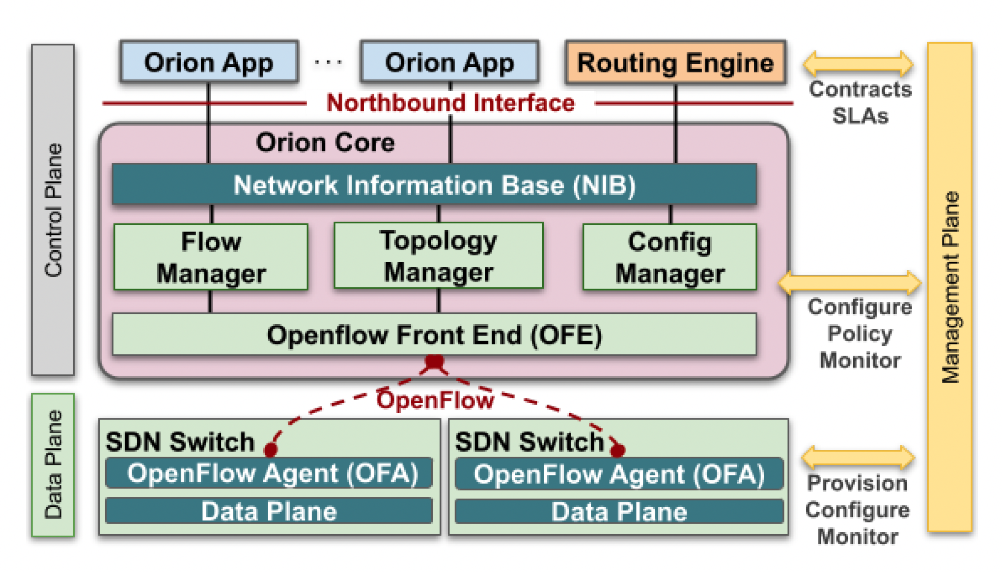
Google ORION SDN control plane
ORION: Google’s SDN control plane (NSDI’21): control plane for Google’s datacenter (Jupiter) and wide area (B4) networks
routing (intradomain, iBGP), traffic engineering: implemented in applications on top of ORION core
edge-edge flow-based controls (e.g., CoFlow scheduling) to meet contract SLAs
management: pub-sub distributed microservices in Orion core, OpenFlow for switch signaling/monitoring
Orion SDN architecture and core apps
Note: ORION provides intradomain services within Google’s network
Notes:
and so in this sense a migration away from “protocols” is indeed underway!
Explain structure of Orion in figure
Repeat after each reveal: no protocol
Coflows: “a collection of flows between two groups of machines with associated semantics and a collective objective”; [Sigcomm’13, Sigcomm’15, Sigcomm’18]. Not unlike multiprocessor scheduling in the 1980’s

Slide 98
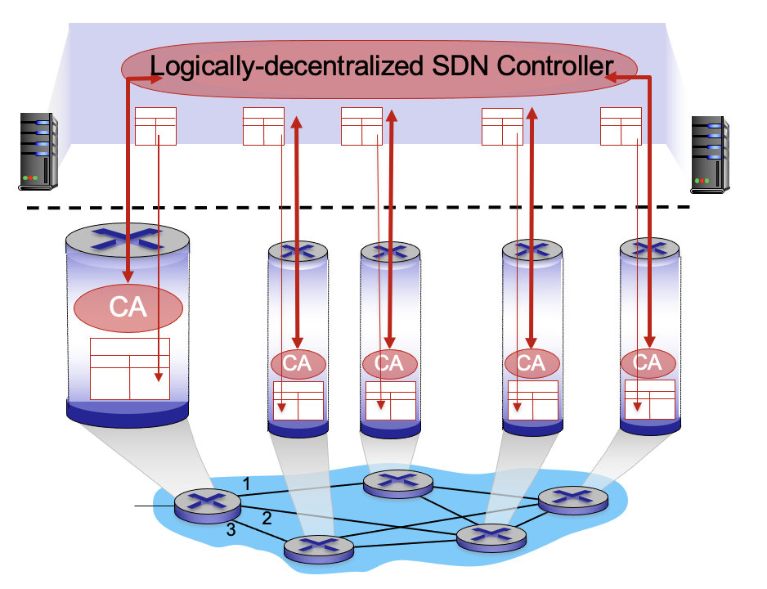

Google, SDN: the value of a logically-centralized abstraction
new opportunities to more formally, intentionally manage configuration
“ ... in a single building or even across a private global WAN such that we[Google] were designing, the location and role of every network element is known ahead of time. So - rather than allowing a node to boot, exchange messages with neighbors, and learn its role in the global network, we knew we could configure the role of all network elements into a logically centralized controller that could then inform all relevant elements of new and changing configurations. This shifted the problem of network management from managing the configuration of individual network elements to managing the configuration of a logical network, dramatically simplifying the problem both from a technical perspective but also from the perspective of the cognitive load on network managers.”∂
https://www.youtube.com/watch?v=qn7d_iK92TI
Amin Vahdat, Engineering Fellow, VP for the Machine Leaning, Systems, and Cloud AI team
Notes:
netPlumber: 1msec to verify an incremental rule change in Google’s backbone network; Veriflow: hundreds of microseconds

Slide 99
SDN: selected challenges
hardening the control plane: dependable, reliable, performance-scalable, secure distributed system
  robustness to failures: leverage strong theory of reliable distributed system for control plane
  dependability, security: “baked in” from day one?
networks, protocols meeting mission-specific requirements
  e.g., real-time, ultra-reliable, ultra-secure
Internet-scaling: beyond a single AS
SDN critical in 5G cellular networks

Slide 100
SDN and the future of traditional network protocols
SDN-computed versus router-computer forwarding tables:
  just one example of logically-centralized-computed versus protocol computed
one could imagine SDN-computed congestion control:
  controller sets sender rates based on router-reported (to controller) congestion levels
How will implementation of network functionality (SDN versus protocols) evolve?

Slide 101
Network layer: “control plane” roadmap
introduction
routing protocols
intra-ISP routing: OSPF
routing among ISPs: BGP
SDN control plane
Internet Control Message Protocol
network management, configuration
  SNMP
  NETCONF/YANG

Slide 102
ICMP: internet control message protocol
used by hosts and routers to communicate network-level information
  error reporting: unreachable host, network, port, protocol
  echo request/reply (used by ping)
network-layer “above” IP:
  ICMP messages carried in IP datagrams
ICMP message: type, code plus first 8 bytes of IP datagram causing error
Type Code description
0 0 echo reply (ping)
3 0 dest. network unreachable
3 1 dest host unreachable
3 2 dest protocol unreachable
3 3 dest port unreachable
3 6 dest network unknown
3 7 dest host unknown
4 0 source quench (congestion
control - not used)
8 0 echo request (ping)
9 0 route advertisement
10 0 router discovery
11 0 TTL expired
12 0 bad IP header

Slide 103

Traceroute and ICMP
3 probes
3 probes
3 probes
source sends sets of UDP segments to destination
  1st set has TTL =1, 2nd set has TTL=2, etc.
datagram in nth set arrives to nth router:
  router discards datagram and sends source ICMP message (type 11, code 0)
  ICMP message possibly includes name of router & IP address
stopping criteria:
UDP segment eventually arrives at destination host
destination returns ICMP “port unreachable” message (type 3, code 3)
source stops
when ICMP message arrives at source: record RTTs

Slide 104
Network layer: “control plane” roadmap
introduction
routing protocols
intra-ISP routing: OSPF
routing among ISPs: BGP
SDN control plane
Internet Control Message Protocol
network management, configuration
  SNMP
  NETCONF/YANG

Slide 105
What is network management?
autonomous systems (aka “network”): 1000s of interacting hardware/software components
other complex systems requiring monitoring, configuration, control:
  jet airplane, nuclear power plant, others?
"Network management includes the deployment, integration
and coordination of the hardware, software, and human
elements to monitor, test, poll, configure, analyze, evaluate,
and control the network and element resources to meet the
real-time, operational performance, and Quality of Service
requirements at a reasonable cost."

Slide 106

Components of network management
Managed device: equipment with manageable, configurable hardware, software components
Managing server: application, typically with network
managers (humans) in the loop
agent
data
managing
server/controller
data
managed device
Data: device “state” configuration data, operational data, device statistics
agent
data
Network management protocol: used by managing server to query, configure, manage device; used by devices to inform managing server of data, events.
agent
data
managed device
managed device
agent
data
agent
data
managed device
managed device

Slide 107
Network operator approaches to management
CLI (Command Line Interface)
  operator issues (types, scripts) direct to individual devices (e.g., vis ssh)
agent
data
managing
server/controller
SNMP/MIB
  operator queries/sets devices data (MIB) using Simple Network Management Protocol (SNMP)
data
managed device
agent
data
agent
data
NETCONF/YANG
  more abstract, network-wide, holistic
  emphasis on multi-device configuration management.
  YANG: data modeling language
  NETCONF: communicate YANG-compatible actions/data to/from/among remote devices
managed device
managed device
agent
data
agent
data
managed device
managed device

Slide 108
SNMP protocol
Two ways to convey MIB info, commands:
data
data
managing
server/controller
managing
server/controller
request
response
trap message
agent
data
agent
data
managed device
managed device
request/response mode
trap mode

Slide 109
SNMP protocol: message types
Message type
Function
GetRequest
GetNextRequest
GetBulkRequest
manager-to-agent: “get me data”
(data instance, next data in list,
block of data).
SetRequest
manager-to-agent: set MIB value
Response
Agent-to-manager: value, response to Request
Trap
Agent-to-manager: inform manager
of exceptional event

Slide 110
SNMP protocol: message formats
Get/set header
Variables to get/set
PDU
type
(0-3)
Error
Status
(0-5)
message types 0-3
Request
ID
Error
Index
Name
Value
Name
Value
….
Trap header
Trap info
PDU
type
4
Trap
Type
(0-7)
message type 4
Enterprise
Agent
Addr
Specific
code
Time
stamp
Name
Value
….
SNMP PDU

Slide 111
SNMP: Management Information Base (MIB)
managed device’s operational (and some configuration) data
gathered into device MIB module
  400 MIB modules defined in RFC’s; many more vendor-specific MIBs
agent
data
Structure of Management Information (SMI): data definition language
example MIB variables for UDP protocol:
Object ID Name Type Comments
1.3.6.1.2.1.7.1 UDPInDatagrams 32-bit counter total # datagrams delivered
1.3.6.1.2.1.7.2 UDPNoPorts 32-bit counter # undeliverable datagrams (no application at port)
1.3.6.1.2.1.7.3 UDInErrors 32-bit counter # undeliverable datagrams (all other reasons)
1.3.6.1.2.1.7.4 UDPOutDatagrams 32-bit counter total # datagrams sent
1.3.6.1.2.1.7.5 udpTable SEQUENCE one entry for each port currently in use

Slide 112
NETCONF overview
goal: actively manage/configure devices network-wide
operates between managing server and managed network devices
  actions: retrieve, set, modify, activate configurations
  atomic-commit actions over multiple devices
  query operational data and statistics
  subscribe to notifications from devices
remote procedure call (RPC) paradigm
  NETCONF protocol messages encoded in XML
  exchanged over secure, reliable transport (e.g., TLS) protocol

Slide 113
NETCONF initialization, exchange, close
managing
server/controller
agent
data
Session initiation,
capabilities exchange: <hello>
data
…
<rpc>
<rpc-reply>
…
…
<rpc>
<rpc-reply>
…
…
<notification>
…
…
<rpc>
<rpc-reply>
…
…
Session close: <close-session>

Slide 114
Selected NETCONF Operations
NETCONF Operation Description
<get-config> Retrieve all or part of a given configuration. A device may have multiple configurations.
<get> Retrieve all or part of both configuration state and operational state data.
<edit-config> Change specified (possibly running) configuration at managed device. Managed device <rpc-reply> contains <ok> or <rpcerror> with rollback.
<lock>, <unlock> Lock (unlock) configuration datastore at managed device (to lock out NETCONF, SNMP, or CLIs commands from other sources).
<create-subscription>, Enable event notification subscription from managed device
<notification>

Slide 115
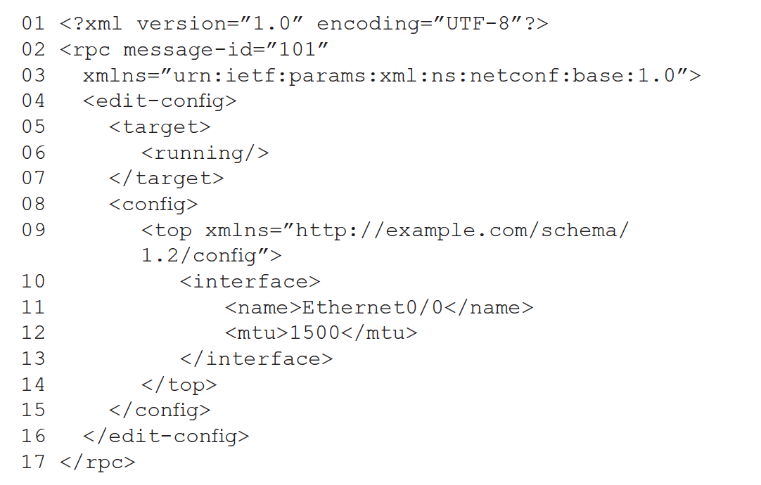
Sample NETCONF RPC message
note message id
change a configuration
change the running configuration
change MTU of Ethernet 0/0 interface to 1500

Slide 116
YANG
data modeling language used to specify structure, syntax, semantics of NETCONF network management data
  built-in data types, like SMI
XML document describing device, capabilities can be generated from YANG description
can express constraints among data that must be satisfied by a valid NETCONF configuration
  ensure NETCONF configurations satisfy correctness, consistency constraints
data
managing
server/controller
NETCONF RPC message
<edit-config>
YANG-generated XML
</edit-config>
YANG
generated
agent
data

Slide 117
Network layer: Summary
we’ve learned a lot!
approaches to network control plane
  per-router control (traditional)
  logically centralized control (software defined networking)
traditional routing algorithms
  implementation in Internet: OSPF , BGP
SDN controllers
  implementation in practice: ODL, ONOS
Internet Control Message Protocol
network management
next stop: link layer!

Slide 118
Network layer, control plane: Done!
introduction
routing protocols
  link state
  distance vector
intra-ISP routing: OSPF
routing among ISPs: BGP
SDN control plane
Internet Control Message Protocol
network management, configuration
  SNMP
  NETCONF/YANG

Slide 119
Additional Chapter 5 slides

Slide 120
Distance vector: another example
D_{x}()
cost to
cost to
x y z
x y z
x
0 2 7
x
0
2
3
y
y
2 0 1
D_{x}(z) = min{c_{x,y}+ D_{y}(z), c_{x,z}+ D_{z}(z)}
= min{2+1 , 7+0} = 3
from
∞
∞
∞
from
z
∞
∞
∞
z
7 1 0
cost to
y
D_{y}()
x y z
2
1
D_{x}(y) = min{c_{x,y} + D_{y}(y), c_{x,z}+ D_{z}(y)}
= min{2+0 , 7+1} = 2
z
x
∞
∞
x
∞
2 0 1
7
from
y
z
∞
∞
∞
D_{z}()
cost to
x y z
x
∞ ∞ ∞
from
y
∞
∞
∞
z
7
1
0
time

Slide 121
Distance vector: another example
D_{x}()
cost to
cost to
cost to
x y z
x y z
x y z
x
0 2 7
x
0
2
3
x
0 2 3
y
y
2 0 1
from
∞
∞
∞
from
y
2 0 1
z
z
from
∞
∞
∞
7 1 0
z
3 1 0
cost to
cost to
cost to
y
D_{y}()
x y z
x y z
x y z
2
1
x
∞
∞
x
0 2 7
x
z
∞
2 0 1
x
0 2 3
7
from
y
y
2 0 1
y
from
from
2 0 1
z
∞
∞
∞
z
7 1 0
z
3 1 0
cost to
cost to
cost to
D_{z}()
x y z
x y z
x y z
x
∞ ∞ ∞
x
0 2 7
x
0 2 3
y
y
2 0 1
from
y
∞
∞
from
2 0 1
from
∞
z
z
3 1 0
z
3 1 0
7
1
0
time

