Slide 1
Log File Analysis & Reporting System
A project to analyze web server logs
By Anuja Kanse

Slide 2
Project Overview
- Read Apache log files line by line
- Extract useful fields using regex
- Store data into MySQL database
- Run CLI commands to get reports
- Real-world simulation of data engineering task

Slide 3
Key Features
This project reads website log files.
- It saves the data (like IP address, time, error) into a database.
- We can create reports to see who visited the site most, what errors happened,
and when people visited.
- We show these reports in the terminal and also with charts.
- It helps us understand how the website is used and what problems happened.

Slide 4
Project File Structure
- main.py : CLI interface and logic
- log_parser.py : Regex-based parser
- mysql_handler.py : MySQL DB operations
- config.ini : DB credentials
- create_table.sql : SQL schema
- access.log : Sample log file

Slide 5
Database Schema
- log_entries : stores parsed log details
- user_agents : stores unique user agents
- Foreign key : log_entries → user_agents
- Indexed fields : IP, timestamp, status_code

Slide 6
CLI Commands
- process_logs access.log → parse & store
- generate_report top_n_ips --n 5
- generate_report error_types
- generate_report peak_hour
- generate_report operating_systems

Slide 7
Sample Log Format
- Extracted fields:
• IP Address
• Timestamp
• HTTP Method and Path
• Status Code and Bytes Sent
• Referrer and User Agent

Slide 8
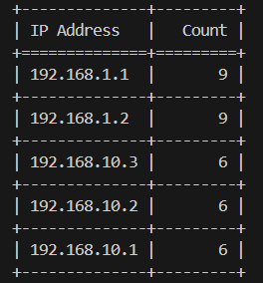
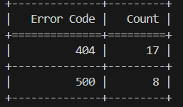
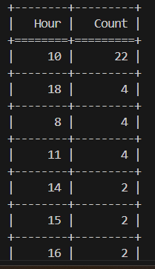
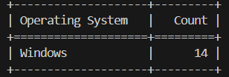
Sample Outputs:

Slide 9
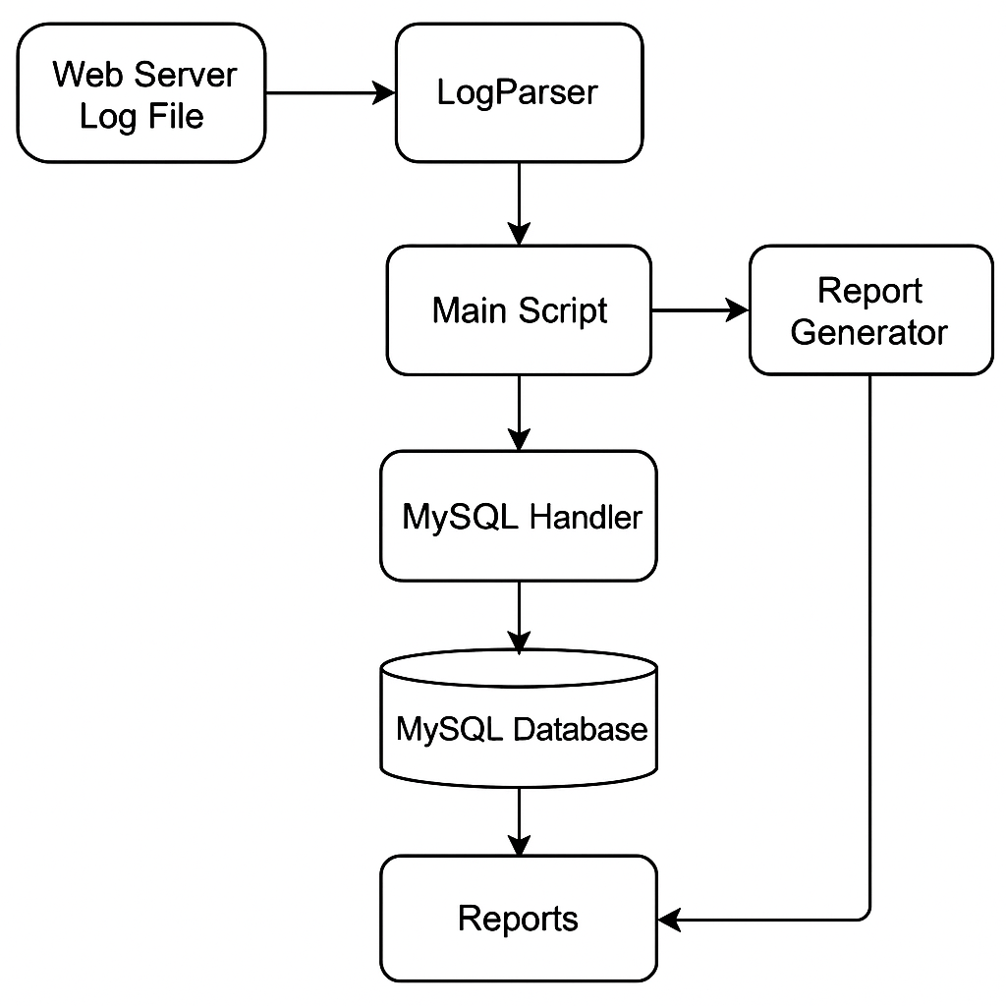
Data Flowchart:

Slide 10
Conclusion
- Clean and simple project for log analysis
- Uses only basic Python libraries and MySQL
- Extensible and good for beginners
- Helps in learning real-world data processing

Slide 11
THANK YOU

