Slide 1

Project 2
Housing Price Prediction
By: Happy Three Friends Group

Slide 2




Who are we?
KANT
MINK
TONZAI

Slide 3

Happy Three Friends Property Agency
We are seeking new opportunity in Ames, Iowa
(aka Happy Trees Town)
Studying dataset for property investment to match client’s need
Low price-sale
Average price-sale
High price-sale

Slide 4

Problem Statement
Invent model to evaluate proper price of the property
according to appointed features
Matching property features and clients
RMSE score is used as key indicator in this project

Slide 5

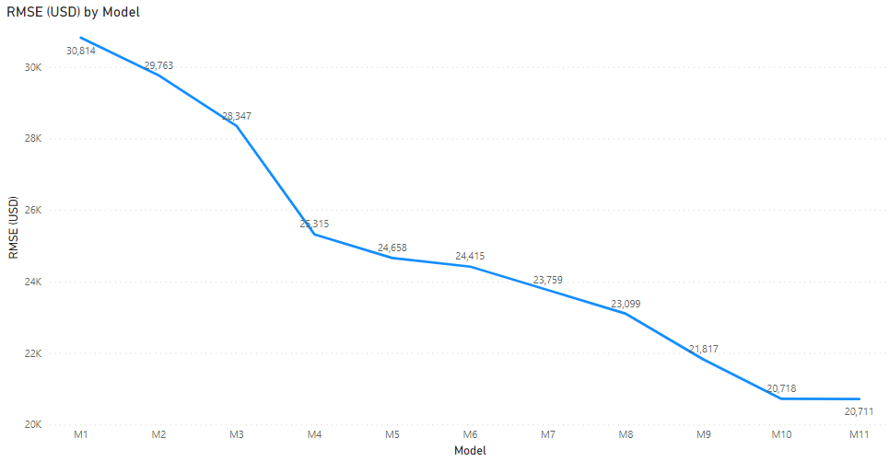
Our Model Journey
Correlation-based
Features selection
RMSE : 30,814
LASSO CV
RMSE 28,347
Log Transformation
RMSE : 21,817
Ridge Regularization
RMSE : 20,711
Dummy Numerical
RMSE : 25,315
Outlier Management
RMSE : 23,759

Slide 6

PROCESS IN THIS PROJECT
by our pure genuine geniusness of our triple brains could’ve ever done

Slide 7

DATA PIPELINE
IMPORT
OUTLIER MANAGEMENT
ENCODING
MODEL TRAINING
Load “AMES Housing Price” Data.
Drop the outlier in the “Sale Price-correlated Feature”
Apply “ONE HOT ENCODING” to categorical-like feature.
Apply the “Ridge Regularizer” to reduce model complexity and prevent overfitting.
CLEANING
LOG TRANSFORMATION
STANDARDIZATION
Mange missing value by following Strategy – “Drop Large Columns, Mean/Mode Imputation”
Scales the feature using Standard Scale to reduce differences in magnitude between features.
Apply Log Transformation to “Sale Price” to reduce skewness.

Slide 8
Read data and EDA
IMPORT
OUTLIER MANAGEMENT
ENCODING
MODEL TRAINING
Load “AMES Housing Price” Data.
Drop the outlier in the “Sale Price-correlated Feature”
Apply “ONE HOT ENCODING” in categorical-like feature.
Apply the “ Ridge Regularizer” to reduce the overfit of traditional Linear Regression.
CLEANING
LOG TRANSFORMATION
STANDARDIZATION
Mange missing value by following Strategy – “Drop Large Columns, Mean/Mode Imputation”
Scale the feature into Standard Scale to reduce imbalance span between features.
Apply Log Transformation in “Sale Price” to reduce skewness.

Slide 9
Outliers Management
IMPORT
OUTLIER MANAGEMENT
ENCODING
MODEL TRAINING
Load “AMES Housing Price” Data.
Drop the outlier in the “Sale Price-correlated Feature”
Apply “ONE HOT ENCODING” in categorical-like feature.
Apply the “ Ridge Regularizer” to reduce the overfit of traditional Linear Regression.
CLEASING
LOG TRANSFORMATION
STANDARDIZATION
Mange missing value by following Strategy – “Drop Large Columns, Fill NA and Imputation”
Scale the feature into Standard Scale to reduce imbalance span between features.
Apply Log Transformation in “Sale Price” to reduce skewness.

Slide 10
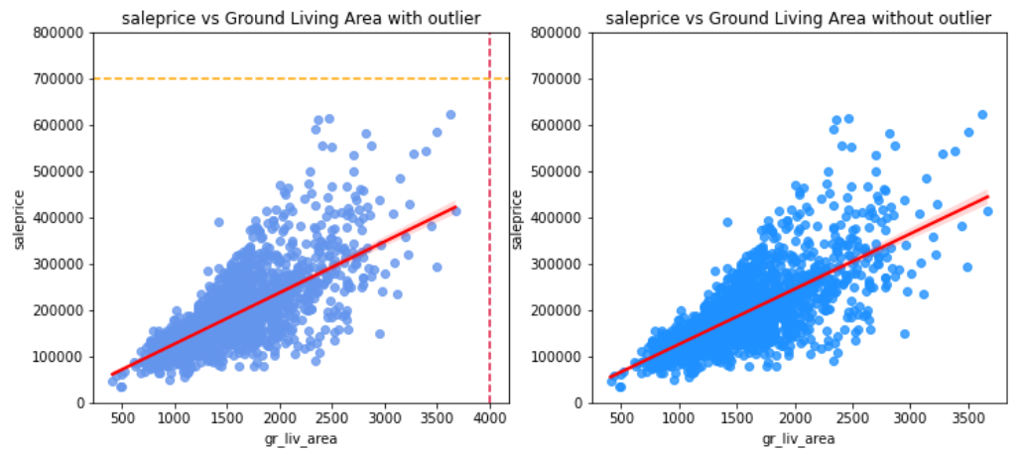
Outliers Management
Outlier Elimination by distance to improve model performance

Slide 11
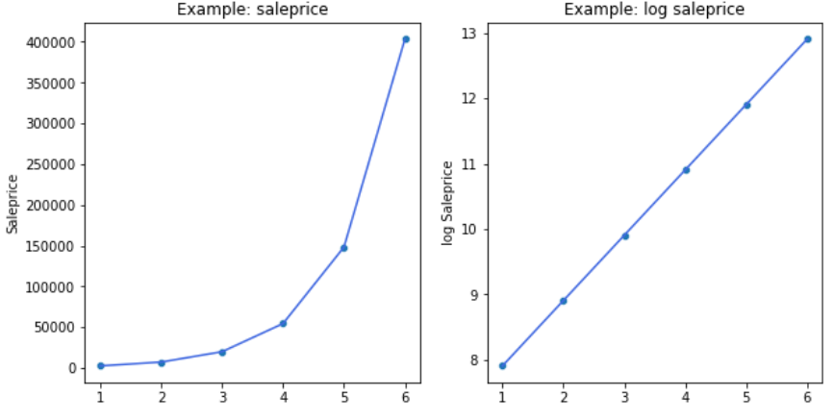
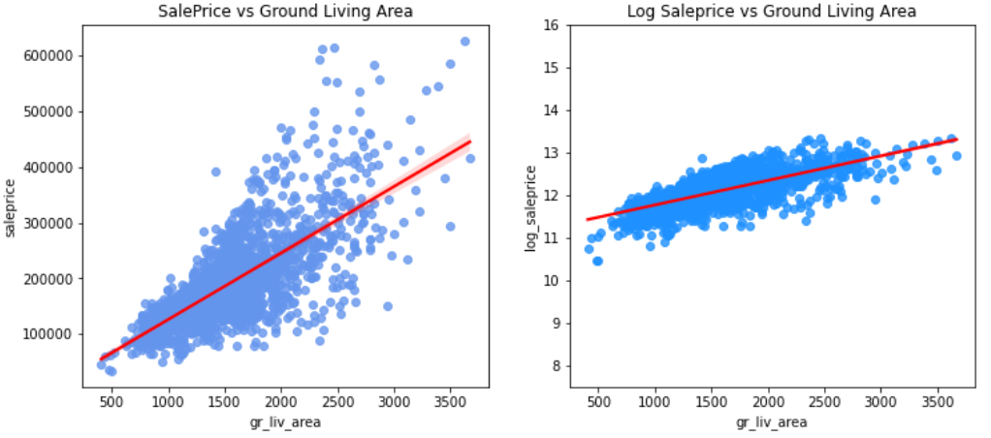
Log Transformation
IMPORT
OUTLIER MANAGEMENT
ENCODING
MODEL TRAINING
Load “AMES Housing Price” Data.
Drop the outlier in the “Sale Price-correlated Feature”
Apply “ONE HOT ENCODING” in categorical-like feature.
Apply the “ Ridge Regularizer” to reduce the overfit of traditional Linear Regression.
Log Transformation
to rescale the Sale Price into normalized scale and equalize Sale Price variance. .
CLEASING
LOG TRANSFORMATION
STANDARDIZATION
Mange missing value by following Strategy – “Drop Large Columns, Fill NA and Imputation”
Scale the feature into Standard Scale to reduce imbalance span between features.
Apply Log Transformation to “Sale Price” to reduce skewness.

Slide 12
Selected features: All numeric columns
MODEL TRAINING
Correlation-based
Feature selection
IMPORT
OUTLIER MANAGEMENT
ENCODING
Apply the “Ridge Regularizer” to reduce model complexity and prevent overfitting.
Load “AMES Housing Price” Data.
Drop the outlier in the “Sale Price-correlated Feature”
Apply “ONE HOT ENCODING” in categorical-like feature.
Dummy Numerical
Outlier Management
CLEASING
LOG TRANSFORMATION
STANDARDIZATION
Mange missing value by following Strategy – “Drop Large Columns, Fill NA and Imputation”
Scales the feature using Standard Scale to reduce differences in magnitude between features.
Log Transformation
Apply Log Transformation in “Sale Price” to reduce skewness.
Ridge Regularization

Slide 13


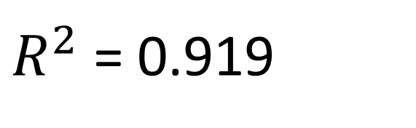
Model Training and Evaluation
BEST MODEL
RMSE = 20,956
MODEL TRAINING
$R^{2}$ = 0.919
Apply the “ Ridge Regularizer” to reduce the overfit of traditional Linear Regression.
REGULARIZATION
STANDARDIZATION
To better optimize the penalization for lower range (log scale).
Scale the feature into Standard Scale to reduce imbalance span between features.

Slide 14



SUMMARY
Price Prediction could personalize the customer demand.
Housing Price feature could be optimized between model performance and cost of Data Storage.
Better Performance improve ROI for 28%.

Slide 15




RECOMMENDATION
FEATURE CUSTOMIZATION
To explore More predictively powerful algorithms.
To Customize key features based on individual city.
To Expand new opportunities in other cities in the U.S. and the world.

Slide 16

Thank you
for your attention

