Slide 1
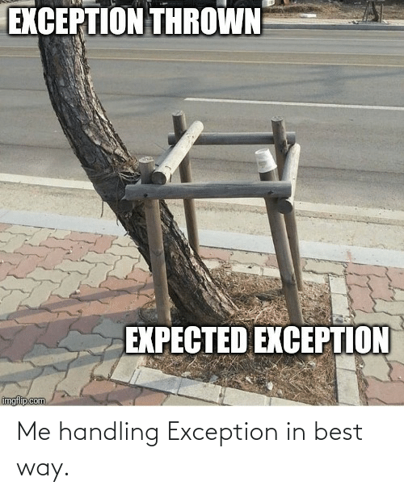
Python
Assertions
&
Exceptions
4.11.2022

Slide 2
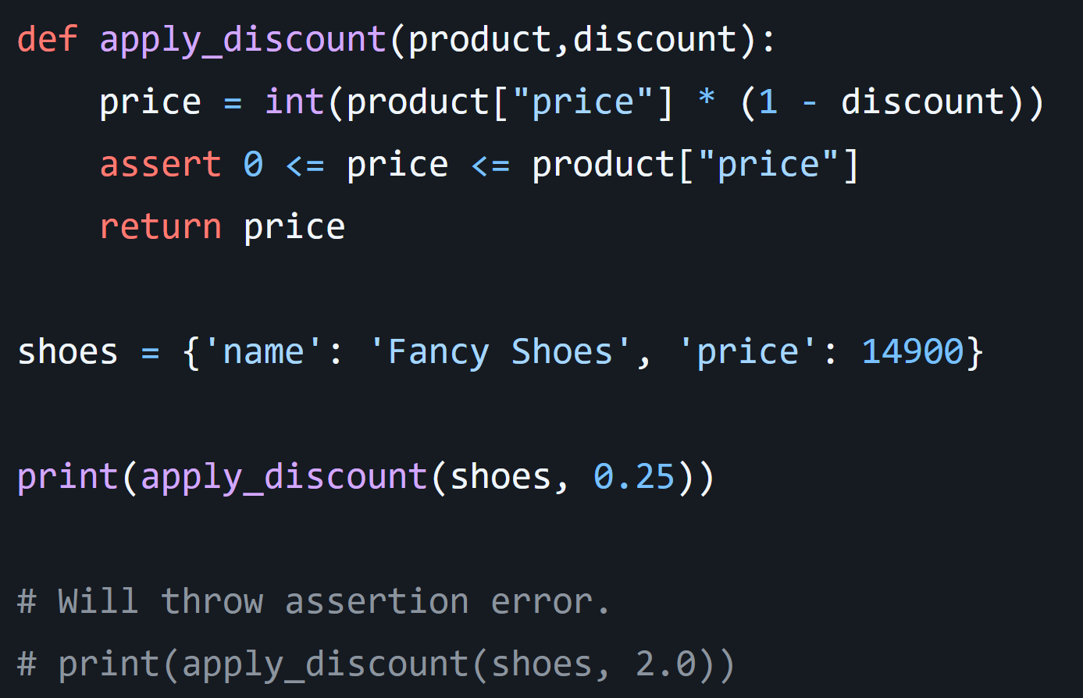
Assertions
İndirim uygula.
Code is Here! - Try it Here!
Assertlerin doğru kullanımı, geliştiricilere bir programdaki kurtarılamayan hatalar hakkında bilgi vermektir.
Assertions, programınız içinde dahili kendi kendine kontroller anlamına gelir.
They work by declaring some conditions as impossible in your code.

Slide 3
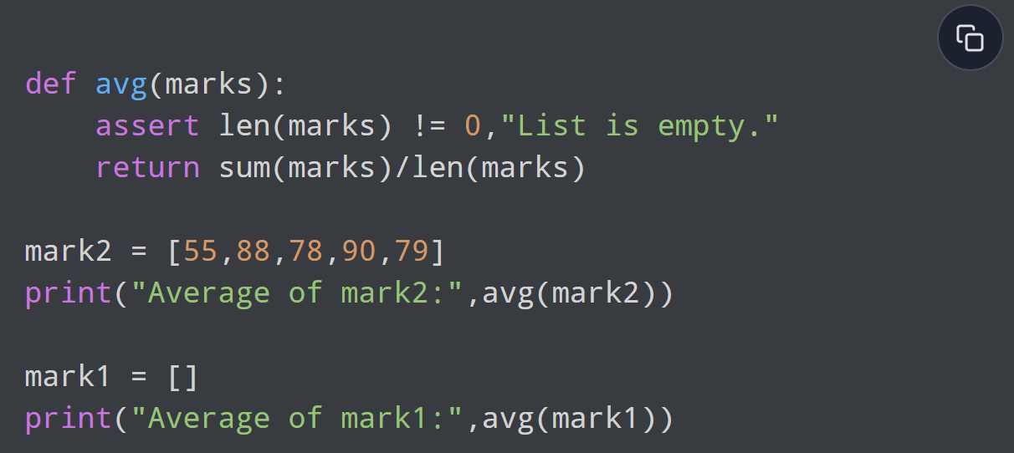
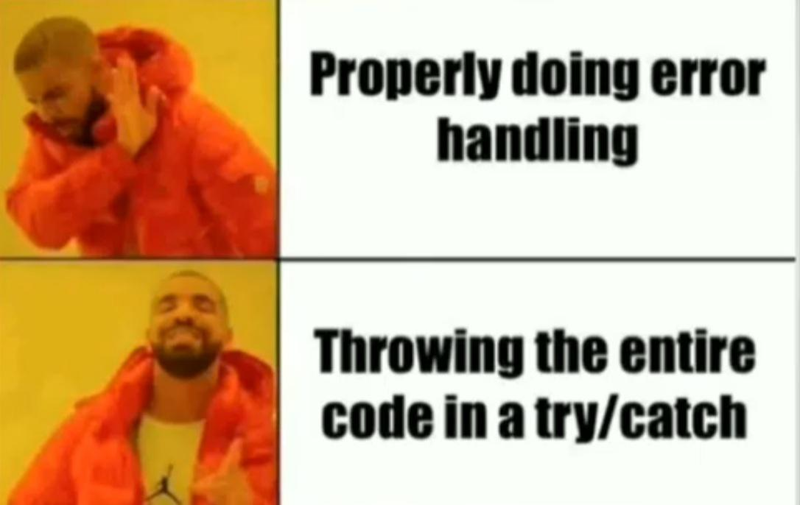
More Assertion Examples
Listenin ortalamasını al.
How can we explain it better?
IN A TRY EXCEPT BLOCK!

Slide 4

Exceptions
try:
from ui.tools.logger import ReadLogger
logger = ReadLogger.getlogger()
except Exception as e:
print (“Exception here!”)

Slide 5


Difference between Syntax Error and Exceptions
Syntax Error
Exceptions
amount = 10000
# check if you can purchase Nike Shoes
if(amount > 2999)
print("No =)")
# initialize the amount variable
marks = 10000
# perform division with 0
a = marks / 0
print(a)

Slide 6
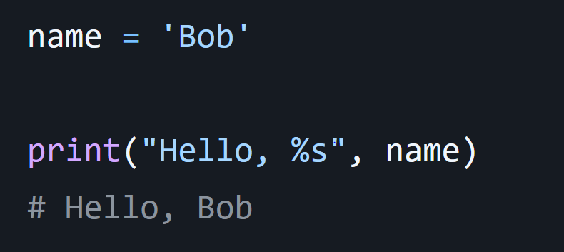
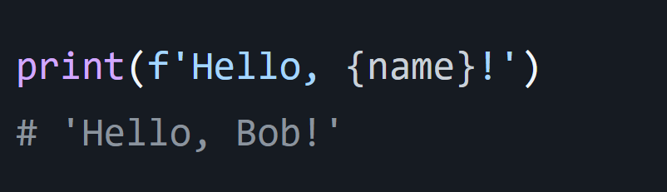
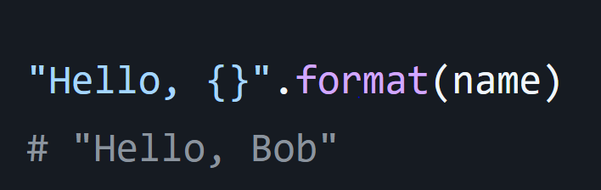
Small Note
Most Optimized String Formatting
There are 4 major ways to do string formatting in Python. Kinda unreal and go against Zen of Python for sure.
f-strings are better, faster, stronger. So use them whenever you can.

Slide 7
L
Third

Slide 8
Run
Third

Slide 9
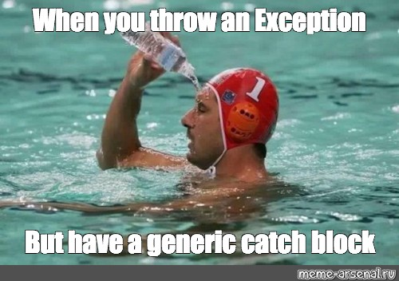
Reddit
YT

Slide 10


