Slide 1

User Management
From Spring boot
Kantee Charoensedtasin 59122040-5

Slide 2
What is project have?
Use Thymeleaf engine for display webpage
Use bootstrap for decoration webpage
Use Spring security for login to system
Connect to Database to get user list and authenticate with spring security
Display list of user and name
Pagination for wrap data content

Slide 3
Login Page
Create custom login form
On the login use Bcrypt instead of MD5. new version of springboot replace with Bcrypt method for encryption.

Slide 4
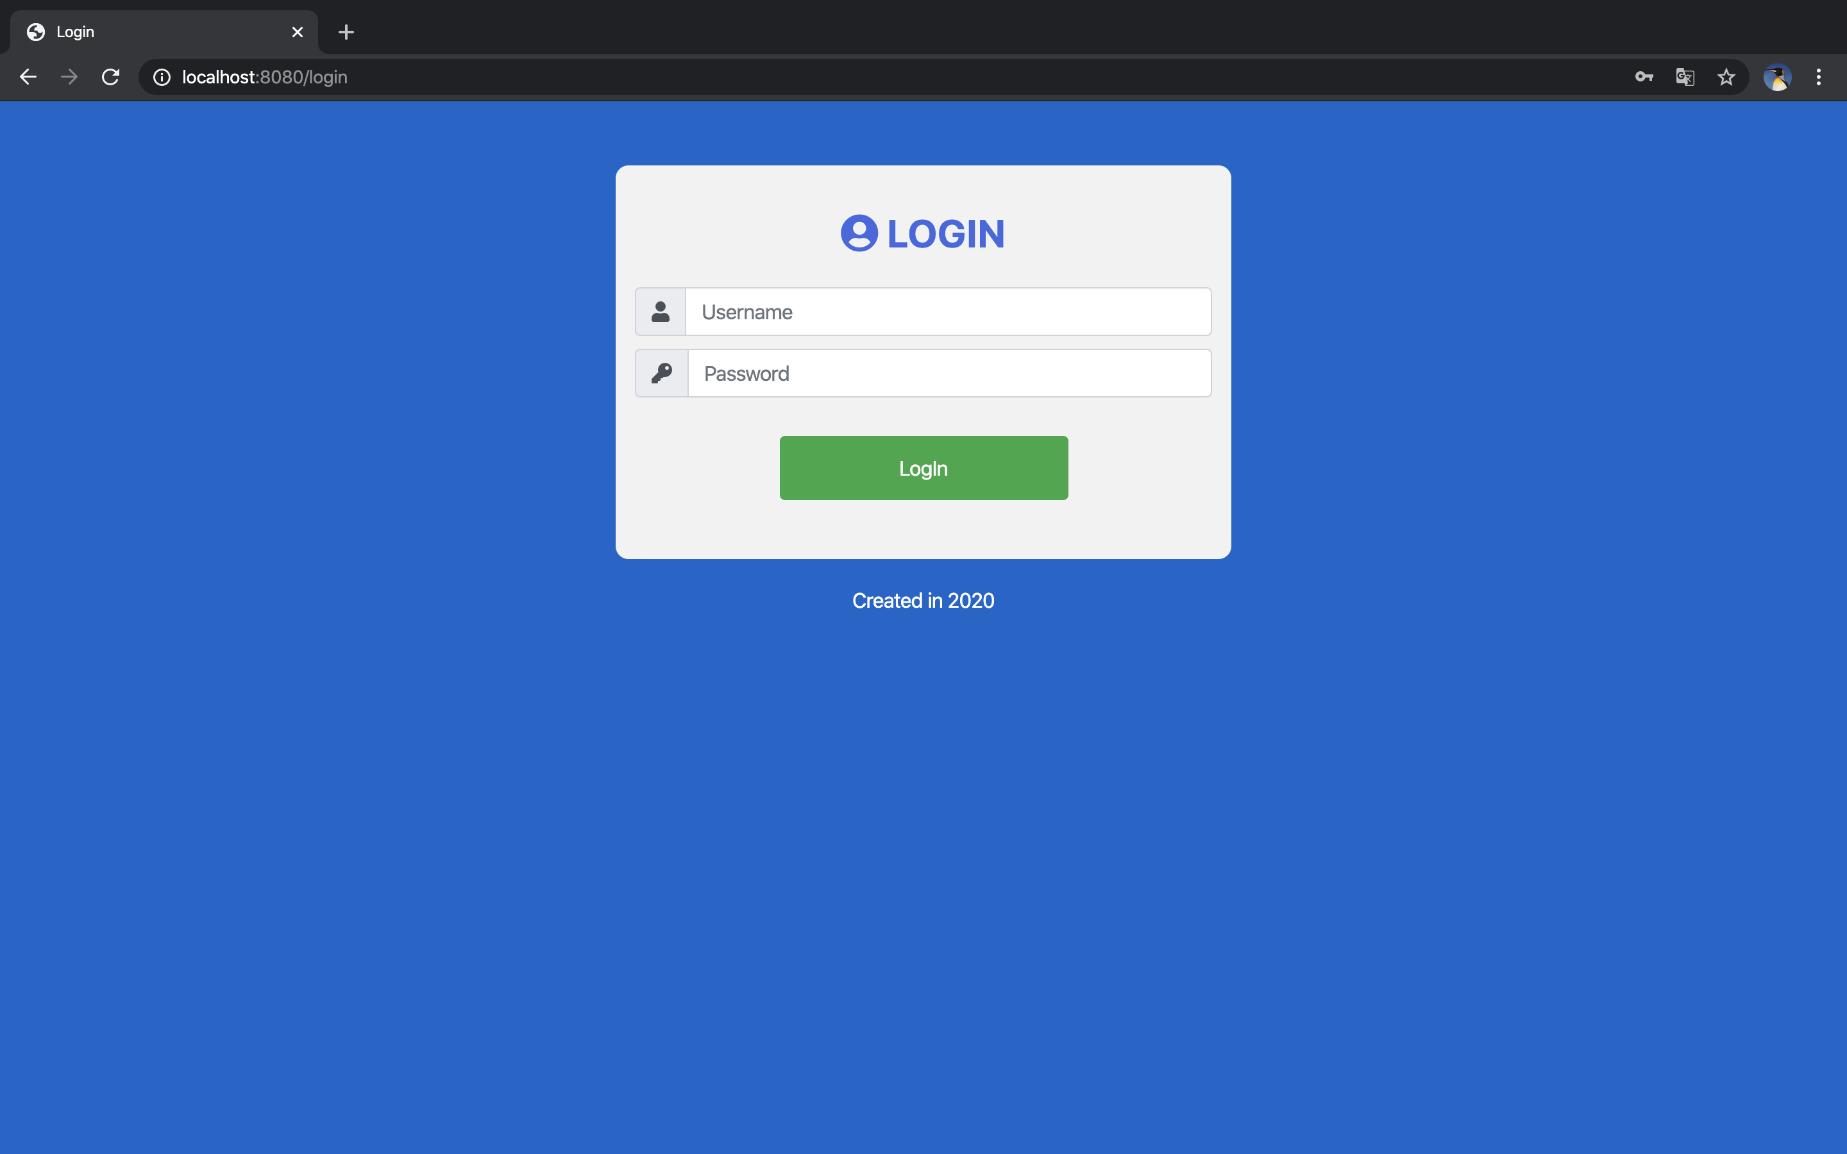
Login page
Custom login Spring security
Matching Username and password from database

Slide 5
User page
Session username
Use bootstrap decoration webpage
Get user data from database mysql
Display the users list
Pagination wrap content data
Pagination can click next or previous page
Pagination can go first and last page

Slide 6
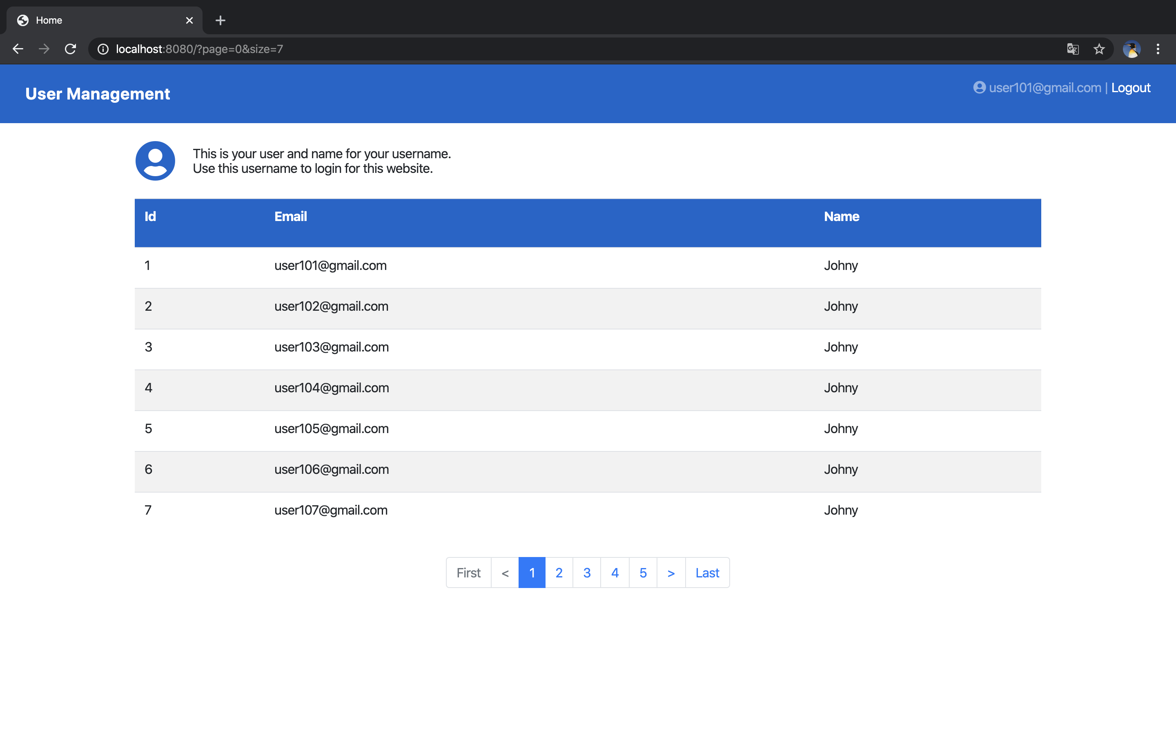
User page
Current Username Session
Table Show Username from database
Pagination for many data

Slide 7
Result for project
Can display list of users
Can use spring security login to website
Create login page with custom spring security
Can display email login
Using Pagination to manage with many users not too long
Can apply these feature for future

Slide 8
Thank You

