Slide 1

SMART INDIA HACKATHON 2026
TITLE PAGE
• Problem Statement ID - [ Insert your official SIH Problem Statement ID ]
• Problem Statement Title - AI-Based Digital Quality Grading & Price Estimation System for Agricultural Produce (Onion) using Computer Vision
• Theme - Agriculture, FoodTech & Rural Development
• PS Category - Software
• Team ID - [ Insert your Team ID ]
• Team Name - GradeLens
Detect → Classify → Grade → Price → Report

Slide 2
PROPOSED SOLUTION
GradeLens
GradeLens — AI-Powered Onion Quality Grading System
THE ISSUE
OUR SOLUTION
WHAT'S DIFFERENT
• Manual grading at mandis depends on whichever inspector is on duty that day - two people can look at the same crate and call two different grades.
• There's no record of how a grading decision was reached, so a farmer who disagrees has nothing to point to.
• Most "AI grading" demos classify the whole photo at once, which breaks down the moment a real crate is a mix of good and bad onions.
• Undersized onions are a genuine grading factor too, but no vision model can "see" real-world size without a reference scale in frame.
• Point a phone at the batch - one onion or a full crate - through a camera-first app; no menu between opening it and taking the shot.
• A YOLO26n model, fine-tuned on our own labelled onion photos, finds every onion in the frame and tags each one Healthy, Damaged, Rotten, or Sprouted with a confidence score.
• Grade-A % = healthy ÷ total detected; a configurable rule maps it to Grade 1 (≥80%), Grade 2 (≥60%), or URS.
• A separate pricing rule applies a per-grade adjustment on a base Rs./quintal figure.
• An optional pixels-per-cm calibration (using a reference object in frame) turns on real undersized detection.
• Every run is saved - original photos, annotated photos, and a downloadable PDF report - so the grade can be checked later, not just trusted blindly.
• It counts onions individually instead of guessing a single grade for the whole photo.
• Grading and pricing rules live in a settings file, outside the model - a threshold changes in a minute, with no retraining.
• Below a 65% average-confidence threshold, the app flags the result for manual review instead of quietly giving an answer anyway.
• One photo or ten - the app decides single vs. batch from how many photos end up in the list, not from a mode you pick first.
• The backend auto-loads whichever trained model file is newest, so shipping a better model is a file drop, not a redeploy.
• Same FastAPI backend, two clients: a native Flutter app and a plain installable web page.
@SIH Idea submission- Template
2

Slide 3
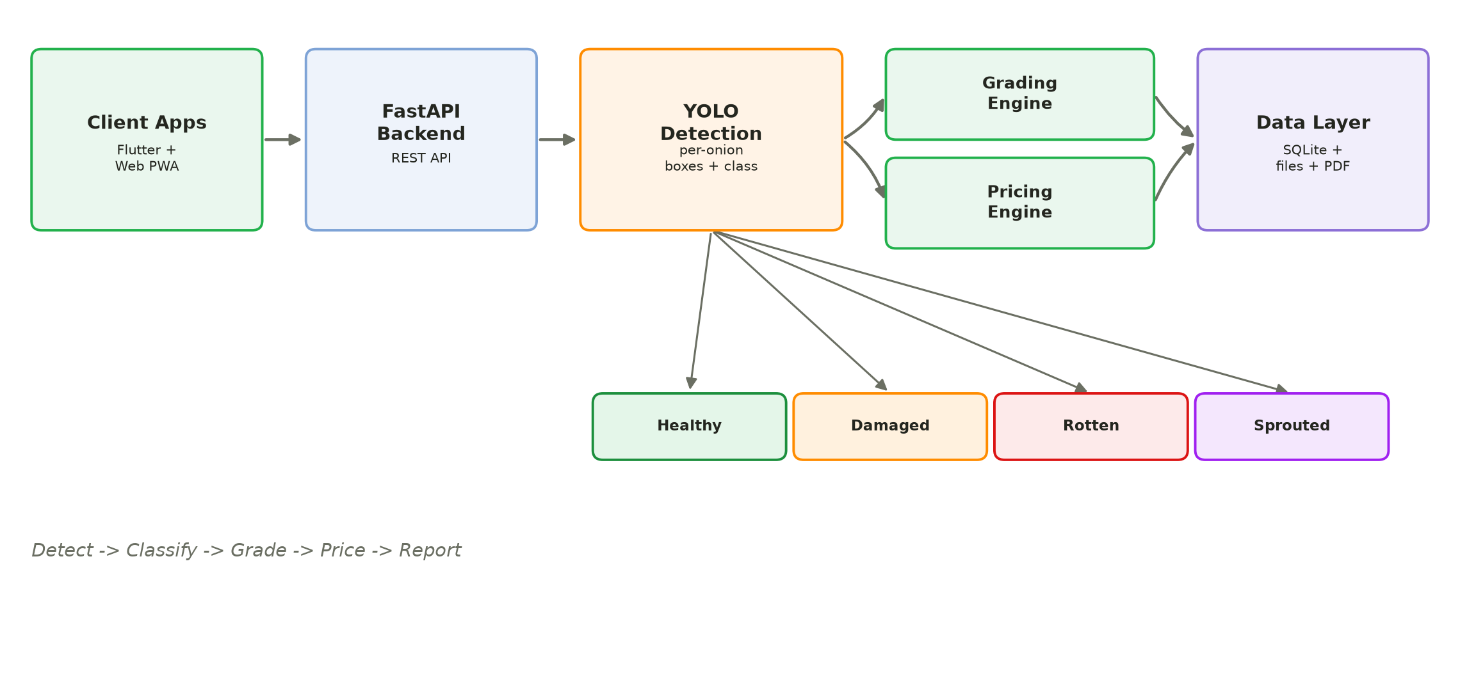
TECHNICAL APPROACH
GradeLens
THE AI ALGORITHM
• YOLO26n (Ultralytics), fine-tuned across several rounds on our own labelled onion photos rather than used off the shelf.
• One forward pass both finds and classifies every onion - box + class + confidence together, no separate cropping step.
• Detection confidence 0.25, IoU 0.45 for box merging, both configurable per deployment.
• Chosen over whole-image classification because a batch photo has many onions in it, each needing its own answer.
• Grading and pricing are ordinary Python, on purpose - a model deciding the price would be much harder to audit than a rule anyone can read.
Stack: Flutter + web PWA (client) · FastAPI + Uvicorn (backend) · Ultralytics YOLO26n / PyTorch · SQLite · ReportLab (PDF)
Measured (held-out validation set): damaged ~98% precision / 92% recall · healthy ~72% · rotten and sprouted improving each retraining round
@SIH Idea submission- Template
3

Slide 4
FEASIBILITY AND VIABILITY
GradeLens
FEASIBILITY
• Already working end to end on an ordinary phone camera - nothing exotic on the hardware side.
• AI, grading, and pricing are three separate pieces, so each improves on its own.
• Backend auto-loads whichever trained model is newest - no redeploy to ship a better one.
HOW WE'RE ADDRESSING THEM
• Retraining on corrected, better-labelled data as we collect more of it - already gone through several rounds mid-project.
• Below a 65% average-confidence threshold, the app flags the result for a human to double-check instead of trusting it outright.
• Simple in-app tips on how to take a usable photo - real batch, moderate spacing between onions.
• Grading and pricing thresholds are editable by an admin, so grades can be tuned to whatever spec procurement actually uses.
• Roadmap: on-device/edge inference for procurement centres with weak connectivity.
CHALLENGES
• A very crowded, overlapping crate photo is still hard for the model to fully count.
• Rotten and sprouted are the classes with the least real training data.
• No offline mode yet - the phone has to reach the backend.
• Getting procurement staff to trust an AI-assisted call over their own eye takes time.
@SIH Idea submission- Template
4

Slide 5
IMPACT AND BENEFITS
GradeLens
SOCIAL
ECONOMIC
GOVERNANCE
• Takes the guesswork out of a decision that currently depends on who happens to be inspecting.
• A photo-backed PDF report gives a farmer something concrete if they want to question a grade.
• Same Grade 1 / Grade 2 / URS standard applies no matter which centre or which inspector is on duty.
• Confidence-gated results mean an uncertain call gets flagged for a human, not silently accepted.
• Fewer disputes over price because the grade is traceable back to an actual photo and a fixed rule, not a person's memory.
• A batch gets inspected in the time it takes to take a few photos, so more batches move through a centre in a day.
• History of past inspections (stored per batch in SQLite) builds into real data on quality and pricing trends over time.
• Base price and per-grade adjustment % are both editable, so the estimate can track a live market feed instead of a fixed number.
• Fits the direction procurement digitisation is already heading in.
• Every grading decision is logged with its photos and the settings snapshot used at the time - reproducible for an audit.
• Grading/pricing values are explicitly labelled as configurable prototype figures in the app and PDF, not asserted as official rates.
• Rules stay editable, so the system can be brought in line with an official spec whenever one applies, rather than being locked to guesses.
@SIH Idea submission- Template
5

Slide 6
RESEARCH AND REFERENCES
GradeLens
1. Feature-adaptive anomaly detection model for onion inspection system
https://www.sciencedirect.com/science/article/pii/S2772375525002163
2. YOLO-ODD: an improved YOLOv8s model for onion foliar disease detection
https://www.ncbi.nlm.nih.gov/pmc/articles/PMC12137250/
3. A systematic review of deep learning-based object detection methods for crop grading
https://www.cabidigitallibrary.org/doi/10.1079/ab.2025.0060
4. YOLOPears: multi-class pear surface defect detection in quality grading systems
https://pmc.ncbi.nlm.nih.gov/articles/PMC11873076/
5. Onion Classification using Color and Convolutional Neural Network
https://www.researchgate.net/publication/376202839_Onion_Classification_using_Color_and_Convolutional_Neural_Network
YouTube demo: [ Insert demo video link ]
GitHub repository: [ Insert repository link ]
Live app: [ Insert deployed link ]
@SIH Idea submission- Template
6

