Slide 1
MuleSoft API Gateway
Architecture for Citizens-Data APIs
Federated edge over SaaS, with private connectivity to the on-prem Microsoft integration stack
Prepared by the Integration Architecture team
v1.0

Slide 2
Synopsis — Why we are doing this
Problem statement, scope, and the decision drivers
• We need a managed API edge for the new citizens-data APIs — security, rate limiting, observability, contract enforcement.
• Orchestration, message transformation, and EDI mediation already run on the existing on-prem Microsoft stack — MuleSoft should NOT replicate that.
• Both internal consumers (employees, internal apps) and external consumers (partners, public portals) must hit the same gateway with appropriate policy isolation.
• Initial scale: 100,000 calls/day with realistic growth toward 1M+ in 24 months — pick a topology that survives that range.
• Hard requirement: API traffic between the gateway and on-prem must NOT traverse the public internet.
• Strong preference: SaaS — minimize infrastructure operations burden, inherit MuleSoft's compliance posture (SOC 2, FedRAMP Mod) for citizen data.
• Identity federation aligned with corporate IdP (Entra ID / Okta); no second user store.
Bottom line: Anypoint Flex Gateway in Connected mode, on a private MuleSoft-managed cloud space, with private connectivity back to on-prem.
MuleSoft API Gateway Architecture — Citizens-Data APIs
2 / 10

Slide 3
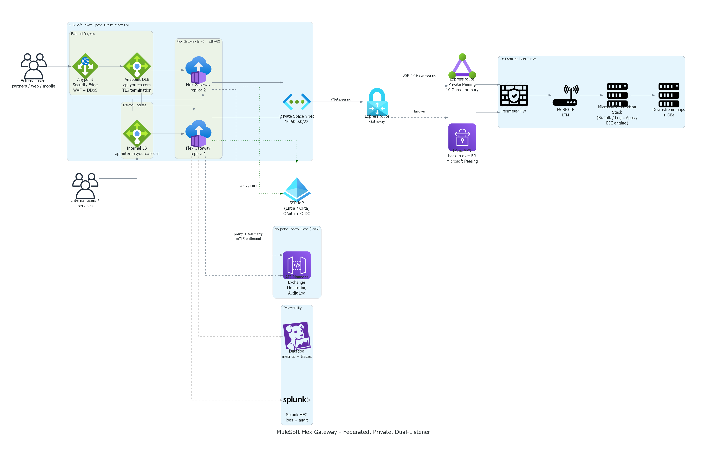
Architecture overview
Federated, dual-listener, private — Anypoint control plane + Private Space data plane
Highlights
• Anypoint control plane (SaaS) — policy, catalog, monitoring; never sees data path
• Private Space data plane — dedicated runtime in MuleSoft-managed cloud
• Two listeners: external (WAF + DLB) and internal (private LB) on the same Flex Gateway
• JWT for external, mTLS for internal — separate policy bundles
• Private connectivity (ExpressRoute or Direct Connect) — no public internet on data path
• Independent IdP federation — Entra ID / Okta
• Dual-shipped observability — Anypoint + Splunk + Datadog
MuleSoft API Gateway Architecture — Citizens-Data APIs
3 / 10

Slide 4
Recommended product — Anypoint Flex Gateway (Connected mode)
Why Flex Gateway, not full Mule runtime
• Purpose-built API gateway — Envoy proxy core wrapped with MuleSoft's policy framework. Not a full integration runtime forced into a gateway role.
• Lightweight runtime — about 50 MB process footprint vs about 1 GB for a Mule runtime worker. Cold start under 5 seconds.
• Single-digit millisecond overhead per request with the full security policy chain attached (JWT + rate limit + schema validation).
• Hot policy reload — change a policy in API Manager and it goes live in seconds, no restart, no traffic drop.
• Cloud-agnostic single binary — runs on Linux, Docker, EKS, AKS, OpenShift, or CloudHub 2.0. Same image everywhere.
• Centrally managed from Anypoint Platform — policy catalog, SLA tiers, analytics, audit log — without writing your own control plane.
Why this for us
Gateway-only role (MS stack does orchestration / transformation / EDI) + private-cloud requirement + SaaS preference + citizen-data sensitivity = Flex Gateway in Connected mode on a Private Space is the lowest-friction, lowest-ops fit.
MuleSoft API Gateway Architecture — Citizens-Data APIs
4 / 10

Slide 5
Flex Gateway vs Full Mule Runtime — side by side
Same vendor, very different products; pick the role that fits
Aspect | Anypoint Flex Gateway | Full Mule Runtime
Primary role | API gateway / edge proxy | Integration runtime + API gateway
Core technology | Envoy proxy (CNCF, battle-tested) | JVM-based Mule engine
Footprint per replica | ~50 MB process | ~1 GB JVM worker
Cold start | < 5 seconds | 30–60 seconds
Per-request overhead (full policies) | Single-digit ms | 10–30 ms
DataWeave transformation | Not available (by design) | Native, first-class
Orchestration / Flows / connectors | Not available | Full capability
Custom logic extensibility | WebAssembly filters (Rust / Go / AssemblyScript) | Java + Groovy + DataWeave
Policy hot reload (no restart) | Yes | Limited — often requires app redeploy
Deployment substrate | Linux / Docker / K8s / CloudHub 2.0 | CloudHub / Runtime Fabric / on-prem JVM
Pricing per replica | Lower (smaller vCore consumption) | Higher
Best fit for our scope | ✔ Pure API edge — our chosen role | Overkill when no integration logic is needed
MuleSoft API Gateway Architecture — Citizens-Data APIs
5 / 10

Slide 6
Network — no public internet on data path
Components to provision for fully private connectivity, internal + external
Component | Provisioned by | Purpose
CloudHub 2.0 Private Space (centralus or AWS region) | MuleSoft | Dedicated runtime VPC/VNet for the Flex Gateway data plane
Anypoint Dedicated Load Balancer (DLB) | MuleSoft | Public custom domain + TLS termination for external listener
Anypoint Security Edge (WAF + DDoS) | MuleSoft | Threat protection on the external listener
Internal Load Balancer (private only) | MuleSoft + Customer DNS | Internal listener reachable only via private network
ExpressRoute Private Peering (Azure) OR Direct Connect + Transit Gateway (AWS) | Customer + Carrier | Primary private link from MuleSoft cloud to on-prem
Site-to-Site IPsec VPN over ER Microsoft Peering / DX Public VIF | Customer | Warm failover path — encrypted, also private
VNet peering (Azure) or VPC/TGW peering (AWS) to MuleSoft Private Space | Customer | Network adjacency between customer cloud and MuleSoft cloud
Customer-side ExpressRoute Gateway / Transit Gateway | Customer Network Team | BGP termination of the private circuit
Private DNS zone link into MuleSoft Private Space | Customer | Backend hostname resolution (e.g. biztalk-prod.internal.yourco)
TLS / mTLS certificates (public CA + internal CA) | Customer PKI | Edge TLS, mTLS for internal listener, mTLS to backend
Firewall rules — allow Private Space CIDR → MS stack on 443 | Customer Network Team | Inbound to on-prem from the gateway only
Splunk HEC private endpoint + Datadog Agent in VPC | Customer | Observability dual-ship without leaving the private network
MuleSoft API Gateway Architecture — Citizens-Data APIs
6 / 10

Slide 7
Capacity planning — 5M calls/day
Traffic math, replica sizing, headroom, and indicative Prod cost
Traffic math
Recommended Prod configuration
Metric | Value
Daily volume | 5,000,000 calls
Average TPS (24h) | ~58
Business-hours avg TPS (8h, 70% concentration) | ~120
Peak TPS (5× business average) | ~600
Worst-case spike (10× business average) | ~1,200
Headroom over spike with recommended config | ≈ 2×
Setting | Value
CH 2.0 deployment size | 0.2 vCore per replica
Replica count | 4 (multi-AZ)
Auto-scaling | Enabled — min 4 / max 8
Scale trigger | CPU > 55% over 5 min
Anypoint DLB | 1 (shared by both listeners)
Security Edge (WAF) | On — external listener only
Anypoint Monitoring tier | Titanium
Indicative monthly cost — Prod only (list pricing)
Line item | Monthly (approx)
4× Flex Gateway replicas @ 0.2 vCore | $1,600 – $3,200
Private Space base fee | $1,500 – $3,000
Dedicated Load Balancer | $250
Anypoint Monitoring (Titanium) | $800 – $1,500
Data transfer (5M/day, ~5 KB avg) | ~$250
Total (list, Prod gateway-tier only) | ≈ $4,400 – $8,200 / mo
Note: 4 environments (DEV / QA / Acceptance / Prod) with QA mirroring Prod for load testing roughly doubles gateway compute spend. List price is the ceiling; enterprise discount typically reduces by 30–50%.
MuleSoft API Gateway Architecture — Citizens-Data APIs
7 / 10

Slide 8
Azure-native vs AWS-native Private Spaces
Same Anypoint product, two cloud substrates — pick by network adjacency
Dimension | Azure-resident (centralus) | AWS-resident (us-east-* / us-west-*)
Cloud provider underneath | Microsoft Azure (centralus, Iowa) | Amazon Web Services
Paired DR region (Anypoint-native) | eastus2 (Virginia) | Customer choice (e.g. us-west-2)
Hybrid connectivity primitive | ExpressRoute (Private Peering) | Direct Connect + Transit Gateway
Customer cloud account required? | No — VNet peering is the path | Yes — AWS account needed for TGW peering
Backup connectivity | IPsec VPN over ER Microsoft Peering | IPsec VPN over public internet OR DX Public VIF
IdP affinity (corporate fit) | Entra ID native — seamless | IAM / Cognito native — fine but separate
Feature parity status | Catching up — confirm GA per region | Reference implementation (most features land here first)
Anypoint Security Edge (WAF) GA? | Verify with MuleSoft sales | GA
Customer-managed keys (CMK) | Verify availability (enterprise add-on) | Verify availability (enterprise add-on)
Pricing meters | Per-vCore + ExpressRoute egress | Per-vCore + DX data transfer
Best fit when… | MS stack runs in Azure; you already use ExpressRoute; Entra-first identity | AWS-native stack; existing DX presence; need newest features first
Risk to flag | Regional GA + feature parity gaps | Need to stand up + operate an AWS account just for peering
MuleSoft API Gateway Architecture — Citizens-Data APIs
8 / 10

Slide 9
On-prem deployment — when SaaS isn't viable
Same Flex Gateway binary, your data center, your operational responsibility
On-prem keeps every byte of citizen data inside your perimeter and removes MuleSoft personnel access from the data plane entirely. The trade-off is that you inherit all operational responsibility — patching, scaling, HA, monitoring, incident response — that the SaaS path would otherwise absorb.
Deployment options
Operational ownership shift
Option | What it is | When
Flex Gateway — Connected mode on-prem | Runtime in your DC; control plane still SaaS (outbound HTTPS to anypoint.mulesoft.com only) | You want central policy management but data plane on-prem
Flex Gateway — Local mode | Standalone — no Anypoint Platform connection; declarative config files only | Fully air-gapped / sovereign; no outbound at all
Mule Runtime on-prem (legacy) | Full Mule runtime + API Manager Gateway plugin | Only if you also need integration logic in-runtime
Concern | SaaS | On-prem
OS / patching | MuleSoft | You
Runtime upgrades | MuleSoft | You
HA setup | Built-in multi-AZ | Active/active across DCs — you build
Capacity planning | Auto-scale | You provision for peak
Monitoring | Anypoint Monitoring built-in | Your SOC + tooling
Personnel access to runtime | MuleSoft (contractual) | You only
Compliance audit posture | Inherited (SOC 2, FedRAMP Mod) | Yours to maintain
Release-window downtime | Rolling, transparent | Your change window
Substrates: bare-metal Linux · RHEL VM · Docker · Kubernetes (OpenShift / Rancher / EKS-Anywhere). Multi-arch images (amd64 + arm64).
When to choose on-prem over SaaS
• Regulatory regime mandates on-prem (some sovereign-cloud regimes, classified, certain healthcare jurisdictions)
• Your risk appetite cannot accept ANY MuleSoft personnel privileged access to runtime — even contractually constrained
• You already operate a hardened on-prem PII platform (HSM, dedicated SOC, DLP, SIEM) — adding the gateway is incremental
• Sustained volume > 5–10M calls/day where amortized on-prem hardware undercuts the SaaS license model
• True air-gap operation required — no outbound connection to anypoint.mulesoft.com is permitted (forces Local mode)
MuleSoft API Gateway Architecture — Citizens-Data APIs
9 / 10

Slide 10
Risks & next steps
What we still need to verify and how we get to go-live
Key risks
Next steps
• Citizen data residency & compliance — requires DPA, possibly BAA, plus the full controls bundle (doc 07).
• Azure Private Space feature parity vs AWS — confirm Security Edge, custom DLB, CMK with MuleSoft account team.
• MuleSoft personnel privileged access — agree memory-dump policy (consent-based, named approvers).
• Vendor lock-in — Anypoint policy format + WASM SDK are MuleSoft-specific.
• Auto-scale latency on CH 2.0 ~1–2 min — mitigate with spike-control policy.
• Talent: Flex Gateway specialists are scarcer than general MuleSoft developers — plan ramp-up.
• Engage MuleSoft account team — confirm centralus Private Space GA, feature matrix, pricing for our scale.
• Open DPA / BAA conversation immediately — these are slow.
• Pre-go-live security checklist (doc 07 §12) as tabletop with CISO / DPO.
• Define IdP-side configuration with the IAM team — clients, scopes, claim shape.
• Network team starts the ExpressRoute / Transit Gateway change request — 2–3 week lead time.
• Stand up POC in a dev Private Space; validate one API end-to-end including private connectivity, mTLS, JWT.
• Decide observability stack (Splunk + Datadog) and provision private endpoints into the Private Space.
MuleSoft API Gateway Architecture — Citizens-Data APIs
10 / 10

