Slide 1
MuleSoft API Gateway
On-Prem Deployment
Anypoint Flex Gateway in your data center — active/active across DCs with full operational control
Prepared by the Integration Architecture team
v1.0 · Companion to the SaaS deck

Slide 2
Why on-prem
The scenarios where SaaS isn't viable, and we accept the operational responsibility in exchange for full control
• Regulatory regime mandates on-prem — some sovereign-cloud, defense, classified, or healthcare contexts where any SaaS-managed runtime is non-starter.
• Risk appetite cannot accept ANY MuleSoft personnel access to runtime infrastructure — even contractually constrained (SOC 2 + DPA insufficient).
• We already operate a hardened on-prem PII platform (HSM, dedicated SOC, DLP, SIEM, internal CA) — adding the gateway is incremental, not greenfield.
• Sustained volume > 5–10M calls/day — at this scale, amortized on-prem hardware undercuts the SaaS license model.
• True air-gap operation required — no outbound connection to anypoint.mulesoft.com is permitted (forces Local mode; no SaaS control plane at all).
• Strategic preference to control upgrade cadence, monitoring stack, incident response, and audit trails entirely in-house.
The trade-off you accept
OS patching, runtime upgrades, HA, scaling, monitoring, incident response — all yours. The SaaS path absorbs these; on-prem doesn't.
MuleSoft API Gateway — On-Prem Deployment
2 / 11

Slide 3
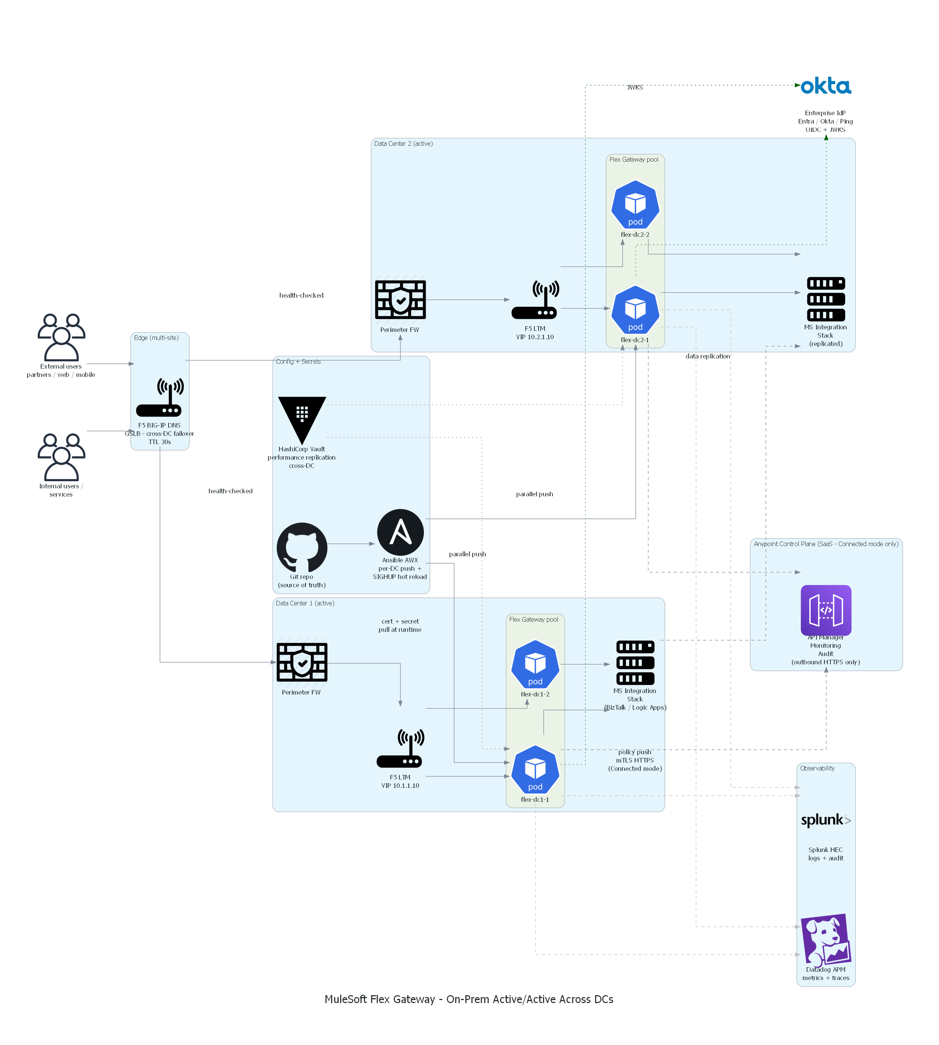
On-prem architecture overview
Active/active two-DC topology with F5 GSLB, GitOps-driven config, Vault-managed secrets
Highlights
• Active/active across two DCs — both serve traffic simultaneously
• F5 BIG-IP DNS / GSLB fronts both DCs with 30s TTL health-checked failover
• Per-DC F5 LTM in front of 2 Flex Gateway replicas (4 replicas total)
• Git is the config source of truth → Ansible AWX pushes to both DCs in parallel
• HashiCorp Vault performance replication keeps secrets in-sync sub-second
• Optional outbound mTLS to Anypoint Control Plane (Connected mode only)
• MS Integration Stack replicated across DCs (own DR mechanism)
• Splunk HEC + Datadog APM dual-shipped from each replica
MuleSoft API Gateway — On-Prem Deployment
3 / 11

Slide 4
Deployment modes — Connected vs Local
Same Flex Gateway binary; the difference is whether you stay tied to the Anypoint Control Plane
Dimension | Connected mode (recommended) | Local mode (fully air-gapped)
Outbound connection to anypoint.mulesoft.com | Required (HTTPS 443, mTLS) | None — fully isolated
Source of truth for policy config | Anypoint API Manager (SaaS) | YAML files in your Git repo
Policy push mechanism | Long-polled from Anypoint, ~2–10s end-to-end | CI pipeline → Ansible AWX → SIGHUP hot reload
Central API catalog (Exchange) | Yes — single source | No — your own catalog (Backstage / wiki)
Anypoint Monitoring | Yes — built-in dashboards + analytics | Not available; SIEM-only
Audit log of admin actions | Anypoint Audit Log + forwarded to SIEM | SIEM only (Git history + Ansible logs)
Resilience to anypoint.mulesoft.com outage | Local policy cache survives ~24h | N/A — no dependency
Licensing | Same Anypoint subscription | Same Anypoint subscription
Best for | Default on-prem path; SaaS control plane fine to use | Hard air-gap mandates / strict no-egress regimes
MuleSoft API Gateway — On-Prem Deployment
4 / 11

Slide 5
Install path — Standalone VM vs Kubernetes
Both supported; pick by existing platform footprint and team skills
Aspect | Standalone VM (RHEL / Ubuntu) | Kubernetes (OpenShift / Rancher / EKS-A)
Install mechanism | RPM / DEB package + systemd | Helm chart + Deployment + Service
HA model | Manual — F5 LTM with VRRP / keepalived | Native — replicas + PodDisruptionBudget + anti-affinity
Self-healing on crash | systemd Restart=on-failure | Liveness/readiness probes + kubelet
Scaling out | Image + provision new VM + add to LB pool | Kubectl scale OR HPA in seconds
Rolling upgrades | Manual orchestration (Ansible Tower) | Native Deployment rolling strategy
Operational tooling | journalctl, systemctl, F5 console — familiar | kubectl, Helm, K8s dashboards — specialist
Compute overhead per node | ~50 MB (just Flex) | ~50 MB Flex + 0.5 vCPU + 1 GB K8s control-plane tax per worker
Config drift control | Ansible (manual discipline) | GitOps + ArgoCD / Flux — declarative
Cluster upgrade complexity | N/A | Quarterly project; rollback plan required
Best fit | ✔ Your team already runs Linux + F5; no existing K8s footprint | ✔ K8s already a platform standard; cloud-native bet
MuleSoft API Gateway — On-Prem Deployment
5 / 11

Slide 6
Hardware sizing — 5M calls/day target
Provision for peak, monitor utilization, scale per the curve
Per-replica spec (production)
Target for 5M calls/day (Prod)
Resource | Value
vCPU | 4 (2 minimum)
RAM | 8 GB (2 GB minimum)
Disk | 100 GB SSD (~10 GB/day logs at 5M)
NIC | 1 Gbps sufficient; 10 Gbps DC fabric
OS | RHEL 9 / Ubuntu 22.04 LTS
Kernel | 5.14+ (better TCP perf)
Time sync | NTP, max 60s skew
Setting | Value
Peak TPS (5×) / spike (10×) | ~600 / ~1,200
Replicas per DC | 4
Number of DCs | 2 (active/active)
Total replicas | 8
Per-replica | 4 vCPU / 8 GB RAM
Total Prod compute footprint | 32 vCPU + 64 GB RAM
Headroom vs 1,200 TPS spike | ~2× (monitor closely)
Sizing curve — when to upsize
Volume | Replicas / DC | Per-replica spec | Total compute (both DCs)
≤ 100K/day | 2 | 2 vCPU / 4 GB | 8 vCPU + 16 GB
1M/day | 2 | 4 vCPU / 8 GB | 16 vCPU + 32 GB
5M/day (current target) | 4 | 4 vCPU / 8 GB | 32 vCPU + 64 GB
10M/day | 4 | 8 vCPU / 16 GB | 64 vCPU + 128 GB
25M/day | 6 | 8 vCPU / 16 GB | 96 vCPU + 192 GB
50M/day | 8+ | 8 vCPU / 16 GB + kernel tuning | 128+ vCPU + 256+ GB
MuleSoft API Gateway — On-Prem Deployment
6 / 11

Slide 7
Environments — DEV / QA / Acceptance / Prod
QA mirrors Prod for accurate load testing — that decision drives roughly half of gateway compute spend
Setting | DEV | QA (= Prod) | Acceptance / UAT | PROD
Volume target | sandbox | full 5M/day load test | smoke + integration | 5M/day
DC topology | single DC | 2 DCs active/active | 2 DCs active/active | 2 DCs active/active
Replicas per DC | 1 | 4 | 2 | 4
Total replicas | 1 | 8 | 4 | 8
Per-replica spec | 2 vCPU / 2 GB | 4 vCPU / 8 GB | 2 vCPU / 4 GB | 4 vCPU / 8 GB
Compute total | 2 + 2 | 32 + 64 | 8 + 16 | 32 + 64
Redis | 1 dev node | Sentinel 3-node × 2 DCs | Sentinel 3-node × 1 DC | Sentinel 3-node × 2 DCs
Service Bus tier (if used) | Standard | Premium (load-test data) | Standard or Premium | Premium
HA / DR drills validated here? | No | Yes — full Prod runbook | Yes | Yes (production)
Aggregated footprint across all 4 environments
Alternative worth considering
Resource | DEV | QA | UAT | PROD | Total
Gateway replicas | 1 | 8 | 4 | 8 | 21
Gateway vCPU | 2 | 32 | 8 | 32 | 74
Gateway RAM (GB) | 2 | 64 | 16 | 64 | 146
Redis nodes | 1 | 6 | 3 | 6 | 16
TOTAL compute (vCPU + GB) | 4 + 4 | 44 + 76 | 14 + 22 | 44 + 76 | ~106 vCPU + ~178 GB
Ephemeral QA — spin up Prod-sized QA only during scheduled load-test windows (e.g. 2 days per release), tear down after.
Saves ~80% of QA compute cost in exchange for IaC / automation maturity.
Especially attractive on K8s (kubectl scale --replicas=0) or with Terraform-driven VMs.
MuleSoft API Gateway — On-Prem Deployment
7 / 11

Slide 8
Components to provision (on-prem)
What your network, PKI, and platform teams need to deliver before first install
Component | Owner | Purpose
F5 BIG-IP DNS (GSLB) with cross-DC health checks, 30s TTL | Network team | Cross-DC failover and traffic distribution
F5 BIG-IP LTM per DC (HA pair, active/passive) | Network team | Per-DC L7 load balancing across Flex Gateway replicas
VMs or K8s nodes per DC, sized per slide 6 | Platform team | Flex Gateway runtime hosts
Internal CA + cert lifecycle automation (cert-manager / Venafi) | PKI team | mTLS for internal listener + backend, public-CA cert for external listener
HashiCorp Vault with performance replication across DCs | Security platform team | Secrets, runtime registration token, backend credentials
Git repo + CI/CD pipeline (Jenkins / GitHub Actions / Tekton) | Platform team | Source of truth for config; pushes to both DCs in parallel
Ansible Tower / AWX per DC | Platform team | Per-DC config deployment + SIGHUP hot reload (Local mode)
Outbound HTTPS to anypoint.mulesoft.com on 443 (Connected mode only) | Network team | Policy push + telemetry to Anypoint Control Plane
Private DNS — internal zone with backend hostnames | DNS team | Backend service resolution (e.g. biztalk-prod.internal.yourco)
Perimeter firewall + east-west FW rules | Network team | Inbound 443/8443 to gateway; outbound 443 to MS stack and IdP
NTP servers (Stratum-2 ideally) | Sysadmins | JWT exp/nbf validation requires < 60s skew
SIEM (Splunk) + APM (Datadog) ingest endpoints | Observability | Dual-shipping from each Flex Gateway replica
Backup target for /etc/flex-gateway + Vault snapshots | Backup team | Disaster recovery; daily cadence
DR-site provisioning (3rd DC or cloud) — optional | Platform team | Multi-region geographic resilience beyond 2 metro DCs
MuleSoft API Gateway — On-Prem Deployment
8 / 11

Slide 9
Disaster recovery — posture options
Pick the RTO/RPO point that matches your business continuity requirement and budget
Posture | Description | RTO | RPO | Cost (vs single DC)
A. Cold standby | DR site provisioned but stopped; manual power-on + DNS flip on failure | 30–60 min | Zero for config (declarative) | 1.1×
B. Warm standby (active/passive) | DR site running but idle; GSLB sends 100% to primary; on failure flips to DR | 1–5 min | Zero | 1.8×
C. Active/active across DCs in same metro (recommended) | Both DCs serve traffic; GSLB weighted round-robin; DC failure = GSLB removes node | < 60 s | Zero | 2.0×
D. Multi-region active/active | DCs in different cities/regions (latency > 50ms apart); geo-affinity routing | < 60 s | Near-zero (config) / backend-dependent (data) | 2.2×
Recommendation for citizen-data workload
Posture C — active/active across DC-1 and DC-2 within the same metro. RTO < 60s with F5 GSLB + 30s DNS TTL is achievable and proven. Multi-region (D) only when geographic resilience is explicitly required.
DNS failover math (Posture C)
Note on persistent connections
Component | Time
GSLB health check interval | 5–15 s
Failure detection (3 consecutive misses) | 15–45 s
DNS TTL expiry on clients | ≤ 30 s
TOTAL worst-case RTO | ≈ 60 s
Long-lived TLS / gRPC streams won't reconnect on DNS-only failover.
Mitigations: TCP RST from the LB to force reconnect; connection-draining timers on the LTM; short max-connection-age limits set by the gateway. Document this in the DR runbook for affected clients.
MuleSoft API Gateway — On-Prem Deployment
9 / 11

Slide 10
Config replication — Connected vs Local mode
How declarative state stays in lockstep across replicas and DCs in real time
Connected mode — Anypoint as source of truth
Local mode — Git + Ansible AWX
Every replica maintains an outbound long-polled HTTPS connection to anypoint.mulesoft.com. Policy changes in API Manager push to all connected replicas globally within seconds. Each replica caches policy locally so brief Anypoint outages don't drop traffic.
Config (declarative YAML) lives in a Git repo — single source of truth. CI pipeline pushes to BOTH DCs in parallel on merge to main. Per-DC Ansible Tower / AWX runs the file deploy + SIGHUP hot reload. Daily reconciliation drift-detects and corrects.
Property | Value
Replication mechanism | Anypoint Control Plane push
Push latency (change → live) | 2–10 s end-to-end
RPO for config | Zero
Customer infrastructure needed | None
Resilience to Anypoint outage | Local cache ~24 h
Network requirement | Outbound 443 to anypoint.mulesoft.com
Property | Value
Replication mechanism | GitOps + Ansible AWX (parallel push)
Push latency (merge → live) | < 30 s typical
RPO for config | Zero (Git is authoritative)
Customer infrastructure needed | Git + CI + AWX per DC + Vault for secrets
Resilience to GitOps outage | Existing config keeps serving
Network requirement | None outbound — fully air-gappable
MuleSoft API Gateway — On-Prem Deployment
10 / 11

Slide 11
Operational ownership · risks · next steps
What changes when you take on-prem and how we get to go-live
Operational ownership shift (vs SaaS)
Key risks
Concern | SaaS | On-prem
OS / patching | MuleSoft | You
Runtime upgrades | MuleSoft | You
HA setup | Built-in multi-AZ | Active/active across DCs — you build
Capacity planning | Auto-scale | You provision for peak
Monitoring | Anypoint built-in + SIEM | Your SOC + SIEM only
Personnel access to runtime | MuleSoft + you (contractual) | You only
Compliance audit posture | Inherited (SOC 2, FedRAMP Mod) | Yours to maintain
Release-window downtime | Rolling, transparent | Your change window
• Self-managed = your patching, your incident response, your MTTR
• K8s + Flex upgrade collisions if not decoupled
• Config drift between DCs without disciplined GitOps
• Secrets-sync lag if Vault replication degrades
• GSLB itself a SPOF — mitigate with multi-site BIG-IP DNS sync
Next steps
• Decide VM vs K8s install path with platform team
• Network team starts F5 GSLB + LTM change requests
• PKI team confirms internal CA + cert-rotation automation
• Stand up Vault HA with cross-DC replication first
• Build CI pipeline; test config push to a single dev replica
• DR drill before go-live — verify < 60 s RTO end-to-end
MuleSoft API Gateway — On-Prem Deployment
11 / 11

