Slide 1

Python Programming Lab:: Lecture topic# Week8# Data Operations#Dictionaries
Dr.K.Srikanth
Assistant Professor
Dept of EEE

Slide 2
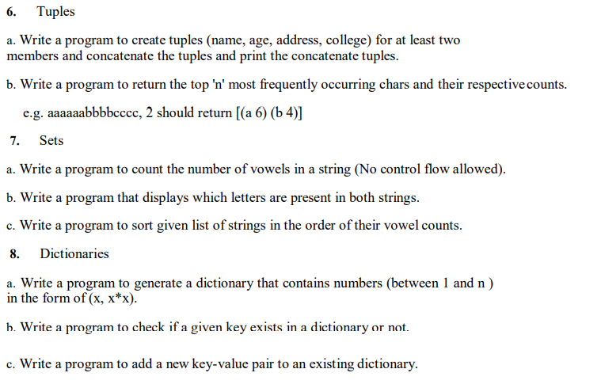
Syllabus:: List of Experiments

Slide 3
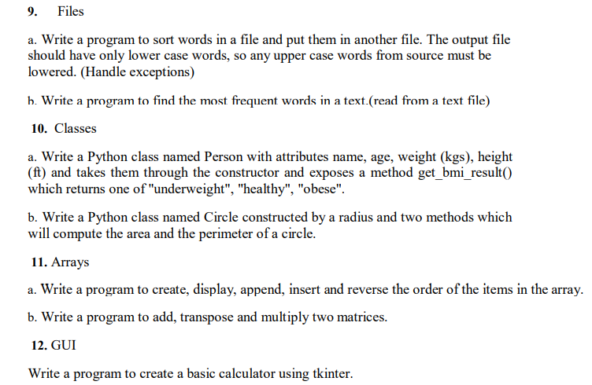
Syllabus:: List of Experiments

Slide 4
Classes:
A class is a template that provides a logical grouping of data and methods that operate on them.
Instances of a class are called objects.
A program of moderate size would comprise several groups of related information.
Keeping track of them in an ad-hoc manner would be a challenging task. Packaging together related code and data in the form of classes would make our job easier.

Slide 5
Classes:
Variables used so far took values of types (also called classes) string (str), integer (int), floating point (float), Boolean (bool), list, tuple, or dictionary (dict).
As these classes are already available in Python, they are called built-in classes.
Python also allows us to define new classes (i.e., types), called user-defined classes.
Data and methods associated with a class are collectively known as class attributes.

Slide 6
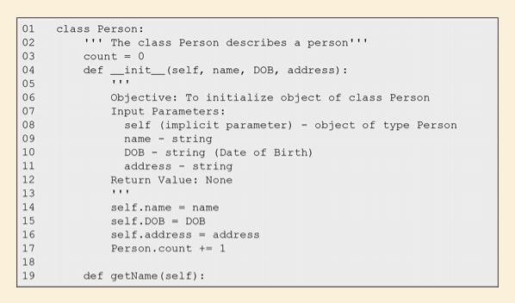
Example#1
Data attributes of class Person: name, DOB, and address

Slide 7
A class definition begins with the keyword class followed by the name of the class, and a colon.
The first letter of the class name is capitalized.
The syntax for class definition is as follows: syntax for class definition
class ClassName: classBody
In the docstring in line 2, we describe the purpose of the class.
In line 3, we introduce the class variable count and initialize it to 0.
It is used to keep count of the number of Person objects created.
The class variables are also called static variables.
The__init__ method is used to initialize data for the instance of the class being constructed and is called class initializer or class constructor.
However, for the sake of completeness, we would like to mention that there may be a class not having any __init__ method.

Slide 8
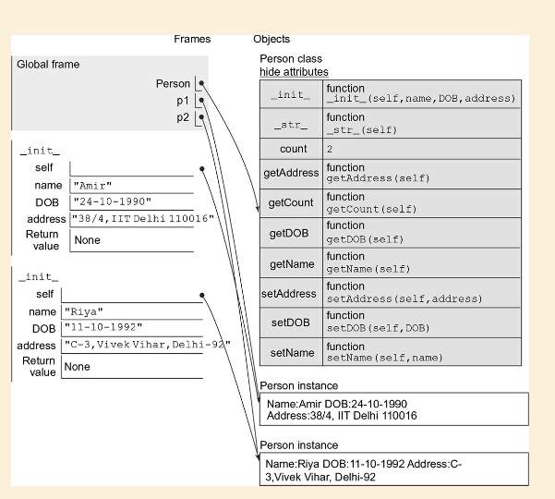

Slide 9
Books:
1. Y. Daniel Liang, Introduction to programming using Python, Pearson Publications, 2017.
2. Sheetal Taneja, Python Programming A Modular Approach, 1st edition, Pearson Publications, 2017.
3. Brett Slatkin (C), Effective Python: 59 Specific Ways to Write Better Python, I/C, 1st edition, Pearson Publications, 2015.
4. Ashok Namdev Kamathane and Amit Ashok Kamathane, Programming and Problem Solving with Python, 1st edition, McGraw Hill Education (India) Private Limited, 2017

Slide 10
References:
Taneja Sheetal; Kumar Naveen. Python Programming: A modular approach . Pearson Education. Kindle Edition.
Mark Lutz, Learning Python, O’Reilly Books
Lecture Slides on Python, Prof. Henning Schulzrrinne, Columbia University
Guido van Rossum, Tutorial Material of ZOPE Corporation, New York
https://giphy.com/explore/python-snake
Cay Hostann, Rance Necaise, Python for Everyone 2/e, Wiley Publications.

Slide 11

Thank you, Any queries?

