Slide 1

Python Programming Lab:: Lecture topic#Week5# Data Operations
Dr.K.Srikanth
Assistant Professor
Dept of EEE

Slide 2

Discussion Content
Built in objects
Python core data types
Lists
Tuples
Dictionaries
Sets
Mutability and Immutability in Python
Example Codes

Slide 3
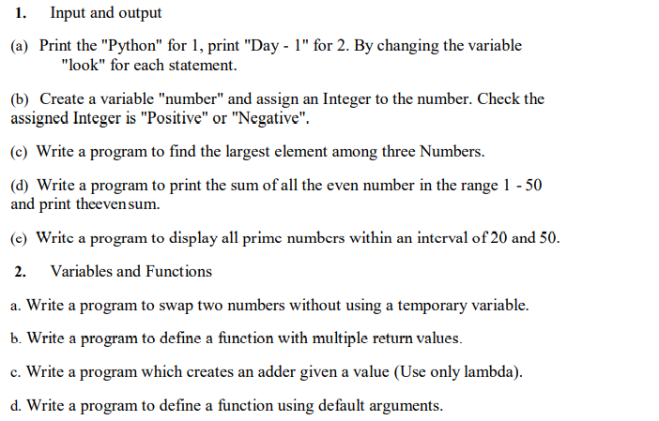
Syllabus:: List of Experiments

Slide 4
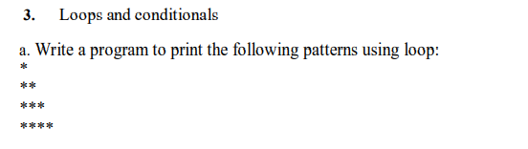
Syllabus:: List of Experiments

Slide 5
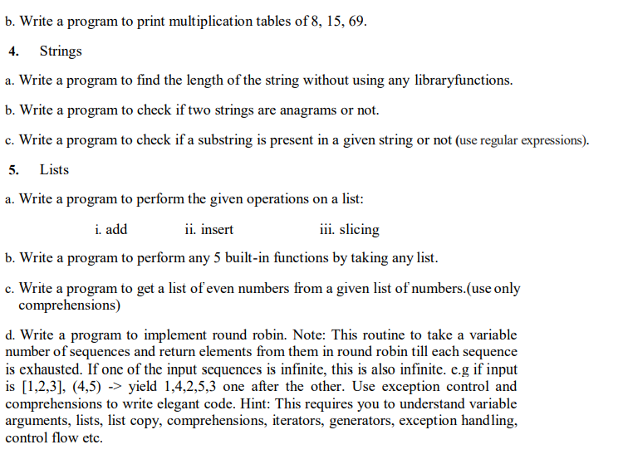

Slide 6
Books:
1. Y. Daniel Liang, Introduction to programming using Python, Pearson Publications, 2017.
2. Sheetal Taneja, Python Programming A Modular Approach, 1st edition, Pearson Publications, 2017.
3. Brett Slatkin (C), Effective Python: 59 Specific Ways to Write Better Python, I/C, 1st edition, Pearson Publications, 2015.
4. Ashok Namdev Kamathane and Amit Ashok Kamathane, Programming and Problem Solving with Python, 1st edition, McGraw Hill Education (India) Private Limited, 2017

Slide 7
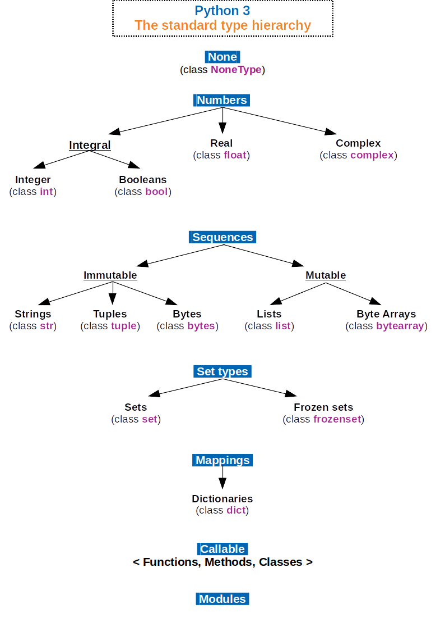

Slide 8
Python core data types
Object type | Example Literals/Creation
Numbers | 1234, 3.14, ob1111, Decimal(), Fraction()
Strings | ‘spam’,”Bomb’s”
Lists | [1, [2, ‘three’],4.5],list(range(10))
Dictionaries | {‘food’: ‘spam’,’taste’: ‘yum’} dict(hours=10)
Tuples | (1, ‘spam’,4’ ‘U’), tuple (‘spam’), namedtuple
Files | open(‘eggs.txt’)
Sets | Set(‘abc’),{‘a’,’b’,’c’}

Slide 9
Mutability
Every object in python is classified as either immutable(unchangeable) or not.
In terms of core types, numbers, strings, and tuples are immutable;
Lists, dictionaries, and sets are not-they can be changed in place freely.
Immutability can be used to guarantee that an object remains constant throughout the program.
Mutable object values can be changed at any time and place.

Slide 10
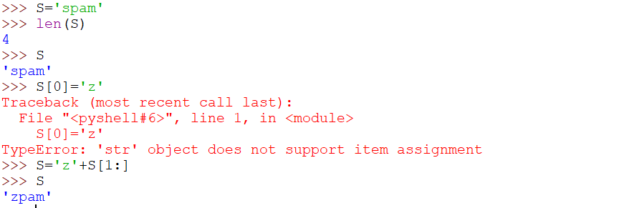
Code test for mutability
Note: We can run expressions to make new objects like ‘zpam’

Slide 11
Issues in Data
Elementary forms of data such as numeric and Boolean are called scalar data types.
Several applications require more complex forms of data, for example, the name of a person, coordinates of a point, a set of objects, or a list of personal records of individuals.
In the previous discussion, we discussed about strings (type str – an immutable structure).
Taneja Sheetal; Kumar Naveen. Python Programming: A modular approach . Pearson Education. Kindle Edition.

Slide 12
Lists
A list is an ordered sequence of values. It is a non-scalar type. Values stored in a list can be of any type such as string, integer, float, or list, for example, a list may be used to store the names of subjects:
list: a comma separated ordered sequence of values, enclosed in square brackets
>>> subjects=['Hindi', 'English', 'Maths', 'History’]
The elements of a list are enclosed in square brackets, separated by commas. Elements of a list are arranged in a sequence beginning index 0, just like characters in a string.
Taneja Sheetal; Kumar Naveen. Python Programming: A modular approach . Pearson Education. Kindle Edition.

Slide 13
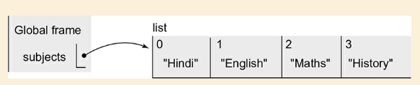
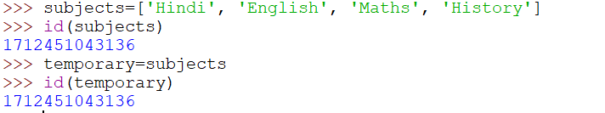
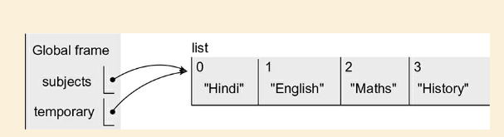
Indexing in lists:

Slide 14
To understand the lists better, let us invoke the function id that returns object identifier for the list object.
Note that each of the names subjects and temporary is associated with the same list object having object id
Taneja Sheetal; Kumar Naveen. Python Programming: A modular approach . Pearson Education. Kindle Edition.

Slide 15
This method of accessing an object by different names is known as aliasing.
Unlike strings, lists are mutable, and therefore, one may modify individual elements of a list.
However, modifying an element of a list does not alter its object id, for example: aliasing: to access objects using different names lists are mutable
Taneja Sheetal; Kumar Naveen. Python Programming: A modular approach . Pearson Education. Kindle Edition.

Slide 16

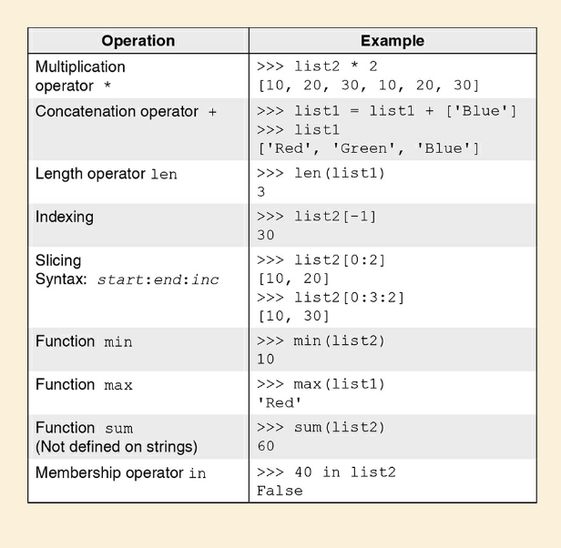
Operations

Slide 17
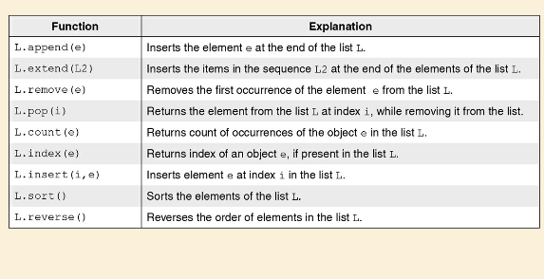
List functions

Slide 18


we want to create a list that contains cubes of numbers ranging from 1 to 10. To do this, we may create an empty list, and write the code as given.

Slide 19

Tuples
A tuple is a non-scalar type defined in Python.
Just like a list, a tuple is an ordered sequence of objects.
However, unlike lists, tuples are immutable, i.e. elements of a tuple cannot be overwritten.
A tuple may be specified by enclosing in the parentheses, the elements of the tuple (possibly of heterogeneous types), separated by commas, for example, the tuple t1 comprises five objects: tuple: a comma separated ordered sequence of values enclosed in parenthesis
Tuples being immutable, an attempt to modify an element of a tuple yields an error:

Slide 20
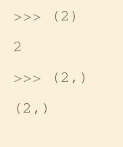
If a tuple comprises a single element, the element should be followed by a comma to distinguish a tuple from a parenthesized expression, for example: singleton tuple: comma required after the element

Slide 21
SETS
A set in Mathematics refers to an unordered collection of objects without any duplicates.
An object of type set may be created by enclosing the elements of the set within curly brackets.
The set objects may also be created by applying the set function to lists, strings, and tuples.
Next, we give some examples of sets: set: a comma separated unordered sequence of values enclosed within curly braces
set(): to convert a sequence to a set.
Taneja Sheetal; Kumar Naveen. Python Programming: A modular approach . Pearson Education. Kindle Edition.

Slide 22
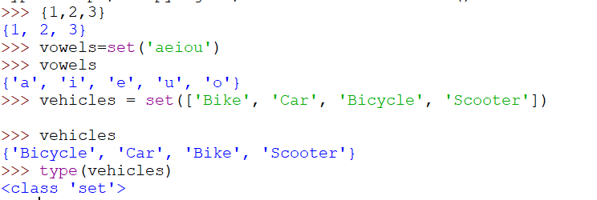
Example

Slide 23
Dictionary
Unlike lists, tuples, and strings, a dictionary is an unordered sequence of key-value pairs.
Indices in a dictionary can be of any immutable type and are called keys. Beginning with an empty dictionary, we create a dictionary of month_number-month_name pairs as follows: dictionary: a comma separated unordered sequence of key-value pairs enclosed in curly braces
Taneja Sheetal; Kumar Naveen. Python Programming: A modular approach . Pearson Education. Kindle Edition.

Slide 24
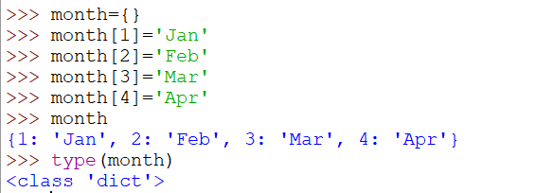
Example

Slide 25
Comprehensions
Comprehension provides an easy shorthand notation for creating lists, sets, and dictionaries. For example, the expression [x**3 for x in range(1, end)] creates a list containing cube of each element in the range (1, end).
Taneja Sheetal; Kumar Naveen. Python Programming: A modular approach . Pearson Education. Kindle Edition.

Slide 26
References:
Taneja Sheetal; Kumar Naveen. Python Programming: A modular approach . Pearson Education. Kindle Edition.
Mark Lutz, Learning Python, O’Reilly Books
Lecture Slides on Python, Prof. Henning Schulzrrinne, Columbia University
Guido van Rossum, Tutorial Material of ZOPE Corporation, New York
https://giphy.com/explore/python-snake
Cay Hostann, Rance Necaise, Python for Everyone 2/e, Wiley Publications.

Slide 27

Thank you, Any queries?

