Slide 1

Python Programming Lab:: Lecture topic#Week2# String Operations
Dr.K.Srikanth
Assistant Professor
Dept of EEE

Slide 2

Discussion Content
Handling Strings
Indexing in Strings
Inbuilt string functions
Additional Examples
Program to find number of matched characters in two strings
Function to find the number of common characters in two strings
Function to find reverse of a string
Reference: Taneja Sheetal; Kumar Naveen. Python Programming: A modular approach . Pearson Education. Kindle Edition.

Slide 3
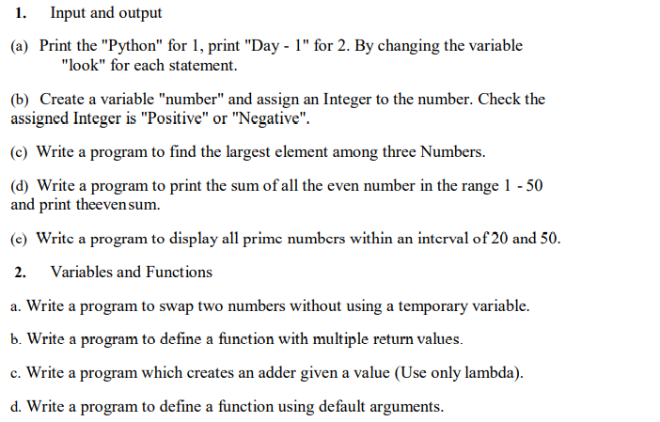
Syllabus:: List of Experiments

Slide 4
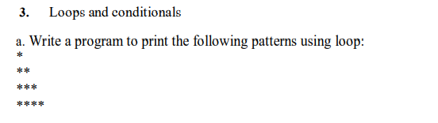
Syllabus:: List of Experiments

Slide 5
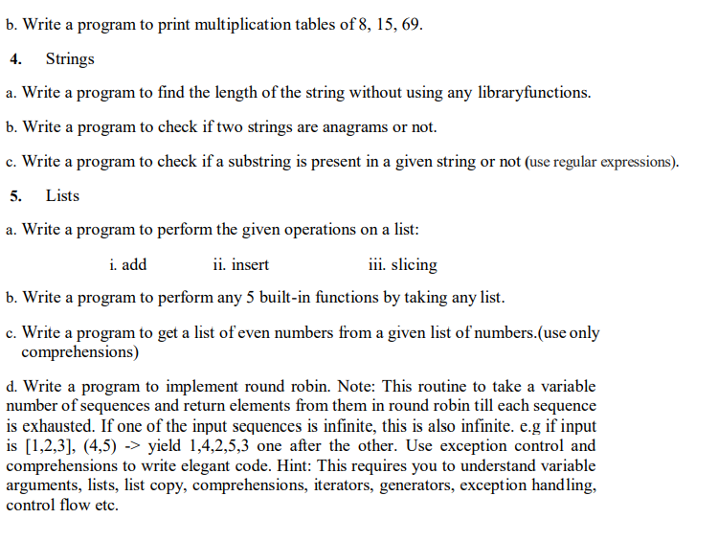

Slide 6
Books:
1. Y. Daniel Liang, Introduction to programming using Python, Pearson Publications, 2017.
2. Sheetal Taneja, Python Programming A Modular Approach, 1st edition, Pearson Publications, 2017.
3. Brett Slatkin (C), Effective Python: 59 Specific Ways to Write Better Python, I/C, 1st edition, Pearson Publications, 2015.
4. Ashok Namdev Kamathane and Amit Ashok Kamathane, Programming and Problem Solving with Python, 1st edition, McGraw Hill Education (India) Private Limited, 2017

Slide 7
Strings::
Elementary forms of data such as numeric and Boolean are called scalar data types.
Several applications require more complex forms of data. For example, the name of a person, or an SMS may be expressed in the form of a string.

Slide 8
Strings::
A string may be specified by placing the member characters of the sequence within quotes (single, double or triple).
Triple quotes are typically used for strings that span multiple lines.
The following assignment statement assigns the string 'Hello Rama' to the variable message.
We may also say that the string 'Hello Rama' has been bound to the name message.
Taneja Sheetal; Kumar Naveen. Python Programming: A modular approach . Pearson Education. Kindle Edition.

Slide 9
Python function len finds the length of a string. Thus,
>>> message = 'Hello Gita'
>>> len(message)
10
Taneja Sheetal; Kumar Naveen. Python Programming: A modular approach . Pearson Education. Kindle Edition.

Slide 10
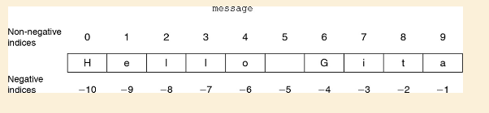
Indexing for variable
Note that the indices start with 0 (index for accessing the first character from the left) and end with one less than the length of the string (index for accessing the last character).
Taneja Sheetal; Kumar Naveen. Python Programming: A modular approach . Pearson Education. Kindle Edition.

Slide 11
Negative indexing
>>> message[-1]
'a’
>>> message[-index]
'e’
Note: negative indexes: used to access the string from the right end
Taneja Sheetal; Kumar Naveen. Python Programming: A modular approach . Pearson Education. Kindle Edition.

Slide 12
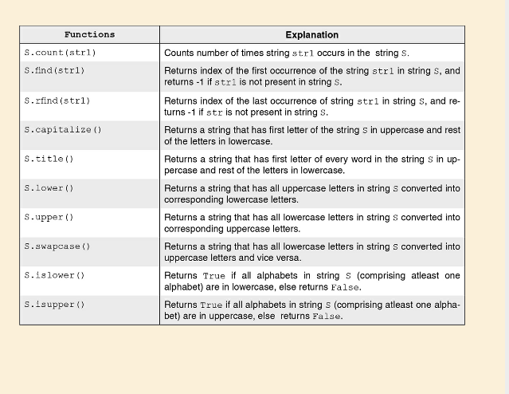

Slide 13
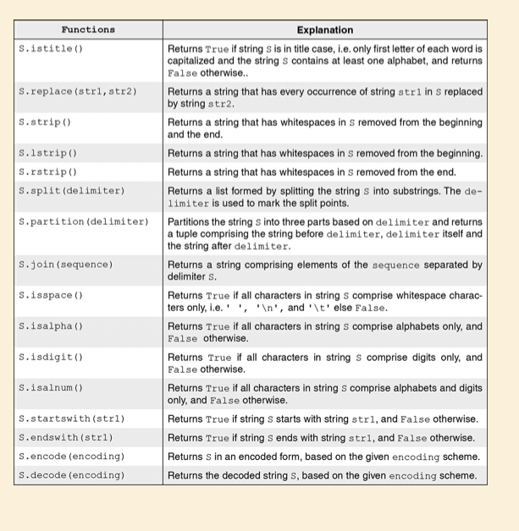

Slide 14
Some Examples
>>> string1='This is a test'
>>> String1.count(is)
SyntaxError: invalid syntax
>>> string1.count('is')
2
>>> string1.capitalize(string1)
Traceback (most recent call last):
File "<pyshell#3>", line 1, in <module>
string1.capitalize(string1)
TypeError: str.capitalize() takes no arguments (1 given)
>>> string1.capitalize()
'This is a test'
>>> string1.upper()
'THIS IS A TEST'

Slide 15
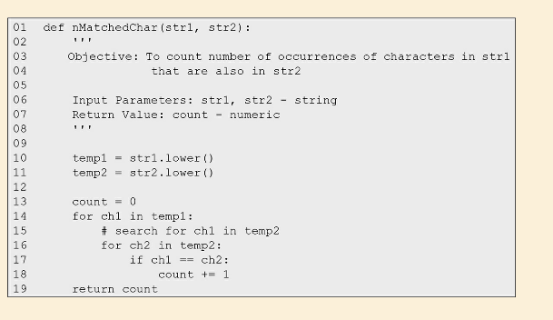

Slide 16
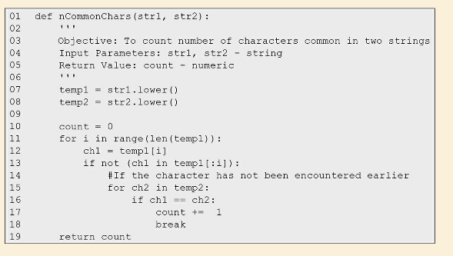

Slide 17
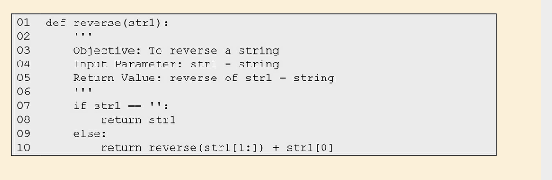

Slide 18
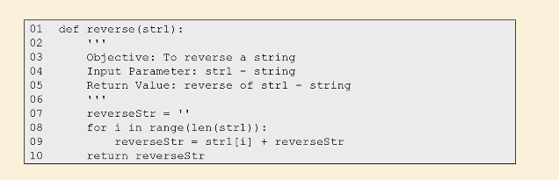

Slide 19
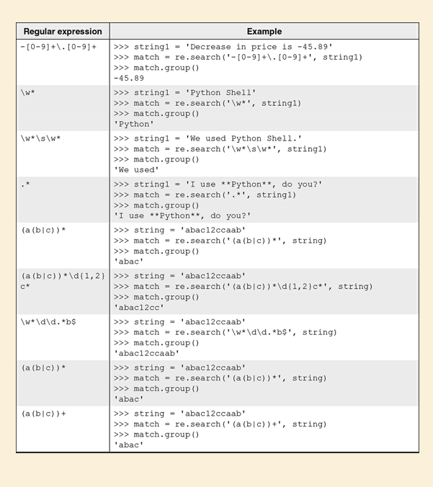

Slide 20
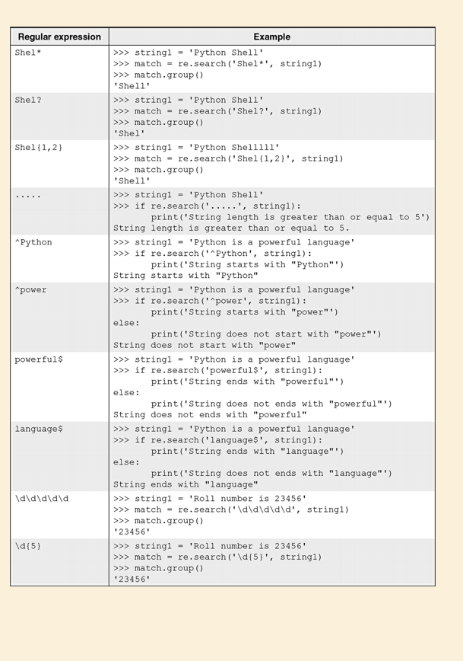

Slide 21
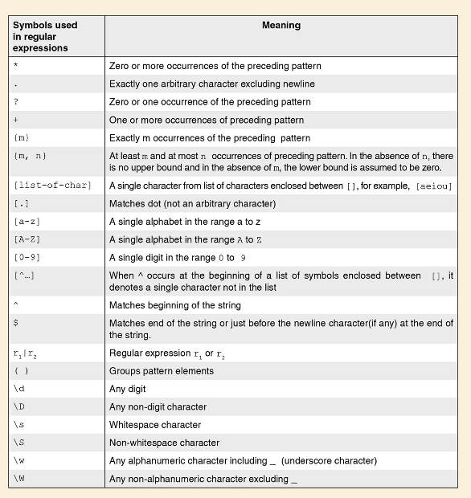

Slide 22
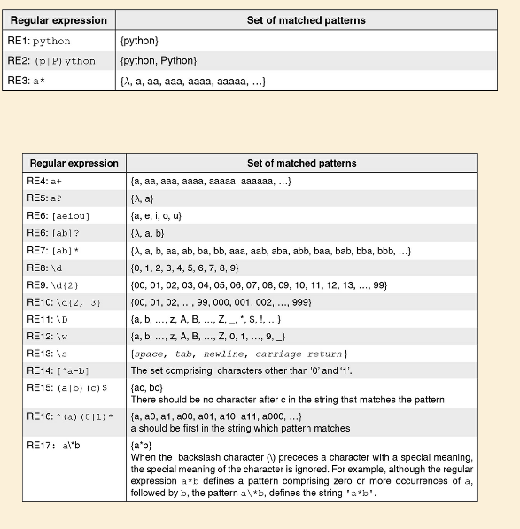
Note: You need to import re module to use the above functions.

Slide 23
References:
Taneja Sheetal; Kumar Naveen. Python Programming: A modular approach . Pearson Education. Kindle Edition.
Mark Lutz, Learning Python, O’Reilly Books
Lecture Slides on Python, Prof. Henning Schulzrrinne, Columbia University
Guido van Rossum, Tutorial Material of ZOPE Corporation, New York
https://giphy.com/explore/python-snake
Cay Hostann, Rance Necaise, Python for Everyone 2/e, Wiley Publications.

Slide 24

Thank you, Any queries?

