Slide 1

Python Programming Lab:: Lecture topic# Week8# Data Operations#Dictionaries
Dr.K.Srikanth
Assistant Professor
Dept of EEE

Slide 2
Discussion Content
Dictionaries
Basics of Dictionaries
Functions
Examples

Slide 3
Python core data types
Object type | Example Literals/Creation
Numbers | 1234, 3.14, ob1111, Decimal(), Fraction()
Strings | ‘spam’,”Bomb’s”
Lists | [1, [2, ‘three’],4.5],list(range(10))
Dictionaries | {‘food’: ‘spam’,’taste’: ‘yum’} dict(hours=10)
Tuples | (1, ‘spam’,4’ ‘U’), tuple (‘spam’), namedtuple
Files | open(‘eggs.txt’)
Sets | Set(‘abc’),{‘a’,’b’,’c’}

Slide 4
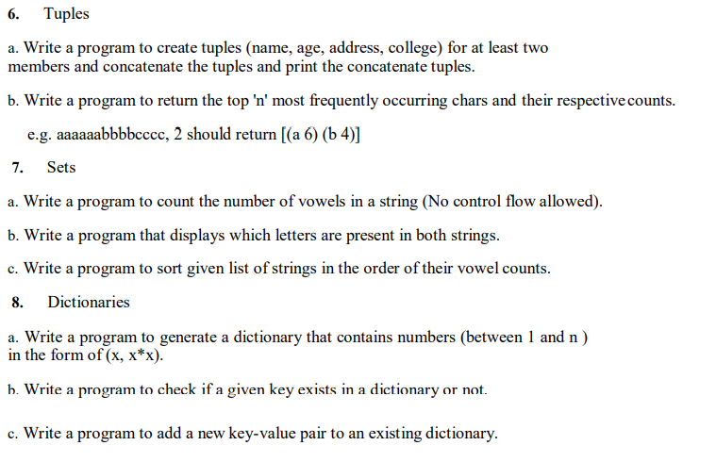
Syllabus:: List of Experiments

Slide 5
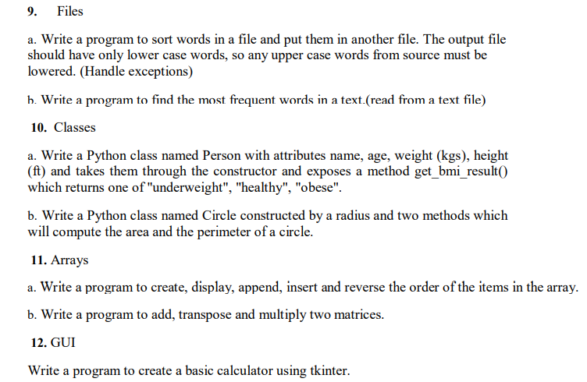
Syllabus:: List of Experiments

Slide 6
Dictionary::
Unlike lists, tuples, and strings, a dictionary is an unordered sequence of key-value pairs. Indices in a dictionary can be of any immutable type and are called keys.
Taneja Sheetal; Kumar Naveen. Python Programming: A modular approach . Pearson Education. Kindle Edition.

Slide 7
>>> month = {}
>>> month[1] = 'Jan’
>>> month[2] = 'Feb’
>>>month[3] = 'Mar’
>>> month[4] = 'Apr’
>>>month
{1: 'Jan', 2: 'Feb', 3: 'Mar', 4: 'Apr’}
>>> type(month)
<class 'dict'>

Slide 8
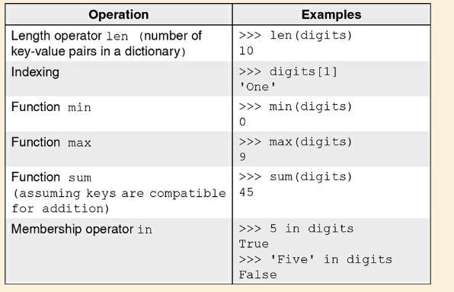
Operations:

Slide 9
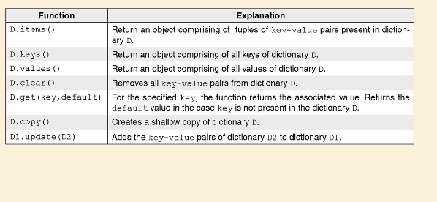
Functions:

Slide 10
Inverted Dictionary
Suppose we are maintaining a dictionary of words and their meanings of the form word:meaning.
For simplicity, we assume that each word has a single meaning.
Even so, there might be a few words that may have shared meaning.
Given this dictionary, we wish to find synonyms of a word, i.e. given a word, we wish to find the list of words that have the same meaning. For this purpose, we would like to build an inverted dictionary invDict of meaning:list-of-words.
Taneja Sheetal; Kumar Naveen. Python Programming: A modular approach . Pearson Education. Kindle Edition.

Slide 11
Inverted Dictionary:
In the function buildInvDict, we begin with an empty dictionary invDict that uses meaning as the key.
For every key-value pair of word:meaning in the dictionary dict1, if it is the first occurrence meaning, then meaning:[word] is entered in the inverted dictionary.
If the key meaning already exists in the inverted dictionary, then word is appended to the list invDict[meaning].
Taneja Sheetal; Kumar Naveen. Python Programming: A modular approach . Pearson Education. Kindle Edition.

Slide 12
Dictionary Comprehensions:
We use comprehensions to drop the words having only one meaning: dictionary comprehension for finding synonyms in a dictionary
{meaning: invDict[x] for x in invDict if len(invDict[x])>1}
Taneja Sheetal; Kumar Naveen. Python Programming: A modular approach . Pearson Education. Kindle Edition.

Slide 13
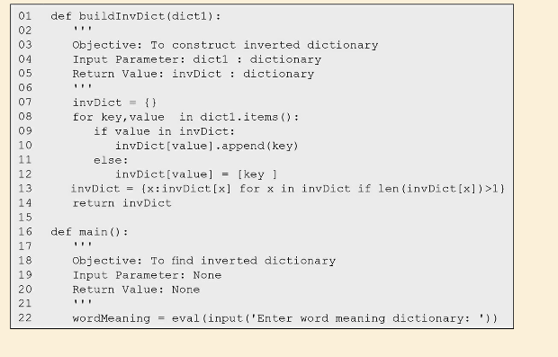
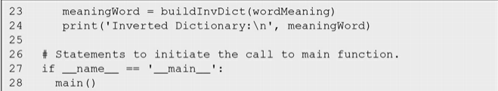

Slide 14
Dictionary Functions
D.items() Return an object comprising of tuples of key-value pairs present in dictionary D. .
D.keys() Return an object comprising of all keys of dictionary D.
D.values() Return an object comprising of all values of dictionary D.
D.clear() Removes all key–value pairs from dictionary D.
D.get(key,default) For the specified key, the function returns the associated value. Returns the default value in case of absence of key in dictionary D.
D.copy() Creates a shallow copy of dictionary D.
D1.update(D2) Adds the key–value pairs of dictionary D2 in dictionary D1.

Slide 15
Books:
1. Y. Daniel Liang, Introduction to programming using Python, Pearson Publications, 2017.
2. Sheetal Taneja, Python Programming A Modular Approach, 1st edition, Pearson Publications, 2017.
3. Brett Slatkin (C), Effective Python: 59 Specific Ways to Write Better Python, I/C, 1st edition, Pearson Publications, 2015.
4. Ashok Namdev Kamathane and Amit Ashok Kamathane, Programming and Problem Solving with Python, 1st edition, McGraw Hill Education (India) Private Limited, 2017

Slide 16
References:
Taneja Sheetal; Kumar Naveen. Python Programming: A modular approach . Pearson Education. Kindle Edition.
Mark Lutz, Learning Python, O’Reilly Books
Lecture Slides on Python, Prof. Henning Schulzrrinne, Columbia University
Guido van Rossum, Tutorial Material of ZOPE Corporation, New York
https://giphy.com/explore/python-snake
Cay Hostann, Rance Necaise, Python for Everyone 2/e, Wiley Publications.

Slide 17

Thank you, Any queries?

